Slide 1



Slide 2
I. Purpose to Work on Like-mindedness (Phil. 2:12, 13)
A. Get active (2:12)
• Though the Philippians felt the heat of Paul’s instructions, they knew taking action to resolve the disunity in the church would be in their best interest.

Slide 3


I. Purpose to Work on Like-mindedness (Phil. 2:12, 13)
A. Get active (2:12)
What does a condescending, harsh approach to instructing believers reveal about the instructor?

Slide 4
I. Purpose to Work on Like-mindedness (Phil. 2:12, 13)
A. Get active (2:12)
• Paul’s tender but firm approach to the Philippians provided an example of how the Philippians were to treat each other while working on their like-mindedness.

Slide 5
I. Purpose to Work on Like-mindedness (Phil. 2:12, 13)
A. Get active (2:12)
When has someone lovingly motivated you to get active in a spiritual matter? How did the person communicate his or her genuine care for you?

Slide 6
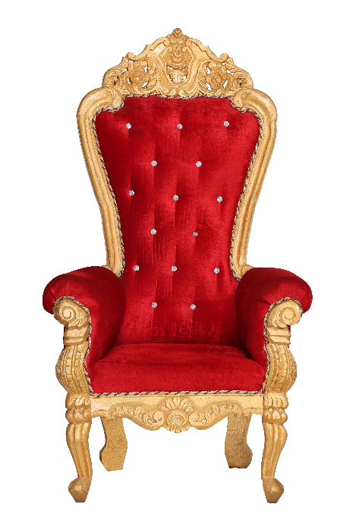
I. Purpose to Work on Like-mindedness (Phil. 2:12, 13)
A. Get active (2:12)
B. Stand awestruck (2:12)
• Consistent reflection on Jesus’ exaltation should have caused the Philippian believers to respect Him and His authority over their lives.

Slide 7
I. Purpose to Work on Like-mindedness (Phil. 2:12, 13)
A. Get active (2:12)
B. Stand awestruck (2:12)
• The Philippians’ knowledge of Jesus’ humiliating death on the cross for their sins, including their sins of disharmony and pride, should have motivated them to want to confess and forsake their grudges and disunity.

Slide 8
I. Purpose to Work on Like-mindedness (Phil. 2:12, 13)
A. Get active (2:12)
B. Stand awestruck (2:12)
How does your view of your sin change when you think about Christ having to hang on the cross for you?

Slide 9
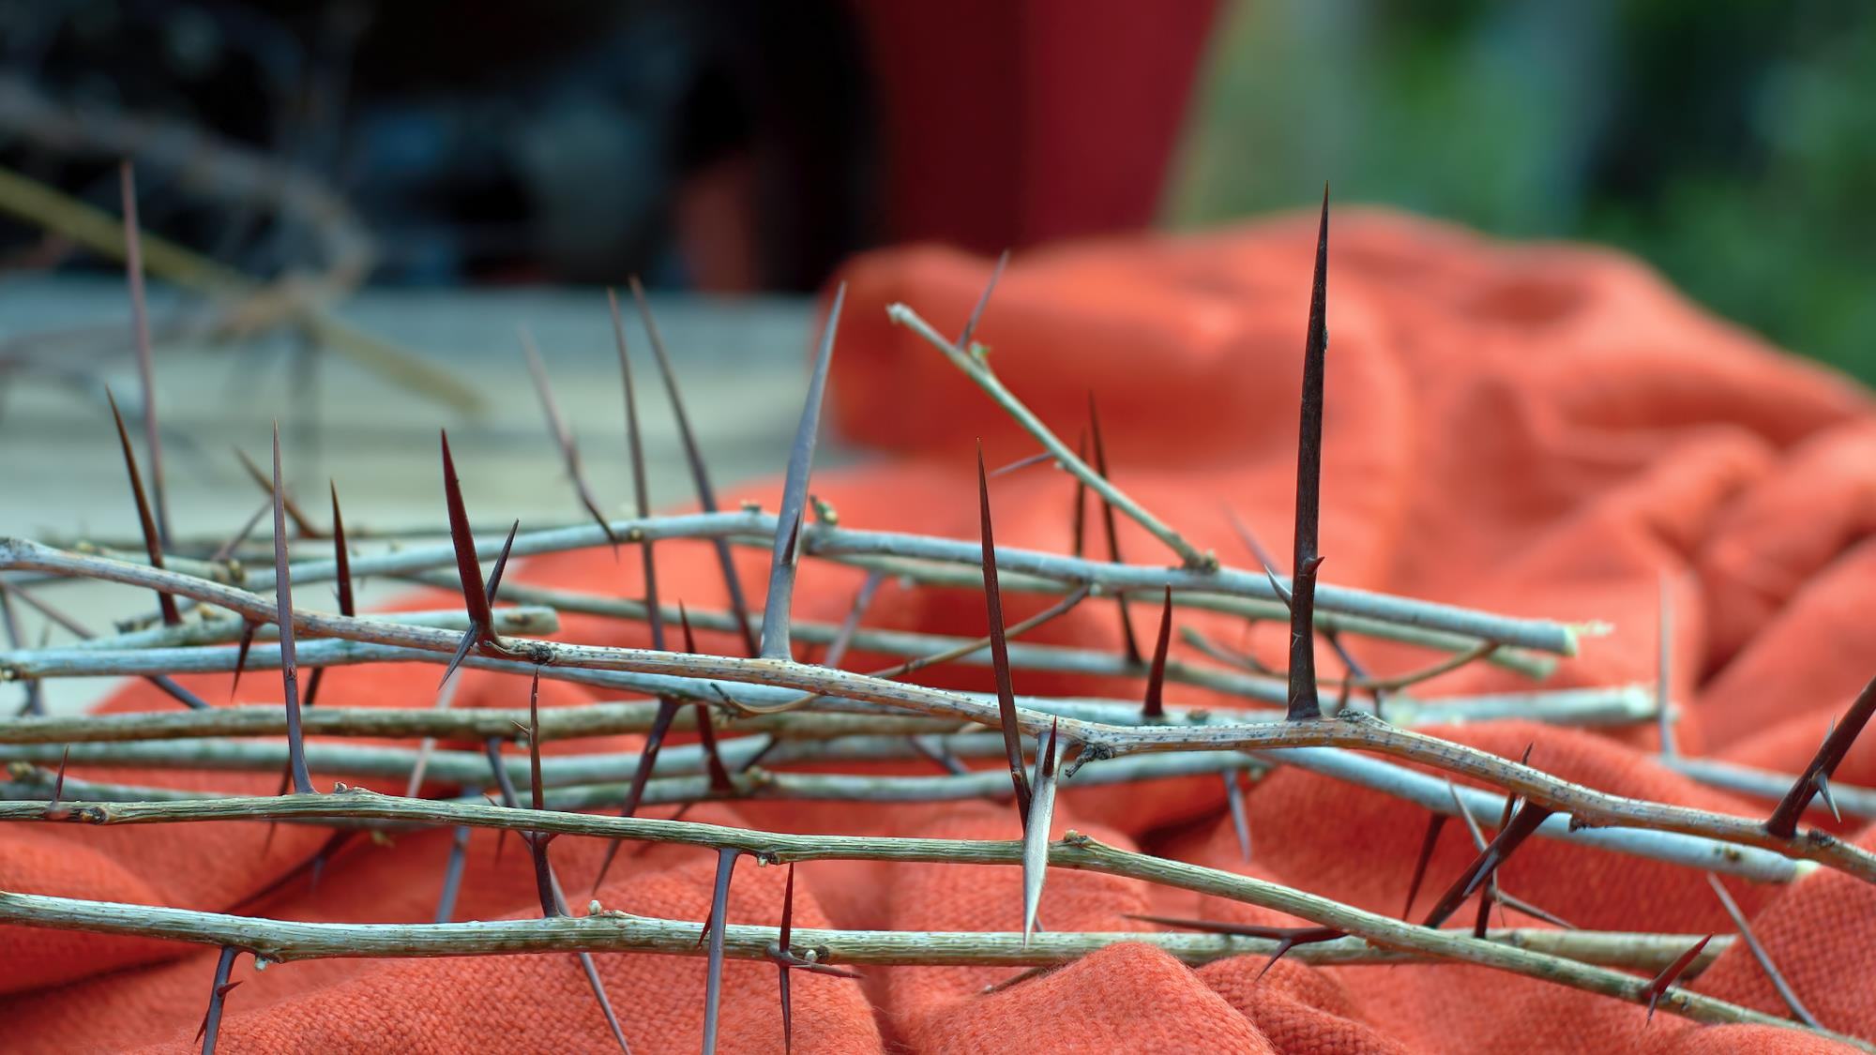

Slide 10
I. Purpose to Work on Like-mindedness (Phil. 2:12, 13)
A. Get active (2:12)
B. Stand awestruck (2:12)
How does the thought of Christ on the cross affect your view of any grudges or hurts you might harbor?

Slide 11
I. Purpose to Work on Like-mindedness (Phil. 2:12, 13)
A. Get active (2:12)
B. Stand awestruck (2:12)
C. Be assured (2:13)
1. Of God’s part
• God creates in us the will to obey Him.

Slide 12

I. Purpose to Work on Like-mindedness (Phil. 2:12, 13)
A. Get active (2:12)
B. Stand awestruck (2:12)
C. Be assured (2:13)
1. Of God’s part
What does God use to affect our wills?

Slide 13
I. Purpose to Work on Like-mindedness (Phil. 2:12, 13)
A. Get active (2:12)
B. Stand awestruck (2:12)
C. Be assured (2:13)
1. Of God’s part
2. Of God’s passion
• God tells us what to do and how to treat each other because He loves us and wants us to know the spiritual blessings of living pure, obedient lives.

Slide 14
I. Purpose to Work on Like-mindedness (Phil. 2:12, 13)
A. Get active (2:12)
B. Stand awestruck (2:12)
C. Be assured (2:13)
1. Of God’s part
2. Of God’s passion
What would be the unwelcome alternative to God’s commands being born out of His love for us?

Slide 15

I. Purpose to Work on Like-mindedness (Phil. 2:12, 13)
A. Get active (2:12)
B. Stand awestruck (2:12)
C. Be assured (2:13)
1. Of God’s part
2. Of God’s passion
When have you found that obeying God leads to freedom rather than a sense of being burdened?

Slide 16
II. Present the Word of Life (Phil. 2:14–18)
A. Shine like Jesus (2:14–16a)
• Believers should never be heard complaining, especially when carrying out God’s will or when talking about a fellow believer.

Slide 17
II. Present the Word of Life (Phil. 2:14–18)
A. Shine like Jesus (2:14–16a)
When believers complain, what message about God do they communicate to the watching world?

Slide 18
II. Present the Word of Life (Phil. 2:14–18)
A. Shine like Jesus (2:14–16a)
• When the world observes a believer’s life, they shouldn’t find any reason to discredit the believer’s message.

Slide 19
II. Present the Word of Life (Phil. 2:14–18)
A. Shine like Jesus (2:14–16a)
Why would Paul call believers the “children of God”? What is he conveying with that designation?

Slide 20
II. Present the Word of Life (Phil. 2:14–18)
A. Shine like Jesus (2:14–16a)
• Paul described the watching world as living according to a crooked, twisted perversion of God’s truth.

Slide 21

II. Present the Word of Life (Phil. 2:14–18)
A. Shine like Jesus (2:14–16a)
What characteristics of our culture makes us stand out as we serve God sincerely with like-mindedness?

Slide 22
II. Present the Word of Life (Phil. 2:14–18)
A. Shine like Jesus (2:14–16a)
What made the gospel offensive to the Romans and therefore something the Philippian believers would need to hold without compromise?

Slide 23
II. Present the Word of Life (Phil. 2:14–18)
A. Shine like Jesus (2:14–16a)
B. Serve with joy (2:16b–18)
• Paul wanted to be able to rejoice in the day of Christ that the Philippians had held fast to the word of life, doing their part to shine the light of life into the dark world by their words and like-minded deeds.

Slide 24
II. Present the Word of Life (Phil. 2:14–18)
A. Shine like Jesus (2:14–16a)
B. Serve with joy (2:16b–18)
Who in your life is pulling for you to succeed spiritually?
For whom are you pulling? In what ways?

Slide 25
II. Present the Word of Life (Phil. 2:14–18)
A. Shine like Jesus (2:14–16a)
B. Serve with joy (2:16b–18)
• The Philippians’ faith was more important to Paul than his own life.

