Slide 1



Slide 2

I. Paul’s Exhortation to Like-mindedness (Phil. 2:1, 2)
A. Reasons to be like-minded (2:1)
• Consolation in Christ
Why should Christ’s consolation of all believers motivate us to be like-minded?

Slide 3



I. Paul’s Exhortation to Like-mindedness (Phil. 2:1, 2)
A. Reasons to be like-minded (2:1)
• Consolation in Christ
Console
Console
• God primarily consoles believers through those believers He has already consoled through the ministry of other believers.

Slide 4


I. Paul’s Exhortation to Like-mindedness (Phil. 2:1, 2)
A. Reasons to be like-minded (2:1)
• Consolation in Christ
• Comfort of God’s love
GOD
GOD
• The bond of a mutual comfort of God’s love allows believers to be like-minded.

Slide 5
I. Paul’s Exhortation to Like-mindedness (Phil. 2:1, 2)
A. Reasons to be like-minded (2:1)
• Consolation in Christ
• Comfort of God’s love
When has God’s love comforted you through someone who came alongside you?

Slide 6
I. Paul’s Exhortation to Like-mindedness (Phil. 2:1, 2)
A. Reasons to be like-minded (2:1)
• Consolation in Christ
• Comfort of God’s love
• Fellowship of the Holy Spirit
• The Spirit moves in our hearts and minds in the same way, making unity possible.

Slide 7
I. Paul’s Exhortation to Like-mindedness (Phil. 2:1, 2)
A. Reasons to be like-minded (2:1)
• Consolation in Christ
• Comfort of God’s love
• Fellowship of the Holy Spirit
What happens when believers refuse to walk in the Spirit?

Slide 8
I. Paul’s Exhortation to Like-mindedness (Phil. 2:1, 2)
A. Reasons to be like-minded (2:1)
• Consolation in Christ
• Comfort of God’s love
• Fellowship of the Holy Spirit
• Affection and outward compassion
• Paul wanted the Philippians to treat one another as God treats them.

Slide 9

I. Paul’s Exhortation to Like-mindedness (Phil. 2:1, 2)
A. Reasons to be like-minded (2:1)
• Consolation in Christ
• Comfort of God’s love
• Fellowship of the Holy Spirit
• Affection and outward compassion
B. Results of like-mindedness (2:2)
• Joy
• Paul wanted the Philippians to be like-minded to bring his joy to completion.

Slide 10
I. Paul’s Exhortation to Like-mindedness (Phil. 2:1, 2)
A. Reasons to be like-minded (2:1)
• Consolation in Christ
• Comfort of God’s love
• Fellowship of the Holy Spirit
• Affection and outward compassion
B. Results of like-mindedness (2:2)
• Joy
When have you had a thought that moved you to action? What motivated your action?

Slide 11
I. Paul’s Exhortation to Like-mindedness (Phil. 2:1, 2)
A. Reasons to be like-minded (2:1)
• Consolation in Christ
• Comfort of God’s love
• Fellowship of the Holy Spirit
• Affection and outward compassion
B. Results of like-mindedness (2:2)
• Joy
• Mutual love
• As believers we can love one another because God’s Spirit has placed divine love in our hearts.
GOD

Slide 12
I. Paul’s Exhortation to Like-mindedness (Phil. 2:1, 2)
A. Reasons to be like-minded (2:1)
• Consolation in Christ
• Comfort of God’s love
• Fellowship of the Holy Spirit
• Affection and outward compassion
B. Results of like-mindedness (2:2)
• Joy
• Mutual love
• Accord
• Being like-minded also means there’s a similarity of attitude and spirit.

Slide 13

I. Paul’s Exhortation to Like-mindedness (Phil. 2:1, 2)
A. Reasons to be like-minded (2:1)
• Consolation in Christ
• Comfort of God’s love
• Fellowship of the Holy Spirit
• Affection and outward compassion
B. Results of like-mindedness (2:2)
• Joy
• Mutual love
• Accord
Do you see the results of like-mindedness (joy, love, accord) in our church? In what ways?

Slide 14
II. Paul’s Explanation of Like-mindedness (Phil. 2:3, 4)
A. Humble attitude (2:3)
• Like-minded ministry comes from hearts of humility rather than from hearts motivated by selfish ambitions and unfounded pride.

Slide 15
II. Paul’s Explanation of Like-mindedness (Phil. 2:3, 4)
A. Humble attitude (2:3)
• Those who set like-mindedness as their goal, root out all strife and vainglory in their hearts.

Slide 16

II. Paul’s Explanation of Like-mindedness (Phil. 2:3, 4)
A. Humble attitude (2:3)
How might we know if we honor others better than ourselves?

Slide 17
II. Paul’s Explanation of Like-mindedness (Phil. 2:3, 4)
A. Humble attitude (2:3)
B. Humble actions (2:4)
• Paul directed the Philippians to purposefully notice other people’s situations in order to show them concern and lend them a helping hand.

Slide 18
II. Paul’s Explanation of Like-mindedness (Phil. 2:3, 4)
A. Humble attitude (2:3)
B. Humble actions (2:4)
What are some examples in our church of believers taking the interests of others seriously?

Slide 19
III. Christ’s Example of Humility (Phil. 2:5–8)
A. His humble attitude (2:5, 6)
• Paul wanted the Philippians to exercise Christ’s mind, so that they think like Him.

Slide 20
III. Christ’s Example of Humility (Phil. 2:5–8)
A. His humble attitude (2:5, 6)
• Christ didn’t regard His existing in a manner equal to God as something to be grasped and exclusively applied for His own advantage.

Slide 21
III. Christ’s Example of Humility (Phil. 2:5–8)
A. His humble attitude (2:5, 6)
What word would you use to describe Christ’s attitude?

Slide 22
III. Christ’s Example of Humility (Phil. 2:5–8)
A. His humble attitude (2:5, 6)
B. His humble actions (2:7, 8)
• By taking the form of a servant, Jesus became the God-Man, possessing a human nature as well as a divine nature.

Slide 23
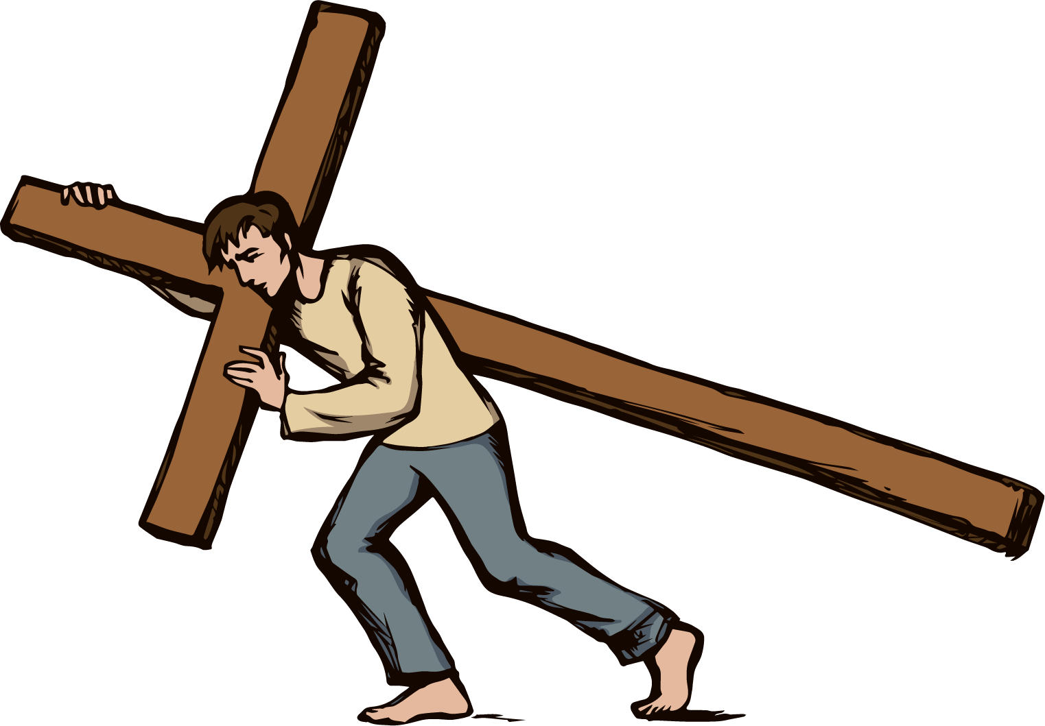
III. Christ’s Example of Humility (Phil. 2:5–8)
A. His humble attitude (2:5, 6)
B. His humble actions (2:7, 8)
How does Jesus’ example of humility help you understand Paul’s command to be and act humbly?

Slide 24
IV. Christ’s Exaltation for Being Humble (Phil. 2:9–11)
A. His unrivaled position (2:9)
• No one else will be exalted to the “rank” Jesus earned through His humble obedience. His position will always be unrivaled.

Slide 25
IV. Christ’s Exaltation for Being Humble (Phil. 2:9–11)
A. His unrivaled position (2:9)
Why will the church (the twenty-four elders) give Christ praise? (Rev. 5:8–10)

Slide 26
IV. Christ’s Exaltation for Being Humble (Phil. 2:9–11)
A. His unrivaled position (2:9)
What did Peter teach concerning humility? (1 Pet. 5:5, 6)

Slide 27
IV. Christ’s Exaltation for Being Humble (Phil. 2:9–11)
A. His unrivaled position (2:9)
B. His universal recognition (2:10, 11)
• God exalted Jesus so that every knee will bow before Jesus and every tongue will confess that Jesus is Lord.

Slide 28


