Slide 1



Slide 2
I. Paul’s Exhortation (Phil. 1:27)
• The Philippians understood that Paul exhorted them to live as worthy citizens of the gospel of Christ.

Slide 3
I. Paul’s Exhortation (Phil. 1:27)
• Paul wanted the Philippians to live in accord with the gospel of Christ.

Slide 4


I. Paul’s Exhortation (Phil. 1:27)
How would you describe a person who lives in a manner worthy of the gospel?

Slide 5

I. Paul’s Exhortation (Phil. 1:27)
Have you noticed any conflicts between being a United States citizen and a citizen of Heaven? What are they? What conflicts might you anticipate arising in days or years to come?

Slide 6
II. Paul’s Expectations (Phil. 1:27)
A. Stand fast in the Spirit
• The Philippians needed unity in order to represent Christ well in Philippi. If they lived as citizens of Heaven, they would be unified.

Slide 7
II. Paul’s Expectations (Phil. 1:27)
A. Stand fast in the Spirit
Think about the broad spectrum of people in our church. What else, besides a unity of spirit through the Holy Spirit, would draw all of us together for a common cause?

Slide 8
II. Paul’s Expectations (Phil. 1:27)
A. Stand fast in the Spirit
B. Striving together in the struggle
• The Philippians needed to struggle together for the faith, that is, the content of the gospel, as it advanced.

Slide 9
II. Paul’s Expectations (Phil. 1:27)
A. Stand fast in the Spirit
B. Striving together in the struggle
What distractions from the furtherance of the gospel does our church face today?

Slide 10
II. Paul’s Expectations (Phil. 1:27)
A. Stand fast in the Spirit
B. Striving together in the struggle
• How an individual responds to his or her role in furthering the gospel will positively or negatively affect other believers.

Slide 11
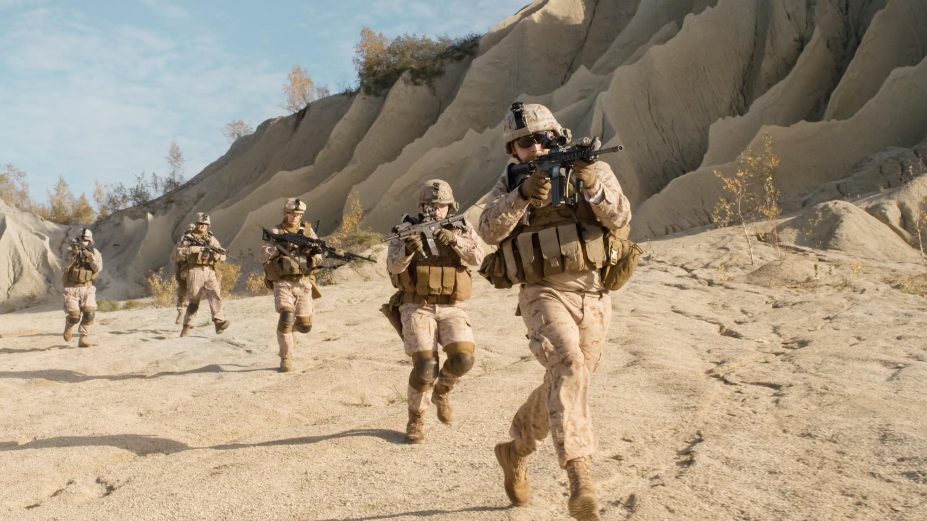

Slide 12
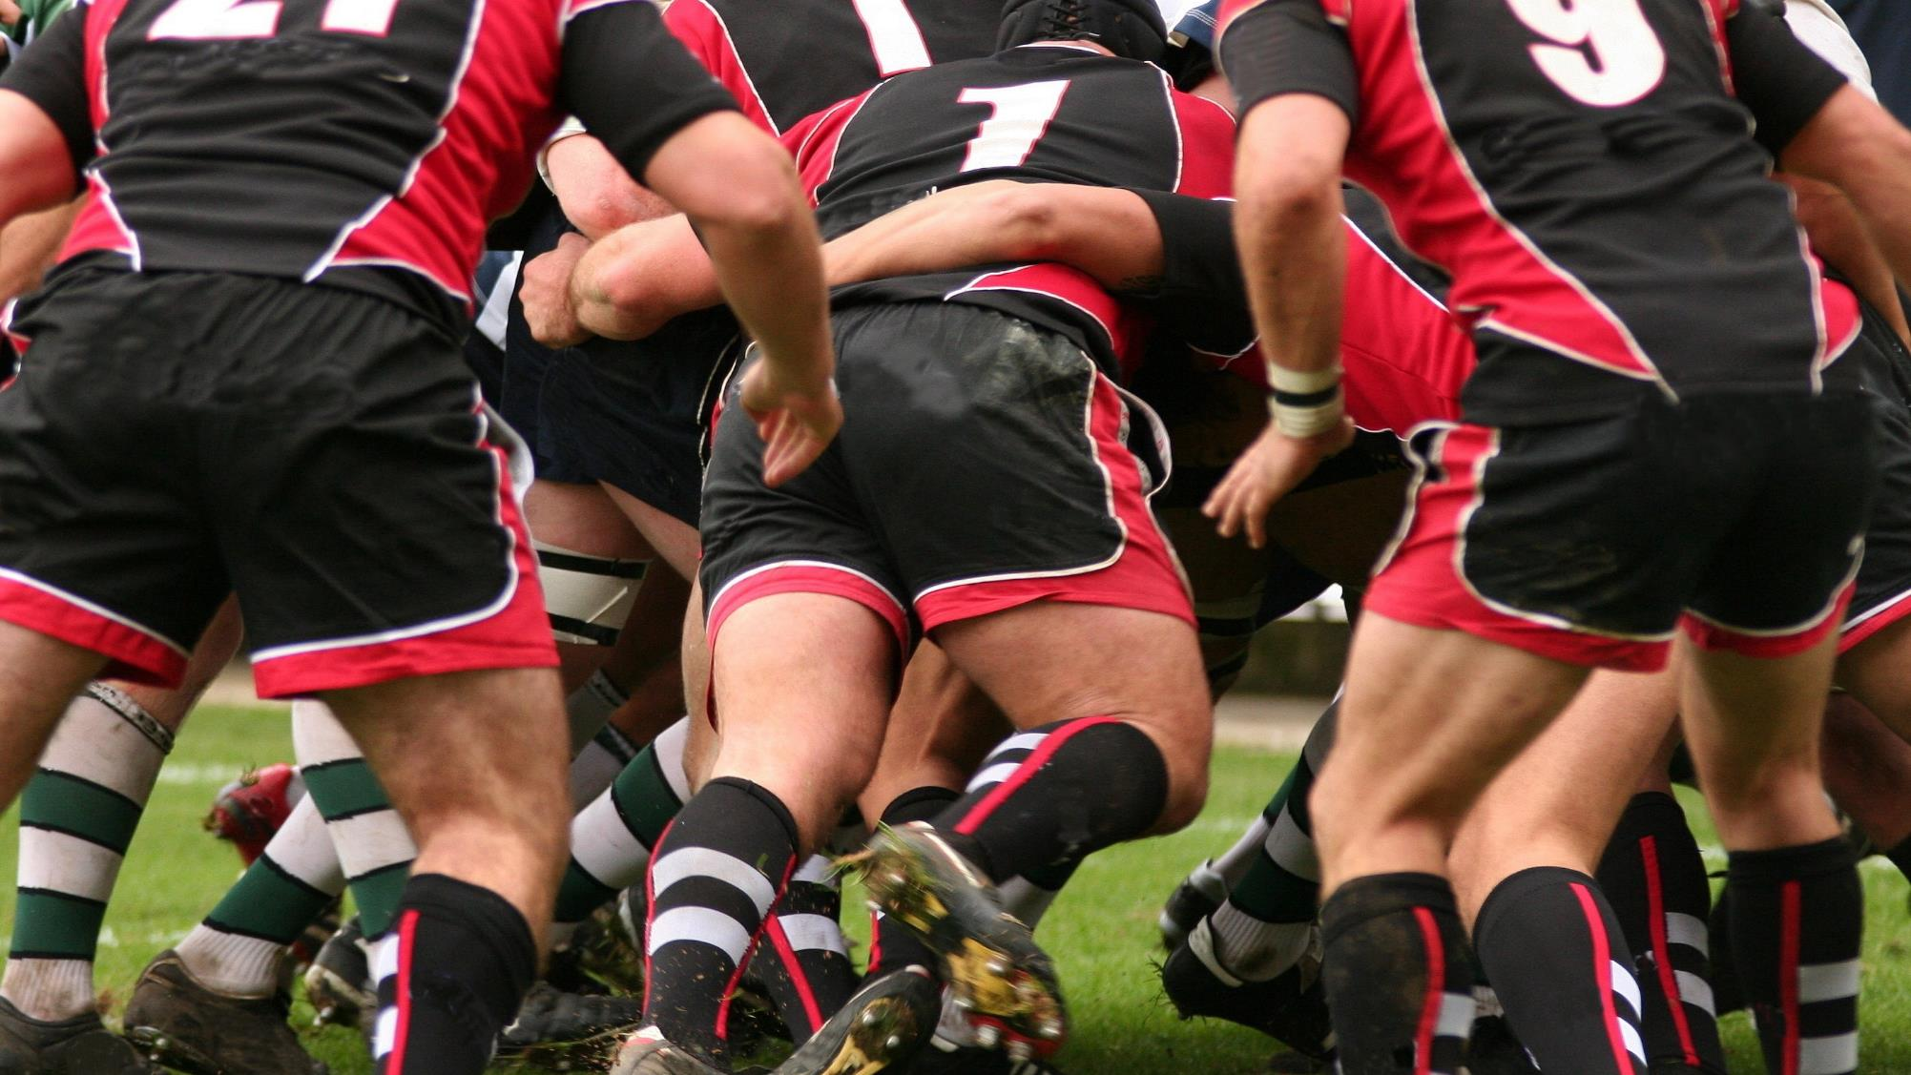

Slide 13
III. The Philippians’ Experiences (Phil. 1:28, 29)
A. Authenticate the gospel (1:28)
• Paul understood the Philippians could become intimidated by their opponents and then panic and “run.” Paul ordered them to take a firm and united stand for the gospel.

Slide 14
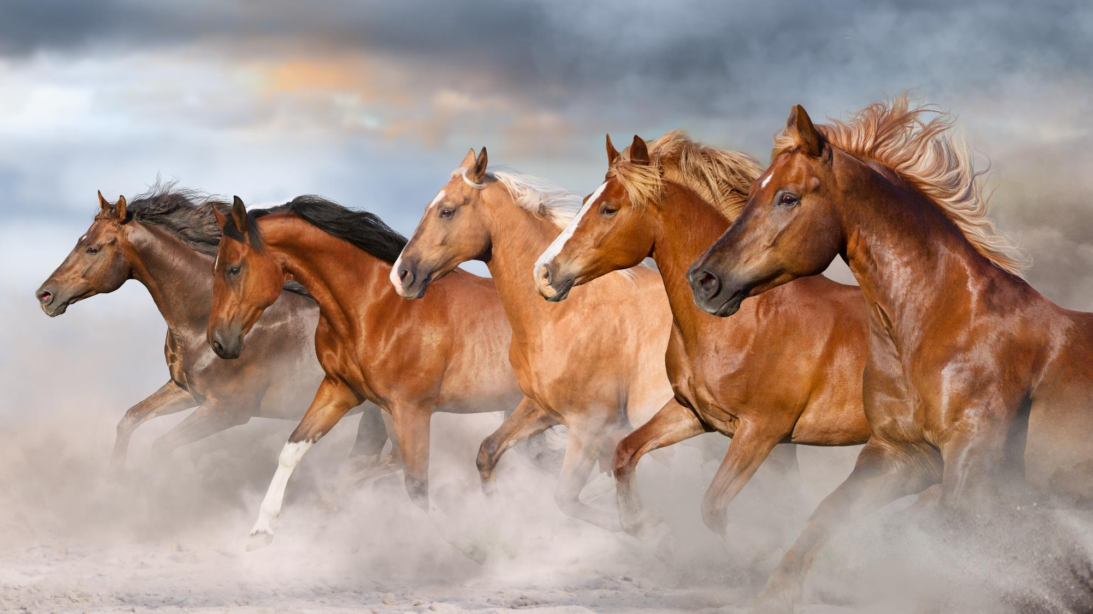

Slide 15
III. The Philippians’ Experiences (Phil. 1:28, 29)
A. Authenticate the gospel (1:28)
• As the believers endured persecution from their enemies, they would demonstrate their deep trust in God and their certainty about their future.

Slide 16
III. The Philippians’ Experiences (Phil. 1:28, 29)
A. Authenticate the gospel (1:28)
• Believers’ steadfastness in the face of danger authenticates their message of hope and serves as an omen of their persecutors’ doom.

Slide 17
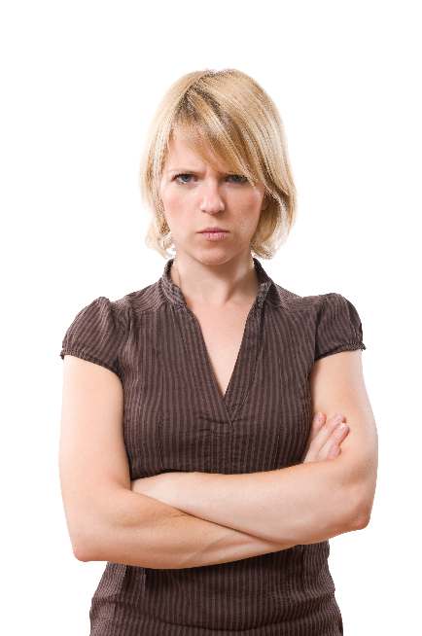
III. The Philippians’ Experiences (Phil. 1:28, 29)
A. Authenticate the gospel (1:28)
When have you been hated because of your testimony as a believer?

Slide 18
III. The Philippians’ Experiences (Phil. 1:28, 29)
A. Authenticate the gospel (1:28)
Do you think your persecutor understood your testimony was for him or her an omen of doom? Explain.

Slide 19

III. The Philippians’ Experiences (Phil. 1:28, 29)
A. Authenticate the gospel (1:28)
B. Appreciate God’s grace (1:29)
• Paul reminded the Philippians that their suffering was granted by God. It was not an accident; it was part of His sovereign purpose.

Slide 20
III. The Philippians’ Experiences (Phil. 1:28, 29)
A. Authenticate the gospel (1:28)
B. Appreciate God’s grace (1:29)
How do most believers normally pray for those who are being persecuted for their faith?

Slide 21
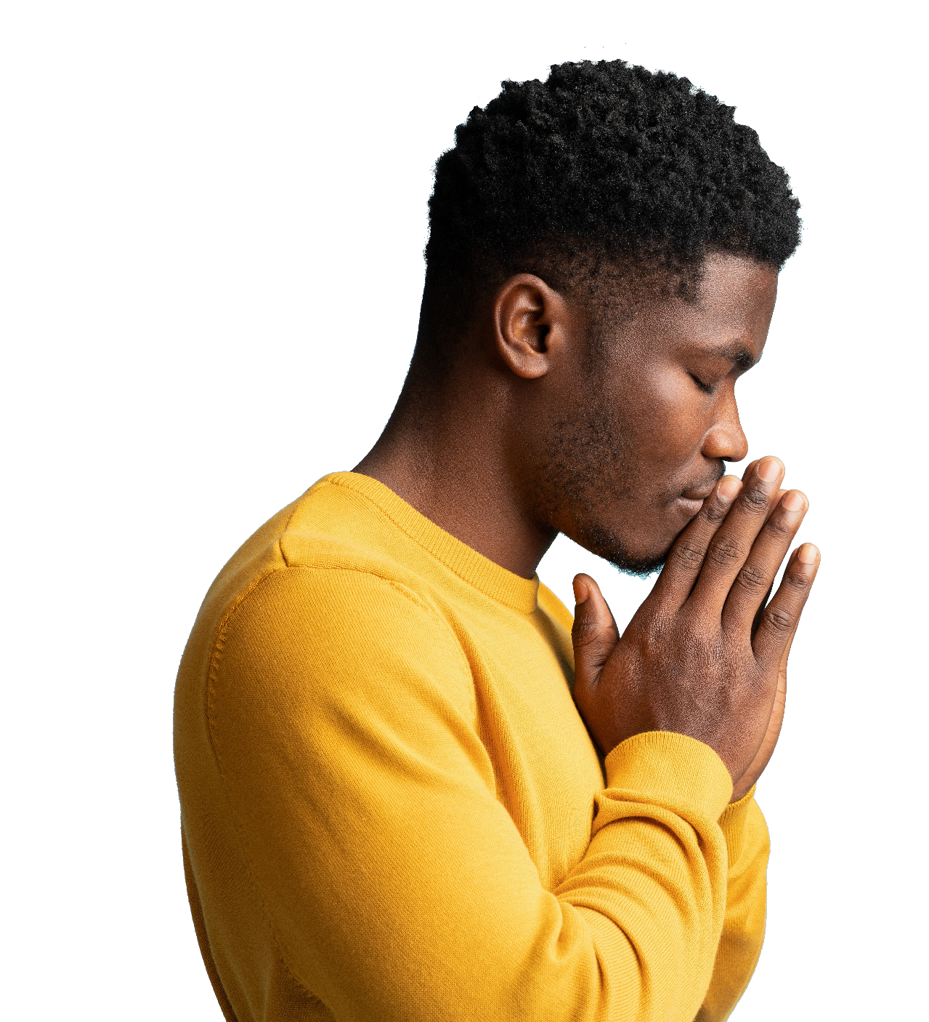
III. The Philippians’ Experiences (Phil. 1:28, 29)
A. Authenticate the gospel (1:28)
B. Appreciate God’s grace (1:29)
How should Philippians 1:29 affect the way believers pray for those persecuted for their faith?

Slide 22
III. The Philippians’ Experiences (Phil. 1:28, 29)
A. Authenticate the gospel (1:28)
B. Appreciate God’s grace (1:29)
• Persecution heightens our awareness of our need for God’s presence and power in our lives.

Slide 23
IV. Paul’s Example (Phil. 1:30)
• Paul reinforced the reality of Christian suffering by referring to his own suffering.

Slide 24
IV. Paul’s Example (Phil. 1:30)
What were some of the benefits of Paul’s suffering in Philippi?

