Slide 1



Slide 2
I. Paul’s Help (Phil. 1:19)
A. His supporters
• Paul had confidence because of the Philippians’ prayers for him.

Slide 3

I. Paul’s Help (Phil. 1:19)
A. His supporters
How do you think the Philippians prayed for Paul?
Do you think they simply asked for his release from prison? Did they pray for his spiritual needs?

Slide 4
I. Paul’s Help (Phil. 1:19)
A. His supporters
• We focus our prayers on persuading God to change a person’s uncomfortable circumstances when we should be praying for God to change the person in the circumstances.

Slide 5
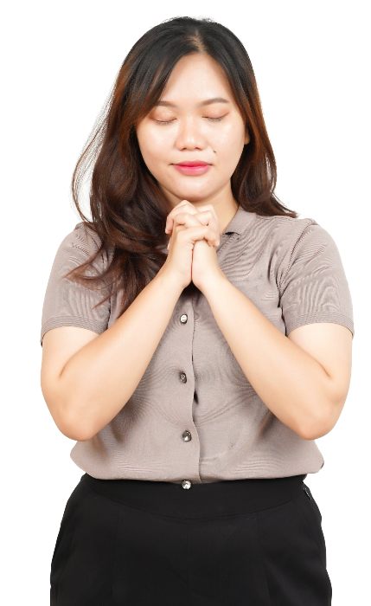
I. Paul’s Help (Phil. 1:19)
A. His supporters
How might we learn to pray for a person’s spiritual needs?

Slide 6
I. Paul’s Help (Phil. 1:19)
A. His supporters
• We must have others praying for us to grow spiritually through our daily trials.

Slide 7

I. Paul’s Help (Phil. 1:19)
A. His supporters
B. His Scriptures
• Paul’s help came from Scriptures he used while under house arrest.

Slide 8

I. Paul’s Help (Phil. 1:19)
A. His supporters
B. His Scriptures
• Paul practiced what he preached, looking to the Scriptures for his learning.

Slide 9
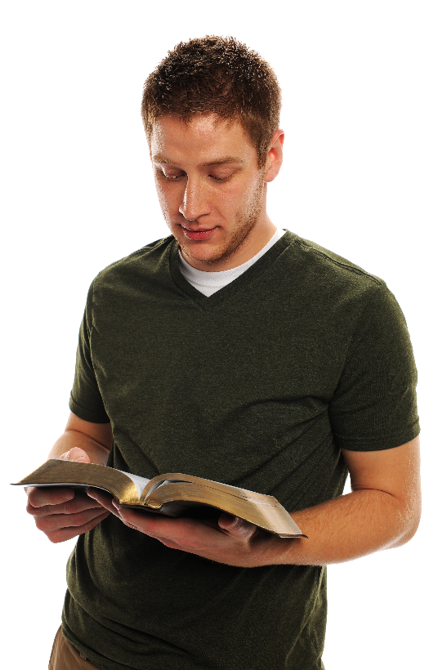
I. Paul’s Help (Phil. 1:19)
A. His supporters
B. His Scriptures
What is the result of turning to the Scriptures for learning (Rom. 15:4–6)?

Slide 10
I. Paul’s Help (Phil. 1:19)
A. His supporters
B. His Scriptures
What helpful truths could Paul have learned from Psalm 34:1–6 as he faced his coming trial and testimony?

Slide 11
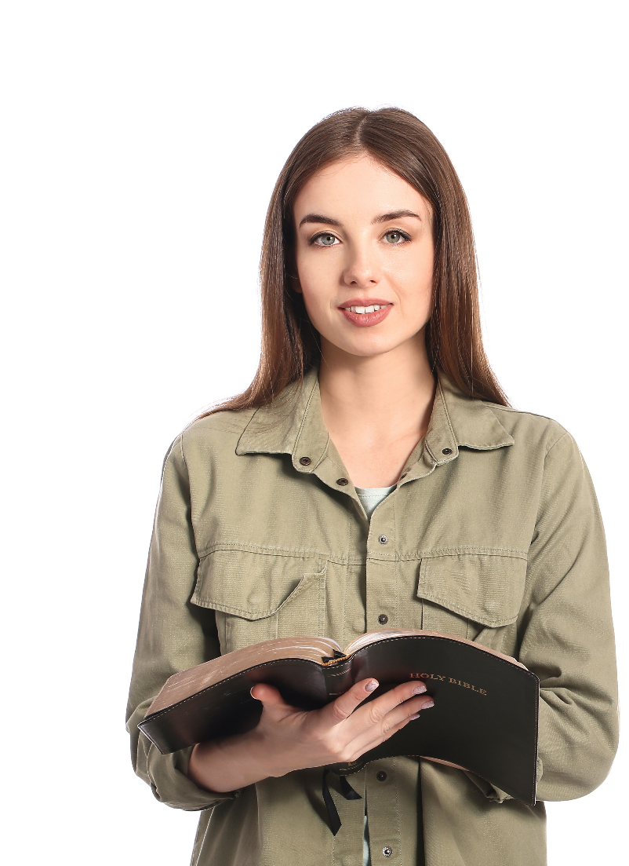
I. Paul’s Help (Phil. 1:19)
A. His supporters
B. His Scriptures
When have you turned to the Scriptures for encouragement? What was the result?

Slide 12
I. Paul’s Help (Phil. 1:19)
A. His supporters
B. His Scriptures
C. His Supply
• The Holy Spirit can’t be our supply if our minds aren’t filled with God’s truth.

Slide 13
I. Paul’s Help (Phil. 1:19)
A. His supporters
B. His Scriptures
C. His Supply
• The Holy Spirit became Paul’s supply to give him the boldness and confidence he would have otherwise lacked.

Slide 14
I. Paul’s Help (Phil. 1:19)
A. His supporters
B. His Scriptures
C. His Supply
How have you known the Spirit’s supply through God’s Word and through the prayers of fellow believers?

Slide 15
II. Paul’s Hope (Phil. 1:20, 21)
A. To maintain his testimony (1:20)
• Paul expected to speak the truth with boldness as he ought to speak it.

Slide 16
II. Paul’s Hope (Phil. 1:20, 21)
A. To maintain his testimony (1:20)
What would you expect to happen to the testimony of a believer who relies on his or her own strength to obey God?

Slide 17

II. Paul’s Hope (Phil. 1:20, 21)
A. To maintain his testimony (1:20)
B. To magnify Christ (1:20, 21)
Which of Christ’s characteristics would have been important for Paul to magnify in the Roman’s pagan world?

Slide 18
II. Paul’s Hope (Phil. 1:20, 21)
A. To maintain his testimony (1:20)
B. To magnify Christ (1:20, 21)
• Paul expected his joyful and loving obedience to Christ would help people understand Christ’s nature.

Slide 19
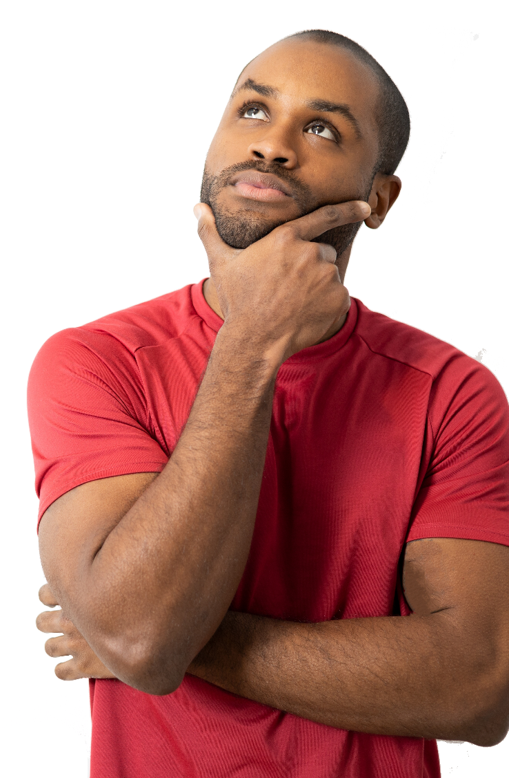
II. Paul’s Hope (Phil. 1:20, 21)
A. To maintain his testimony (1:20)
B. To magnify Christ (1:20, 21)
What about Christ makes Him a mystery for today’s culture?

Slide 20
II. Paul’s Hope (Phil. 1:20, 21)
A. To maintain his testimony (1:20)
B. To magnify Christ (1:20, 21)
• Paul could say that for him living meant “Christ” because of how God’s Word and the Holy Spirit had affected his life.

Slide 21
II. Paul’s Hope (Phil. 1:20, 21)
A. To maintain his testimony (1:20)
B. To magnify Christ (1:20, 21)
Finish the following statement: For me to live is . . . and to die is . .

Slide 22
III. Paul’s Homecoming (Phil. 1:22–26)
A. His “choices” (1:22–24)
Why would Paul entertain a choice that wasn’t his to make? What do you think he is trying to communicate to the Philippians?

Slide 23
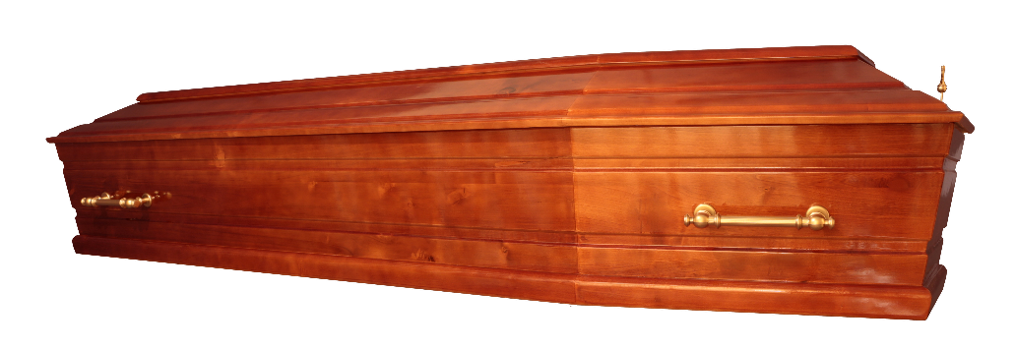
III. Paul’s Homecoming (Phil. 1:22–26)
A. His “choices” (1:22–24)
• Paul demonstrated the confidence that comes from living for Christ. He had no fear in death because he served Christ with his life.

Slide 24
III. Paul’s Homecoming (Phil. 1:22–26)
A. His “choices” (1:22–24)
• In Heaven Paul would be freed from the sorrows of sin. Yet he was willing to continue life on earth if God had more work for him to do.

Slide 25
III. Paul’s Homecoming (Phil. 1:22–26)
A. His “choices” (1:22–24)
B. His confidence (1:25, 26)
• Paul expressed his confidence he would continue to serve the Philippians to help them realize the joy of progressing in their Christlikeness.

