Slide 1
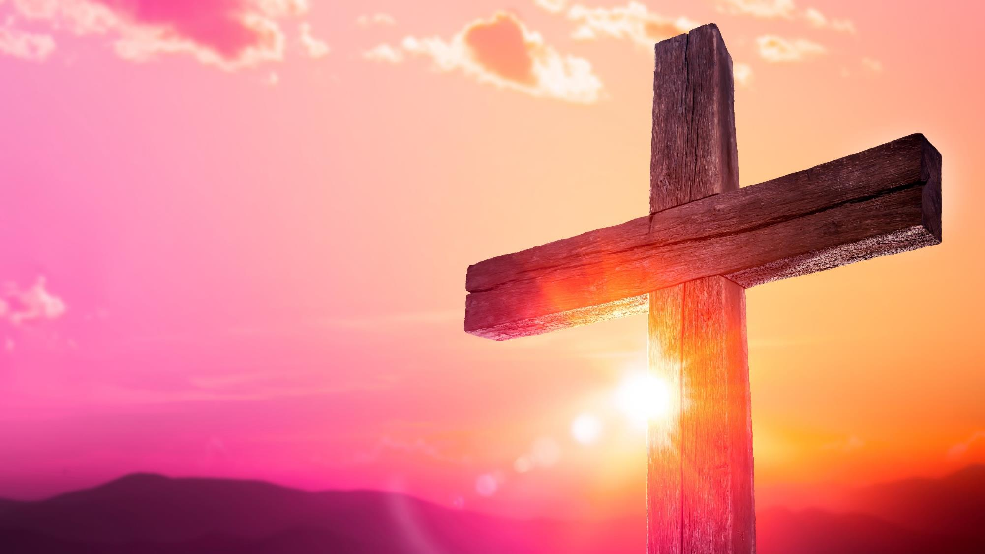


Slide 2
I. God Worked to Further the Gospel (Phil. 1:12)
A. God used opposition
• God used the scheming and plotting of His opponents to launch Paul’s trip to Rome.

Slide 3
I. God Worked to Further the Gospel (Phil. 1:12)
A. God used opposition
• What plans Satan intends for destruction, God can use to further the gospel.

Slide 4

I. God Worked to Further the Gospel (Phil. 1:12)
A. God used opposition
When have you recognized that God has used His opposition to further the gospel?

Slide 5
I. God Worked to Further the Gospel (Phil. 1:12)
A. God used opposition
B. God used creation
• En route to Rome, Paul’s ship was tossed for fourteen days in a terrible storm and then wrecked on the island of Malta.

Slide 6
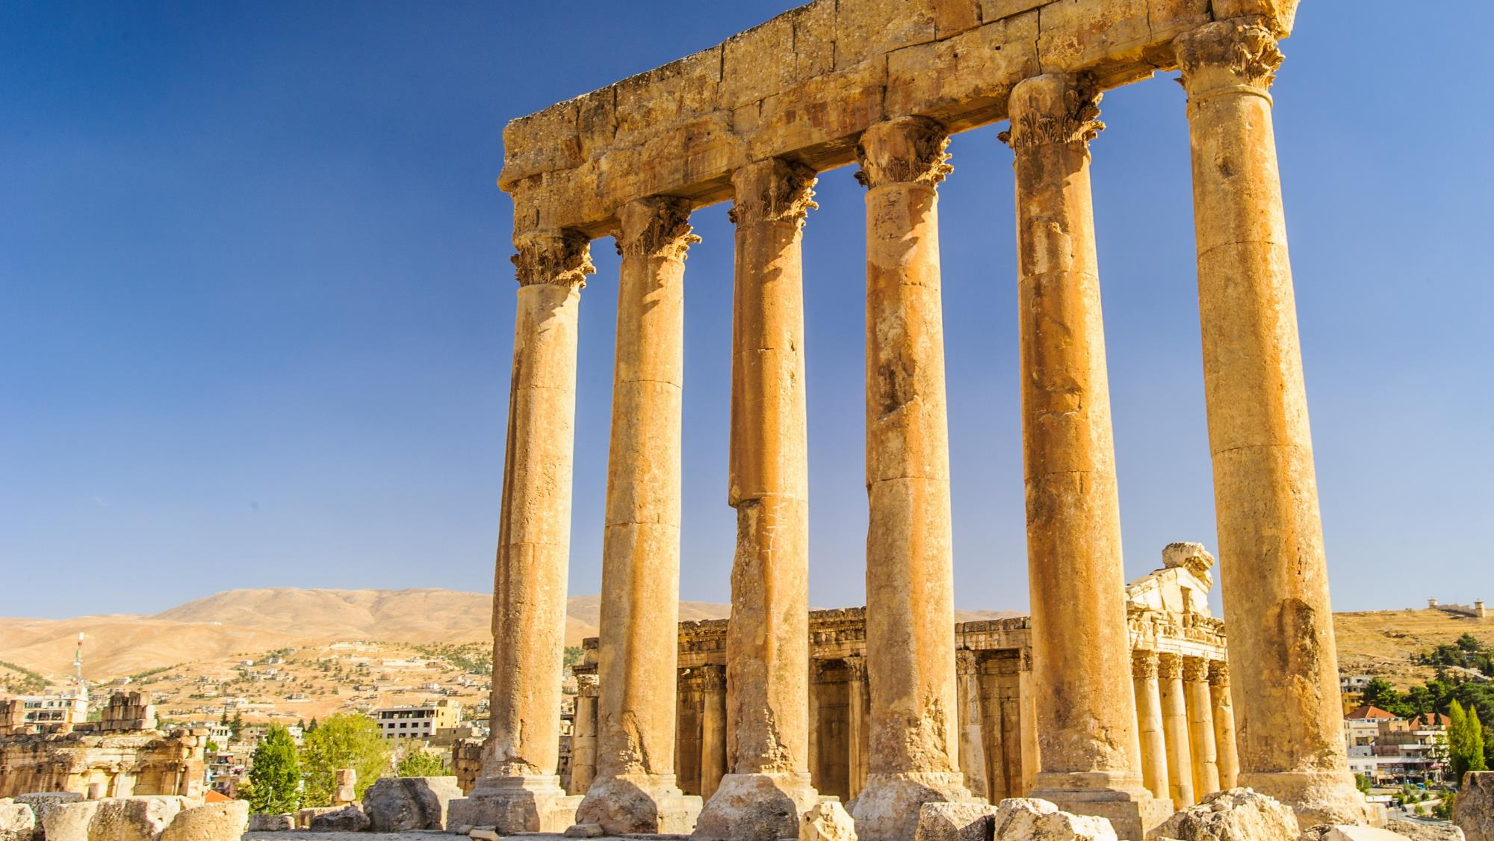
Temple of Jupiter in Roman Heliopolis

Slide 7
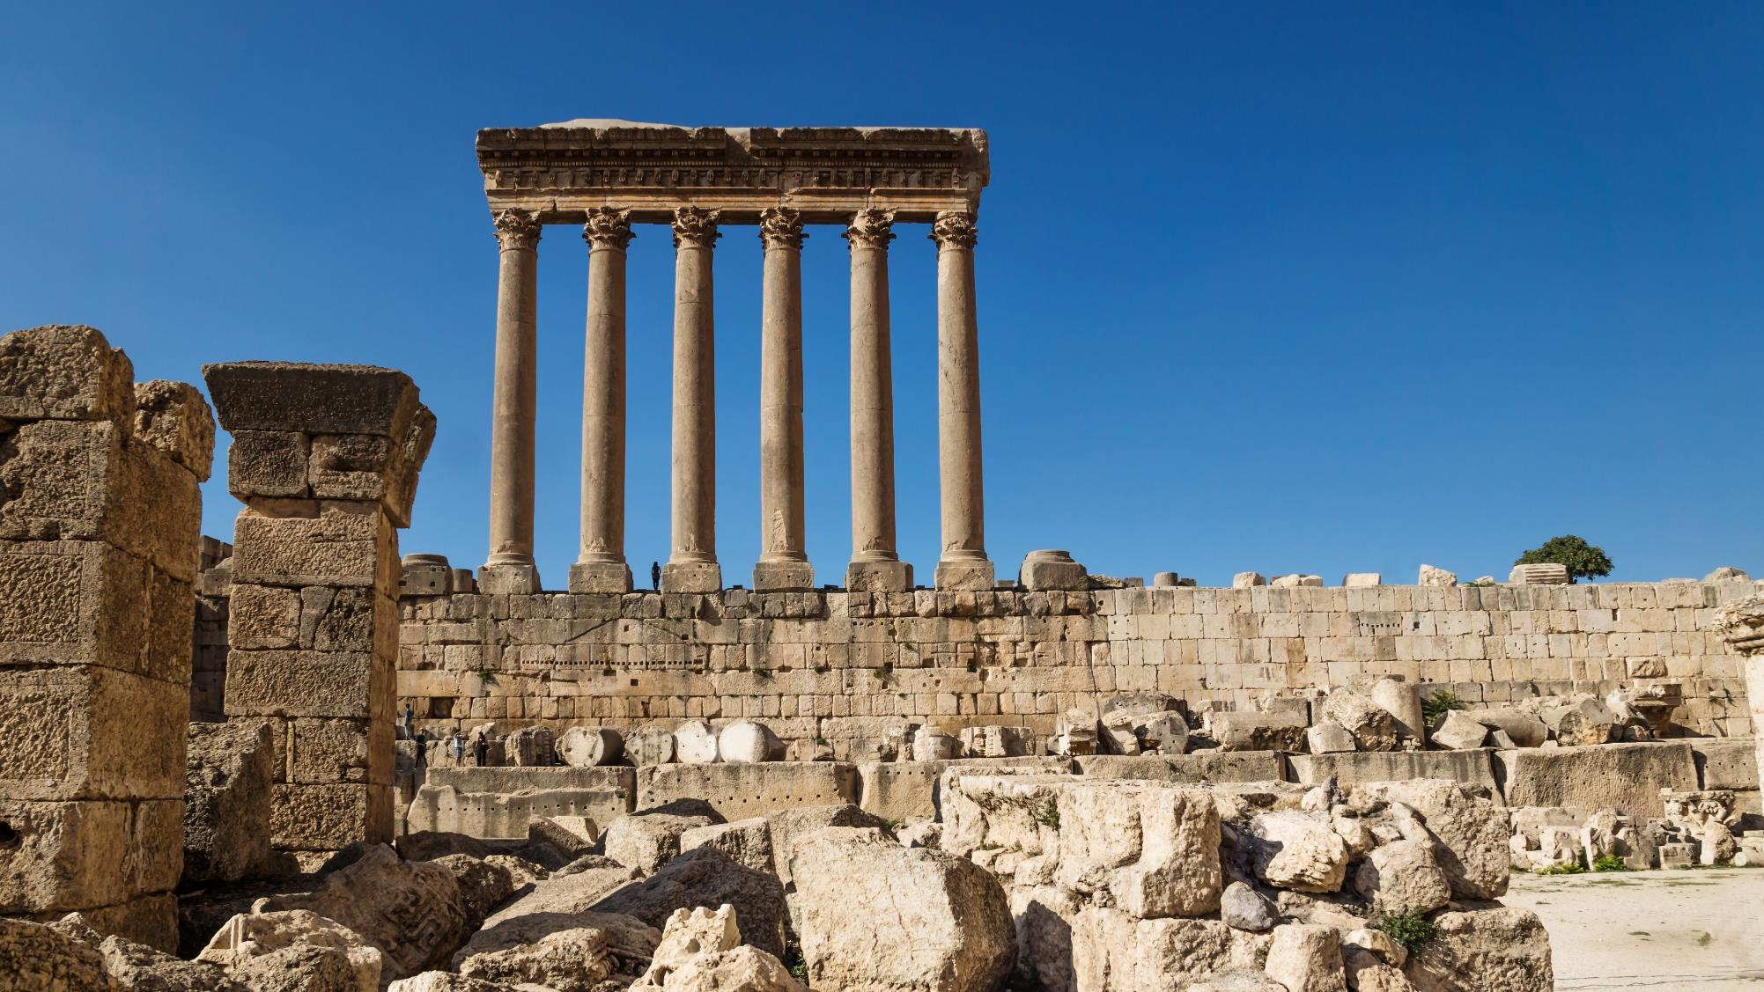
Temple of Jupiter in Roman Heliopolis

Slide 8
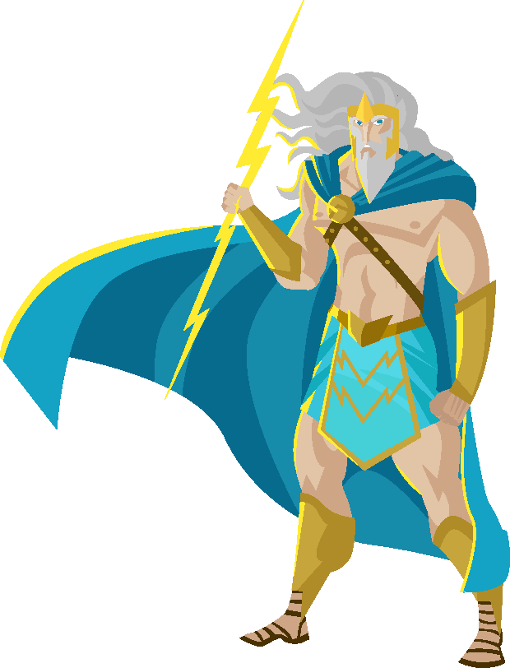
I. God Worked to Further the Gospel (Phil. 1:12)
A. God used opposition
B. God used creation
What would the Romans have expected to happen to Paul in a severe, “Jupiter-controlled” storm?

Slide 9
I. God Worked to Further the Gospel (Phil. 1:12)
A. God used opposition
B. God used creation
• The storm gave Paul a personal illustration of God’s sovereign control over the weather and God’s power to save lives.

Slide 10
I. God Worked to Further the Gospel (Phil. 1:12)
A. God used opposition
B. God used creation
When has God used the weather or other uncomfortable circumstances to further the gospel through your life or the life of a fellow believer?

Slide 11
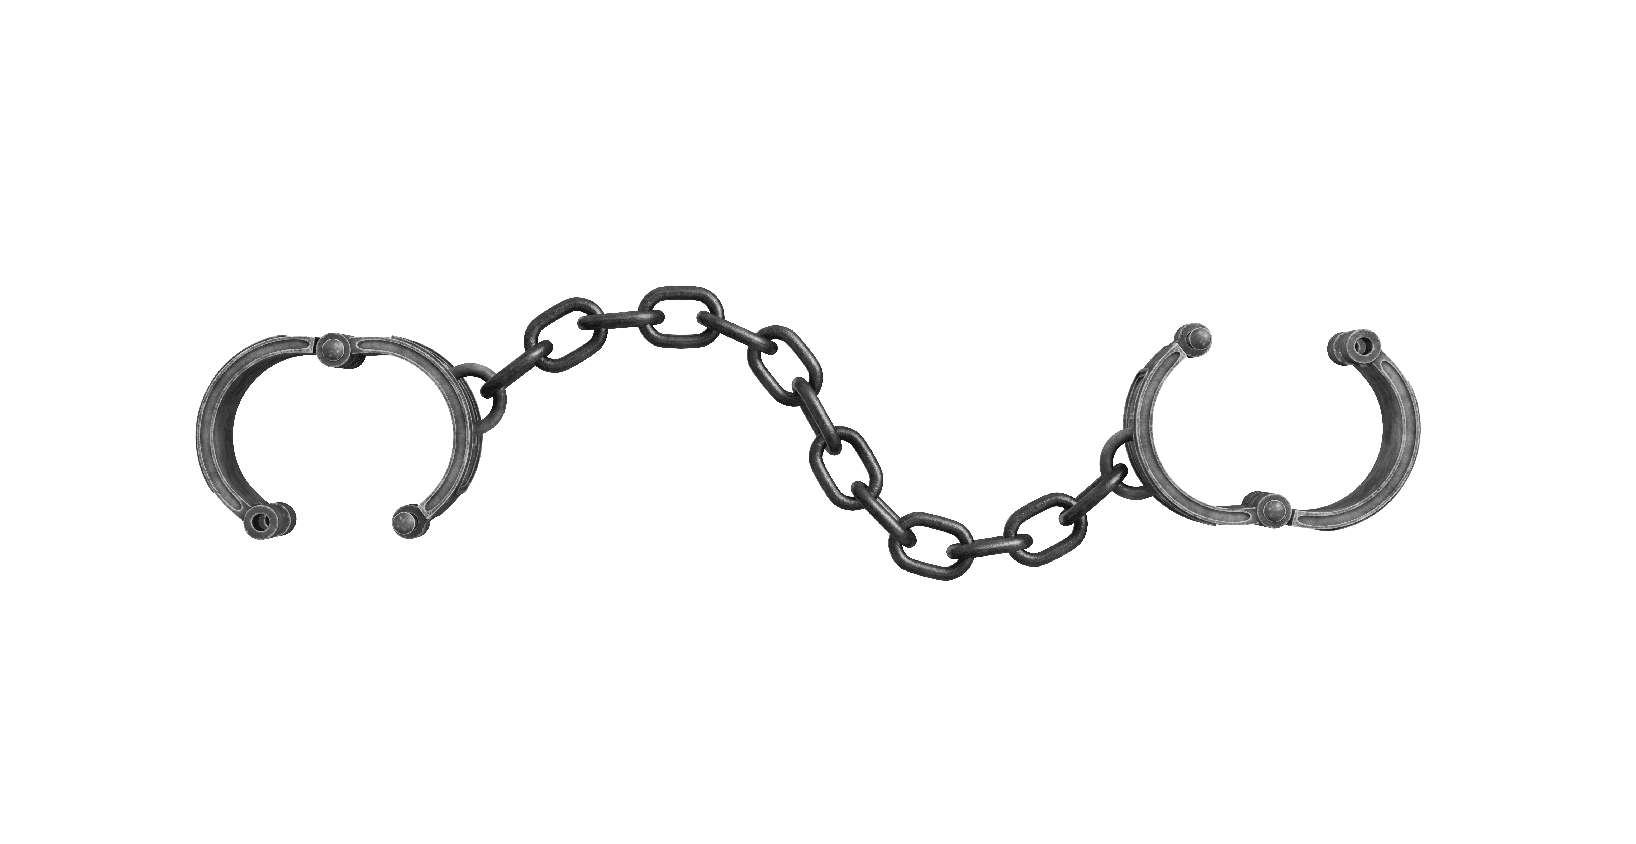
II. Paul Lived to Further the Gospel (Phil. 1:13–17)
A. He exemplified commitment (1:13)
What challenges did Paul endure while being chained to soldiers for two years?

Slide 12
II. Paul Lived to Further the Gospel (Phil. 1:13–17)
A. He exemplified commitment (1:13)
• Based on Paul’s outstanding testimony, the soldiers and others in Nero’s household concluded Paul was under arrest for being a devoted Christian.

Slide 13
II. Paul Lived to Further the Gospel (Phil. 1:13–17)
A. He exemplified commitment (1:13)
• Paul knew by experience that those committed to live for Christ will share in Christ’s suffering.

Slide 14
II. Paul Lived to Further the Gospel (Phil. 1:13–17)
A. He exemplified commitment (1:13)
How does your commitment to Christ show to those who rub shoulders with you?

Slide 15
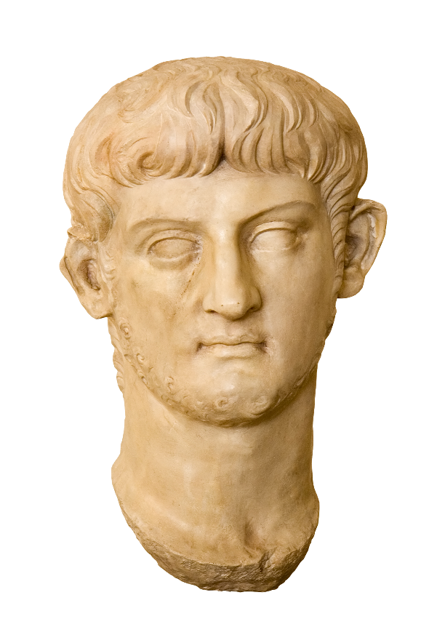
II. Paul Lived to Further the Gospel (Phil. 1:13–17)
A. He exemplified commitment (1:13)
B. He encouraged missions (1:14)
• Nero was one of the harshest emperors the early church endured.

Slide 16
II. Paul Lived to Further the Gospel (Phil. 1:13–17)
A. He exemplified commitment (1:13)
B. He encouraged missions (1:14)
• Roman believers preached about the one true God with newfound courage being persuaded by Paul’s chains that suffering for Christ is a natural and even welcome part of the Christian life.

Slide 17
II. Paul Lived to Further the Gospel (Phil. 1:13–17)
A. He exemplified commitment (1:13)
B. He encouraged missions (1:14)
Whose example has encouraged you to serve God courageously?

Slide 18
II. Paul Lived to Further the Gospel (Phil. 1:13–17)
A. He exemplified commitment (1:13)
B. He encouraged missions (1:14)
C. He emphasized motives (1:15–17)
• Some Roman believers were preaching out of envy, using Paul’s imprisonment as an opportunity to gain personal prestige and pats on the back.

Slide 19
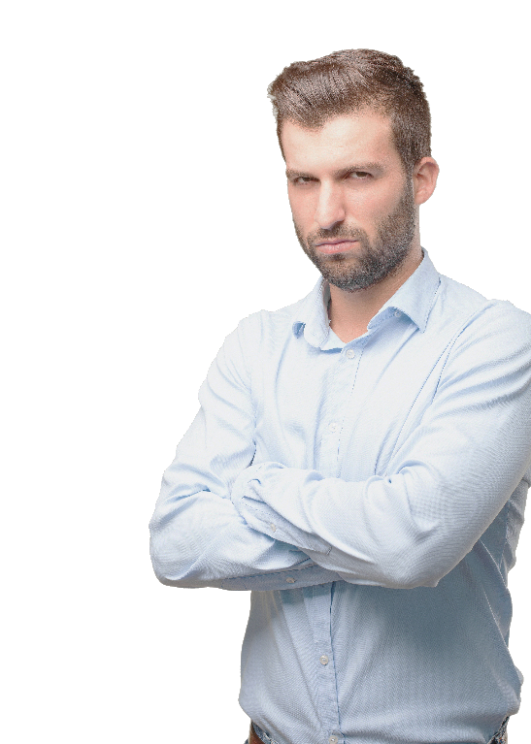
II. Paul Lived to Further the Gospel (Phil. 1:13–17)
A. He exemplified commitment (1:13)
B. He encouraged missions (1:14)
C. He emphasized motives (1:15–17)
How might believers respond to feelings of jealousy toward those with strong ministry abilities that contribute to their ministry success?

Slide 20
II. Paul Lived to Further the Gospel (Phil. 1:13–17)
A. He exemplified commitment (1:13)
B. He encouraged missions (1:14)
C. He emphasized motives (1:15–17)
• Paul never cared about who got credit for evangelistic success so long as the gospel continued to impact lives.

Slide 21
II. Paul Lived to Further the Gospel (Phil. 1:13–17)
A. He exemplified commitment (1:13)
B. He encouraged missions (1:14)
C. He emphasized motives (1:15–17)
• Those with pure motives loved God more than themselves and consequently elevated the needs of the lost above their own.

Slide 22
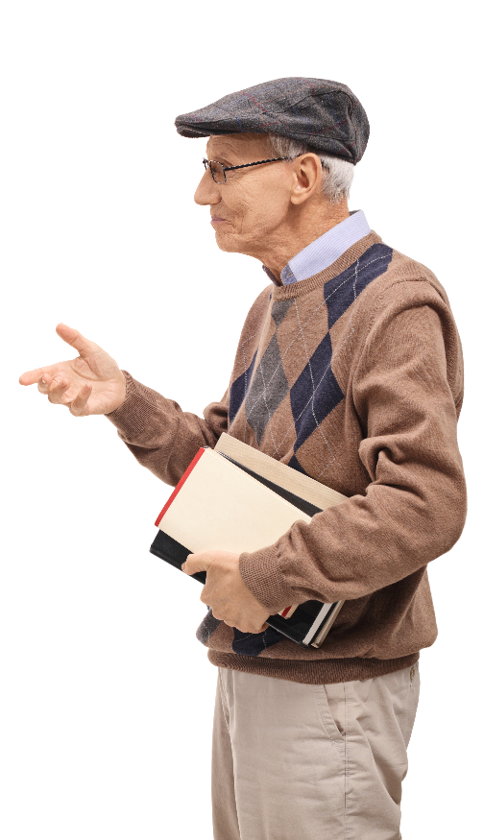
II. Paul Lived to Further the Gospel (Phil. 1:13–17)
A. He exemplified commitment (1:13)
B. He encouraged missions (1:14)
C. He emphasized motives (1:15–17)
What characterizes the gospel presentations of those who love Christ?

Slide 23

II. Paul Lived to Further the Gospel (Phil. 1:13–17)
A. He exemplified commitment (1:13)
B. He encouraged missions (1:14)
C. He emphasized motives (1:15–17)
• Remembering our personal evaluation before Christ in Heaven should motivate us to serve God sincerely.

Slide 24

III. Paul Rejoiced in the Gospel’s Furtherance (1:18)
• What causes a person to rejoice speaks to that person’s perspective on life. Paul rejoiced in the gospel’s furtherance because he looked at life from God’s perspective.

Slide 25
III. Paul Rejoiced in the Gospel’s Furtherance (1:18)
What causes you to rejoice? What do your reasons for joy reveal about your perspective on life?

