Slide 1



Slide 2



I. Love Increasingly (Phil. 1:9)
A. Love directed toward God
GOD
What does a greater love for God look like in a believer’s life?

Slide 3

I. Love Increasingly (Phil. 1:9)
A. Love directed toward God
GOD
OTHERS
What happens to a believer’s relationships when his or her love for God abounds?

Slide 4
I. Love Increasingly (Phil. 1:9)
A. Love directed toward God
B. Love directed by God
• Paul prayed the Philippians’ love would be guided by knowledge and discerning judgment.

Slide 5
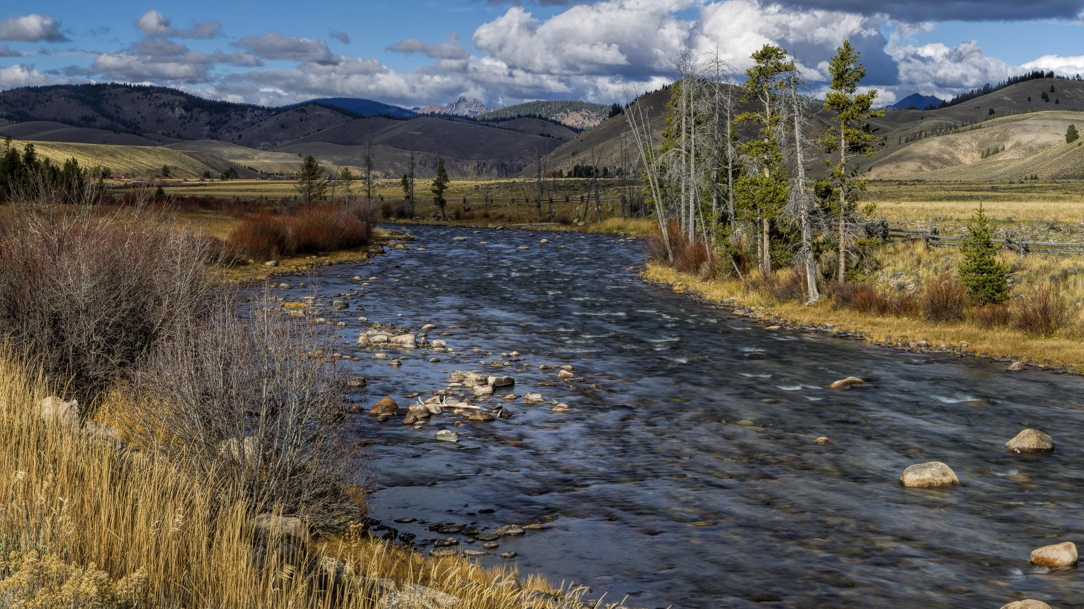

Slide 6
I. Love Increasingly (Phil. 1:9)
A. Love directed toward God
B. Love directed by God
Name some biblical truths and principles that should guide our love for others.

Slide 7
I. Love Increasingly (Phil. 1:9)
A. Love directed toward God
B. Love directed by God
Name some instances when believers might accept or excuse a person’s sin in the name of love.

Slide 8
I. Love Increasingly (Phil. 1:9)
A. Love directed toward God
B. Love directed by God
What harm could come from excusing sin out of “love”?

Slide 9
II. Love Wisely (Phil. 1:10)
Name an example of a church choosing what is good to the neglect of choosing what is best.

Slide 10

II. Love Wisely (Phil. 1:10)
• God’s Word guides churches to wisely discern what is best and balanced so the church grows in love for each other and the lost.

Slide 11
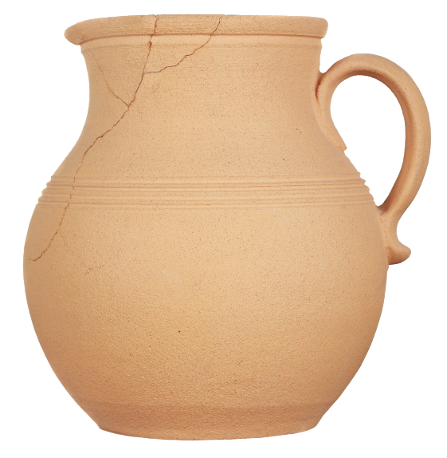
III. Love Purely (Phil. 1:10)
A. Have pure intentions
How would you define “sincere”?

Slide 12
III. Love Purely (Phil. 1:10)
A. Have pure intentions
Why does sincerity matter when serving God?

Slide 13
III. Love Purely (Phil. 1:10)
A. Have pure intentions
How might we know if our intentions for serving God are pure?

Slide 14
III. Love Purely (Phil. 1:10)
A. Have pure intentions
B. Keep a pure testimony
• Paul wanted the Philippians to live increasingly more like Christ so their actions would not cause believers to stumble or unbelievers to reject Christ.

Slide 15
III. Love Purely (Phil. 1:10)
A. Have pure intentions
B. Keep a pure testimony
Describe the testimony unbelievers might expect from those who witness to them.

Slide 16

III. Love Purely (Phil. 1:10)
A. Have pure intentions
B. Keep a pure testimony
C. Prepare for the purity test
• Christ will evaluate believers’ good works to see if the works are worthy of reward.

Slide 17
III. Love Purely (Phil. 1:10)
A. Have pure intentions
B. Keep a pure testimony
C. Prepare for the purity test
How often do you think about the Judgment Seat of Christ?

Slide 18
III. Love Purely (Phil. 1:10)
A. Have pure intentions
B. Keep a pure testimony
C. Prepare for the purity test
How might you use the Judgment Seat of Christ as motivation to live purely and blamelessly?

Slide 19

IV. Love Effectively (Phil. 1:11)
A. Bear fruit through Christ
What does it take to engage the Spirit to produce fruit in our lives?

Slide 20
IV. Love Effectively (Phil. 1:11)
A. Bear fruit through Christ
• Jesus, our vine, provides the “nutrition” to produce righteous and glorious fruit in our lives.

Slide 21
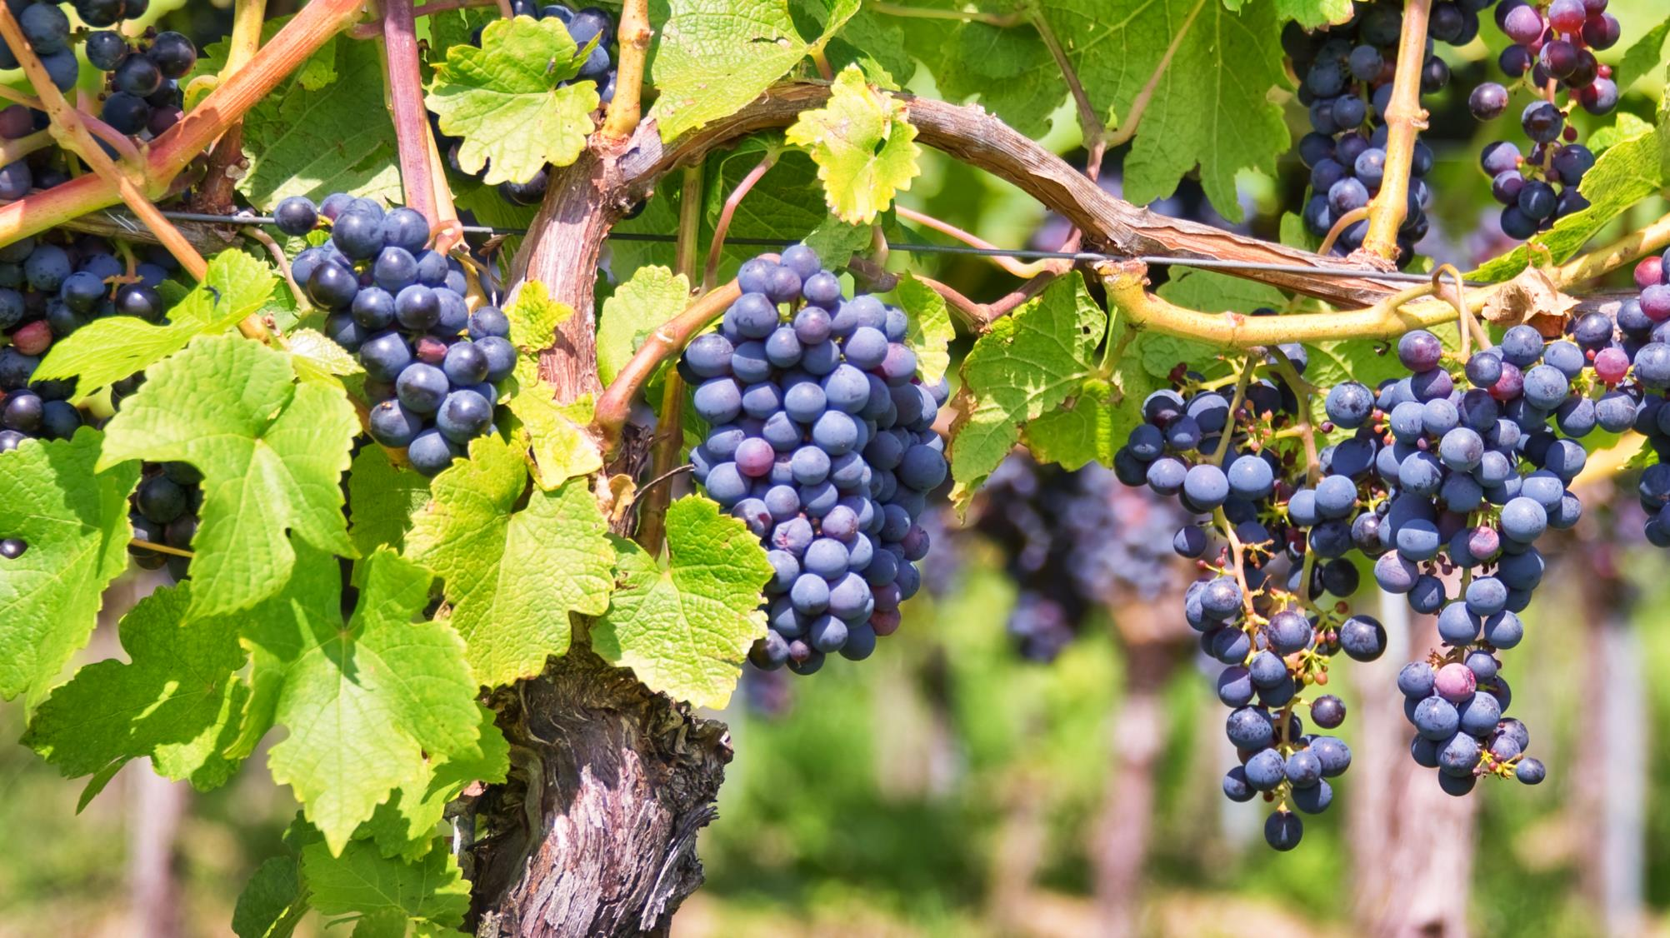

Slide 22
IV. Love Effectively (Phil. 1:11)
A. Bear fruit through Christ
B. Bring glory to God
Why does God deserve the praise for the glorious spiritual fruit in our lives?

