Slide 1



Slide 2
I. Participate in Generous Giving (Phil. 4:14–16)
A. Partner sacrificially (4:14)
• Paul made sure the Philippians understood his deep appreciation for their sacrifice and for their willingness to join him in his distress.

Slide 3


I. Participate in Generous Giving (Phil. 4:14–16)
A. Partner sacrificially (4:14)
When have you obeyed the Spirit’s prompting to give generously to meet another believer’s need? (James 4:17)

Slide 4
I. Participate in Generous Giving (Phil. 4:14–16)
A. Partner sacrificially (4:14)
How might we know God is leading us to help other believers through our sacrificial giving?

Slide 5
I. Participate in Generous Giving (Phil. 4:14–16)
A. Partner sacrificially (4:14)
B. Share persistently (4:15, 16)
• Paul recognized the Philippian believers for their habit of giving. They kept track of Paul’s needs.

Slide 6

I. Participate in Generous Giving (Phil. 4:14–16)
A. Partner sacrificially (4:14)
B. Share persistently (4:15, 16)
What does our church do to keep track of our missionaries’ growing and changing needs?

Slide 7
I. Participate in Generous Giving (Phil. 4:14–16)
A. Partner sacrificially (4:14)
B. Share persistently (4:15, 16)
How did the Philippians’ persistent giving fit Paul’s teaching in Philippians 2:3 and 4?

Slide 8
II. Benefits of Gracious Giving (4:17–19)
A. Spiritual fruit (4:17)
• The Philippians’ sacrificial giving played an important role in Paul’s ministry of spreading the gospel, and Paul knew God would reward their efforts.

Slide 9

II. Benefits of Gracious Giving (4:17–19)
A. Spiritual fruit (4:17)
• As the Philippians gave, they would know the joy of the Lord and have genuine contentment.

Slide 10
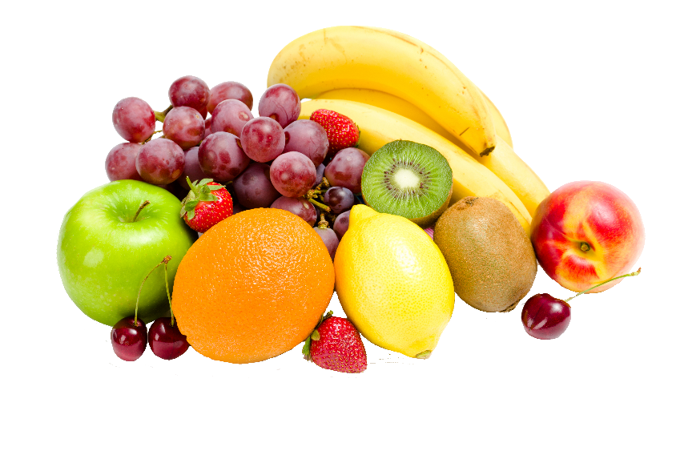
II. Benefits of Gracious Giving (4:17–19)
A. Spiritual fruit (4:17)
How has the spiritual fruit that comes from giving sacrificially affected your desire to continue to give?

Slide 11
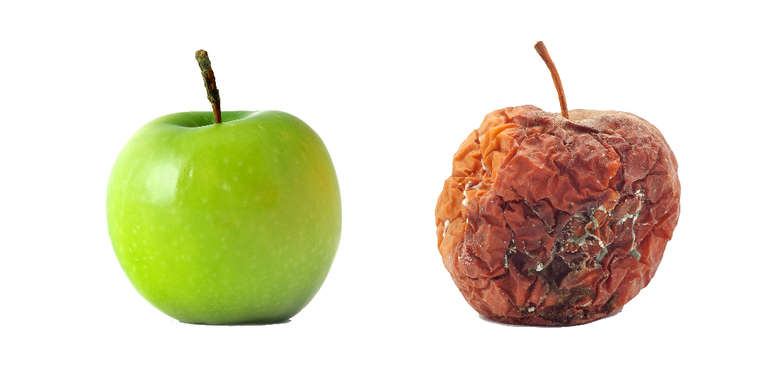
II. Benefits of Gracious Giving (4:17–19)
A. Spiritual fruit (4:17)
Compare the “fruit” that comes from giving to the “fruit” that comes from being greedy and selfish.

Slide 12
II. Benefits of Gracious Giving (4:17–19)
A. Spiritual fruit (4:17)
B. Divine pleasure (4:18)
• God’s holiness and love, among other attributes, motivated the Philippians to give sacrificially to God.

Slide 13
II. Benefits of Gracious Giving (4:17–19)
A. Spiritual fruit (4:17)
B. Divine pleasure (4:18)
Does God’s greatness motivate your sacrificial giving? How do you know?

Slide 14

II. Benefits of Gracious Giving (4:17–19)
A. Spiritual fruit (4:17)
B. Divine pleasure (4:18)
• The Philippians’ sacrificial gift metaphorically produced a sweet-smelling aroma that God couldn’t help but notice.

Slide 15
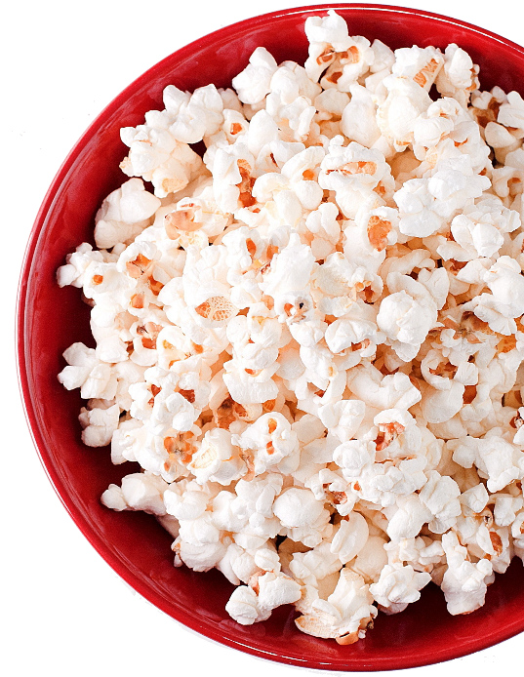
II. Benefits of Gracious Giving (4:17–19)
A. Spiritual fruit (4:17)
B. Divine pleasure (4:18)
How do you respond when you smell chocolate chip cookies in the oven, steaks on a barbecue grill, or popcorn fresh out of the microwave?

Slide 16
II. Benefits of Gracious Giving (4:17–19)
A. Spiritual fruit (4:17)
B. Divine pleasure (4:18)
How would you respond to someone who thinks his sacrifices for God are too meager for God to notice?

Slide 17
II. Benefits of Gracious Giving (4:17–19)
A. Spiritual fruit (4:17)
B. Divine pleasure (4:18)
• God accepted the Philippians’ sacrificial gift as a satisfactory and proper recognition of His greatness.

Slide 18
II. Benefits of Gracious Giving (4:17–19)
A. Spiritual fruit (4:17)
B. Divine pleasure (4:18)
How does Paul’s sacrifice metaphor enhance your understanding of your sacrificial service for God? Which truths motivate you to want to give sacrificially to God?

Slide 19

II. Benefits of Gracious Giving (4:17–19)
A. Spiritual fruit (4:17)
B. Divine pleasure (4:18)
C. Replenished supply (4:19, 20)
What would you include in a list of the Philippians’ needs? (Phil. 4:19)

Slide 20
II. Benefits of Gracious Giving (4:17–19)
A. Spiritual fruit (4:17)
B. Divine pleasure (4:18)
C. Replenished supply (4:19, 20)
• The Philippians did not need to fear that their gift to Paul would cause a severe lack in their own lives.

Slide 21
II. Benefits of Gracious Giving (4:17–19)
A. Spiritual fruit (4:17)
B. Divine pleasure (4:18)
C. Replenished supply (4:19, 20)
• God chooses to use people because it means spiritual fruit for them and glory and pleasure for Him.

Slide 22
II. Benefits of Gracious Giving (4:17–19)
A. Spiritual fruit (4:17)
B. Divine pleasure (4:18)
C. Replenished supply (4:19, 20)
Have you viewed giving as a command you must obey or as an opportunity to know God’s blessings? Explain.

Slide 23
II. Benefits of Gracious Giving (4:17–19)
A. Spiritual fruit (4:17)
B. Divine pleasure (4:18)
C. Replenished supply (4:19, 20)
• God gives in accordance with His graciousness and greatness.

Slide 24

II. Benefits of Gracious Giving (4:17–19)
A. Spiritual fruit (4:17)
B. Divine pleasure (4:18)
C. Replenished supply (4:19, 20)
Finish this sentence: I will give sacrificially to God because He is . . .

Slide 25
II. Benefits of Gracious Giving (4:17–19)
A. Spiritual fruit (4:17)
B. Divine pleasure (4:18)
C. Replenished supply (4:19, 20)
D. Gracious friendships (4:21–23)
• The Philippines’ sacrificial and consistent giving endeared them to Paul.

Slide 26
II. Benefits of Gracious Giving (4:17–19)
A. Spiritual fruit (4:17)
B. Divine pleasure (4:18)
C. Replenished supply (4:19, 20)
D. Gracious friendships (4:21–23)
• All believers are saints in that they all belong to God and are available for His use.

Slide 27
II. Benefits of Gracious Giving (4:17–19)
A. Spiritual fruit (4:17)
B. Divine pleasure (4:18)
C. Replenished supply (4:19, 20)
D. Gracious friendships (4:21–23)
• It is through grace that we can partake of God’s generosity in Christ, which motivates us to give generously of ourselves in ministry to others.

