Slide 1



Slide 2
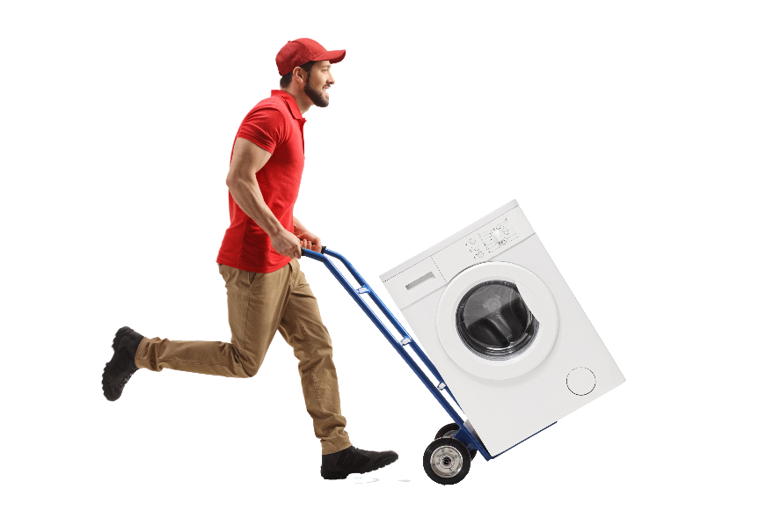

I. Making Connections (Acts 16:6–40)
A. Following God to places (16:6–10)
Does God lead us to places (cities, houses, workplaces, groups) today? Explain.

Slide 3
I. Making Connections (Acts 16:6–40)
A. Following God to places (16:6–10)
Why are you where you are? Does God top your list of reasons?

Slide 4
I. Making Connections (Acts 16:6–40)
A. Following God to places (16:6–10)
• No matter our location or vocation, gospel work is our primary work.

Slide 5
I. Making Connections (Acts 16:6–40)
A. Following God to places (16:6–10)
What is the difference between serving God where we go and serving God where He leads?

Slide 6

I. Making Connections (Acts 16:6–40)
A. Following God to places (16:6–10)
How can we be sure we are following God when we make decisions that move us to new neighborhoods, cities, states, or countries?

Slide 7
I. Making Connections (Acts 16:6–40)
A. Following God to places (16:6–10)
B. Following God to people (16:11–40)
1. To religious people (16:11–15)
• Lydia’s former religion and recognition of God were commendable, but the religious are just as lost as the pagans.

Slide 8
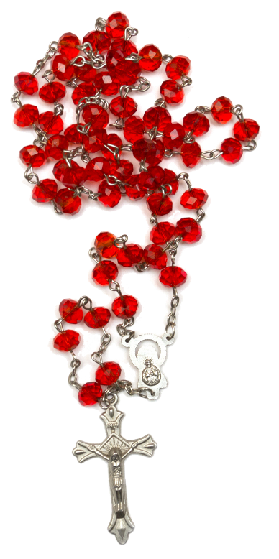
I. Making Connections (Acts 16:6–40)
A. Following God to places (16:6–10)
B. Following God to people (16:11–40)
1. To religious people (16:11–15)
Why might we be tempted to ignore the spiritual needs of those who are religious but lost?

Slide 9
I. Making Connections (Acts 16:6–40)
A. Following God to places (16:6–10)
B. Following God to people (16:11–40)
1. To religious people (16:11–15)
2. To desperate people (16:16–25)
What would be the normal response to being unjustly beaten and incarcerated?

Slide 10
I. Making Connections (Acts 16:6–40)
A. Following God to places (16:6–10)
B. Following God to people (16:11–40)
1. To religious people (16:11–15)
2. To desperate people (16:16–25)
In what sense is every unbeliever condemned?

Slide 11
I. Making Connections (Acts 16:6–40)
A. Following God to places (16:6–10)
B. Following God to people (16:11–40)
1. To religious people (16:11–15)
2. To desperate people (16:16–25)
How has God directed you to encounter desperate people? How did you respond to the circumstances?

Slide 12
I. Making Connections (Acts 16:6–40)
A. Following God to places (16:6–10)
B. Following God to people (16:11–40)
1. To religious people (16:11–15)
2. To desperate people (16:16–25)
• Paul and Silas understood that to whom God had led them was far more important than how God had led them.

Slide 13
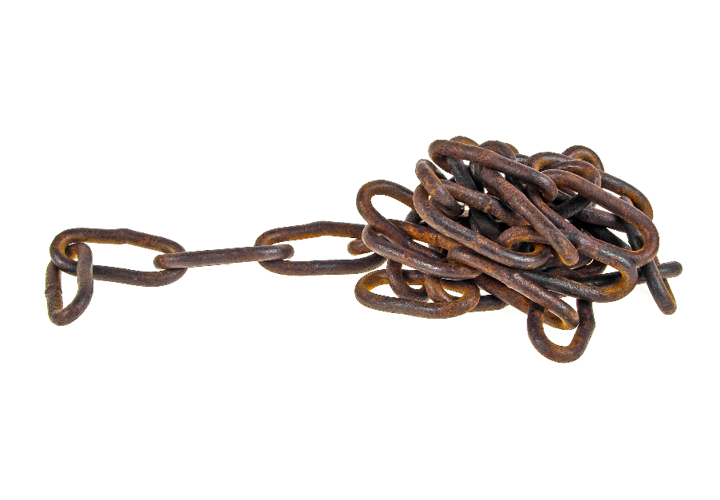
I. Making Connections (Acts 16:6–40)
A. Following God to places (16:6–10)
B. Following God to people (16:11–40)
1. To religious people (16:11–15)
2. To desperate people (16:16–25)
3. To troubled people (16:26–40)
• The missionaries realized that God hadn’t loosed their chains and opened the doors so they could escape the prison. They sat and waited for the “aftershock.”

Slide 14
I. Making Connections (Acts 16:6–40)
A. Following God to places (16:6–10)
B. Following God to people (16:11–40)
1. To religious people (16:11–15)
2. To desperate people (16:16–25)
3. To troubled people (16:26–40)
What did the jailer learn from the missionaries’ refusal to flee?

Slide 15
I. Making Connections (Acts 16:6–40)
A. Following God to places (16:6–10)
B. Following God to people (16:11–40)
1. To religious people (16:11–15)
2. To desperate people (16:16–25)
3. To troubled people (16:26–40)
To what “trembling” unbelievers has God led you? What were the circumstances that led you to them? How did you respond to those circumstances?

Slide 16
II. Maintaining Connections (Phil. 1:1–8)
A. Keeping believers in our thoughts (1:1–3)
Do you purposefully think about fellow believers? What is your response? Do you have jealousy, hatred, and regret or thankfulness, concern, and joy?

Slide 17
II. Maintaining Connections (Phil. 1:1–8)
A. Keeping believers in our thoughts (1:1–3)
What might we reveal about ourselves by rehearsing how we’ve been hurt by fellow believers?

Slide 18
II. Maintaining Connections (Phil. 1:1–8)
A. Keeping believers in our thoughts (1:1–3)
B. Keeping believers in our prayers (1:4–6)
What characterized Paul’s requests for the Philippians?

Slide 19
II. Maintaining Connections (Phil. 1:1–8)
A. Keeping believers in our thoughts (1:1–3)
B. Keeping believers in our prayers (1:4–6)
• Keeping fellow believers in our prayers isn’t just nice, it is necessary if they are to grow in the Lord.

Slide 20
II. Maintaining Connections (Phil. 1:1–8)
A. Keeping believers in our thoughts (1:1–3)
B. Keeping believers in our prayers (1:4–6)
C. Keeping believers in our hearts (1:7, 8)
When have you experienced God’s grace through the prayers of your fellow believers?

Slide 21

II. Maintaining Connections (Phil. 1:1–8)
A. Keeping believers in our thoughts (1:1–3)
B. Keeping believers in our prayers (1:4–6)
C. Keeping believers in our hearts (1:7, 8)
What are some characteristics of Christ’s affection for others?

Slide 22

II. Maintaining Connections (Phil. 1:1–8)
A. Keeping believers in our thoughts (1:1–3)
B. Keeping believers in our prayers (1:4–6)
C. Keeping believers in our hearts (1:7, 8)
• We are to have Paul’s kind of Christ-originating, God-verifying love for others.

