Slide 1



Slide 2
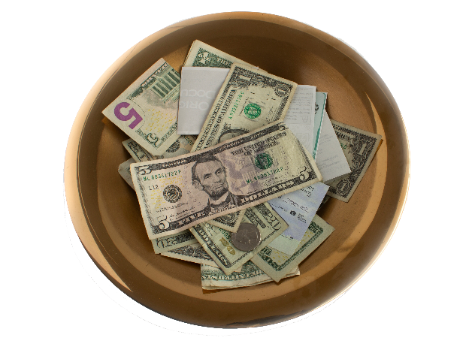

I. Be Content by Living Like Christ (Phil. 4:10)
A. Live joyfully
What is often true of the spiritual level of those who give generously and sacrificially?

Slide 3
I. Be Content by Living Like Christ (Phil. 4:10)
A. Live joyfully
• The evidence of the Philippians’ spiritual maturity caused Paul joy.

Slide 4
I. Be Content by Living Like Christ (Phil. 4:10)
A. Live joyfully
B. Exercise patience
What might Paul have written if he had become impatient with the delay in the Philippians’ giving?

Slide 5

I. Be Content by Living Like Christ (Phil. 4:10)
A. Live joyfully
B. Exercise patience
• The contented exhibit patience even in the most trying circumstances. They don’t waver
in their trust in God or complain when God
delays His provision.

Slide 6
II. Be Content by Learning from Christ (Phil. 4:11, 12)
A. Learn to be abased (4:11, 12)
Why is contentment difficult to learn?

Slide 7

II. Be Content by Learning from Christ (Phil. 4:11, 12)
A. Learn to be abased (4:11, 12)
• Contentment is all about deepening one’s relationship with God rather than changing one’s circumstances.

Slide 8
II. Be Content by Learning from Christ (Phil. 4:11, 12)
A. Learn to be abased (4:11, 12)
When have you failed to find contentment by changing your circumstances for the better?

Slide 9
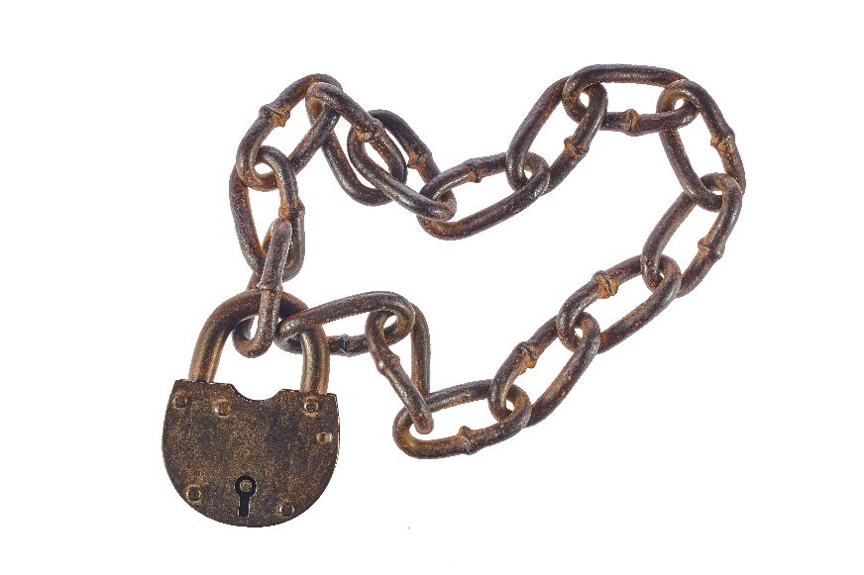
II. Be Content by Learning from Christ (Phil. 4:11, 12)
A. Learn to be abased (4:11, 12)
What do Paul’s experiences reveal about circumstances and contentment? (1 Cor. 4:11; 2 Cor. 11:23–27)

Slide 10
II. Be Content by Learning from Christ (Phil. 4:11, 12)
A. Learn to be abased (4:11, 12)
How did Paul and Silas express their contented peace even when imprisoned in Philippi? (Acts 16:25)

Slide 11
II. Be Content by Learning from Christ (Phil. 4:11, 12)
A. Learn to be abased (4:11, 12)
B. Learn to abound (4:12)
Why do people still need to learn contentment even when they have all their needs met?

Slide 12
II. Be Content by Learning from Christ (Phil. 4:11, 12)
A. Learn to be abased (4:11, 12)
B. Learn to abound (4:12)
Do you think it’s harder to be content with little or content with much? Why?

Slide 13

II. Be Content by Learning from Christ (Phil. 4:11, 12)
A. Learn to be abased (4:11, 12)
B. Learn to abound (4:12)
• Learning to abound means to praise God for His blessings and to look for ways to use them to help others in need.

Slide 14
III. Be Content by Leaning on Christ (Phil. 4:13)
A. Leaning on Christ for strength
• The Stoics’ highest aim was to develop a state of mind that let them feel self-sufficient.

Slide 15
III. Be Content by Leaning on Christ (Phil. 4:13)
A. Leaning on Christ for strength
Describe the life of the contented according to the Stoic.

Slide 16
III. Be Content by Leaning on Christ (Phil. 4:13)
A. Leaning on Christ for strength
• Paul remained independent of circumstances because he remained dependent on Christ.

Slide 17

III. Be Content by Leaning on Christ (Phil. 4:13)
A. Leaning on Christ for strength
What might people try to substitute for “Christ” in Paul’s statement that he can do all things through Christ?

Slide 18

III. Be Content by Leaning on Christ (Phil. 4:13)
A. Leaning on Christ for strength
What are some trying situations in which Christ will give us the strength to be content?

Slide 19
III. Be Content by Leaning on Christ (Phil. 4:13)
A. Leaning on Christ for strength
B. Leaning on Christ for courage
• In Christ, God gives us courage to do His will, even when He calls us to do something challenging or difficult.

Slide 20
III. Be Content by Leaning on Christ (Phil. 4:13)
A. Leaning on Christ for strength
B. Leaning on Christ for courage
When do you need to lean on Christ for courage?

