Slide 1



Slide 2
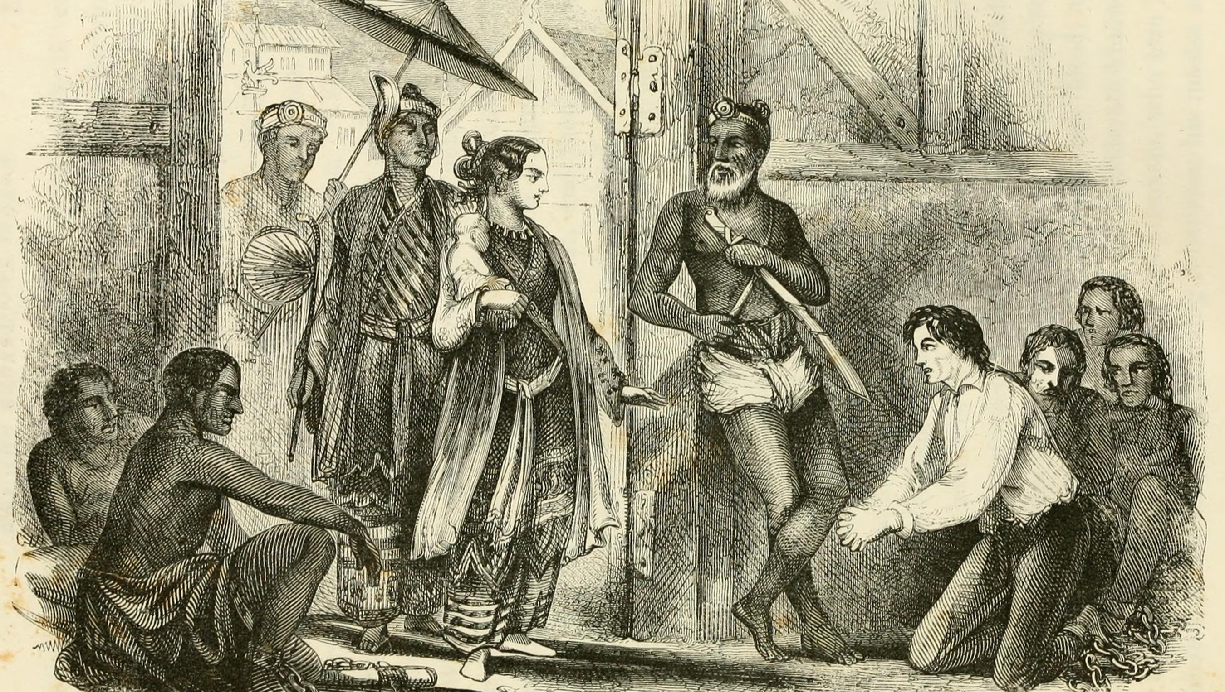
Anne Visits Adoniram Judson in Prison

Slide 3


I. Timothy’s Like-mindedness (Phil. 2:19–24)
A. Sincere care (2:19–21)
Pretend cell phones were a first century reality. How do you think Paul would have used his? How might his use compare to ours?

Slide 4
I. Timothy’s Like-mindedness (Phil. 2:19–24)
A. Sincere care (2:19–21)
• Timothy shared Christ’s mindset and values and therefore shared Paul’s concern for the Philippians.

Slide 5

I. Timothy’s Like-mindedness (Phil. 2:19–24)
A. Sincere care (2:19–21)
What ministries in our church might compare to the rigor of traveling well over a thousand miles by foot or ship to check up on and report back on another church?

Slide 6
I. Timothy’s Like-mindedness (Phil. 2:19–24)
A. Sincere care (2:19–21)
What correlation do you see between the believers who sought their own things and the teaching of Paul in Philippians 2:4?

Slide 7
I. Timothy’s Like-mindedness (Phil. 2:19–24)
A. Sincere care (2:19–21)
How do you think Timothy felt once he made the trip to Philippi and back?

Slide 8
I. Timothy’s Like-mindedness (Phil. 2:19–24)
A. Sincere care (2:19–21)
What did Jesus say is the road to honor in His coming Kingdom? (Mark 10:42–44)

Slide 9

I. Timothy’s Like-mindedness (Phil. 2:19–24)
A. Sincere care (2:19–21)
B. Humble preparation (2:22–24)
• Timothy worked alongside Paul with a slave mindset in that he disregarded his own needs and interests to meet the needs and interests of others.

Slide 10
I. Timothy’s Like-mindedness (Phil. 2:19–24)
A. Sincere care (2:19–21)
B. Humble preparation (2:22–24)
How is Timothy’s humility evident in Paul’s final words about their relationship? (2 Timothy 3:10–12)

Slide 11
I. Timothy’s Like-mindedness (Phil. 2:19–24)
A. Sincere care (2:19–21)
B. Humble preparation (2:22–24)
How do you think the Philippians responded to Paul’s plan to visit them as soon as possible?

Slide 12

I. Timothy’s Like-mindedness (Phil. 2:19–24)
A. Sincere care (2:19–21)
B. Humble preparation (2:22–24)
How should believers today respond to Christ’s any-moment return?

Slide 13
II. Epaphroditus’s Like-mindedness (Phil. 2:25–30)
A. Personal sacrifice (2:25–28)
What do you learn about Epaphroditus from the titles Paul gave him (brother, companion in labor, fellow soldier)?

Slide 14

II. Epaphroditus’s Like-mindedness (Phil. 2:25–30)
A. Personal sacrifice (2:25–28)
• Epaphroditus brought a financial offering to support Paul’s basic need for food, but he also came to offer himself sacrificially as Paul’s helper.

Slide 15
II. Epaphroditus’s Like-mindedness (Phil. 2:25–30)
A. Personal sacrifice (2:25–28)
When have you received the benefits of someone’s personal sacrifice on your behalf? How did benefiting from someone’s service affect you?

Slide 16
II. Epaphroditus’s Like-mindedness (Phil. 2:25–30)
A. Personal sacrifice (2:25–28)
• Epaphroditus experienced a distressing heaviness in his heart when he learned the Philippians were unsure of his condition.

Slide 17
II. Epaphroditus’s Like-mindedness (Phil. 2:25–30)
A. Personal sacrifice (2:25–28)
Evaluate this statement: Those who seek to bring joy and gladness to others will themselves know true joy and gladness as a result.

Slide 18
II. Epaphroditus’s Like-mindedness (Phil. 2:25–30)
A. Personal sacrifice (2:25–28)
B. Honorable sacrifice (2:29, 30)
Why might a church need to be told to honor someone who served the Lord sacrificially?

Slide 19

II. Epaphroditus’s Like-mindedness (Phil. 2:25–30)
A. Personal sacrifice (2:25–28)
B. Honorable sacrifice (2:29, 30)
• Epaphroditus put his life on the line for the work of Christ because he had a deep concern for others.

Slide 20
II. Epaphroditus’s Like-mindedness (Phil. 2:25–30)
A. Personal sacrifice (2:25–28)
B. Honorable sacrifice (2:29, 30)
How does our church honor individuals for their sacrificial service?

