Slide 1



Slide 2

Beware of . . .

Slide 3

Beware of . . .

Slide 4


I. Reject False Teaching (Phil. 3:1–3)
A. True teaching is Christ-centered (3:1)
What happens to our focus on ourselves when we begin to think of reasons to rejoice in the Lord?

Slide 5
I. Reject False Teaching (Phil. 3:1–3)
A. True teaching is Christ-centered (3:1)
• Paul refused to tinker with the gospel message’s focus on Christ, for to change the gospel is to destroy the gospel.

Slide 6
I. Reject False Teaching (Phil. 3:1–3)
A. True teaching is Christ-centered (3:1)
B. False teaching is man-centered (3:2, 3)

Slide 7
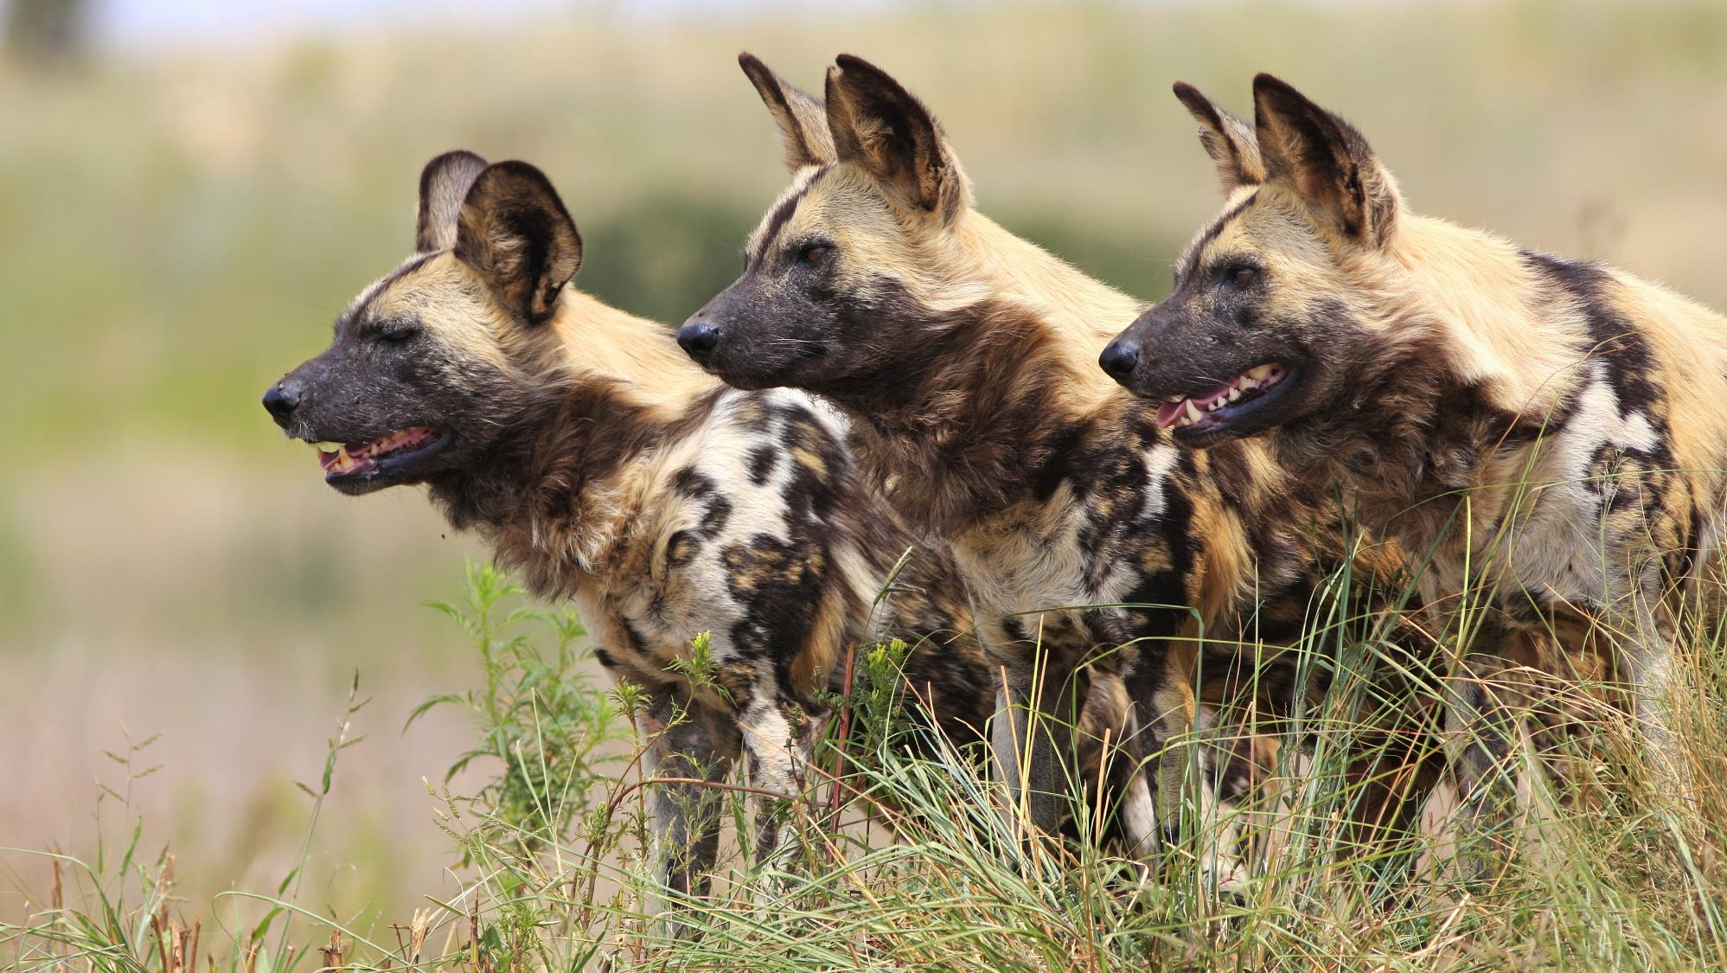

Slide 8
I. Reject False Teaching (Phil. 3:1–3)
A. True teaching is Christ-centered (3:1)
B. False teaching is man-centered (3:2, 3)
• The Judaizers wanted believers to think they needed to adopt Jewish standards and laws in order to be saved.

Slide 9
I. Reject False Teaching (Phil. 3:1–3)
A. True teaching is Christ-centered (3:1)
B. False teaching is man-centered (3:2, 3)
With what groups that preach false gospels should our church not join in ministry endeavors?

Slide 10
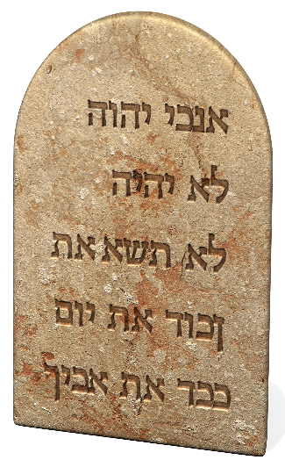
I. Reject False Teaching (Phil. 3:1–3)
A. True teaching is Christ-centered (3:1)
B. False teaching is man-centered (3:2, 3)
• The Judaizers committed a spiritual mutilation on their converts by adding circumcision and the Old Testament law to the gospel.

Slide 11

I. Reject False Teaching (Phil. 3:1–3)
A. True teaching is Christ-centered (3:1)
B. False teaching is man-centered (3:2, 3)
• When God examines worshipers, He looks
at their hearts, not their rituals. He honors
faith in Christ rather than confidence in the flesh.

Slide 12
I. Reject False Teaching (Phil. 3:1–3)
A. True teaching is Christ-centered (3:1)
B. False teaching is man-centered (3:2, 3)
How forthright have you been with religious people who trust in their works for salvation? How might you show them love?

Slide 13
II. Relinquish False Confidence (Phil. 3:4–6)
A. Confidence in heritage is futile (3:4, 5)
• Paul considered any merit he gained from his heritage to be worthless in his quest for righteousness.

Slide 14
II. Relinquish False Confidence (Phil. 3:4–6)
A. Confidence in heritage is futile (3:4, 5)
What did God conclude when He considered Paul’s Jewish heritage?

Slide 15
II. Relinquish False Confidence (Phil. 3:4–6)
A. Confidence in heritage is futile (3:4, 5)
B. Confidence in devotion is futile (3:5, 6)
• Paul was not a religious spectator or a nominal Jew; he was heavily involved in promoting Pharisaical beliefs.

Slide 16
II. Relinquish False Confidence (Phil. 3:4–6)
A. Confidence in heritage is futile (3:4, 5)
B. Confidence in devotion is futile (3:5, 6)
Who is the central character in verses 5 and 6?

Slide 17
II. Relinquish False Confidence (Phil. 3:4–6)
A. Confidence in heritage is futile (3:4, 5)
B. Confidence in devotion is futile (3:5, 6)
• Before salvation, Paul was all about Paul. After salvation, Paul understood self-promotion and disciplined devotion can’t make a person righteous.

Slide 18
II. Relinquish False Confidence (Phil. 3:4–6)
A. Confidence in heritage is futile (3:4, 5)
B. Confidence in devotion is futile (3:5, 6)
To what might we compare Paul’s attempt to please God with his good deeds?

Slide 19

III. Receive True Righteousness (Phil. 3:7–11)
A. Give up self-righteousness (3:7, 8)
• So he might gain Christ, Paul counted as worthless all he had once believed was gain to him.

Slide 20
III. Receive True Righteousness (Phil. 3:7–11)
A. Give up self-righteousness (3:7, 8)
In what sense were Paul’s good works a “loss”?

Slide 21
III. Receive True Righteousness (Phil. 3:7–11)
A. Give up self-righteousness (3:7, 8)
• Paul had a settled conviction to disregard not only his works but also “all things” that would come between him and his developing relationship with Christ.

Slide 22
III. Receive True Righteousness (Phil. 3:7–11)
A. Give up self-righteousness (3:7, 8)
What pursuits threaten your relationship with Christ?

Slide 23
III. Receive True Righteousness (Phil. 3:7–11)
A. Give up self-righteousness (3:7, 8)
B. Gain Christ’s righteousness (3:9–11)
• When Paul put his faith in Christ for salvation, God declared Paul righteous based on Christ’s work on Paul’s behalf.

Slide 24

III. Receive True Righteousness (Phil. 3:7–11)
A. Give up self-righteousness (3:7, 8)
B. Gain Christ’s righteousness (3:9–11)
• The knowledge of Christ that Paul desired was not book knowledge but knowledge based on constant personal contact with the Lord.

Slide 25
III. Receive True Righteousness (Phil. 3:7–11)
A. Give up self-righteousness (3:7, 8)
B. Gain Christ’s righteousness (3:9–11)
How might you tap into the resurrection power in your daily life?

Slide 26
III. Receive True Righteousness (Phil. 3:7–11)
A. Give up self-righteousness (3:7, 8)
B. Gain Christ’s righteousness (3:9–11)
Have you considered whether you want to know the fellowship of Christ’s suffering? What might a typical believer want instead?

Slide 27

III. Receive True Righteousness (Phil. 3:7–11)
A. Give up self-righteousness (3:7, 8)
B. Gain Christ’s righteousness (3:9–11)
Finish this sentence: When I am resurrected or raptured, I will be . . .

Slide 28
III. Receive True Righteousness (Phil. 3:7–11)
A. Give up self-righteousness (3:7, 8)
B. Gain Christ’s righteousness (3:9–11)
What can you do to make what you will be at your resurrection your goal for this life?

