Slide 1



Slide 2


I. Focus on Christlikeness (Phil. 3:12–14)
A. Focus with purpose (3:12)
Do you have a sense of purpose? How does your sense of purpose affect your daily focus?

Slide 3
I. Focus on Christlikeness (Phil. 3:12–14)
A. Focus with purpose (3:12)
• Salvation puts us at the starting blocks of the race to become like Christ. God expects all believers to move off the starting blocks.

Slide 4


Slide 5
I. Focus on Christlikeness (Phil. 3:12–14)
A. Focus with purpose (3:12)
What resistances do you face in your desire to become like Christ? How do the resistances you face compare to those faced by Paul or Christ?

Slide 6
I. Focus on Christlikeness (Phil. 3:12–14)
A. Focus with purpose (3:12)
B. Forget the past (3:13)
• Paul’s past sins threatened to drag him down and discourage him.

Slide 7
I. Focus on Christlikeness (Phil. 3:12–14)
A. Focus with purpose (3:12)
B. Forget the past (3:13)
What does a refusal to let go of our past sins reveal about our understanding of God’s forgiving grace?

Slide 8
I. Focus on Christlikeness (Phil. 3:12–14)
A. Focus with purpose (3:12)
B. Forget the past (3:13)
• Paul’s past successes threatened to slow him down in his quest to become like Christ.

Slide 9
I. Focus on Christlikeness (Phil. 3:12–14)
A. Focus with purpose (3:12)
B. Forget the past (3:13)
Given what Paul had already accomplished in his Christian service, what could he have felt entitled to do once he got out of prison?

Slide 10
I. Focus on Christlikeness (Phil. 3:12–14)
A. Focus with purpose (3:12)
B. Forget the past (3:13)
C. Press for the prize (3:14–16)
• God set the course and called Paul to the race which has as its end the full realization of Christlikeness in God’s presence.

Slide 11
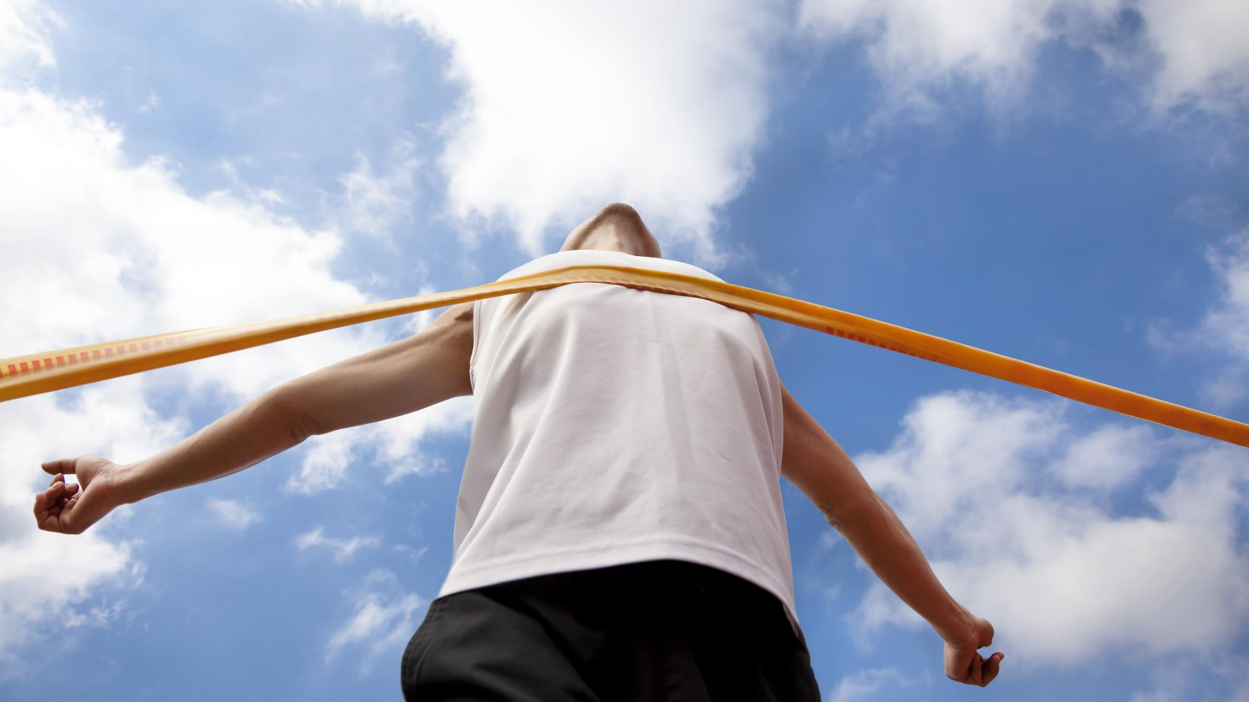

Slide 12
I. Focus on Christlikeness (Phil. 3:12–14)
A. Focus with purpose (3:12)
B. Forget the past (3:13)
C. Press for the prize (3:14–16)
• Paul knew that if the Philippians thought as he did, they would run the race as he did. Their focused thinking would lead to faithful performance.

Slide 13
I. Focus on Christlikeness (Phil. 3:12–14)
A. Focus with purpose (3:12)
B. Forget the past (3:13)
C. Press for the prize (3:14–16)
How does the publican reflect the mature attitude Paul laid out in Philippians 3:12–14 and called for in verse 15? (Luke 18:9–14)

Slide 14
I. Focus on Christlikeness (Phil. 3:12–14)
A. Focus with purpose (3:12)
B. Forget the past (3:13)
C. Press for the prize (3:14–16)
• Paul expressed his trust in God to help the Philippians come to the place of understanding and accepting what it means to live a mature Christian life.

Slide 15
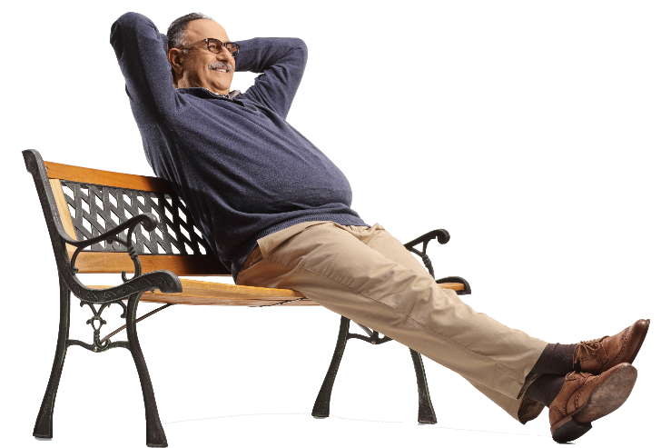
I. Focus on Christlikeness (Phil. 3:12–14)
A. Focus with purpose (3:12)
B. Forget the past (3:13)
C. Press for the prize (3:14–16)
Evaluate this statement: Becoming
satisfied with strides made toward Christlikeness will cause a
believer to slide back in pride.

Slide 16
II. Identify Christlike Laborers to Follow (Phil. 3:17–19)
A. Follow sacrificial examples (3:17)
• Paul encouraged the Philippians to look at his life as an example of how to live for the Lord.

Slide 17

II. Identify Christlike Laborers to Follow (Phil. 3:17–19)
A. Follow sacrificial examples (3:17)
What practical lessons might we learn from following the example of a godly believer?

Slide 18
II. Identify Christlike Laborers to Follow (Phil. 3:17–19)
A. Follow sacrificial examples (3:17)
B. Avoid selfish patterns (3:18, 19)
How did Paul describe those who were unfit patterns? (Philippians 3:18, 19)

Slide 19
II. Identify Christlike Laborers to Follow (Phil. 3:17–19)
A. Follow sacrificial examples (3:17)
B. Avoid selfish patterns (3:18, 19)
Why might believers be tempted to follow the bad examples of these enemies of the cross?

Slide 20
III. Anticipate Citizenship in Heaven (Phil. 3:20—4:1)
A. Anticipate relocation (3:20)
• God considered the Philippians as citizens of Heaven. He wanted them to think and live with heavenly values.

Slide 21

III. Anticipate Citizenship in Heaven (Phil. 3:20—4:1)
A. Anticipate relocation (3:20)
What might the world notice about believers who eagerly await the return of Christ?

Slide 22
III. Anticipate Citizenship in Heaven (Phil. 3:20—4:1)
A. Anticipate relocation (3:20)
B. Anticipate transformation (3:21)
• At Christ’s return, we will become residents of Heaven, and God will immediately transform our weak, mortal bodies into perfect, immortal bodies like His own.

Slide 23
III. Anticipate Citizenship in Heaven (Phil. 3:20—4:1)
A. Anticipate relocation (3:20)
B. Anticipate transformation (3:21)
C. Anticipate with dedication (4:1)
Do you consider your fellow believers your longed-for brothers and sisters in Christ? Why?

Slide 24
III. Anticipate Citizenship in Heaven (Phil. 3:20—4:1)
A. Anticipate relocation (3:20)
B. Anticipate transformation (3:21)
C. Anticipate with dedication (4:1)
How might a deeper understanding of Christ’s passion for you help you grow in your passion for your fellow believers?

