Slide 1






Slide 2
I. The Gospel Has a Divine Origination
(Gal. 1:11, 12)

Slide 3
II. The Gospel Causes Life Transformation
(Gal. 1:13, 14)

Slide 4
III. The Gospel Fits in God’s Revelation
(Gal. 1:15–20)

Slide 5
IV. The Gospel Brings God’s Glorification
(Gal. 1:21–24)

Slide 6
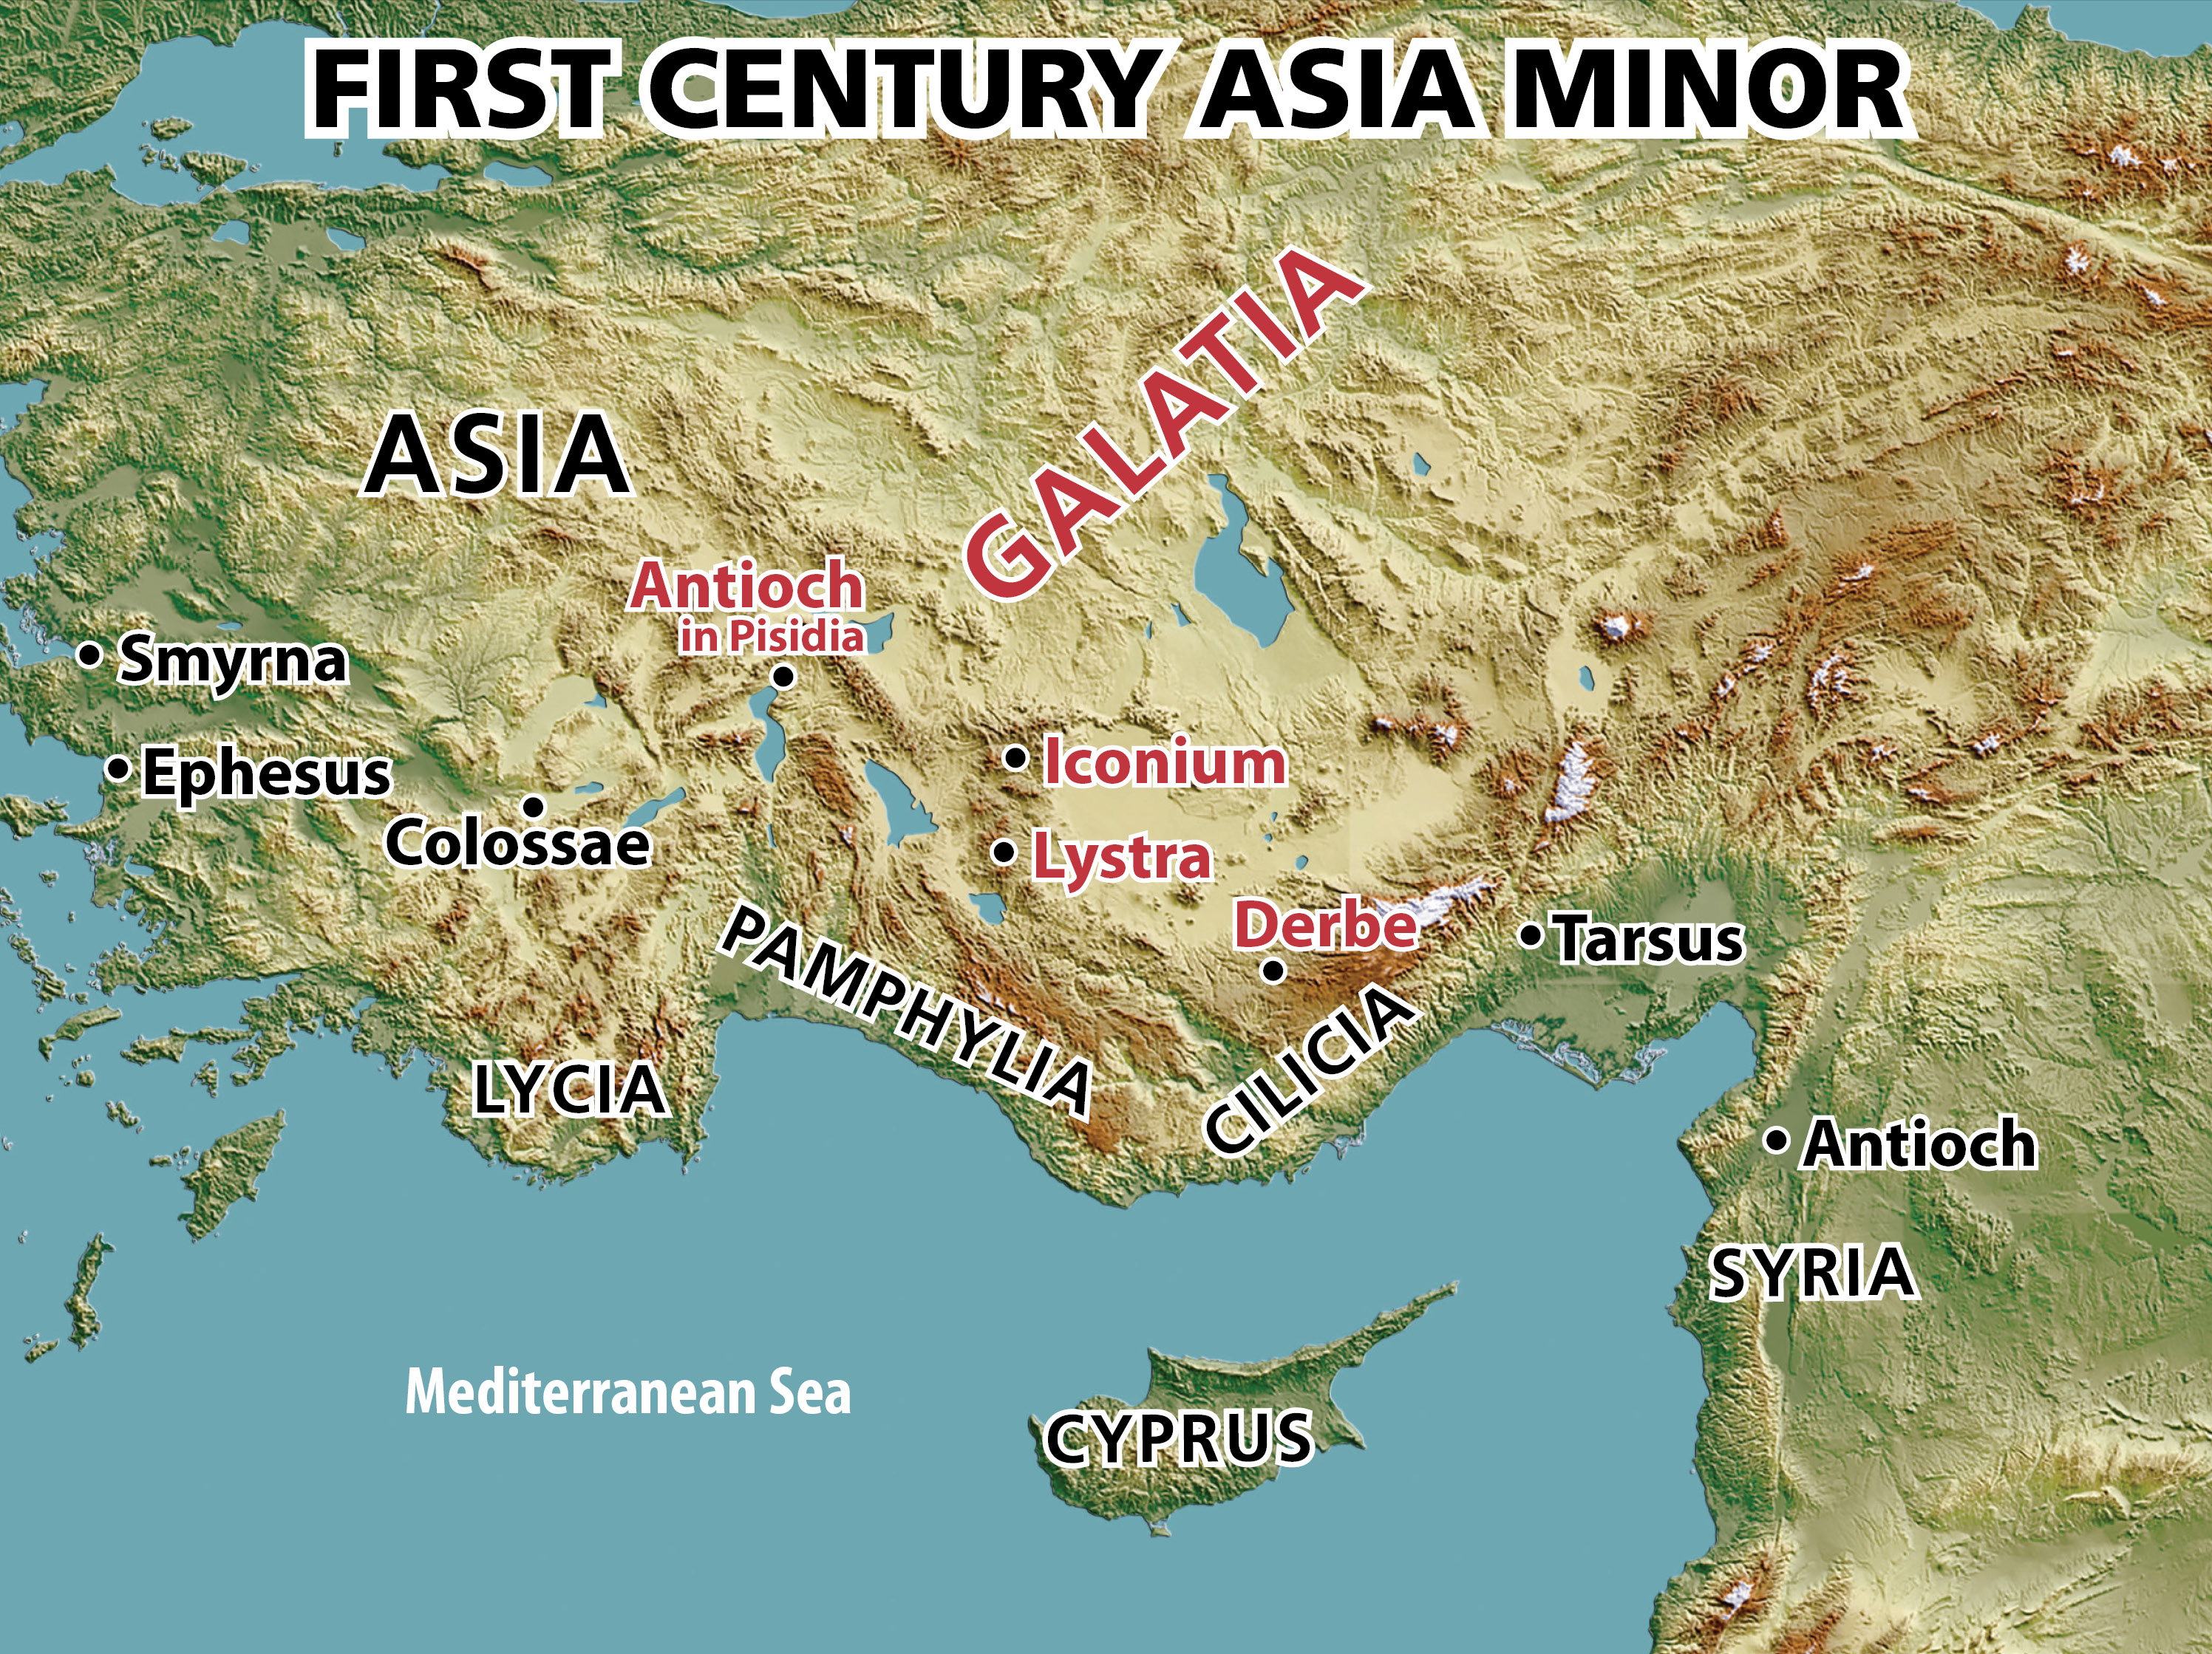

Slide 7
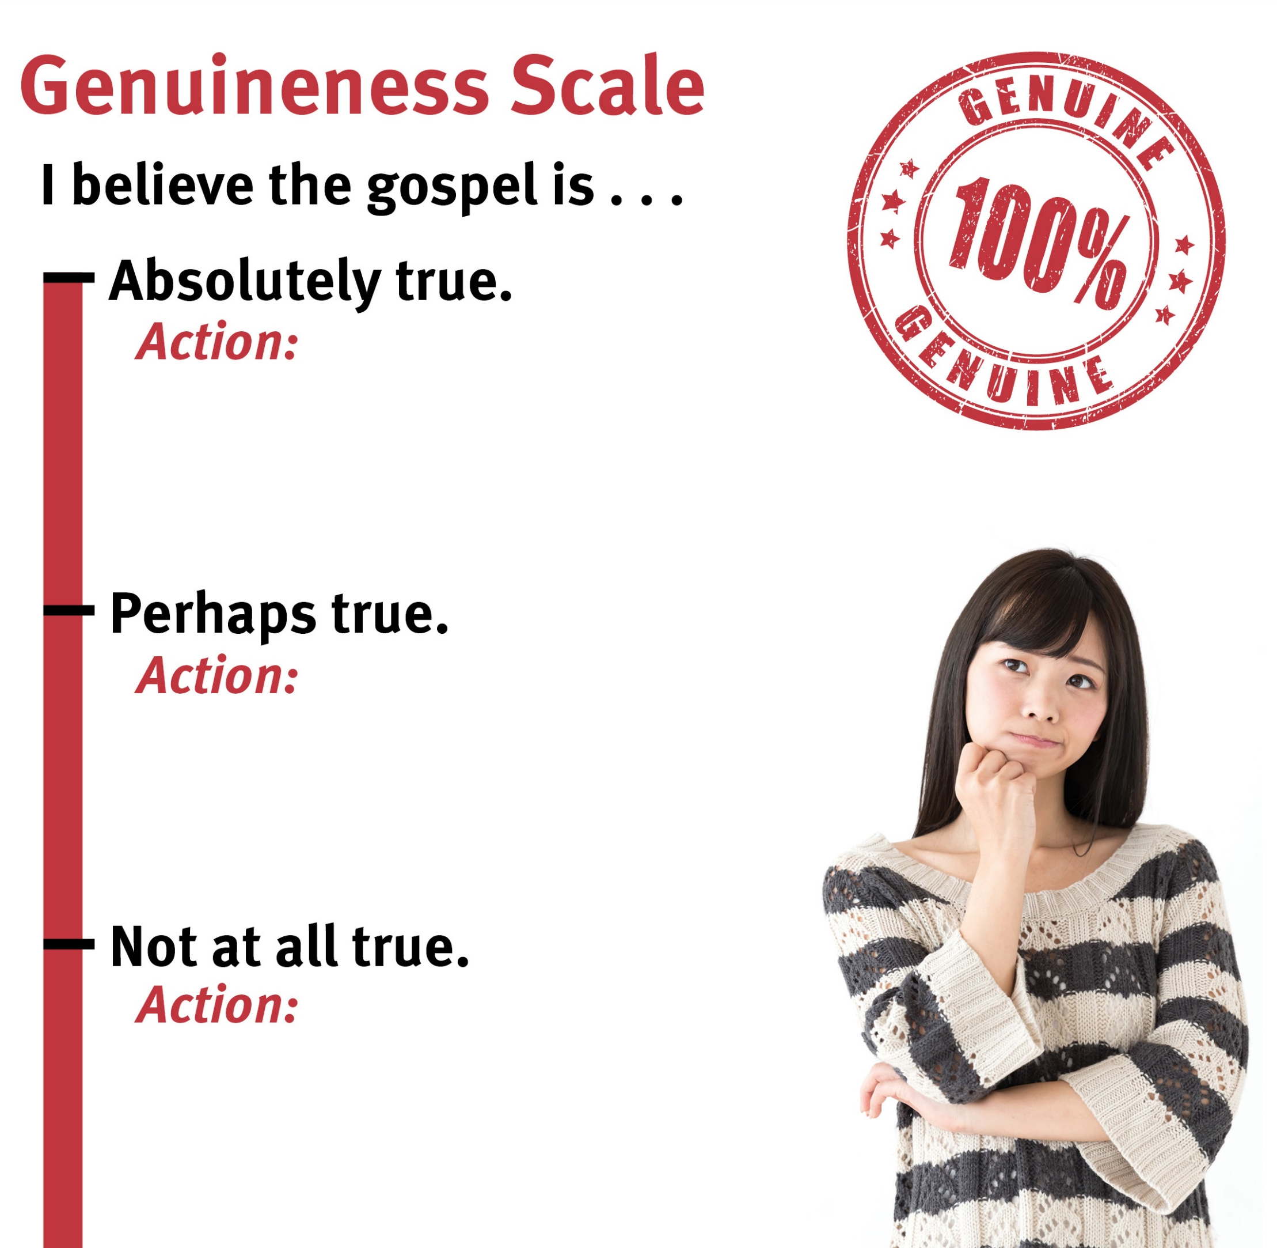
Learn it.
Take opportunities to share it.
Defend it.
Discuss its merits.
Give lip service to it.
Investigate it.
Oppose those who believe it.
Discredit it.
Ignore it.

Slide 8
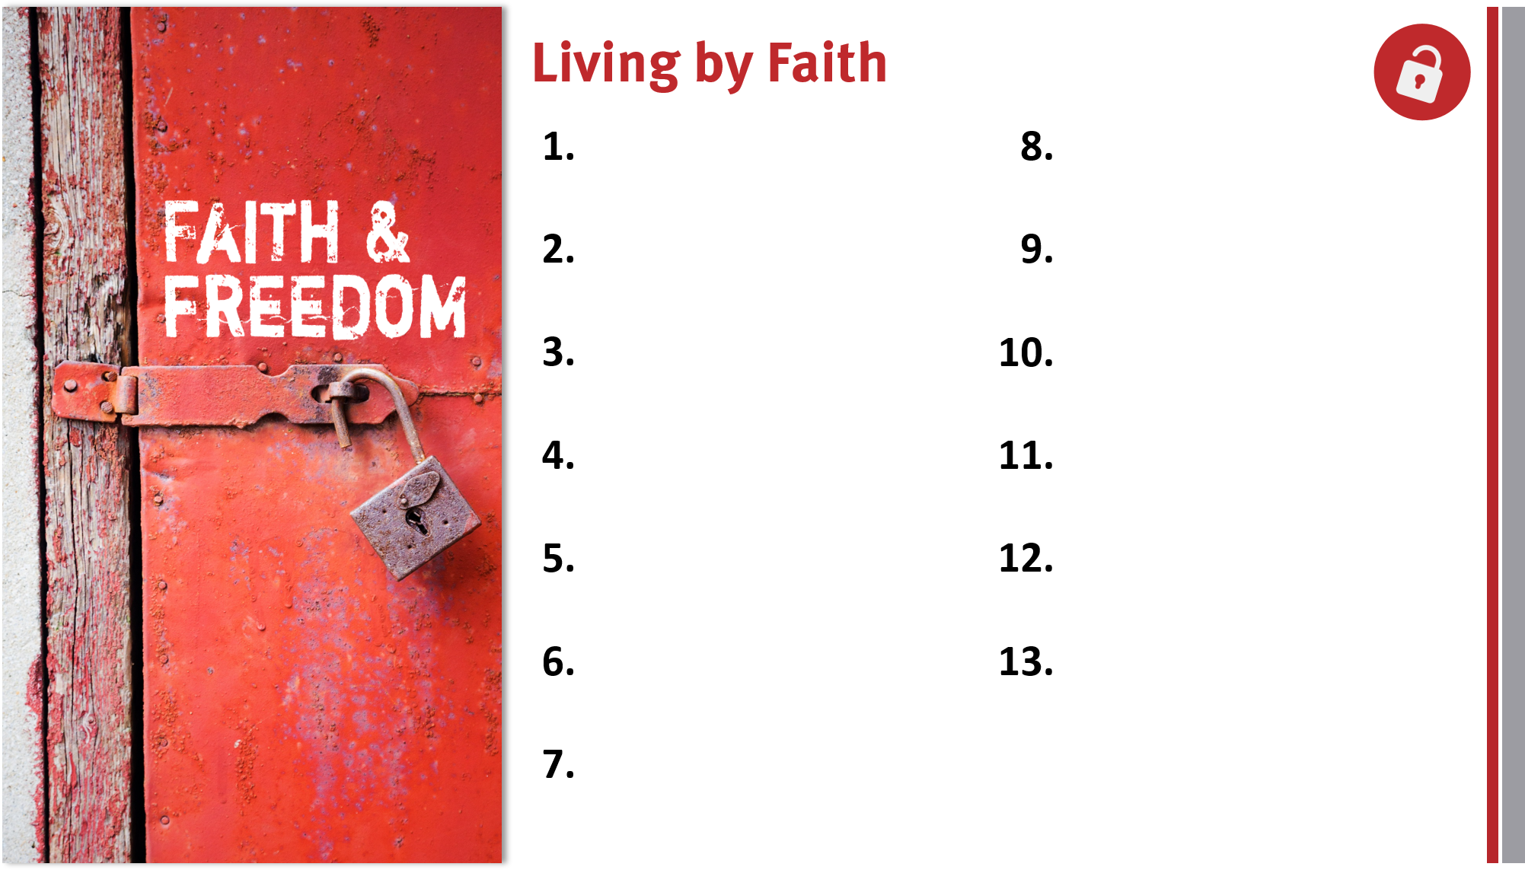
Appreciate, defend, and share the gospel.
Share the genuine gospel frequently and boldly.

