Slide 1






Slide 2
NO SUBSTITUTE FOR THE GOSPEL
I. Paul Established His Authority (Gal. 1:1–5)

Slide 3
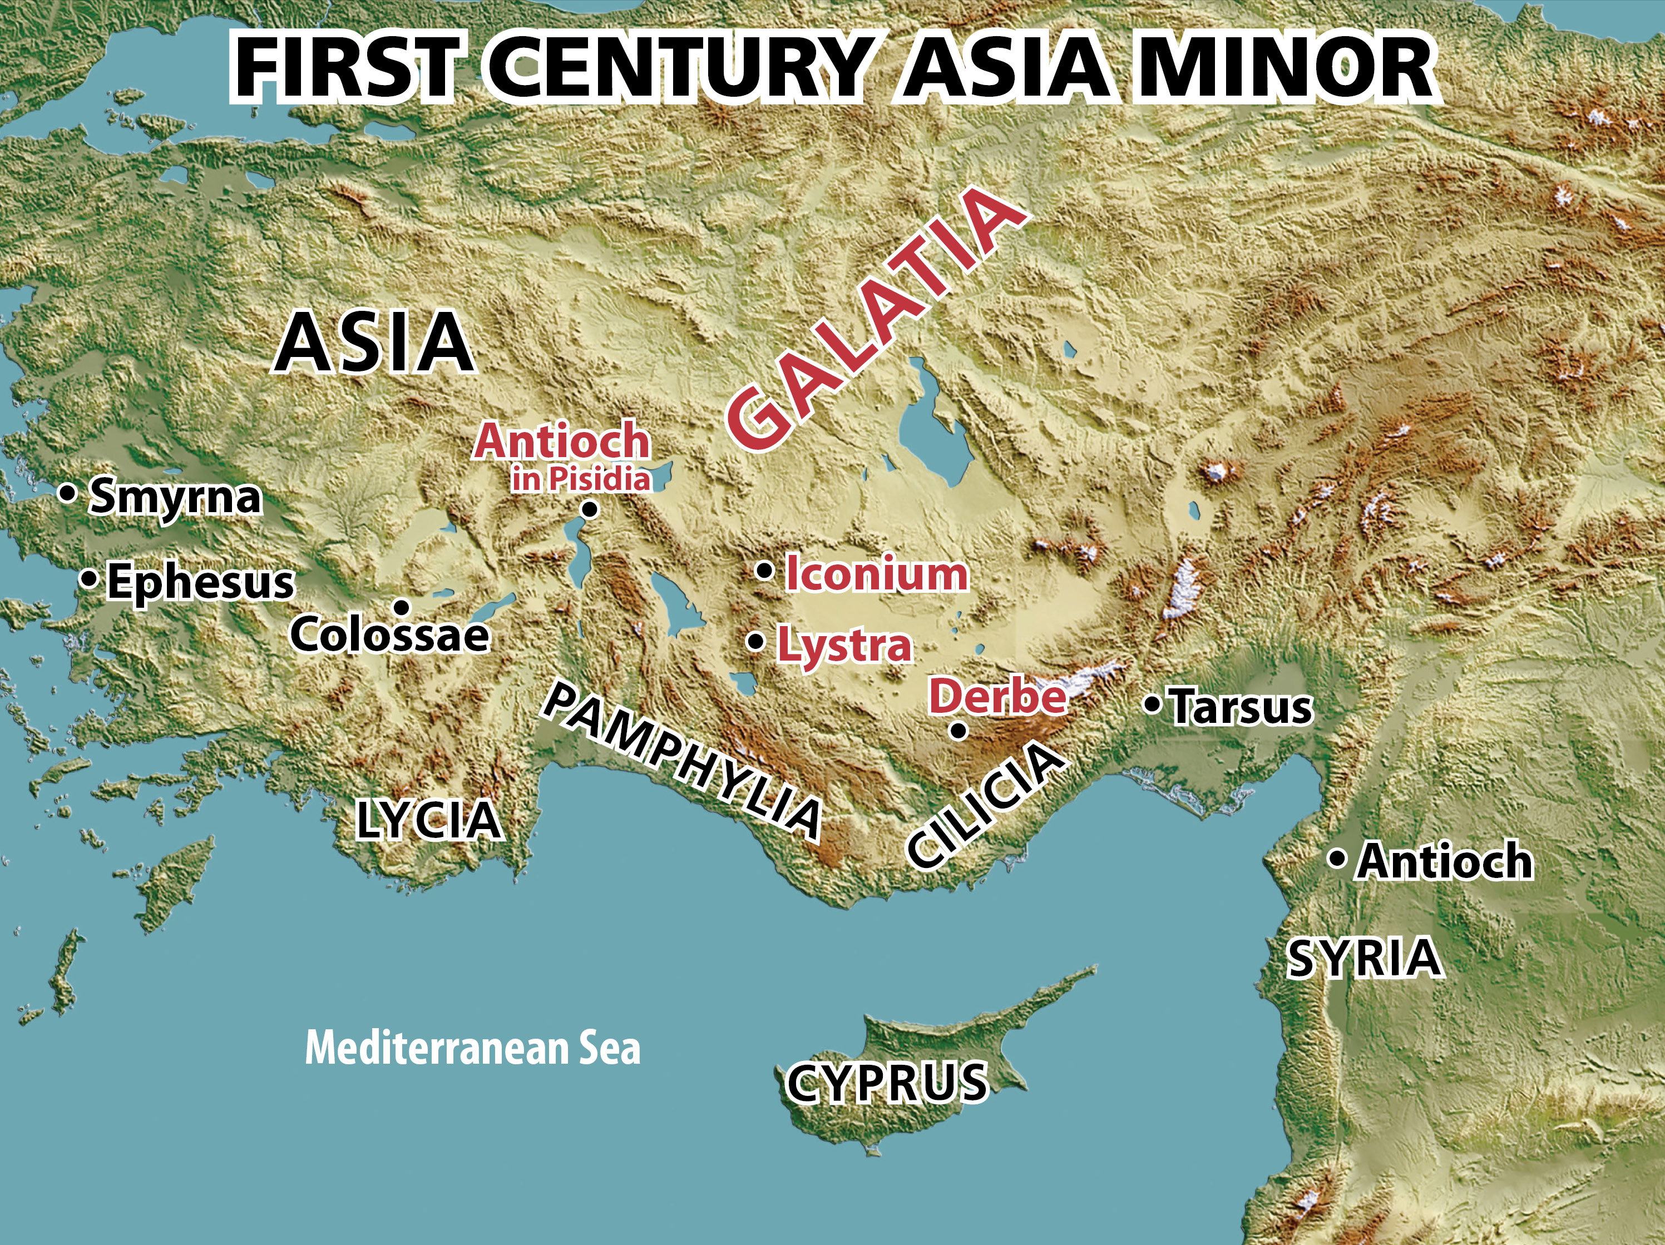

Slide 4
NO SUBSTITUTE FOR THE GOSPEL
I. Paul Established His Authority (Gal. 1:1–5)
A. His personal credentials (1:1, 2)
B. His powerful message (1:3–5)

Slide 5
NO SUBSTITUTE FOR THE GOSPEL
II. Paul Exercised His Authority (Gal. 1:6–10)
A. Called the new gospel perverted (1:6, 7)
B. Commanded new gospels be prohibited
(1:8, 9)
C. Communicated the gospel preacher’s
purpose (1:10)

Slide 6


Slide 7

Appreciate, defend, and share the gospel.

