Slide 1






Slide 2
I. Expect a Satisfying Reward for Ministry
(Gal. 6:6–10)
A. Support your teacher (6:6)
B. Sow to the Spirit (6:7, 8)
C. Sustain your focus (6:9, 10)

Slide 3
II. Establish a Sincere Motive for Ministry
(Gal. 6:11–18)
A. The Judaizers’ selfishness (6:11–13)
B. Paul’s selflessness (6:14–18)

Slide 4

The believer doesn’t clamor for attention.
Praises the Lord a lot.
Prays for strength and wisdom.
Volunteers for menial tasks.
Rejoices to serve God.

Slide 5
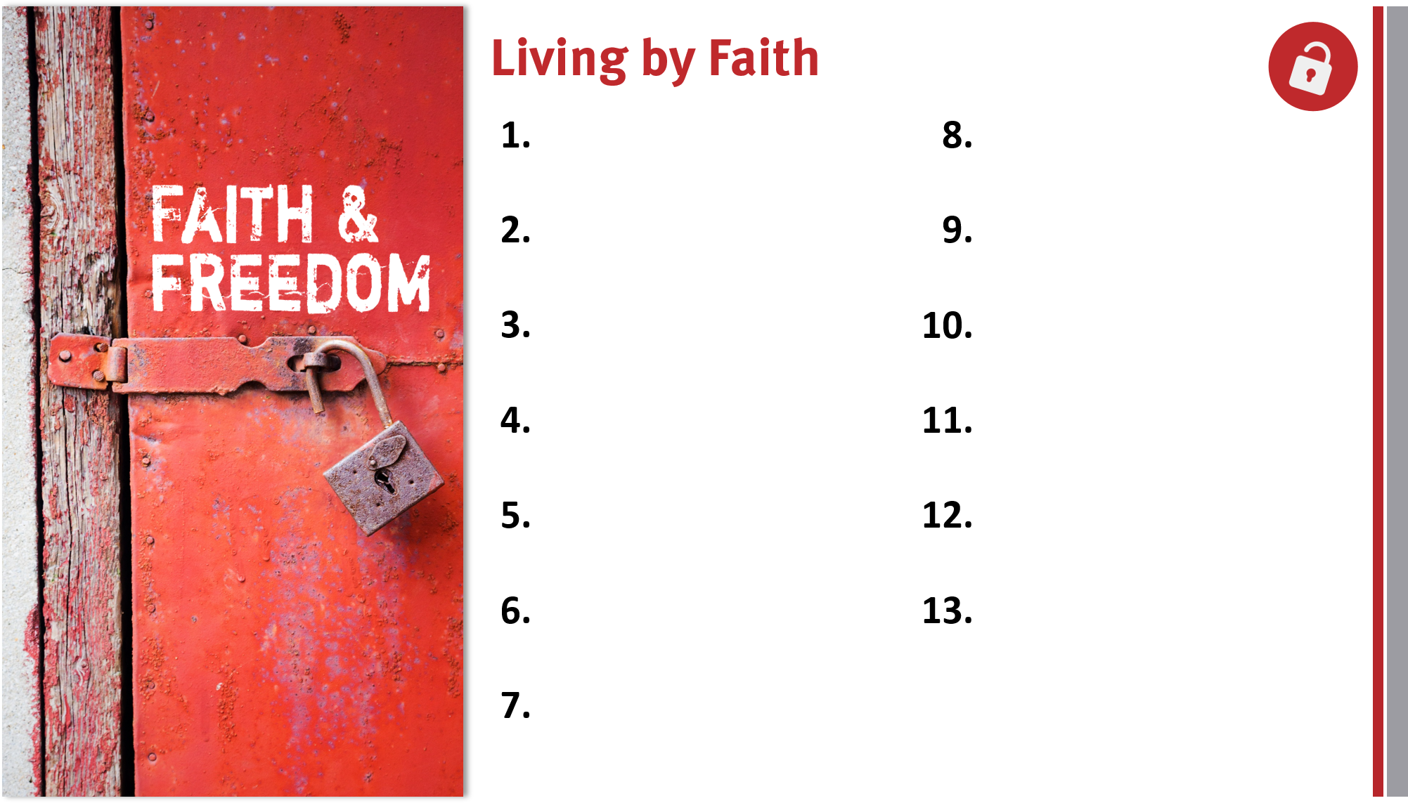
Appreciate, defend, and share the gospel.
Remain loyal to God
and the gospel.
Share the genuine gospel frequently and boldly.
Live out the freedom of liberty in Christ.
Proactively take the gospel across cultures.
Lovingly serve others and God.
Live for and serve God by faith in Him.
Rely on the Holy Spirit for victory over the flesh.
Realize God’s blessings through faith in Christ.
Prepare to help bear others’ burdens.
Trust God’s promises for salvation and life.
Make God’s glory the motivation for living.
Appreciate members in God’s family.

