Slide 1






Slide 2
I. True Faith Produces Love (Gal. 5:2–6)
A. Holding to the law makes Christ
unnecessary (5:2–4)
B. Holding to Christ makes love necessary
(5:5, 6)

Slide 3
II. False Teaching Deserves Judgment
(Gal. 5:7–12)
A. Source of false teaching (5:7, 8)
B. Influence of false teaching (5:9)
C. Judgment of false teaching (5:10)
D. Rejection of false teaching (5:11, 12)

Slide 4
III. True Love Produces Service (Gal. 5:13–15)
A. Principle of loving service (5:13)

Slide 5


Slide 6
III. True Love Produces Service (Gal. 5:13–15)
A. Principle of loving service (5:13)
B. Basis of loving service (5:14)
C. Contrast of loving service (5:15)

Slide 7
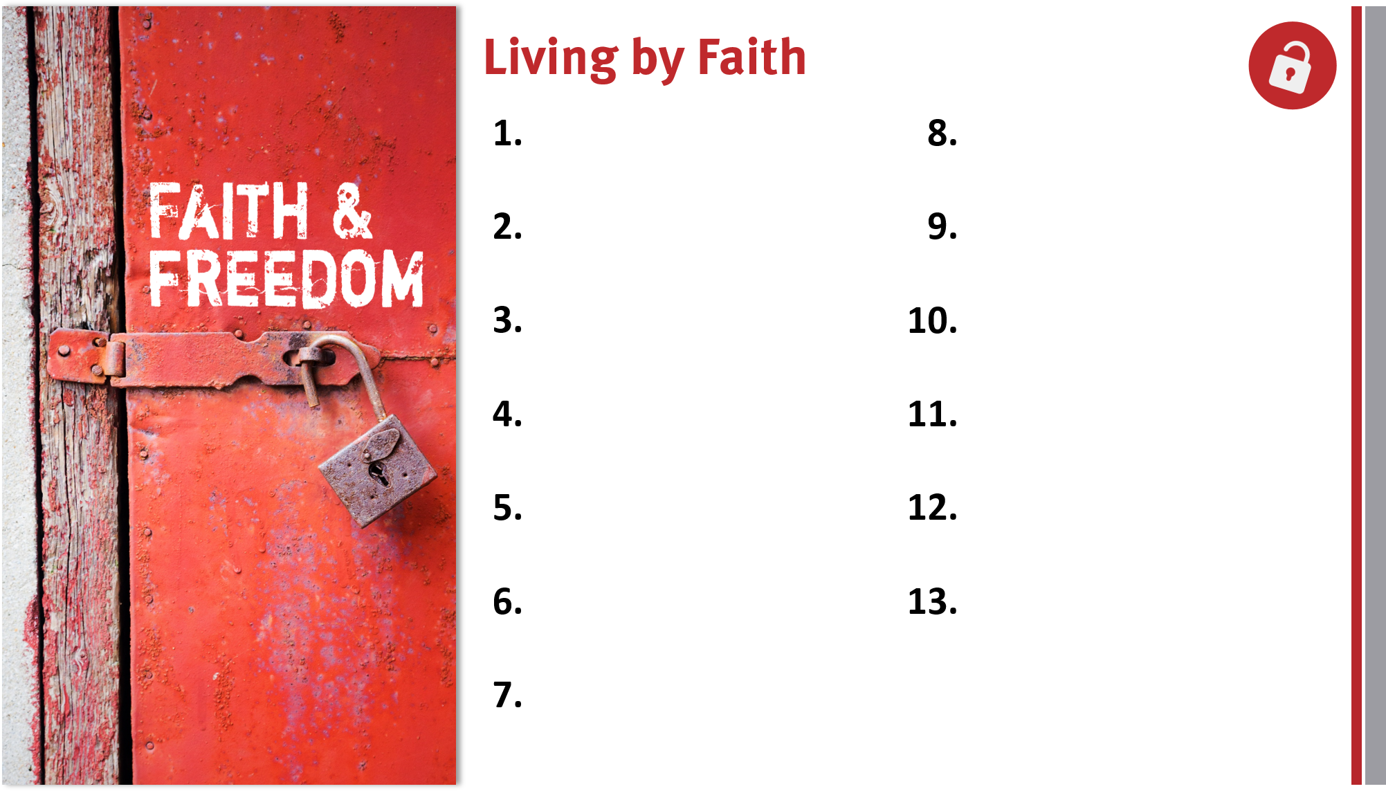
Appreciate, defend, and share the gospel.
Remain loyal to God
and the gospel.
Share the genuine gospel frequently and boldly.
Live out the freedom of liberty in Christ.
Proactively take the gospel across cultures.
Lovingly serve others and God.
Live for and serve God by faith in Him.
Realize God’s blessings through faith in Christ.
Trust God’s promises for salvation and life.
Appreciate members in God’s family.

