Slide 1






Slide 2
I. Love Enough to Restore (Gal. 6:1)

Slide 3
II. Love Enough to Support (Gal. 6:2)

Slide 4
III. Love Enough to Work (Gal. 6:3–5)
A. Conduct a humble examination (6:3, 4)
B. Shoulder a person responsibility (6:5)

Slide 5
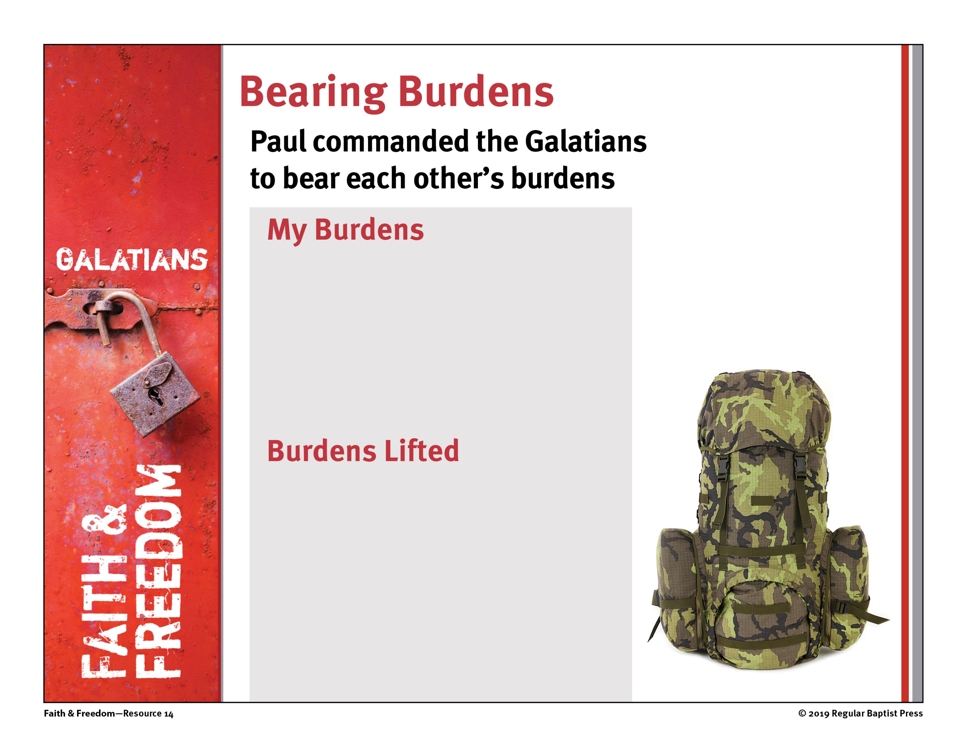
Witnessing
Edifying other believers
Serving others
Fellowshipping with believers
Worshiping God
Guilt
Fear
Pain
Loneliness
Anxiety

Slide 6
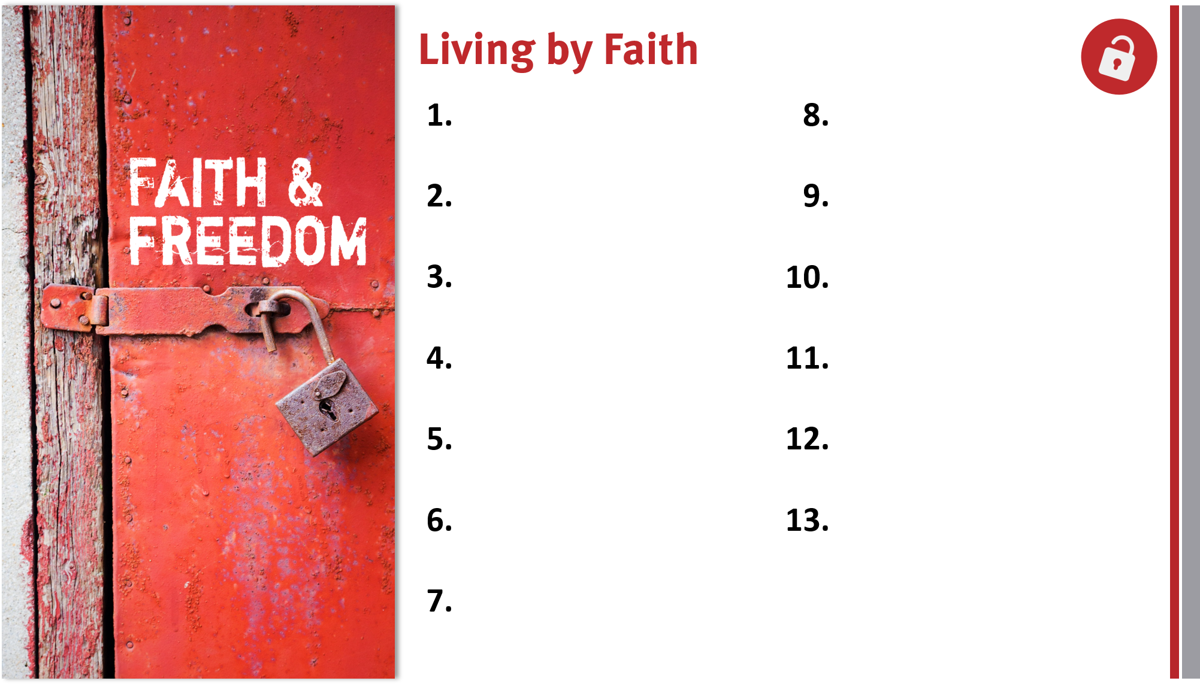
Appreciate, defend, and share the gospel.
Remain loyal to God
and the gospel.
Share the genuine gospel frequently and boldly.
Live out the freedom of liberty in Christ.
Proactively take the gospel across cultures.
Lovingly serve others and God.
Live for and serve God by faith in Him.
Rely on the Holy Spirit for victory over the flesh.
Realize God’s blessings through faith in Christ.
Prepare to help bear others’ burdens.
Trust God’s promises for salvation and life.
Appreciate members in God’s family.

