Slide 1






Slide 2
I. Principle of Spiritual Victory (Gal. 5:16–18)
A. Dynamic of walking in the Spirit (5:16)
B. Internal struggle for control (5:17)
C. Power for victory (5:18)

Slide 3
II. Production of Spiritual Victory (Gal. 5:19–23)
A. Works of the flesh (5:19–21)

Slide 4
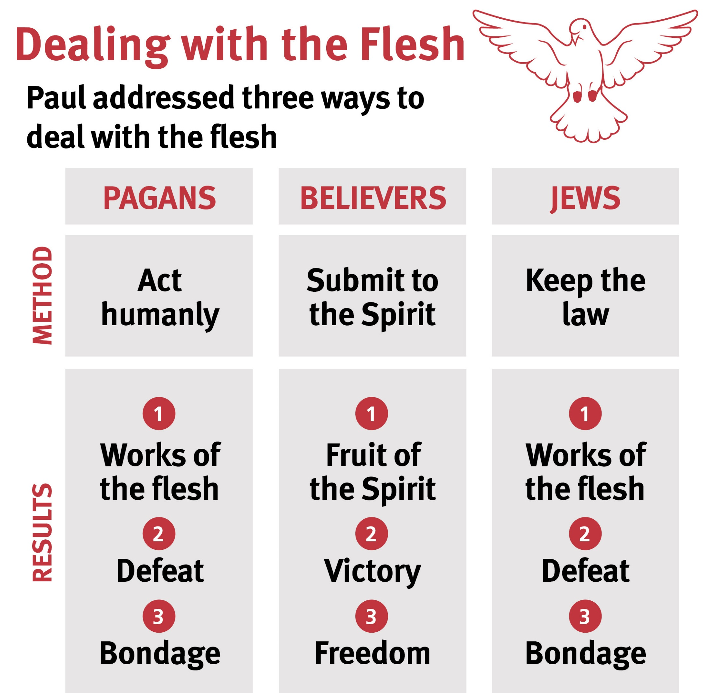

Slide 5
II. Production of Spiritual Victory (Gal. 5:19–23)
A. Works of the flesh (5:19–21)
B. Fruit of the Spirit (5:22, 23)

Slide 7
III. Practice of Spiritual Victory (Gal. 5:24–26)
A. Remember who you are (5:24)
B. Walk in the Spirit (5:25)
C. Deny the flesh (5:26)

Slide 8
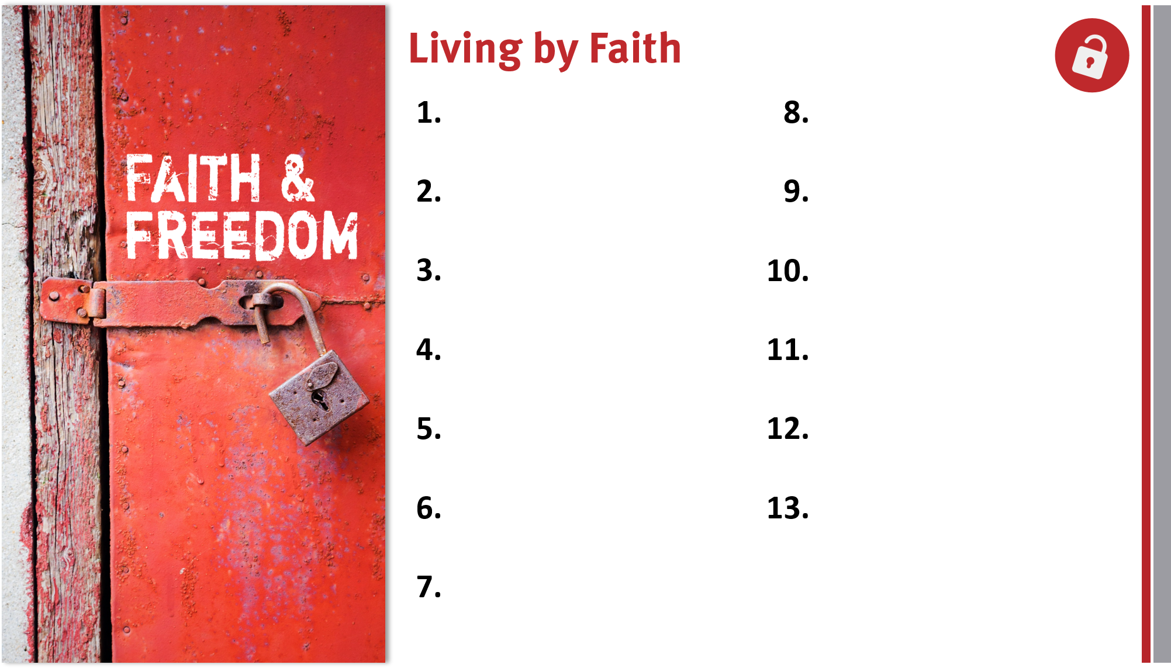
Appreciate, defend, and share the gospel.
Remain loyal to God
and the gospel.
Share the genuine gospel frequently and boldly.
Live out the freedom of liberty in Christ.
Proactively take the gospel across cultures.
Lovingly serve others and God.
Live for and serve God by faith in Him.
Rely on the Holy Spirit for victory over the flesh.
Realize God’s blessings through faith in Christ.
Trust God’s promises for salvation and life.
Appreciate members in God’s family.

