Slide 1






Slide 2
I. Paul’s Concern for the Galatians (Gal. 4:8–11)
A. Their past bondage (4:8)
B. Their return to bondage (4:9, 10)
C. Paul’s reason for concern (4:11)

Slide 3
II. Paul’s Compassion for the Galatians
(Gal. 4:12–20)
A. The Galatians received Paul (4:12–14)
B. The Galatians resisted Paul (4:15–18)
C. Paul responded to the Galatians (4:19, 20)

Slide 4

Add answers here.

Slide 5
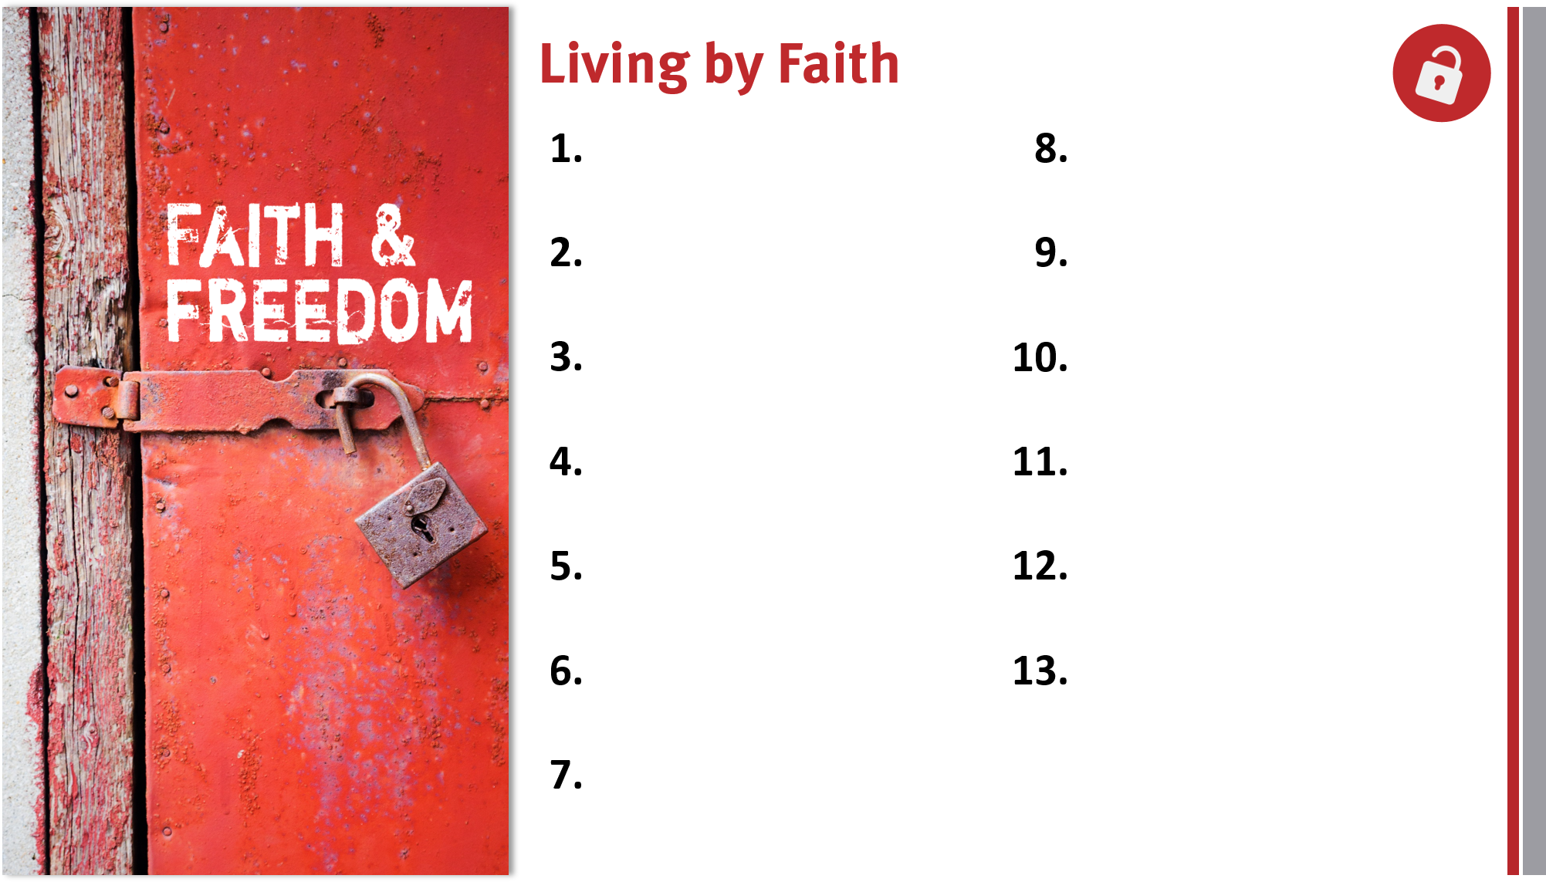
Appreciate, defend, and share the gospel.
Remain loyal to God
and the gospel.
Share the genuine gospel frequently and boldly.
Proactively take the gospel across cultures.
Live for and serve God by faith in Him.
Realize God’s blessings through faith in Christ.
Trust God’s promises for salvation and life.
Appreciate members in God’s family.

