Slide 1






Slide 2
I. God’s Promise and the Law (Gal. 3:15–18)
A. How promises work (3:15)
B. What God promised (3:16)
C. When God made His promise (3:17)
D. Why God’s promise remains (3:18)

Slide 3
II. God’s Purpose of the Law (Gal. 3:19–22)
A. Reveals sin (3:19, 20)
B. Points to Christ (3:21, 22)

Slide 4

Power for service (Acts 1:8).
Spiritual victories (1 Cor. 10:13).
Comfort in trials (2 Cor. 1:3, 4).
Eternal life (John 3:16).
Eternal rewards (2 Cor. 5:10)

Slide 5
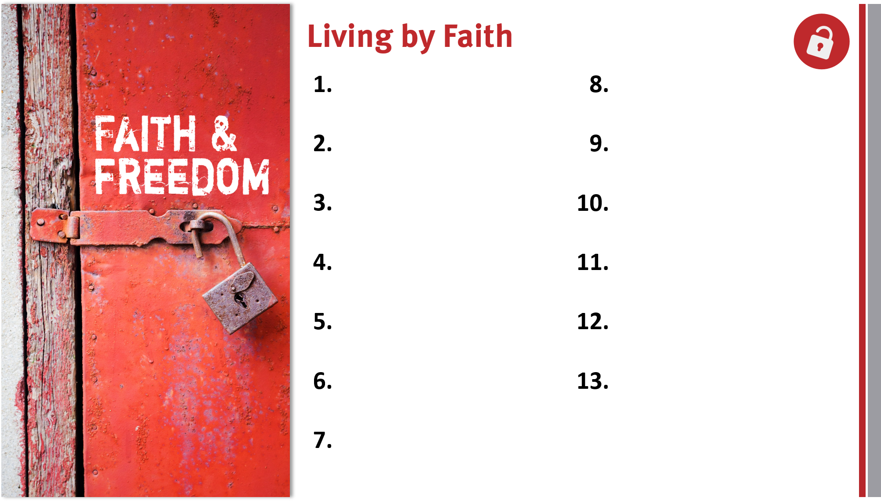
Appreciate, defend, and share the gospel.
Share the genuine gospel frequently and boldly.
Proactively take the gospel across cultures.
Live for and serve God by faith in Him.
Realize God’s blessings through faith in Christ.
Trust God’s promises for salvation and life.

