Slide 1



Slide 2
I. Expect Barriers While Serving God (1 Thess. 2:17, 18)

Slide 3
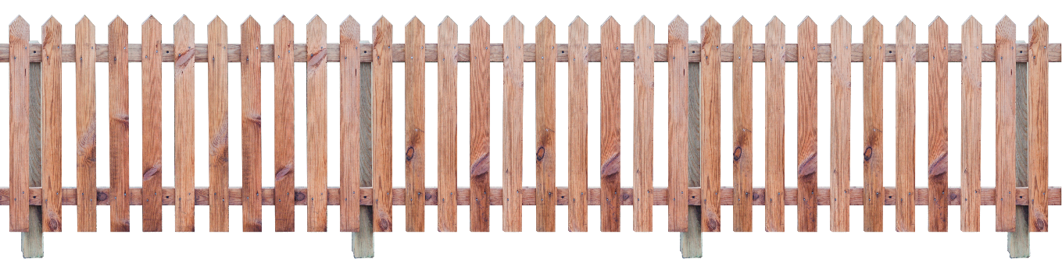
I. Expect Barriers While Serving God (1 Thess. 2:17, 18)
A. People-placed barriers (2:17)

Slide 4
I. Expect Barriers While Serving God (1 Thess. 2:17, 18)
A. People-placed barriers (2:17)
B. Satan-placed barriers (2:18)

Slide 5
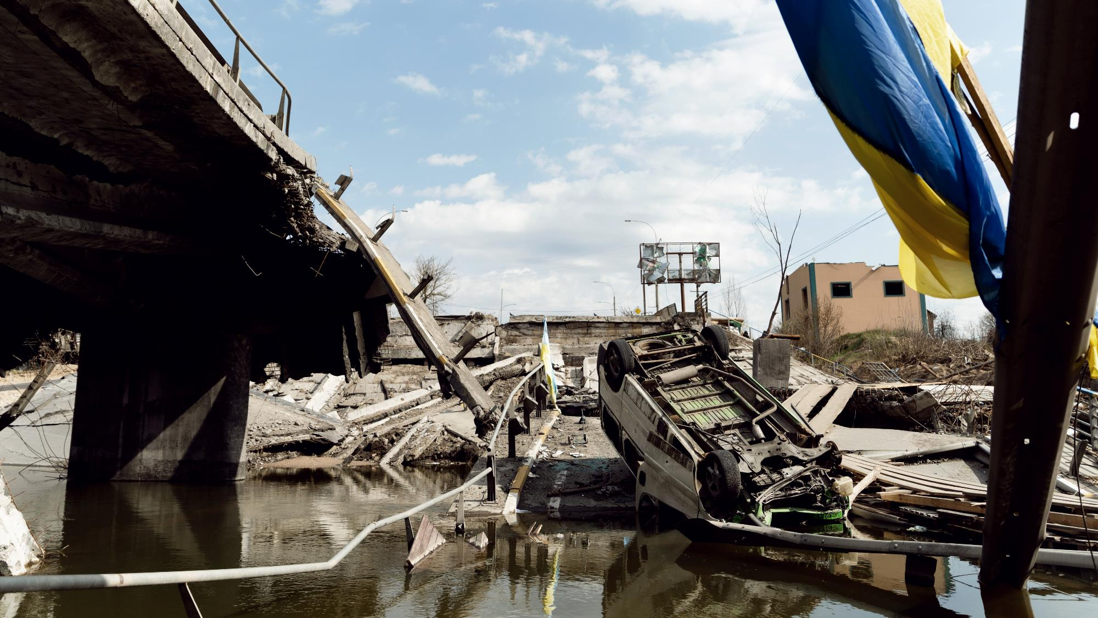
Bombed Bridge in Ukraine

Slide 6
I. Expect Barriers While Serving God (1 Thess. 2:17, 18)
A. People-placed barriers (2:17)
B. Satan-placed barriers (2:18)

Slide 7
II. Expect Success While Serving God (1 Thess. 2:19—3:2)
A. Expect future glory (2:19, 20)

Slide 8
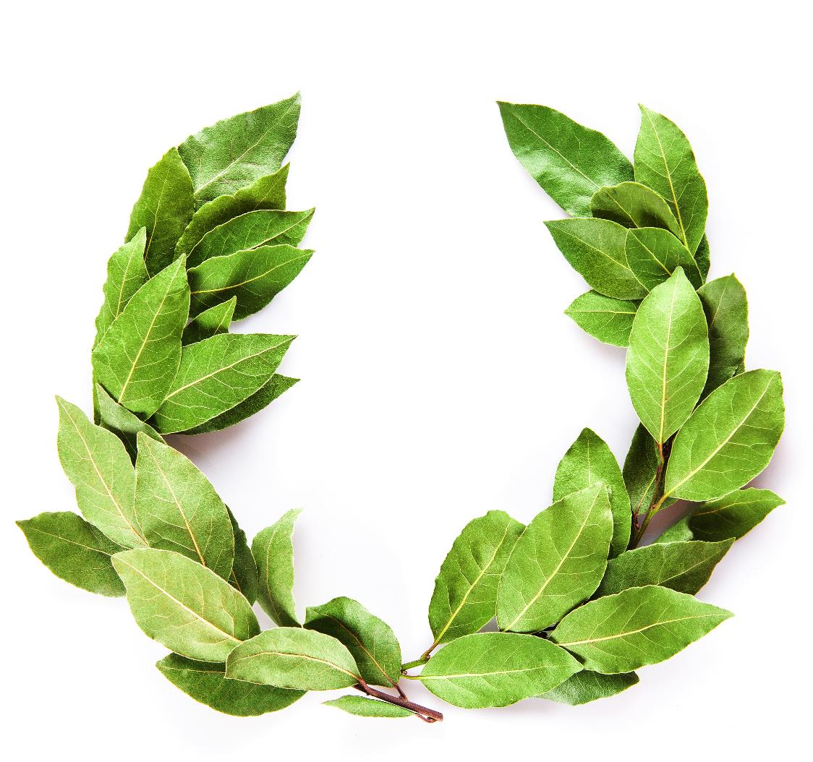
Laurel Wreath Crown

Slide 9

II. Expect Success While Serving God (1 Thess. 2:19—3:2) A. Expect future glory (2:19, 20)

Slide 10
II. Expect Success While Serving God (1 Thess. 2:19—3:2) A. Expect future glory (2:19, 20)
B. Expect growth toward maturity (3:1, 2)

Slide 11
III. Expect Temptations While Serving God (1 Thess. 3:3–5)
A. Deceptive temptations (3:3, 4)

Slide 12
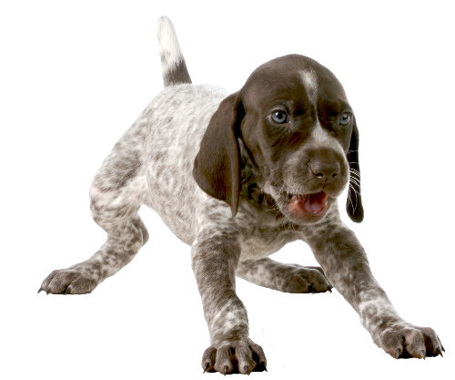
III. Expect Temptations While Serving God (1 Thess. 3:3–5) A. Deceptive temptations (3:3, 4)

Slide 13
III. Expect Temptations While Serving God (1 Thess. 3:3–5) A. Deceptive temptations (3:3, 4)
B. The destructive tempter (3:5)

