Slide 1



Slide 2
I. Christlikeness Taught (Acts 17:1–10)
A. One message (17:1–3)

Slide 3
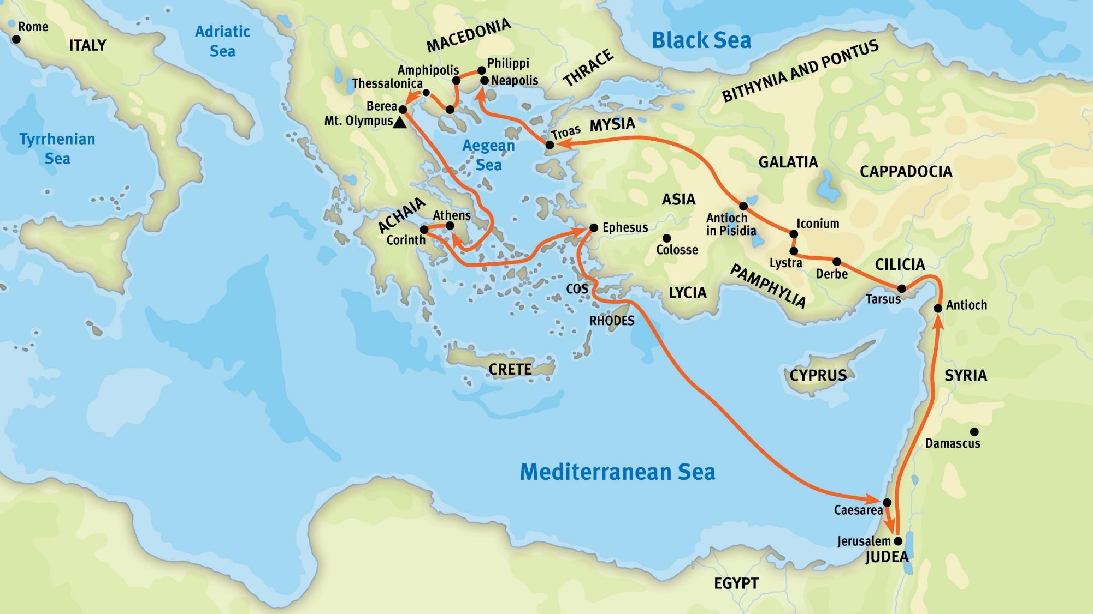
Paul’s Second Missionary Journey

Slide 4
I. Christlikeness Taught (Acts 17:1–10)
A. One message (17:1–3)

Slide 5
I. Christlikeness Taught (Acts 17:1–10)
A. One message (17:1–3)
B. Two responses (17:4–10)
1. Reception (17:4)

Slide 6
I. Christlikeness Taught (Acts 17:1–10)
A. One message (17:1–3)
B. Two responses (17:4–10)
1. Reception (17:4)
2. Rejection (17:5–10)

Slide 7

II. Christlikeness Caught (1 Thess. 1:1–5)
A. Evidence of Christlikeness (1:1–3)

Slide 8
II. Christlikeness Caught (1 Thess. 1:1–5)
A. Evidence of Christlikeness (1:1–3)
B. Election to Christlikeness (1:4)

Slide 9
II. Christlikeness Caught (1 Thess. 1:1–5)
A. Evidence of Christlikeness (1:1–3)
B. Election to Christlikeness (1:4)
C. Empowerment for Christlikeness (1:5)

Slide 10
III. Christlikeness Trumpeted (1 Thess. 1:6–10)
A. Walking by the Spirit (1:6–8)

Slide 11
III. Christlikeness Trumpeted (1 Thess. 1:6–10)
A. Walking by the Spirit (1:6–8)
B. Worshiping God (1:9)

Slide 12
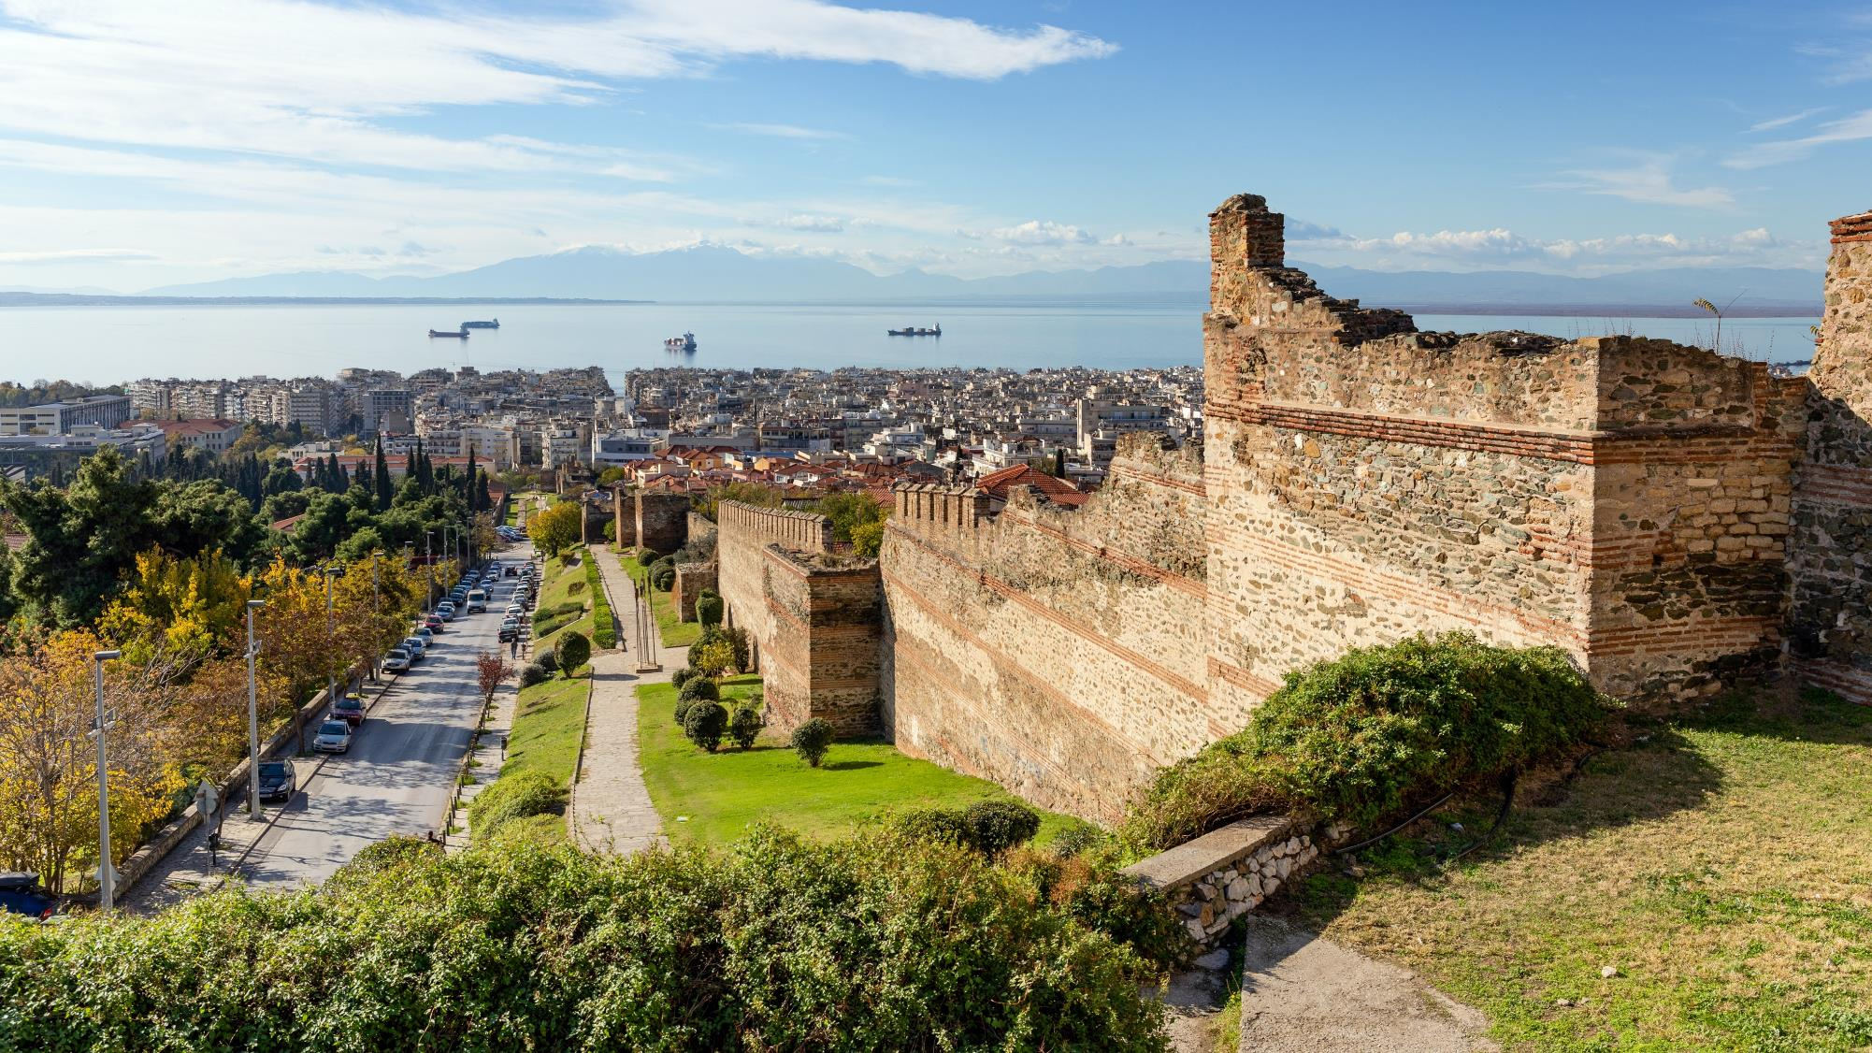
Mount Olympus from Thessalonica

Slide 13
III. Christlikeness Trumpeted (1 Thess. 1:6–10)
A. Walking by the Spirit (1:6–8)
B. Worshiping God (1:9)

Slide 14
III. Christlikeness Trumpeted (1 Thess. 1:6–10)
A. Walking by the Spirit (1:6–8)
B. Worshiping God (1:9)
C. Waiting for Christ (1:10)

Slide 15
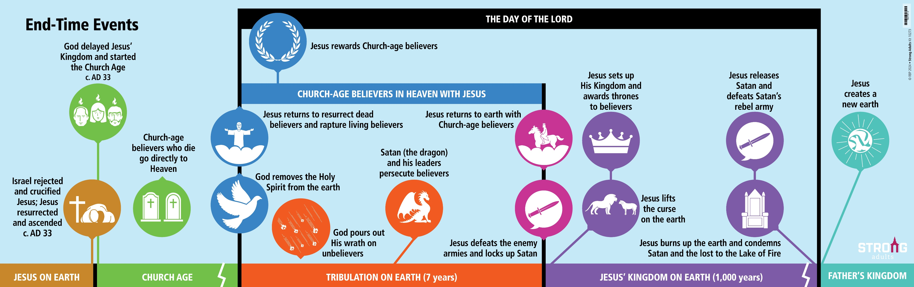
End-Time Events
God’s Wrath
God’s Wrath

Slide 16
III. Christlikeness Trumpeted (1 Thess. 1:6–10)
A. Walking by the Spirit (1:6–8)
B. Worshiping God (1:9)
C. Waiting for Christ (1:10)

