Slide 1



Slide 2
I. Seeks to Please God (1 Thess. 2:1, 2)
A. Shares God’s message (2:1, 2)

Slide 3
I. Seeks to Please God (1 Thess. 2:1, 2)
A. Shares God’s message (2:1, 2)
B. Has godly motives (2:3–6)

Slide 4
II. Shows Motherly Care (1 Thess. 2:7, 8)
A. Sincerely cherishes others (2:7)

Slide 5
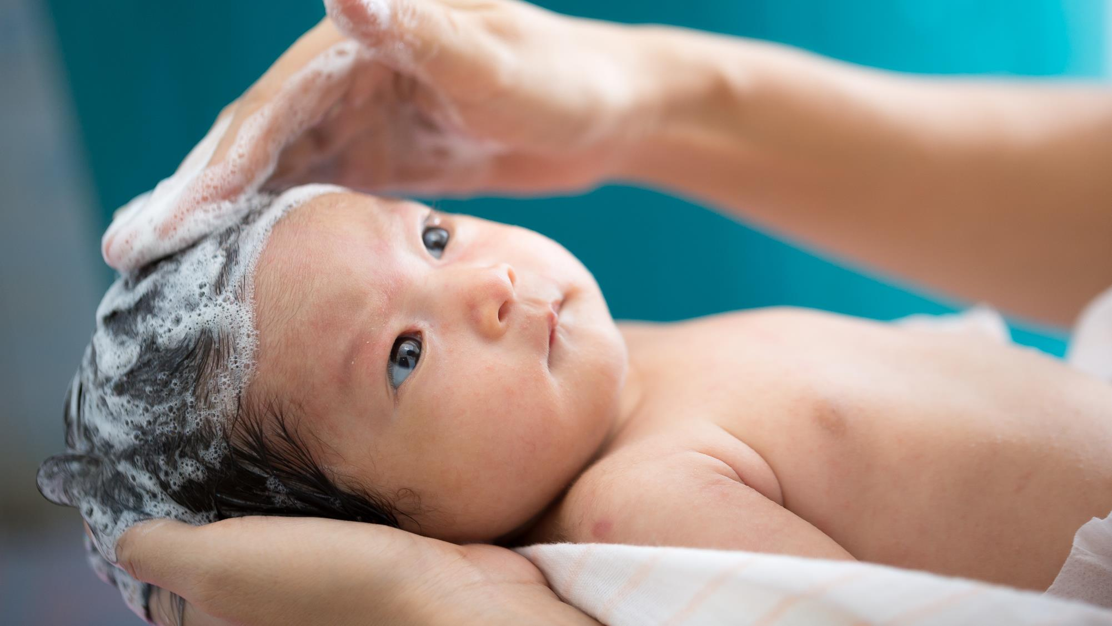

Slide 6
II. Shows Motherly Care (1 Thess. 2:7, 8)
A. Sincerely cherishes others (2:7)

Slide 7
II. Shows Motherly Care (1 Thess. 2:7, 8)
A. Sincerely cherishes others (2:7)
B. Sacrificially cares for others (2:8)

Slide 8
III. Gives Fatherly Instructions (1 Thess. 2:9–12)
A. By example (2:9, 10)

Slide 9
III. Gives Fatherly Instructions (1 Thess. 2:9–12)
A. By example (2:9, 10)
B. By exhortation (2:11, 12)

Slide 10
IV. Gives Thanks to God (1 Thess. 2:13–16)
A. For His saving work (2:13, 14)

Slide 11
IV. Gives Thanks to God (1 Thess. 2:13–16)
A. For His saving work (2:13, 14)
B. For His righteous wrath (2:15, 16)

