Slide 1



Slide 2
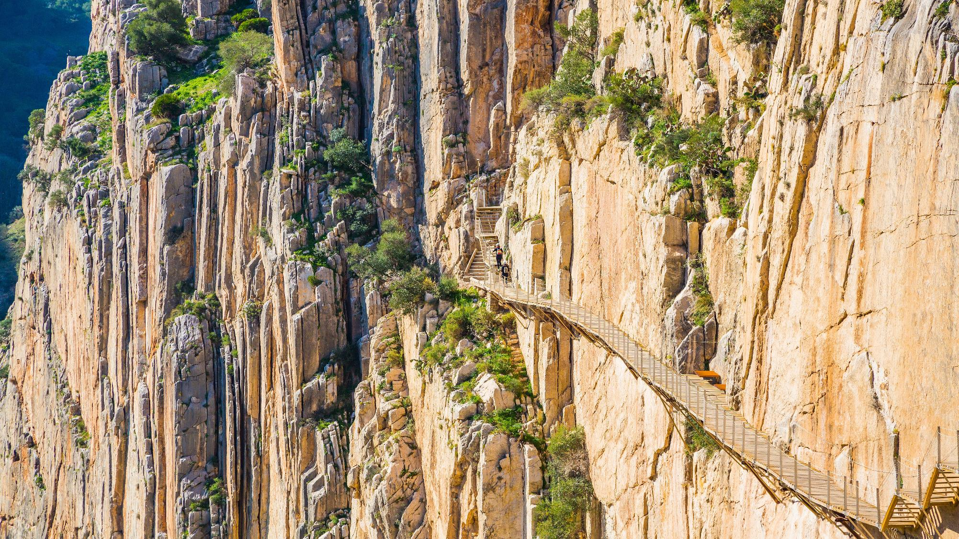
Caminito del Rey Trail, Spain

Slide 3
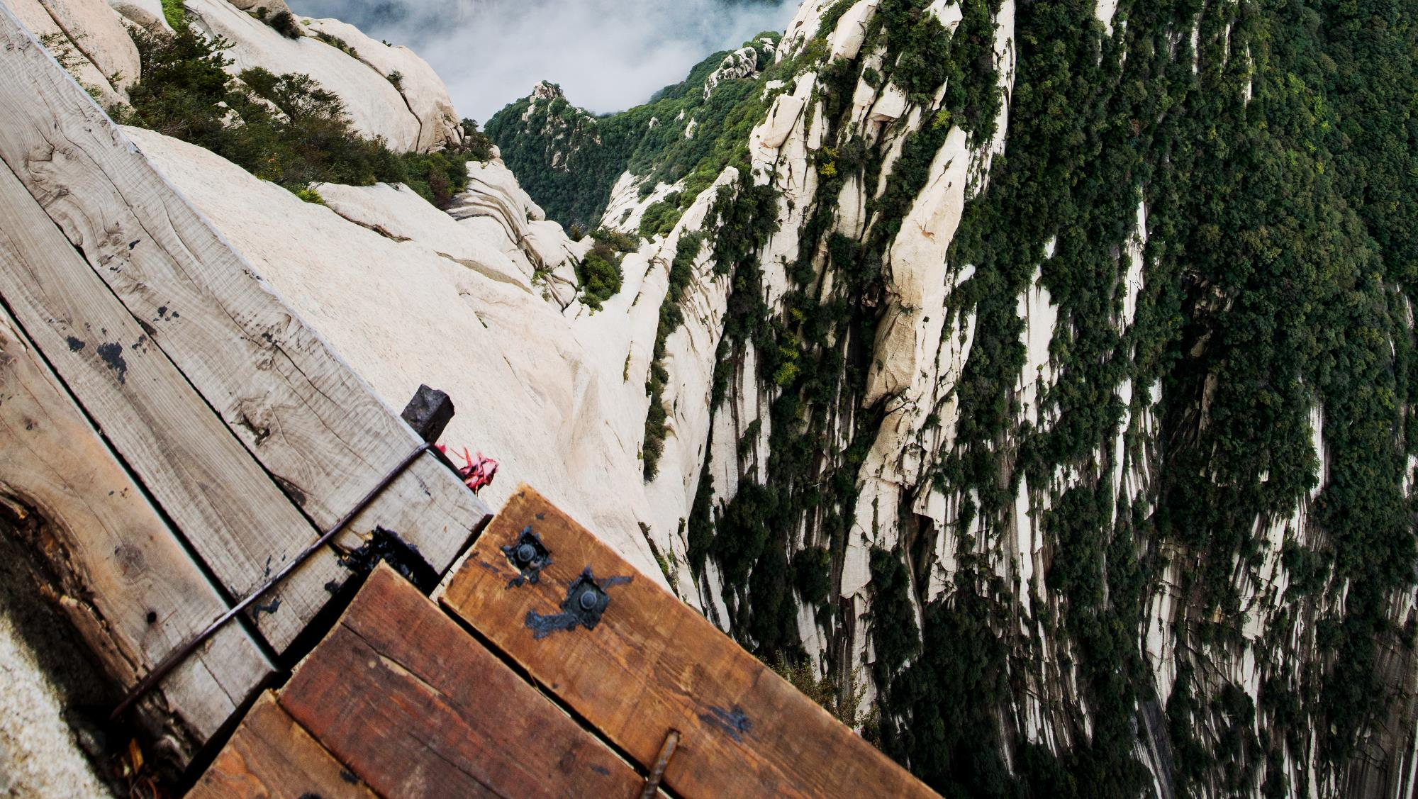
Huashan Plank Walk, China

Slide 4
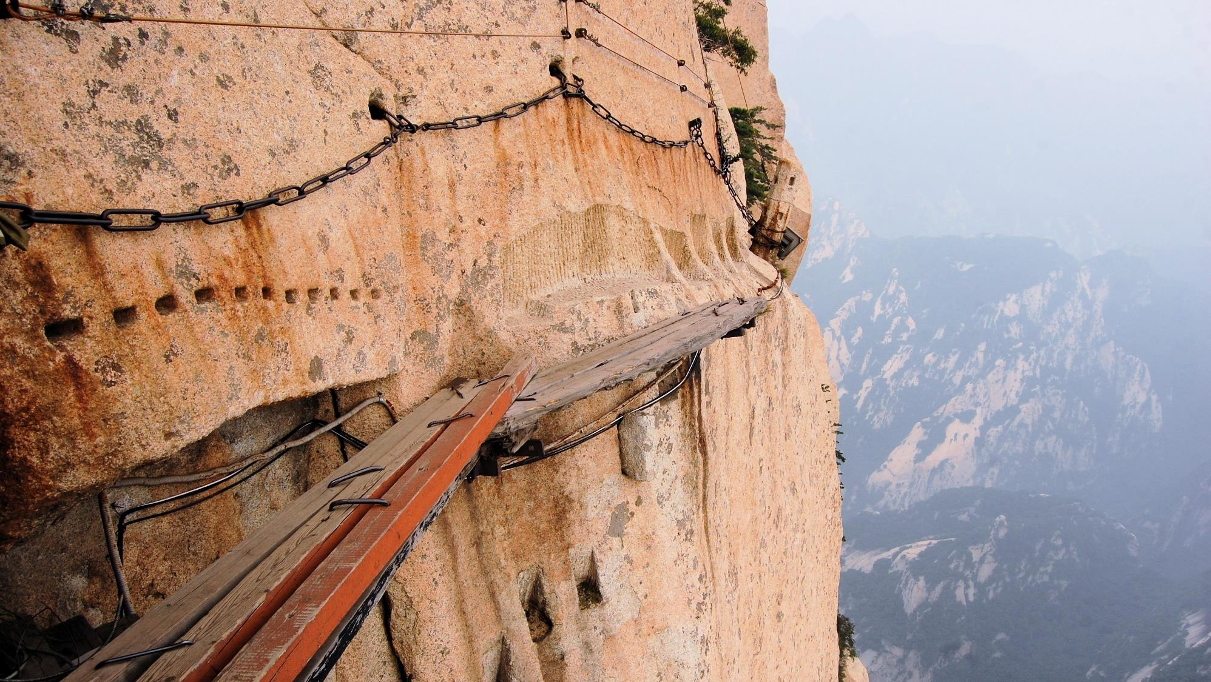
Huashan Plank Walk, China

Slide 5
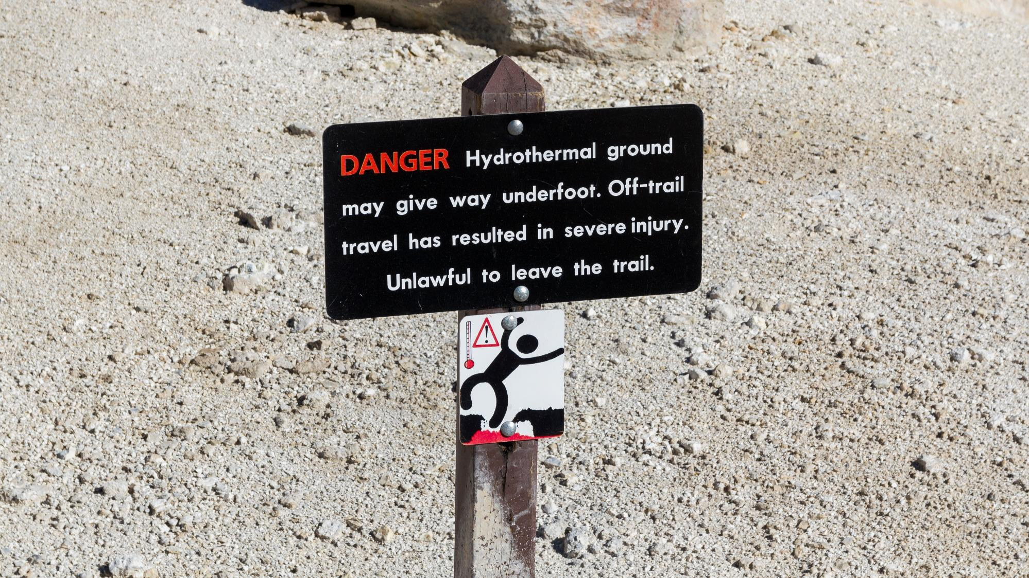
Lassen Volcanic National Park Warning Sign

Slide 6
I. The Believer’s Salvation (2 Thess. 2:13, 14)
A. Chosen by God (2:13)

Slide 7
I. The Believer’s Salvation (2 Thess. 2:13, 14)
A. Chosen by God (2:13)
B. Called by God (2:14)
1. Through human witnesses (2:14)

Slide 8
I. The Believer’s Salvation (2 Thess. 2:13, 14)
A. Chosen by God (2:13)
B. Called by God (2:14)
1. Through human witnesses (2:14)
2. To glorification (2:14)

Slide 9
II. The Believers’ Responsibility (2 Thess. 2:15)
A. Persist in belief (2:15)

Slide 10
II. The Believers’ Responsibility (2 Thess. 2:15)
A. Persist in belief (2:15)
B. Hold on to truth (2:15)

Slide 11
III. The Believer’s Support (2 Thess. 2:16, 17)
A. Eternal hope from God (2:16)

Slide 12
III. The Believer’s Support (2 Thess. 2:16, 17)
A. Eternal hope from God (2:16)
B. Present help from God (2:17)

