Slide 1
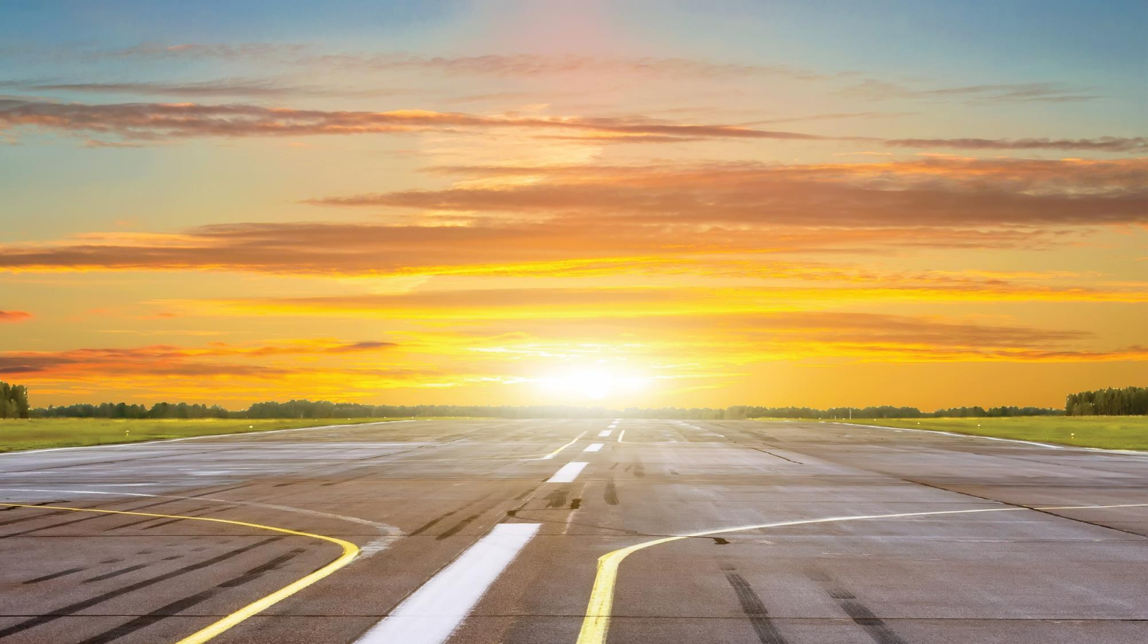


Slide 2
I. God Enables Believers in Trials (2 Thess. 1:1–4)
A. He gives grace to grow (1:1–3)

Slide 3
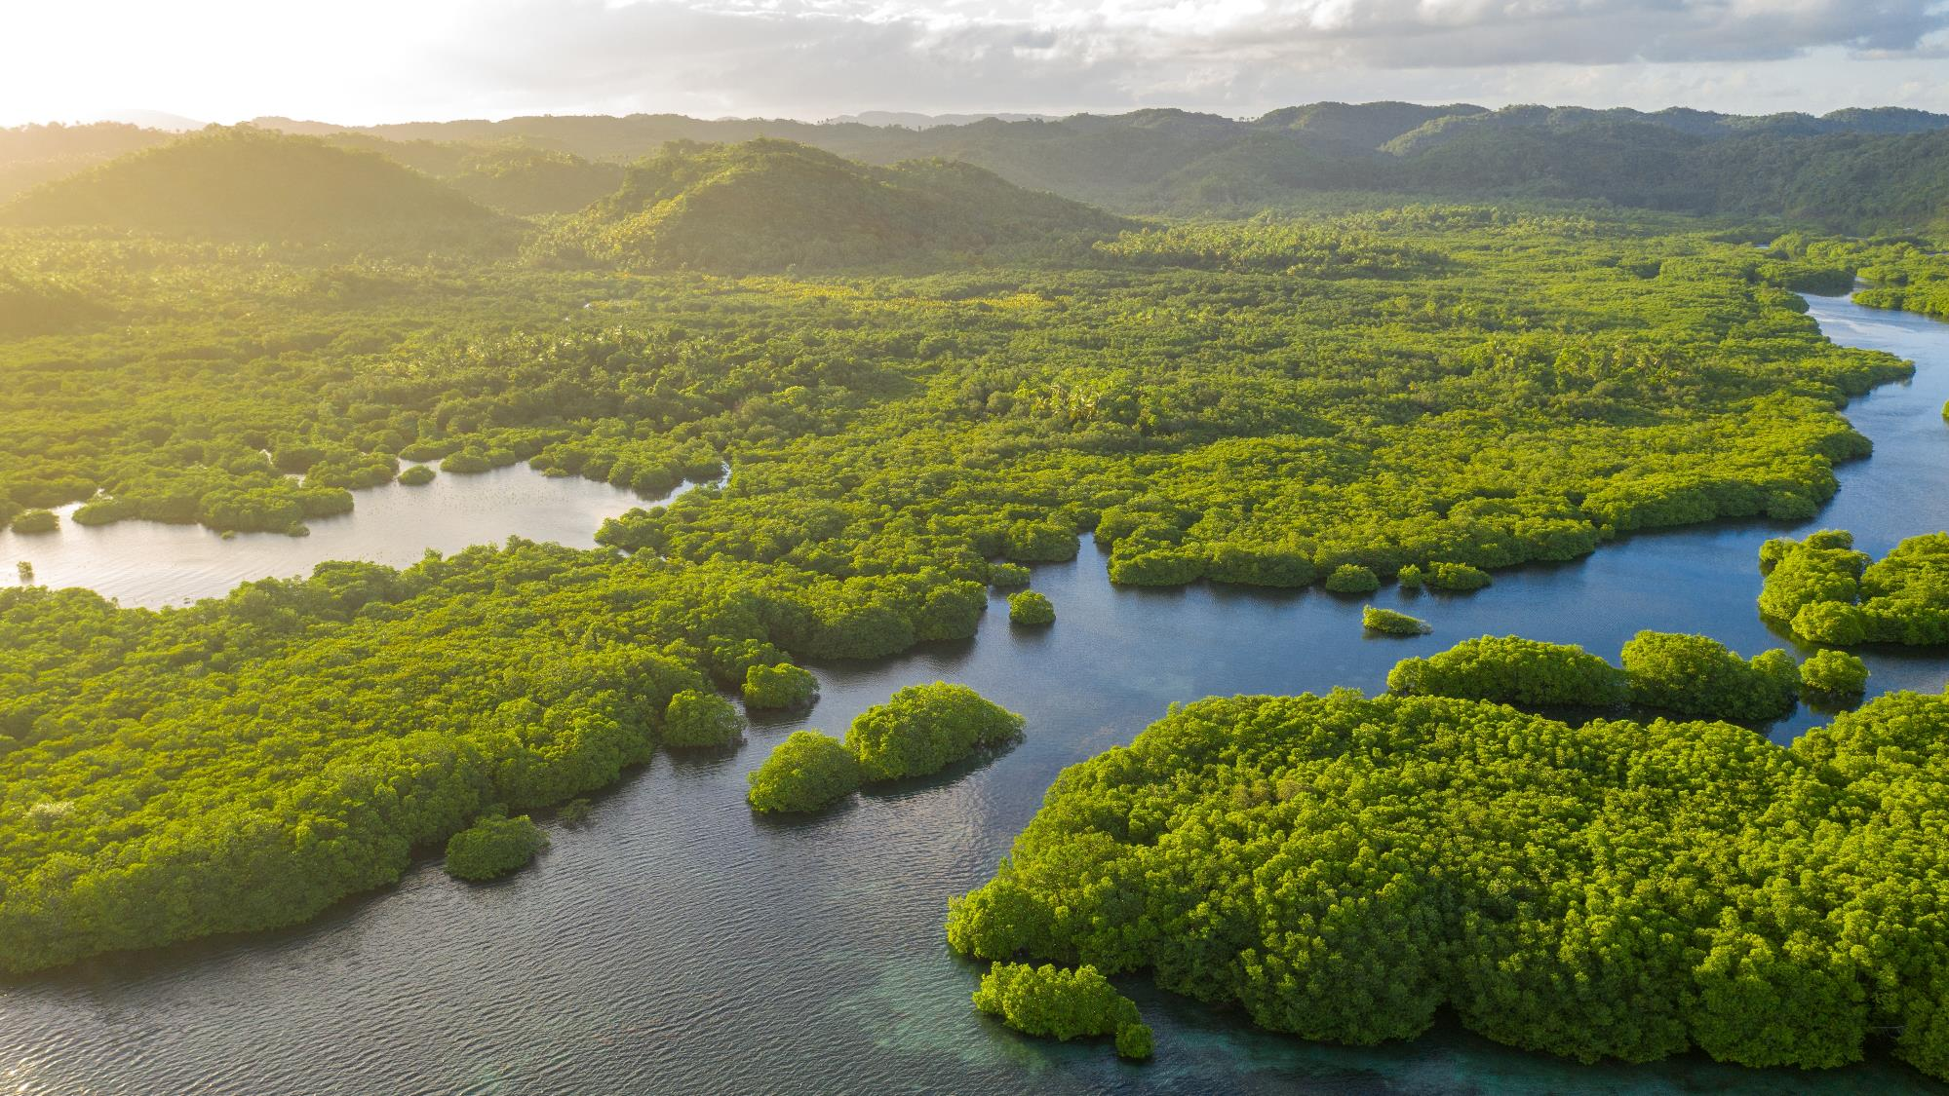
Flooded River

Slide 4
I. God Enables Believers in Trials (2 Thess. 1:1–4)
A. He gives grace to grow (1:1–3)

Slide 5
I. God Enables Believers in Trials (2 Thess. 1:1–4)
A. He gives grace to grow (1:1–3)
B. He gives patience in persecution (1:4)

Slide 6
II. God Justly Judges All People (2 Thess. 1:5–9)
A. He justly sustains believers (1:5)

Slide 7
II. God Justly Judges All People (2 Thess. 1:5–9)
A. He justly sustains believers (1:5)
B. He justly repays persecutors (1:6)

Slide 8
II. God Justly Judges All People (2 Thess. 1:5–9)
A. He justly sustains believers (1:5)
B. He justly repays persecutors (1:6)
C. He justly rewards believers (1:7)

Slide 9
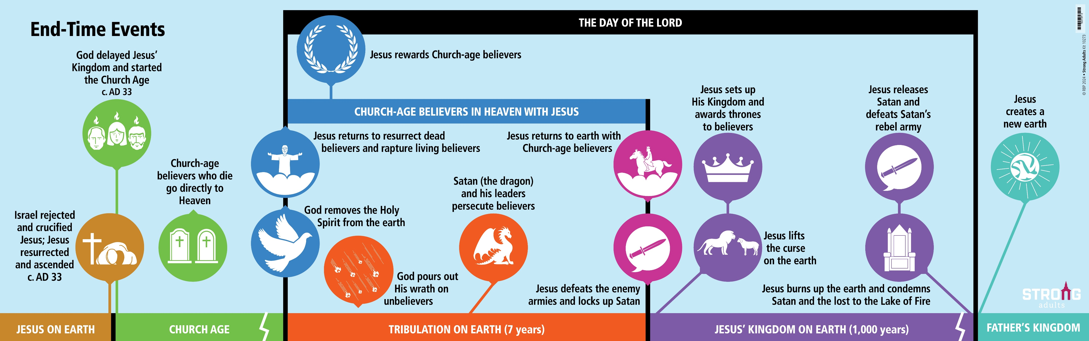
End-Time Events

Slide 10
II. God Justly Judges All People (2 Thess. 1:5–9)
A. He justly sustains believers (1:5)
B. He justly repays persecutors (1:6)
C. He justly rewards believers (1:7)

Slide 11
II. God Justly Judges All People (2 Thess. 1:5–9)
A. He justly sustains believers (1:5)
B. He justly repays persecutors (1:6)
C. He justly rewards believers (1:7)
D. He justly punishes unbelievers (1:8, 9)

Slide 12
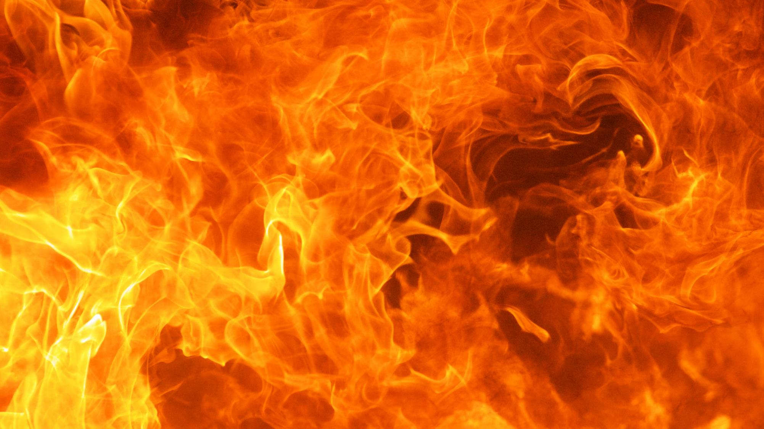

Slide 13
II. God Justly Judges All People (2 Thess. 1:5–9)
A. He justly sustains believers (1:5)
B. He justly repays persecutors (1:6)
C. He justly rewards believers (1:7)
D. He justly punishes unbelievers (1:8, 9)

Slide 14
III. God Enables Believers to Glorify Christ (2 Thess. 1:10–12)
A. On the day of Christ’s return (1:10)

Slide 15
III. God Enables Believers to Glorify Christ (2 Thess. 1:10–12)
A. On the day of Christ’s return (1:10)
B. Every day of our lives (1:11, 12)

