Slide 1




Slide 2

I. Be Strong in the Lord (6:10)
What do you predict would happen to the believer who lives oblivious to Satan’s desire to defeat him or her?

Slide 3
II. Put on the Armor of God (6:11–17)
A. Purpose for the armor (6:11–13)
Read 1 Peter 5:8. What do we learn about the Devil by comparing him to a roaring lion?

Slide 4
II. Put on the Armor of God (6:11–17)
A. Purpose for the armor (6:11–13)
Which of the life issues Paul covered in Ephesians 4:1—6:9 seem to be Satan’s favorite battlefronts?

Slide 5
II. Put on the Armor of God (6:11–17)
A. Purpose for the armor (6:11–13)
Read Acts 5:40, 41; 7:59, 60. How did the apostles respond to the Devil’s fury?

Slide 6
II. Put on the Armor of God (6:11–17)
A. Purpose for the armor (6:11–13)
B. Pieces of the armor (6:14–17)
1. Belt of truth (6:14)
What are some truths believers must remember in battle?

Slide 7
II. Put on the Armor of God (6:11–17)
A. Purpose for the armor (6:11–13)
B. Pieces of the armor (6:14–17)
1. Belt of truth (6:14)
2. Breastplate of righteousness (6:14)
Have you ever had Satan tell you that you’re a miserable failure? How did you respond?

Slide 8
II. Put on the Armor of God (6:11–17)
A. Purpose for the armor (6:11–13)
B. Pieces of the armor (6:14–17)
1. Belt of truth (6:14)
2. Breastplate of righteousness (6:14)
3. Sandals of peace (6:15)
When have you witnessed the gospel bringing peace to a “new recruit”?

Slide 9
II. Put on the Armor of God (6:11–17)
A. Purpose for the armor (6:11–13)
B. Pieces of the armor (6:14–17)
1. Belt of truth (6:14)
2. Breastplate of righteousness (6:14)
3. Sandals of peace (6:15)
4. Shield of faith (6:16)
How has the shield of faith recently extinguished one of Satan’s fiery darts in your life?

Slide 10
II. Put on the Armor of God (6:11–17)
A. Purpose for the armor (6:11–13)
B. Pieces of the armor (6:14–17)
1. Belt of truth (6:14)
2. Breastplate of righteousness (6:14)
3. Sandals of peace (6:15)
4. Shield of faith (6:16)
5. Helmet of salvation (6:17)
How might a church encourage its members to wear their “helmets” in battle?

Slide 11
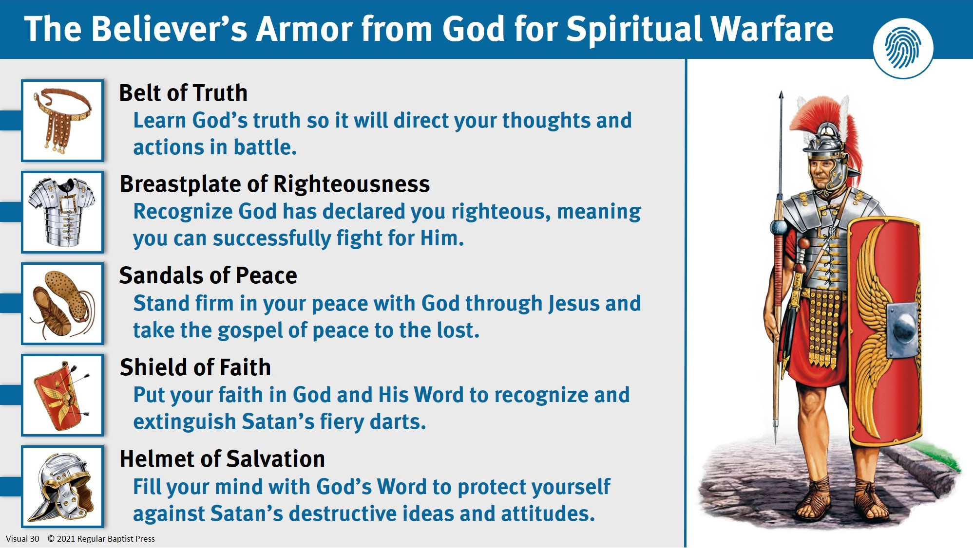

Slide 12
III. Join the Battle (6:17–24)
A. Pick up your sword (6:17)
What verses have you memorized in preparation for Satanic attacks?

Slide 13
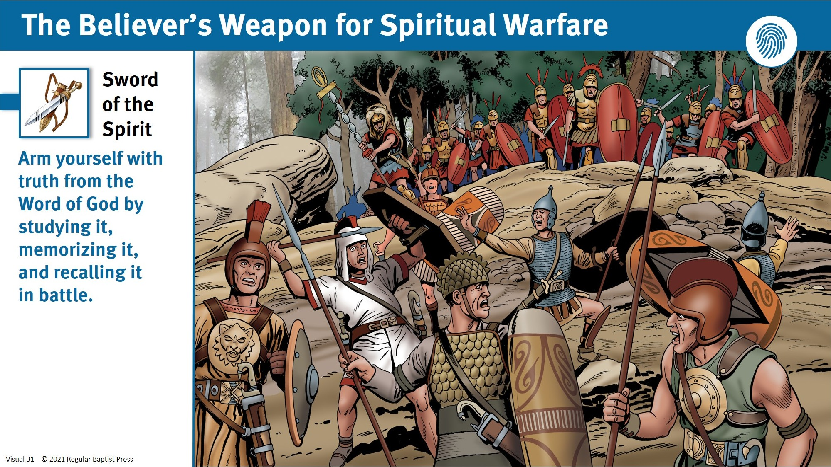

Slide 14
III. Join the Battle (6:17–24)
A. Pick up your sword (6:17)
B. Support your fellow soldiers (6:18–24)
Describe the openness Paul used in requesting prayer for himself?

Slide 15
III. Join the Battle (6:17–24)
A. Pick up your sword (6:17)
B. Support your fellow soldiers (6:18–24)
How might refusing to share our fears and struggles help the enemy gain ground in his battle against us?

Slide 16

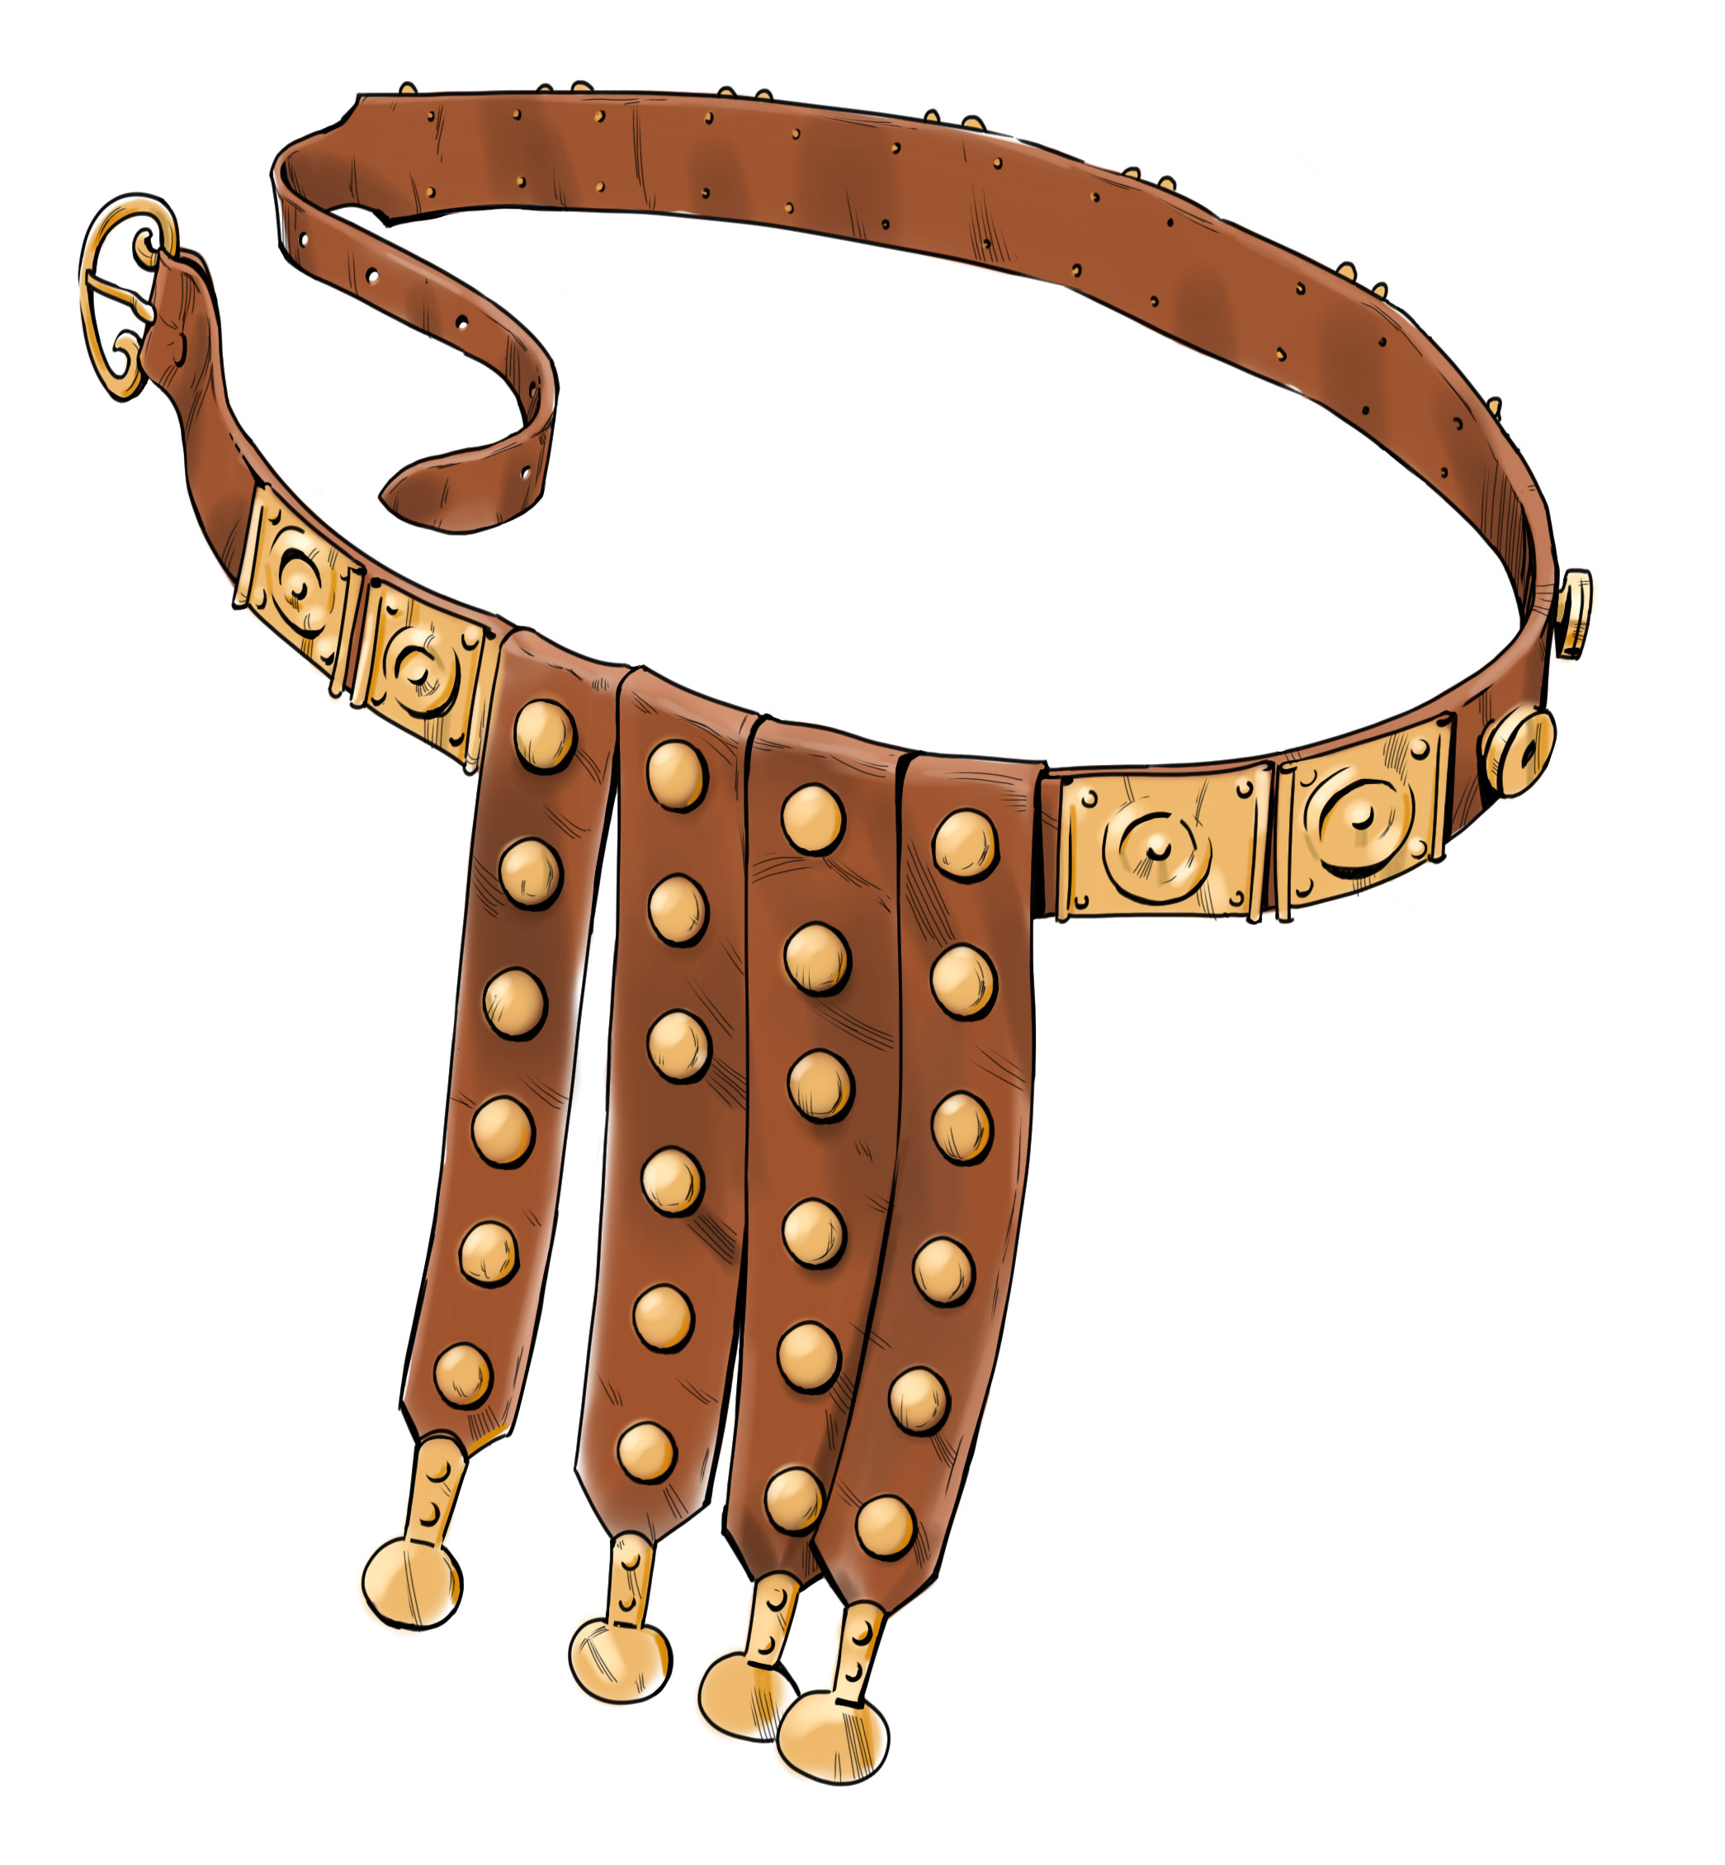
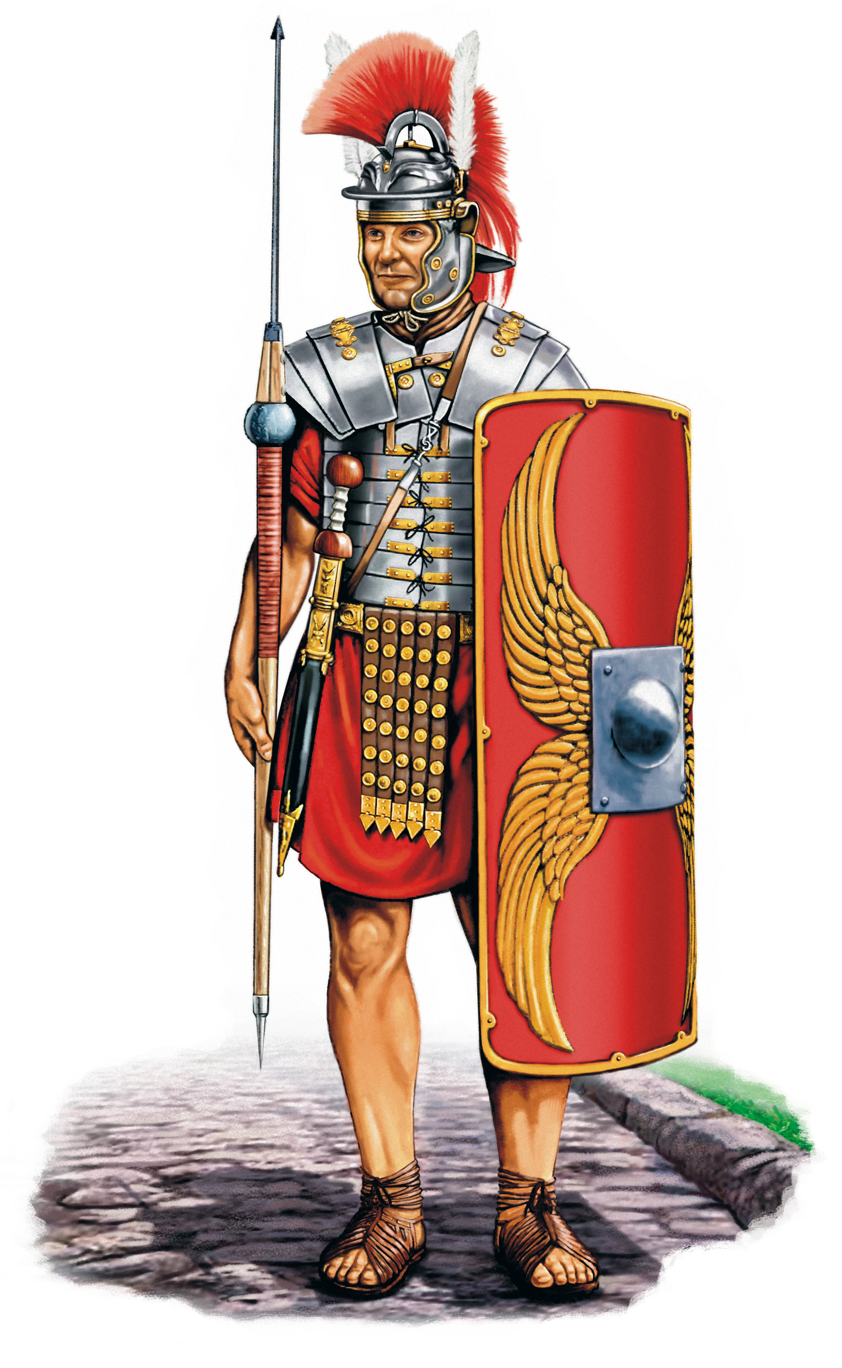
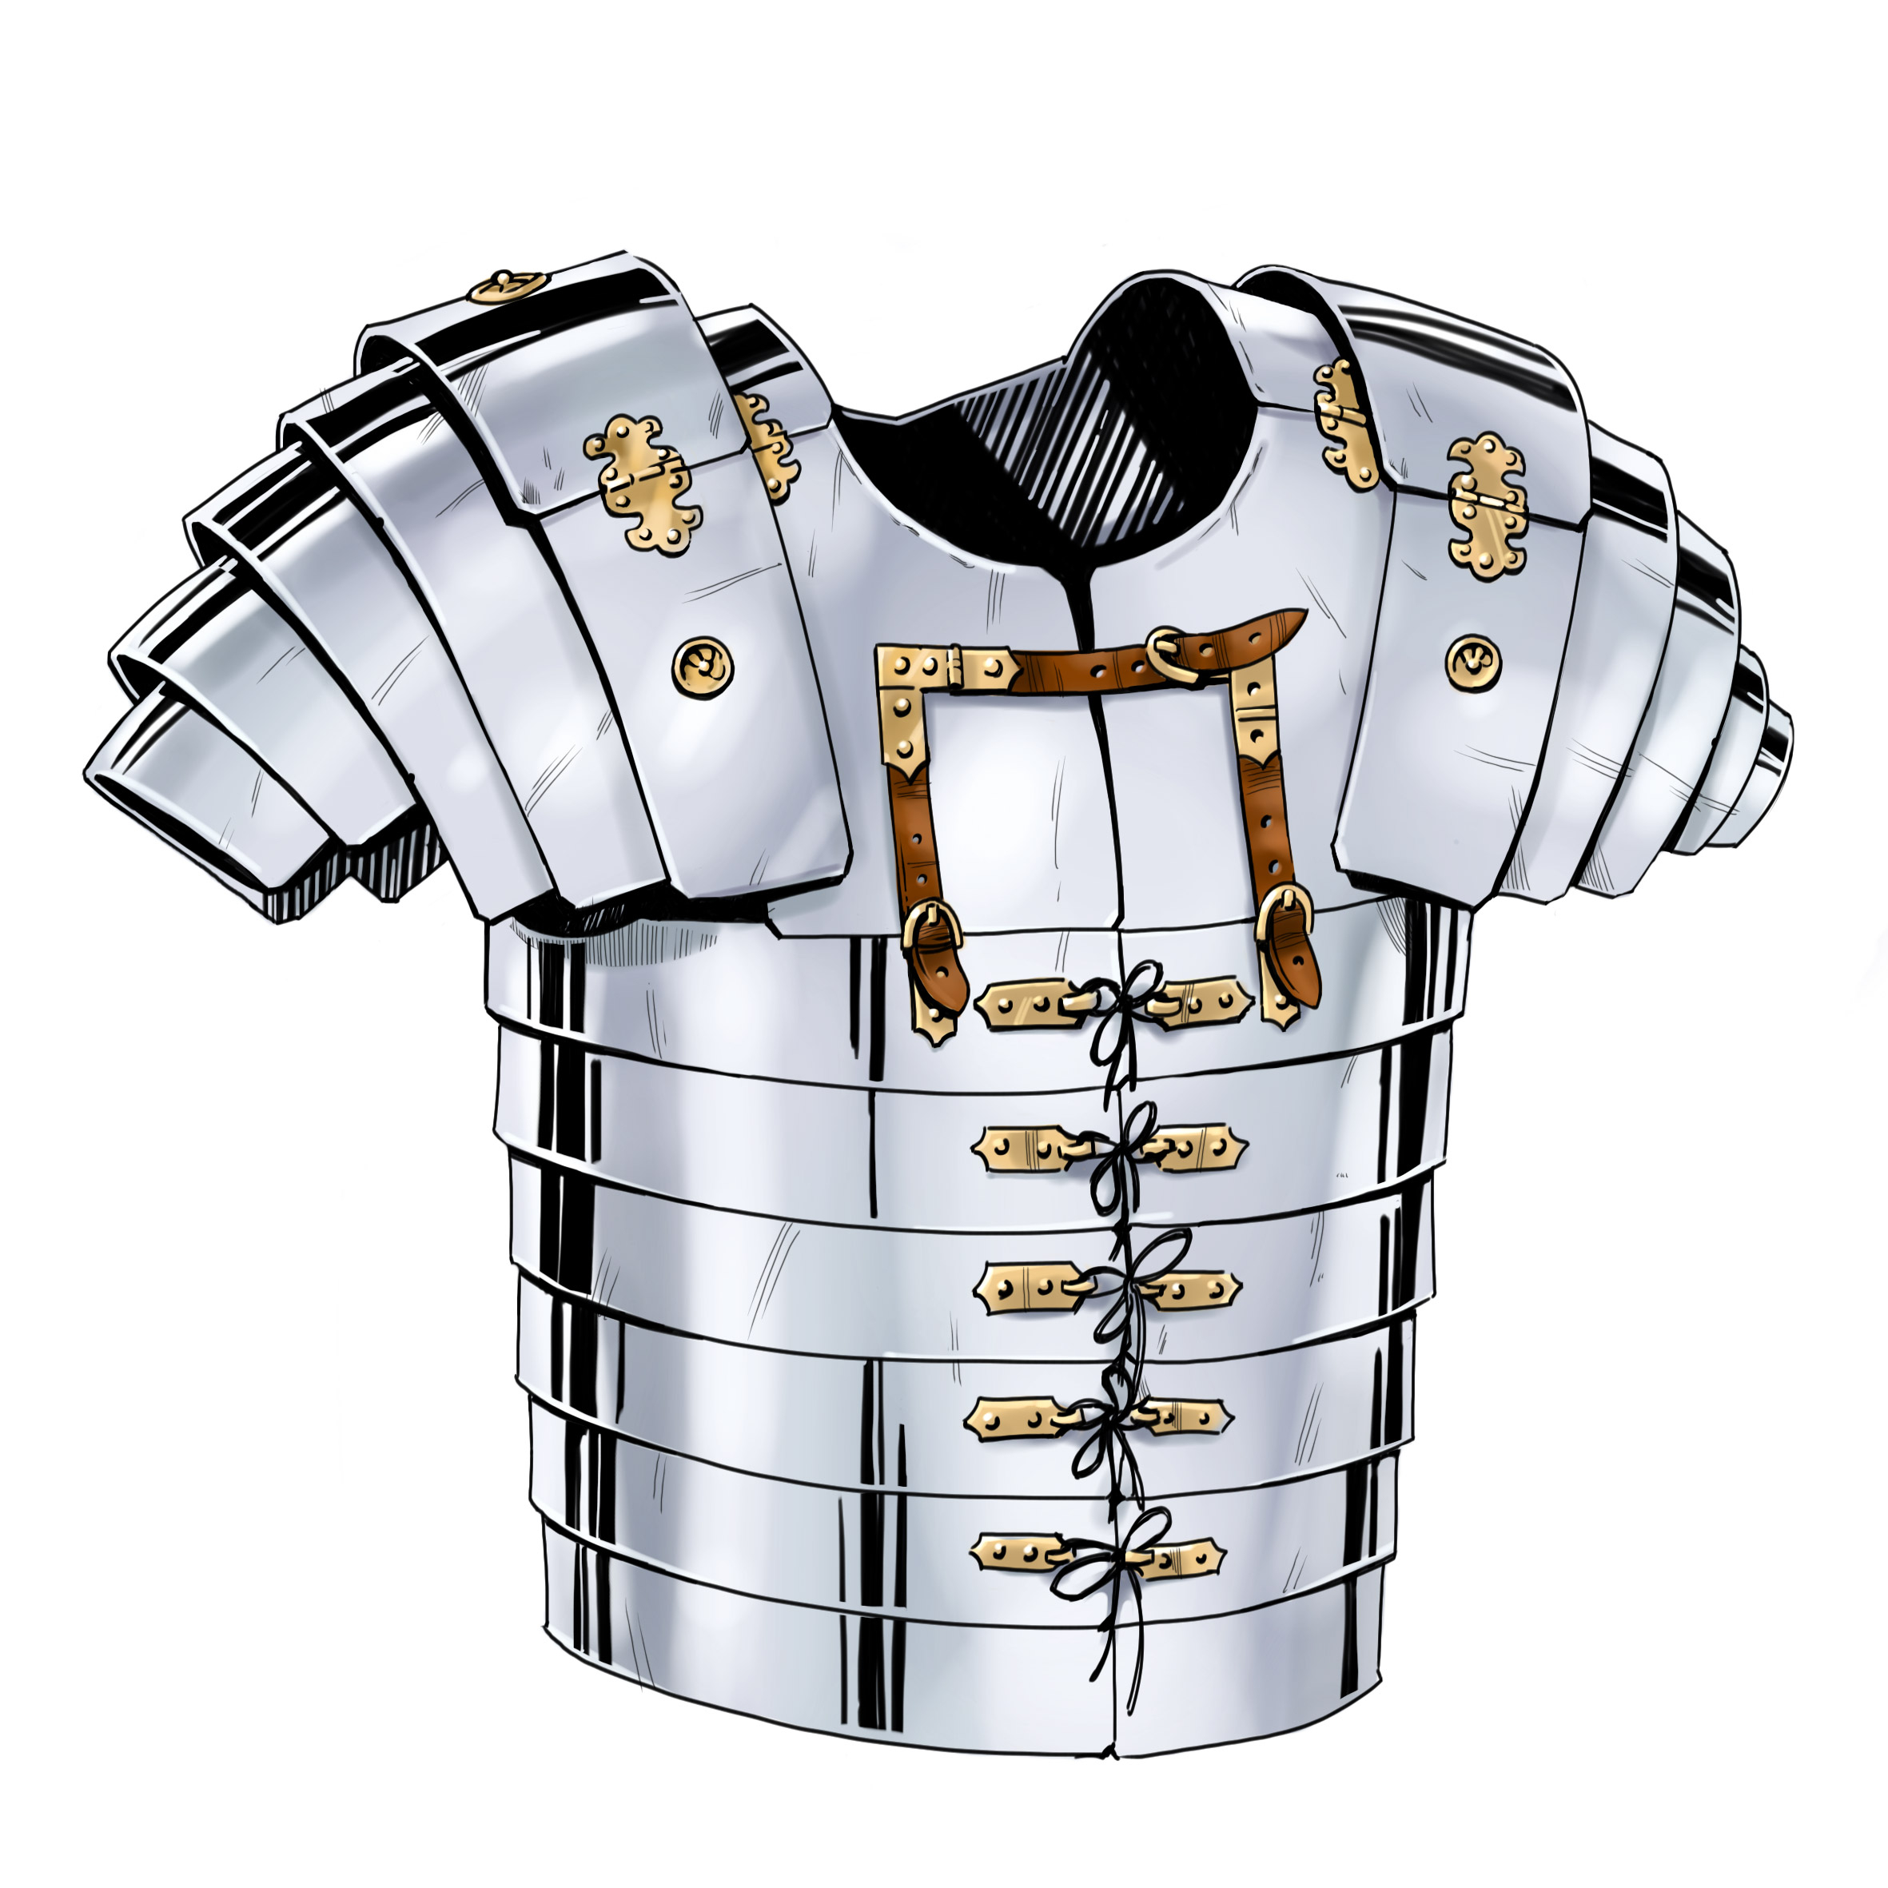
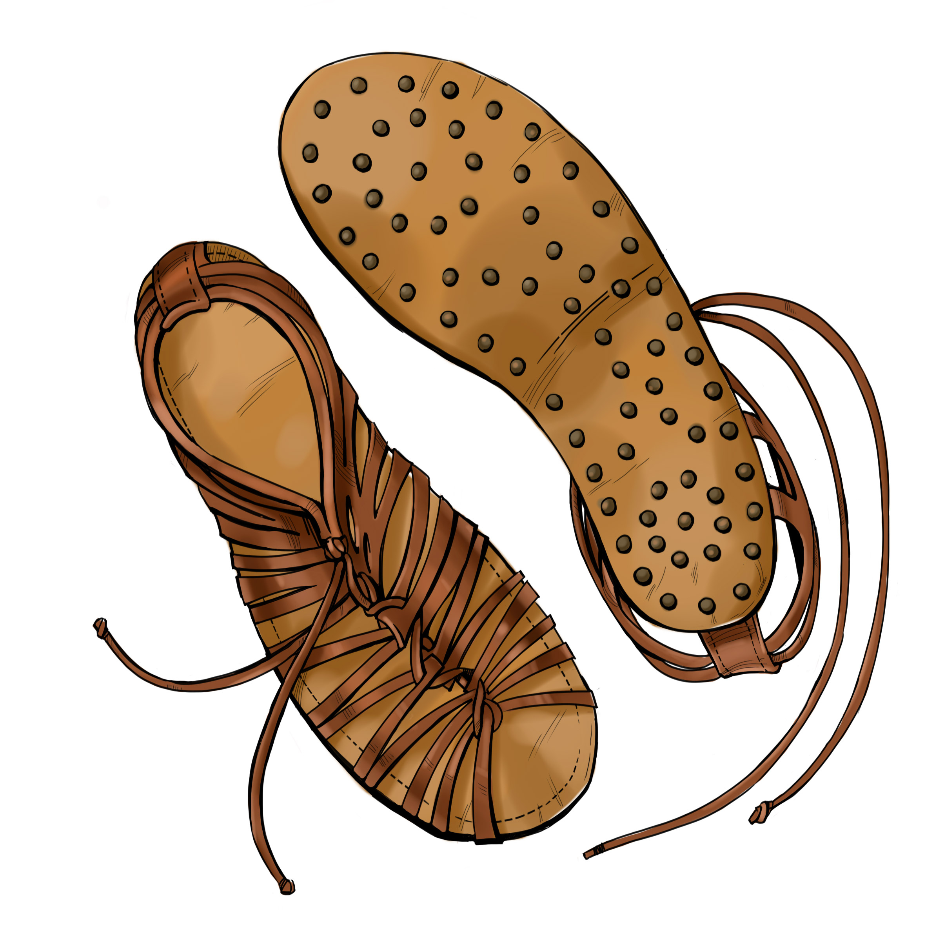
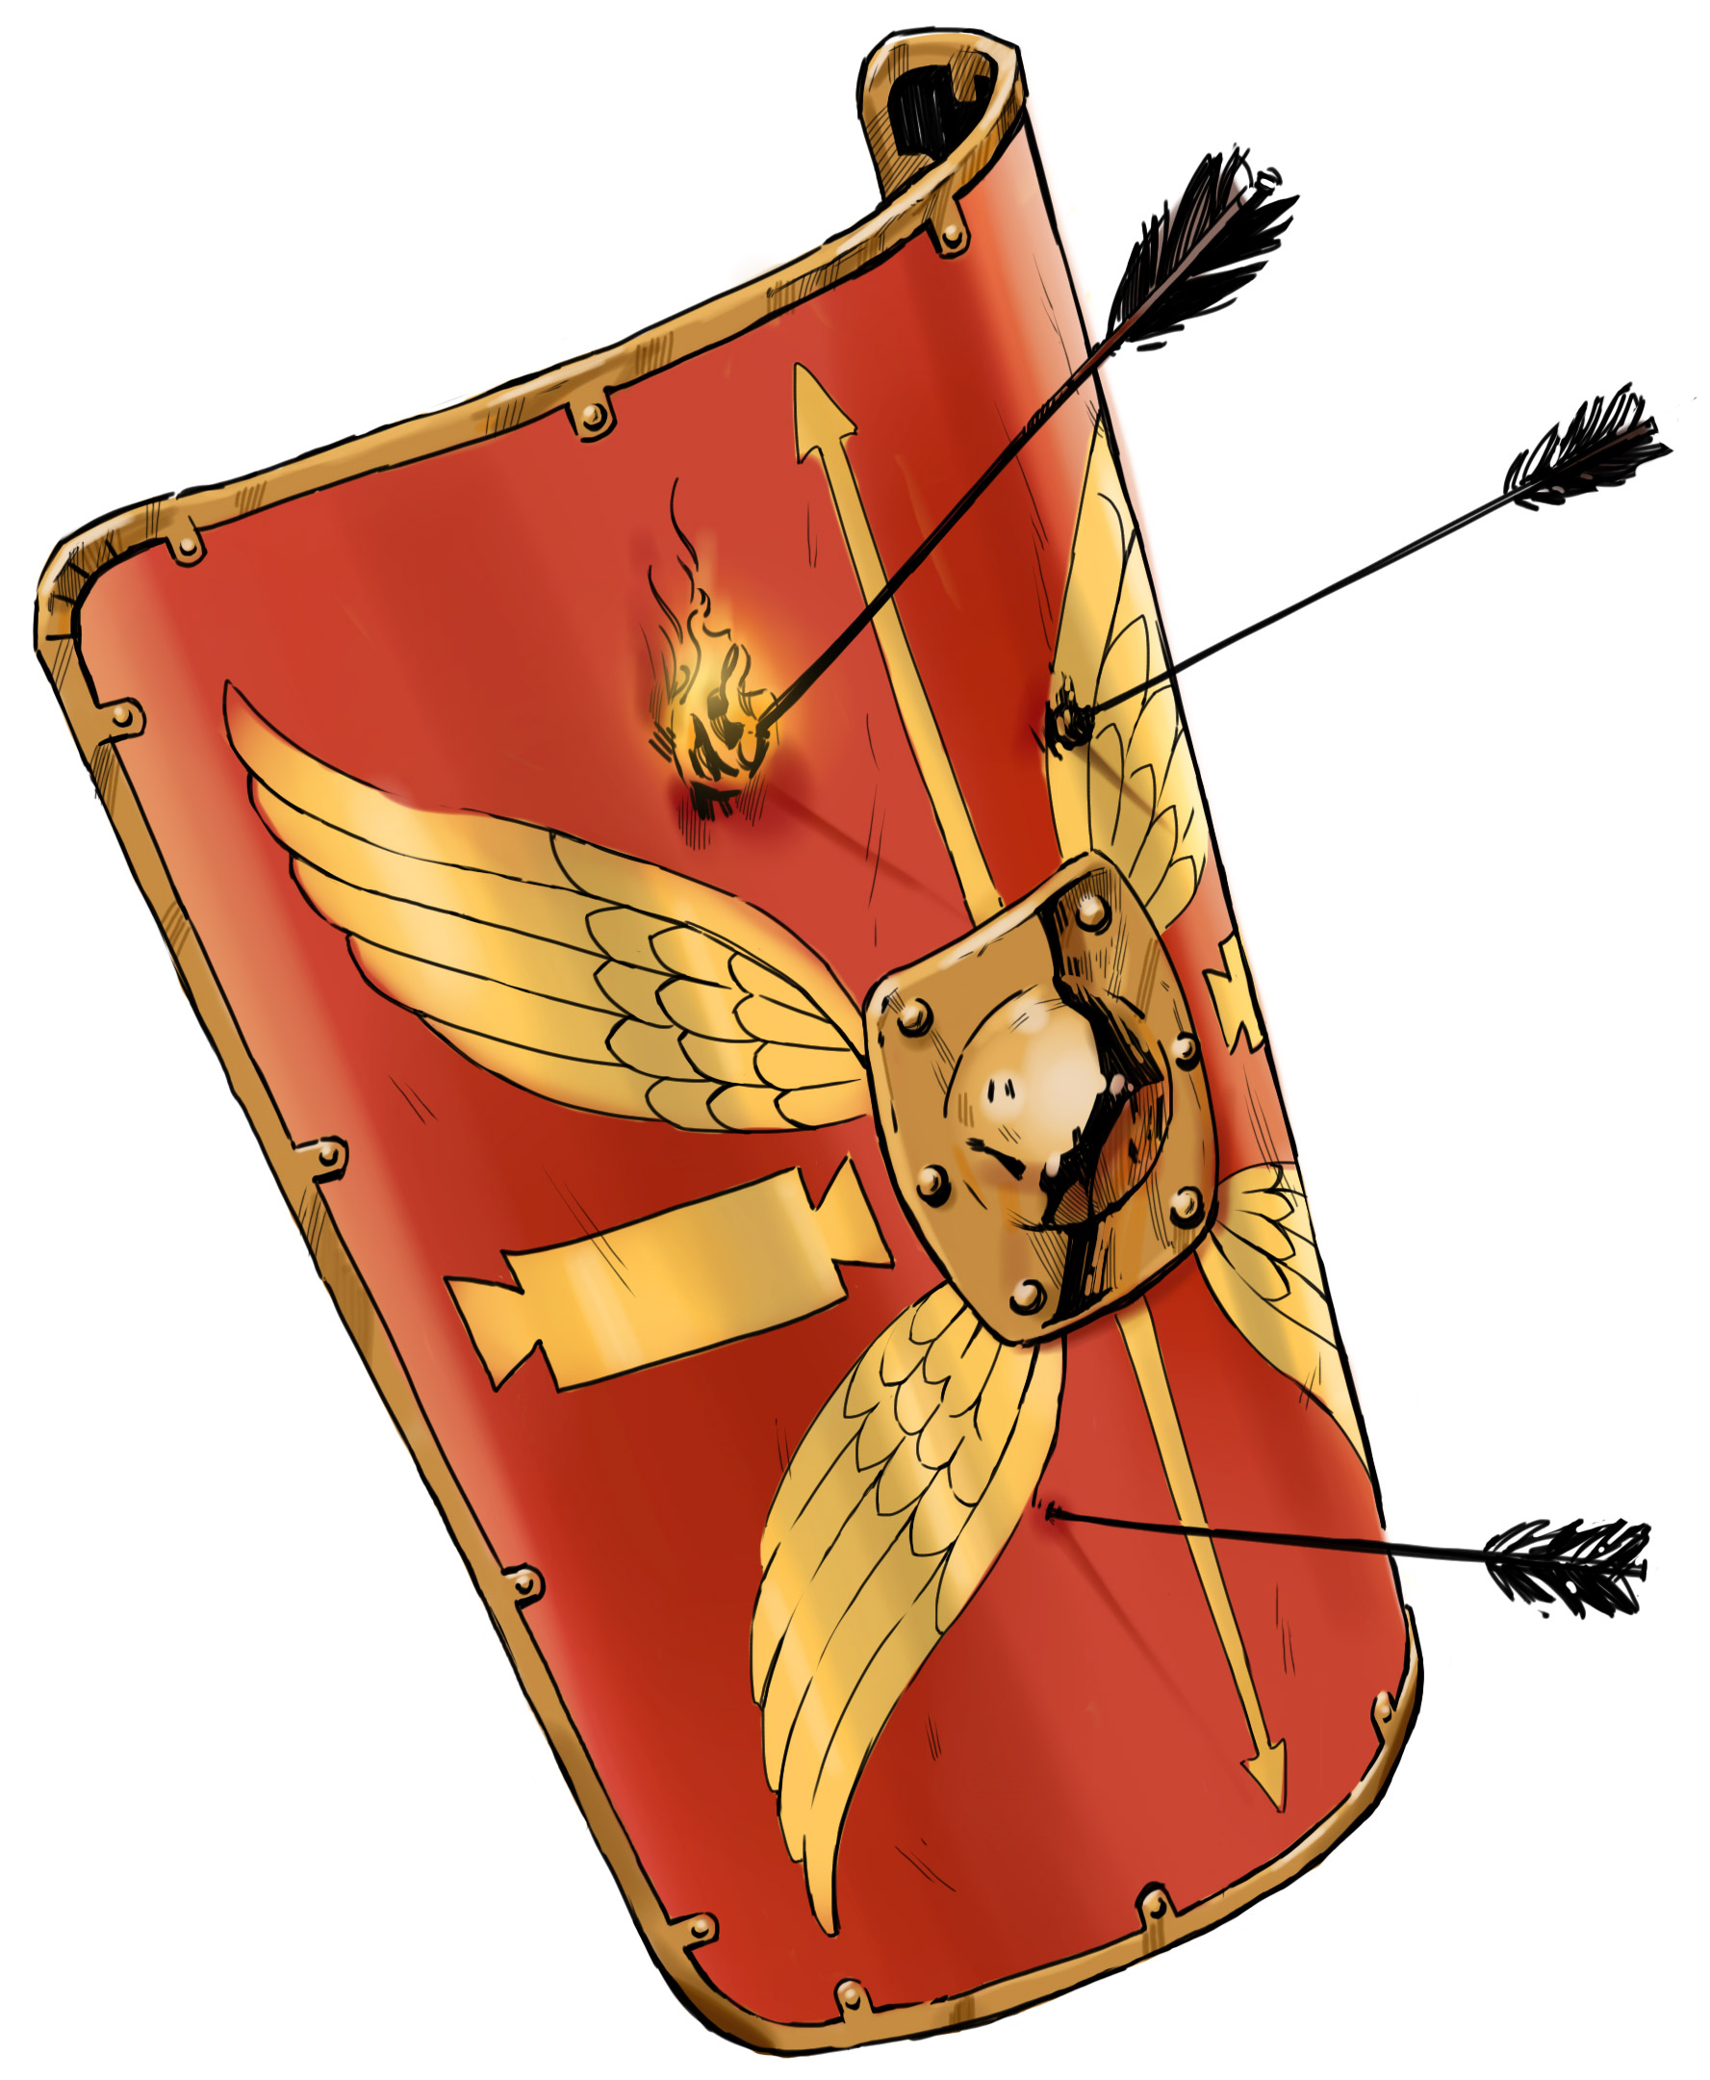
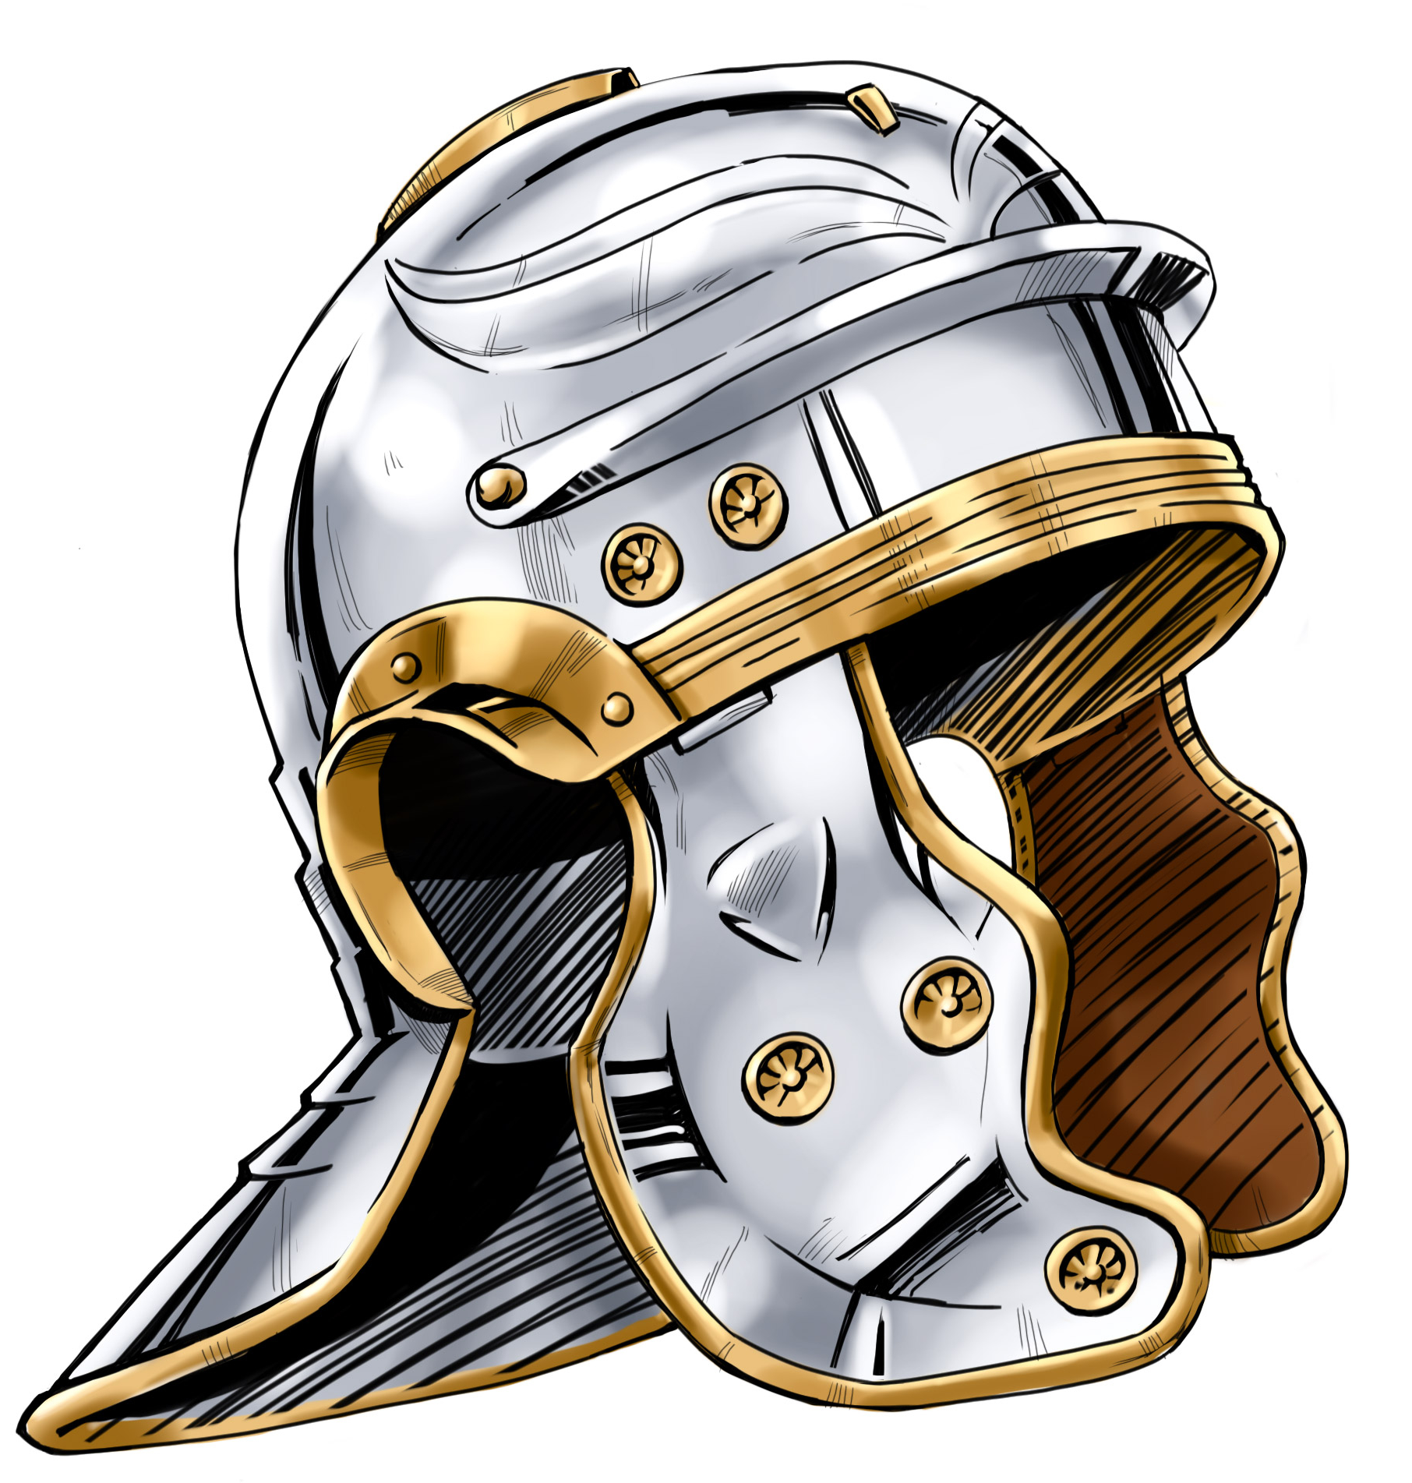
The Believer’s Armor from God for Spiritual Warfare
Belt of Truth
Learn God’s truth so it will direct your thoughts and actions in battle.
Breastplate of Righteousness
Recognize God has declared you righteous, meaning you can successfully fight for Him.
Sandals of Peace
Stand firm in your peace with God through Jesus and take the gospel of peace to the lost.
Shield of Faith
Put your faith in God and His Word to recognize and extinguish Satan’s fiery darts.
Helmet of Salvation
Fill your mind with God’s Word to protect yourself against Satan’s destructive ideas and attitudes.

