Slide 1




Slide 2

I. Parent-Child Relationships (6:1–4)
A. Exhortations to children (6:1–3)
1. Obey your parents (6:1)
What happens to children who fail to make a connection between their obedience to their parents and their obedience to God?

Slide 3
I. Parent-Child Relationships (6:1–4)
A. Exhortations to children (6:1–3)
1. Obey your parents (6:1)
2. Honor your parents (6:2, 3)
When, if ever, are children free from the duty to honor their parents?

Slide 4
I. Parent-Child Relationships (6:1–4)
A. Exhortations to children (6:1–3)
1. Obey your parents (6:1)
2. Honor your parents (6:2, 3)
When has honoring your parents proved beneficial to you?

Slide 5
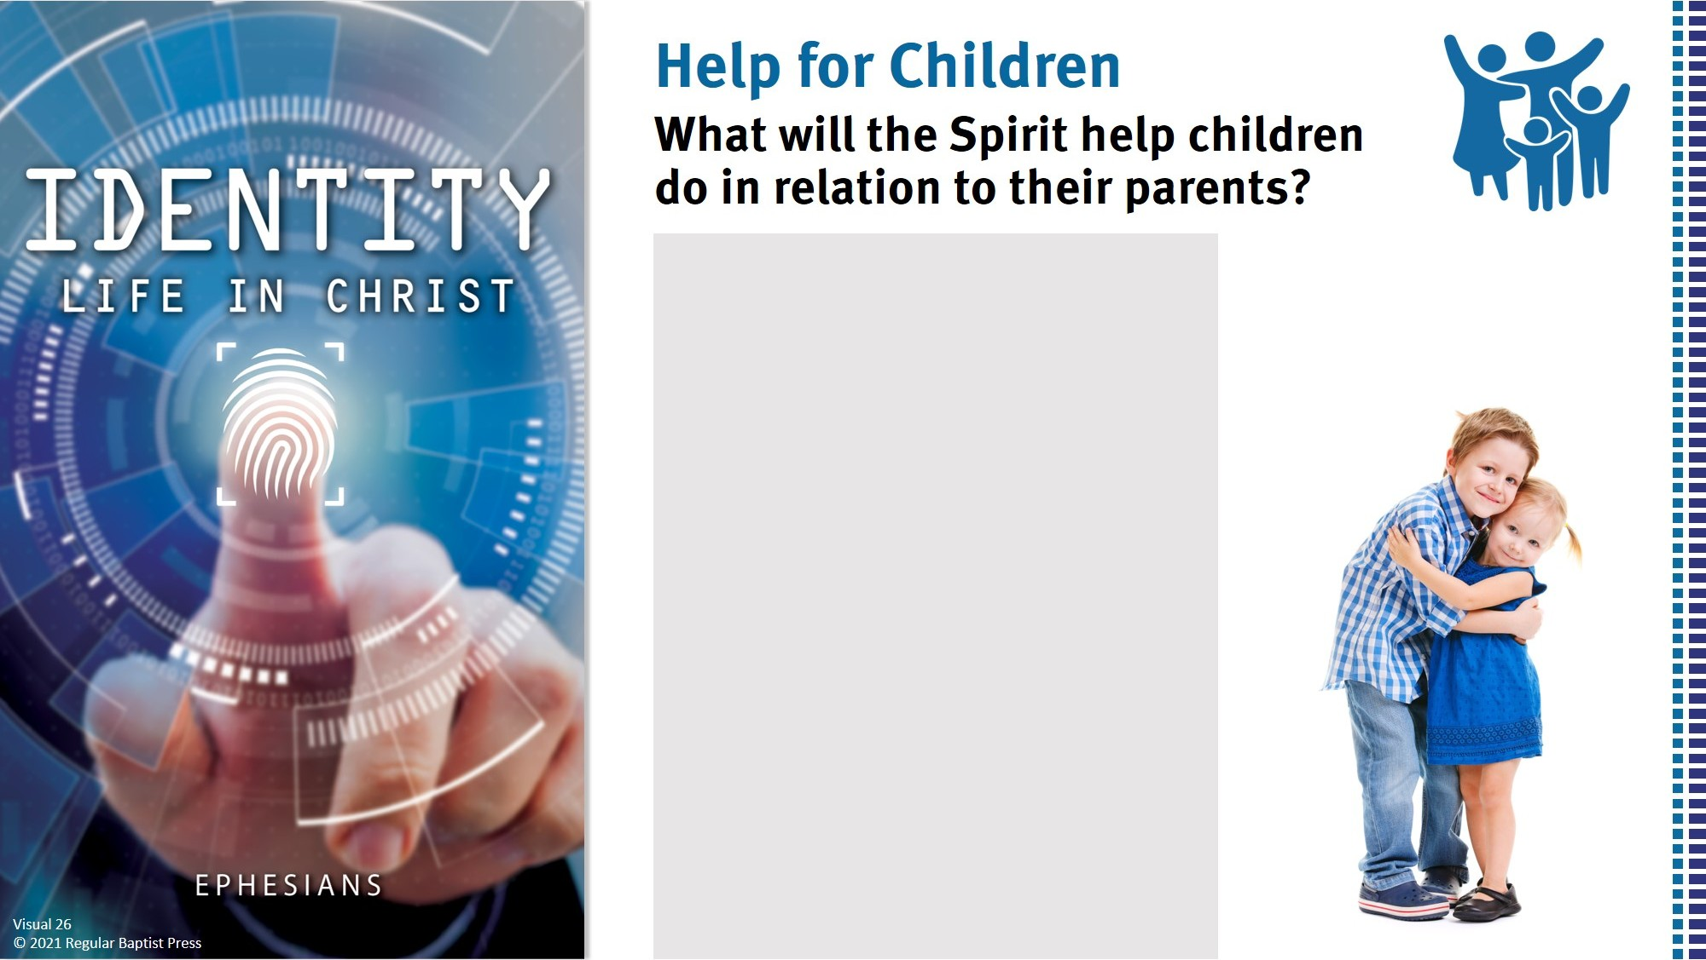
To obey when they don’t want to obey.
To obey right away.
To rejoice in obeying.
To obey when it’s unpopular.
To love their family.
To value their parents.

Slide 6
I. Parent-Child Relationships (6:1–4)
A. Exhortations to children (6:1–3)
1. Obey your parents (6:1)
2. Honor your parents (6:2, 3)
B. Exhortations to parents (6:4)
1. Don’t provoke (6:4)
What are some unreasonable demands that might provoke a child to wrath?

Slide 7
I. Parent-Child Relationships (6:1–4)
A. Exhortations to children (6:1–3)
1. Obey your parents (6:1)
2. Honor your parents (6:2, 3)
B. Exhortations to parents (6:4)
1. Don’t provoke (6:4)
What might a child learn about God from watching and listening to his or her parents?

Slide 8
I. Parent-Child Relationships (6:1–4)
A. Exhortations to children (6:1–3)
1. Obey your parents (6:1)
2. Honor your parents (6:2, 3)
B. Exhortations to parents (6:4)
1. Don’t provoke (6:4)
2. Train and admonish (6:4)
What types of discipline would help a child remember to be more responsible?

Slide 9
I. Parent-Child Relationships (6:1–4)
A. Exhortations to children (6:1–3)
1. Obey your parents (6:1)
2. Honor your parents (6:2, 3)
B. Exhortations to parents (6:4)
1. Don’t provoke (6:4)
2. Train and admonish (6:4)
Read Deuteronomy 6:4–9. Besides formal instruction, how else could parents teach their children?

Slide 10
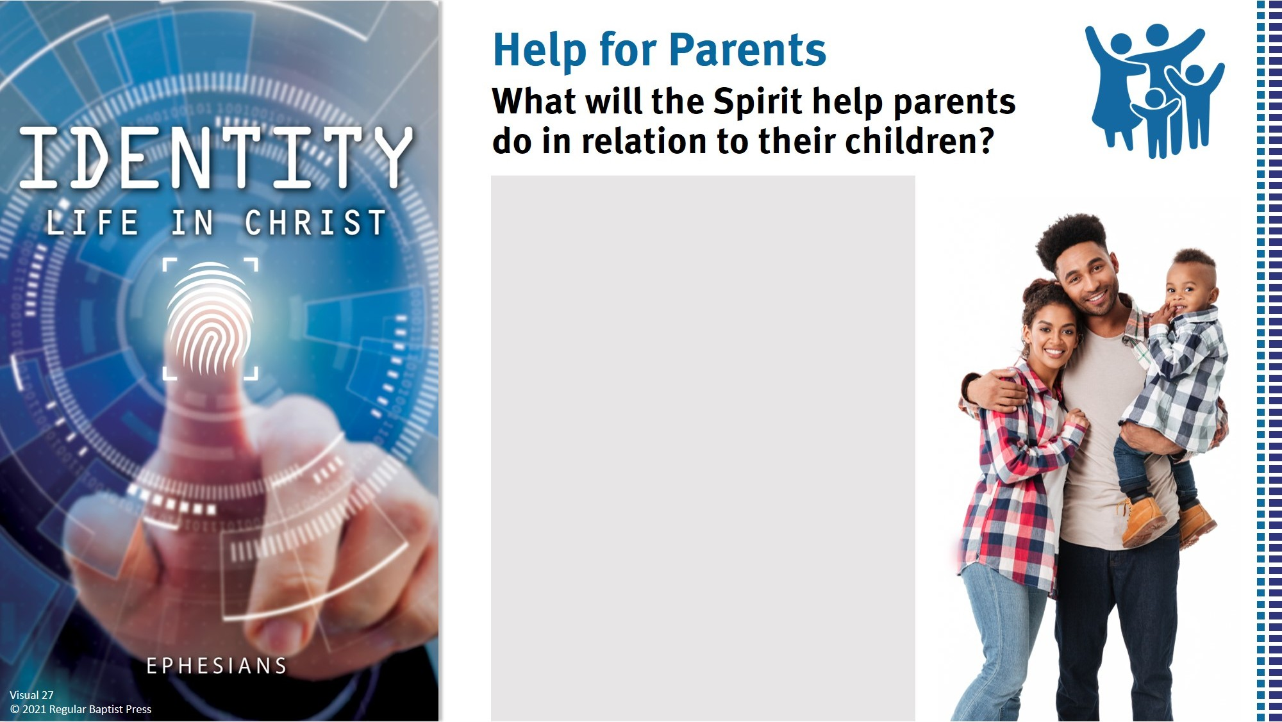
Respond wisely.
Remain consistent.
Admit wrongs.
Enjoy parenting.
Find peace in all circumstances.
Parent sacrificially.

Slide 11
II. Servant-Master Relationships (6:5–9)
A. Exhortations to servants (6:5–8)
1. Sincerely obey (6:5–7)
How aware are you of Christ’s interest in how you respond to the leadership in your workplace?

Slide 12
II. Servant-Master Relationships (6:5–9)
A. Exhortations to servants (6:5–8)
1. Sincerely obey (6:5–7)
How should seeing Christ as a believer’s ultimate boss change his or her work habits?

Slide 13
II. Servant-Master Relationships (6:5–9)
A. Exhortations to servants (6:5–8)
1. Sincerely obey (6:5–7)
Read Ephesians 5:8, 9. How should the instructions in these verses inform an employee’s approach to work?

Slide 14
II. Servant-Master Relationships (6:5–9)
A. Exhortations to servants (6:5–8)
1. Sincerely obey (6:5–7)
2. Expect reward (6:8)

Slide 15
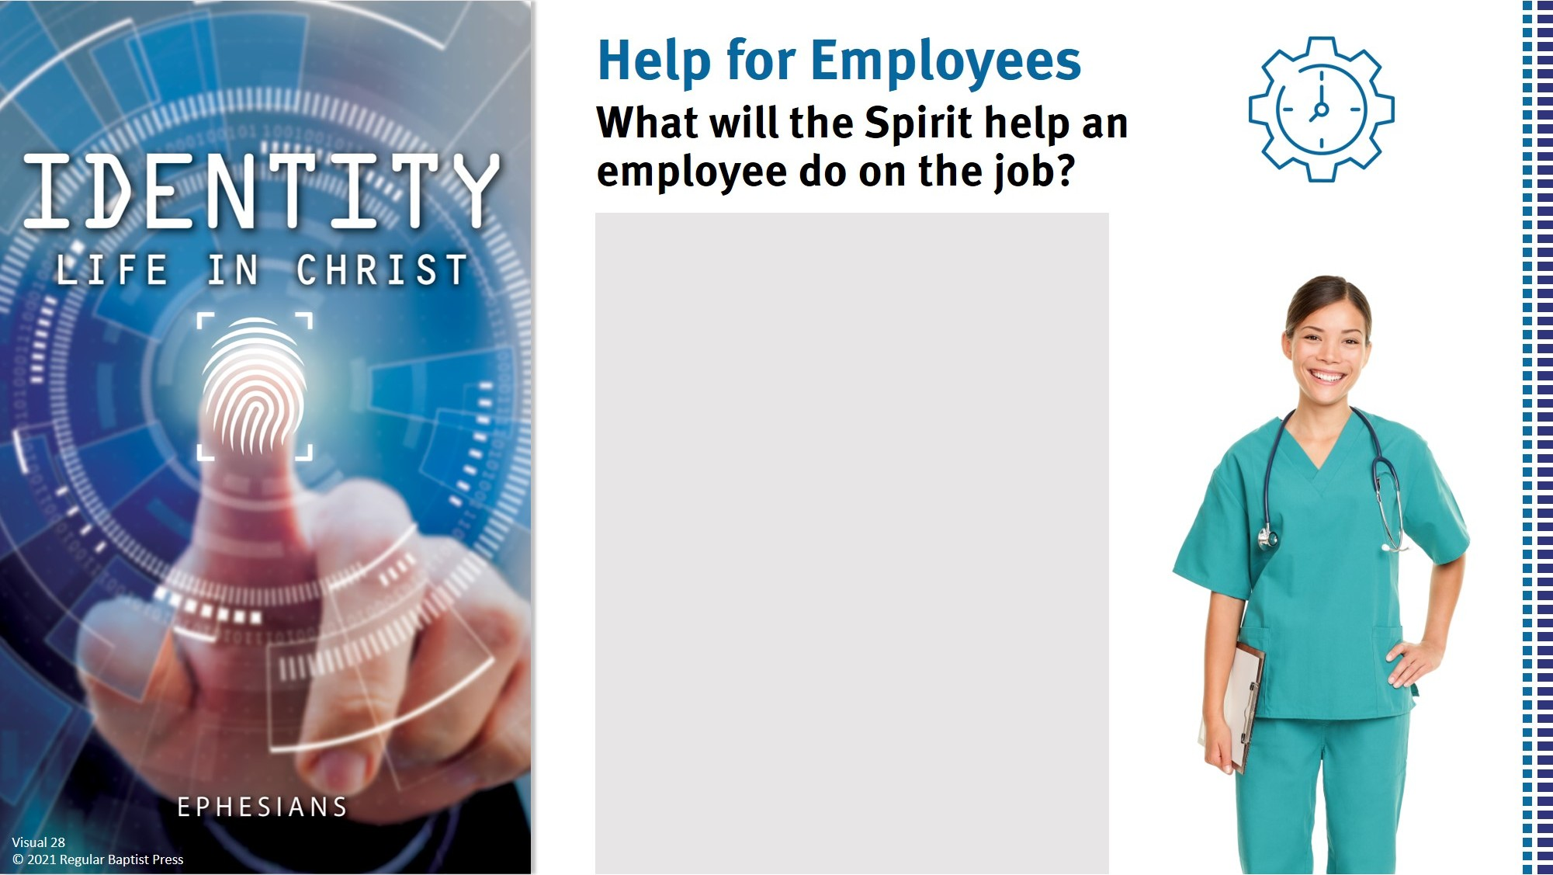
Be a good testimony and witness.
Serve well.
Endure hardship for the sake of Christ.
Rejoice to do the job.
Submit to difficult leaders.

Slide 16
II. Servant-Master Relationships (6:5–9)
A. Exhortations to servants (6:5–8)
1. Sincerely obey (6:5–7)
2. Expect reward (6:8)
B. Exhortations to masters (6:9)
1. Don’t threaten (6:9)
2. Remember your Master (6:9)

Slide 17
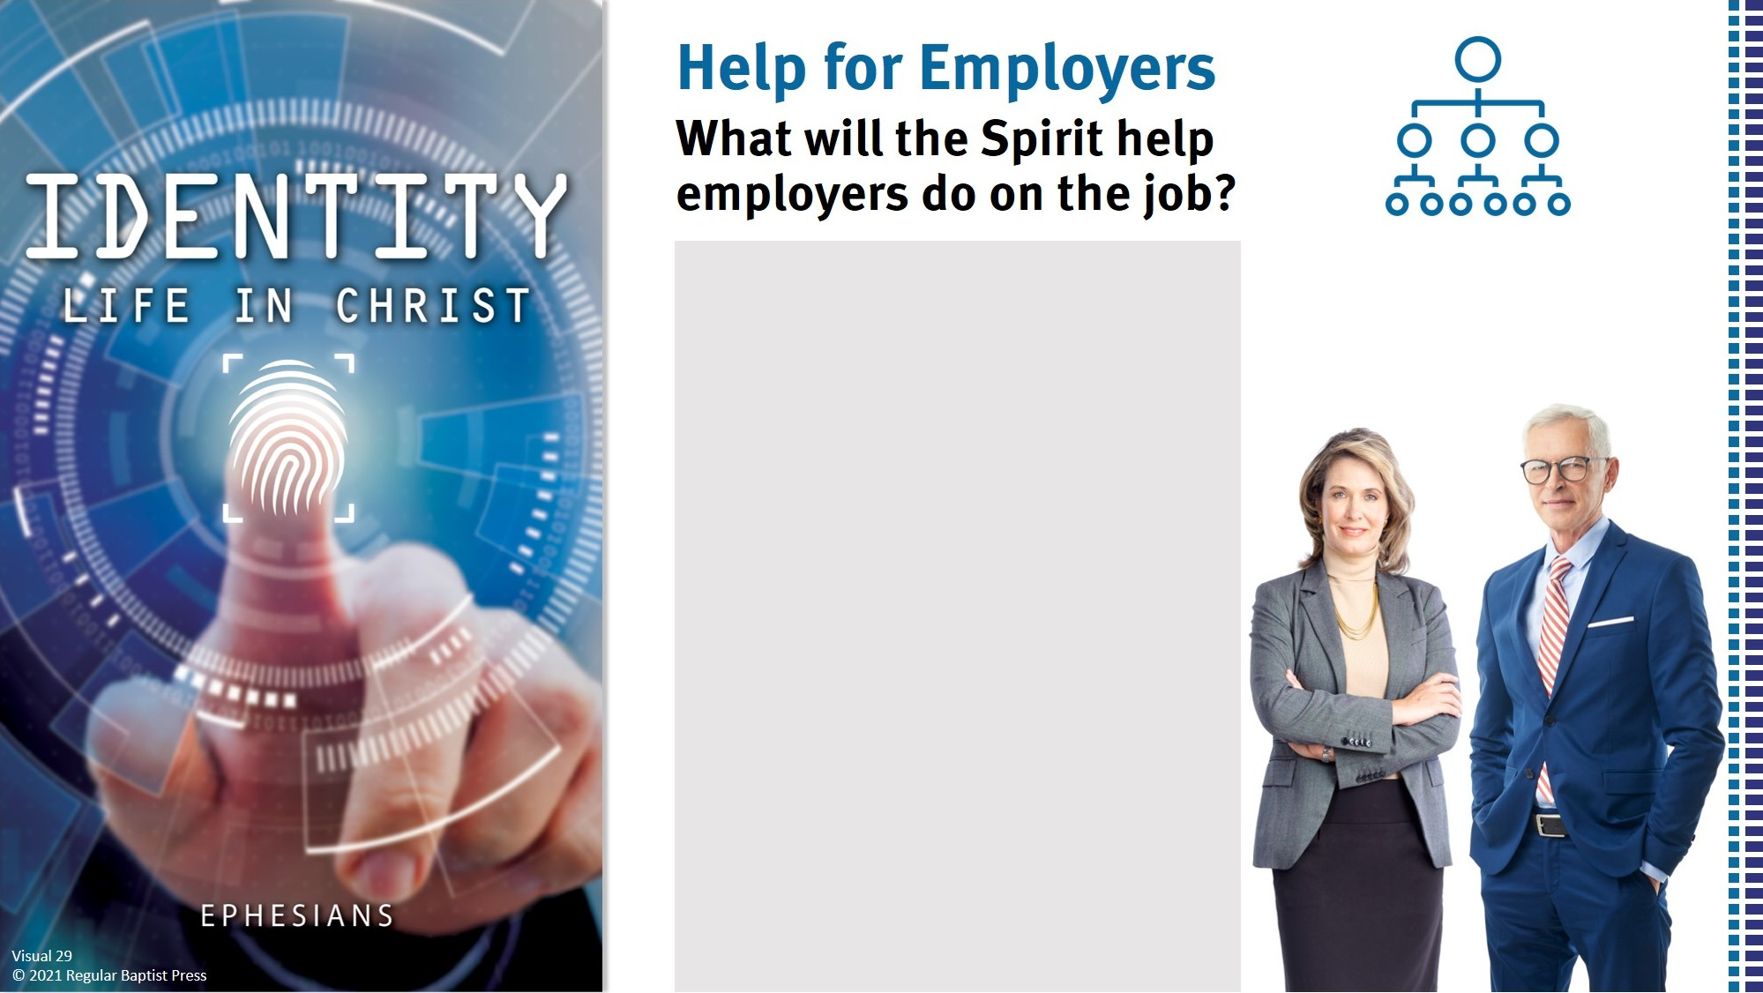
Be a good testimony and witness.
Lead with wisdom.
Handle conflict well.
Be fair to employees.
Be always joyful.

