Slide 1




Slide 2
I. Walk in Love (5:1–7)
A. Follow Christ’s sacrificial example (5:1, 2)

Slide 3
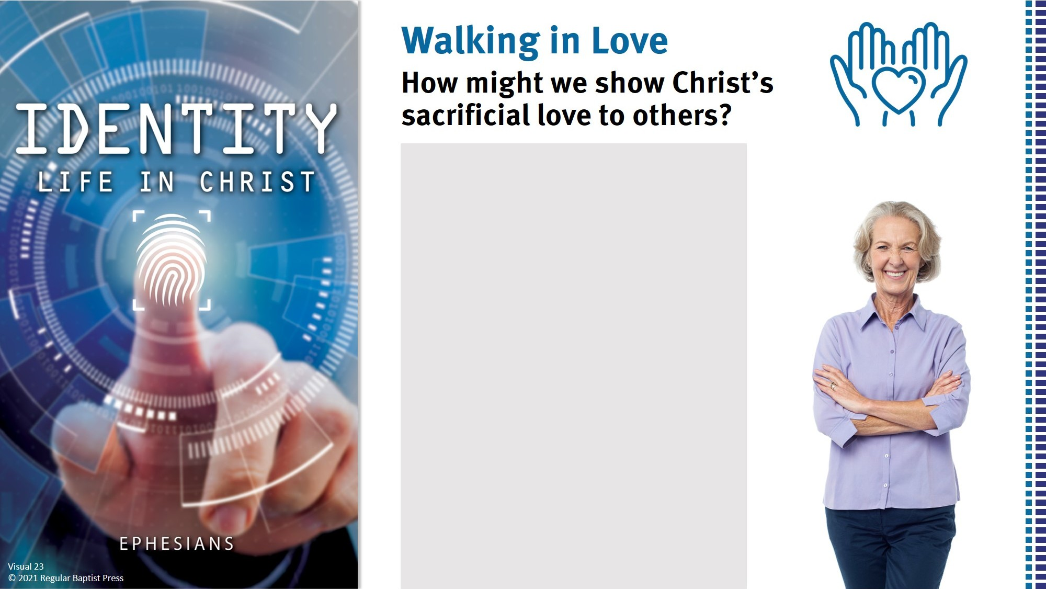
Willingly give them your time.
Give up your resources to meet their needs.
Don’t give up on them.
Love those others deem unlovable.

Slide 4

I. Walk in Love (5:1–7)
A. Follow Christ’s sacrificial example (5:1, 2)
B. Resist the world’s sinful expressions (5:3, 4)
1. Immoral behavior (5:3)
How concerned is the immoral person with the needs of others?

Slide 5
I. Walk in Love (5:1–7)
A. Follow Christ’s sacrificial example (5:1, 2)
B. Resist the world’s sinful expressions (5:3, 4)
1. Immoral behavior (5:3)
2. Covetous desires (5:3)
How concerned is the covetous person with the needs of others?

Slide 6
I. Walk in Love (5:1–7)
A. Follow Christ’s sacrificial example (5:1, 2)
B. Resist the world’s sinful expressions (5:3, 4)
1. Immoral behavior (5:3)
2. Covetous desires (5:3)
Is a rich person less likely to be covetous than a poor person? Why or why not?

Slide 7
I. Walk in Love (5:1–7)
A. Follow Christ’s sacrificial example (5:1, 2)
B. Resist the world’s sinful expressions (5:3, 4)
1. Immoral behavior (5:3)
2. Covetous desires (5:3)
3. Sinful speech (5:4)
How do Paul’s instructions in verse 4 relate to the forms of entertainment we choose?

Slide 8
I. Walk in Love (5:1–7)
A. Follow Christ’s sacrificial example (5:1, 2)
B. Resist the world’s sinful expressions (5:3, 4)
1. Immoral behavior (5:3)
2. Covetous desires (5:3)
3. Sinful speech (5:4)
What truths about God does our consistent thankfulness reveal to unbelievers?

Slide 9
I. Walk in Love (5:1–7)
A. Follow Christ’s sacrificial example (5:1, 2)
B. Resist the world’s sinful expressions (5:3, 4)
1. Immoral behavior (5:3)
2. Covetous desires (5:3)
3. Sinful speech (5:4)
C. Consider God’s coming wrath (5:5–7)
Why should knowing the wrath of God is coming on unbelievers motivate us to be different from them?

Slide 10
II. Walk in Light (5:8–17)
A. Recognize your light (5:8)
B. Depend on the Spirit (5:9, 10)
When was the last time someone noticed goodness, righteousness or truth in your life?

Slide 11
II. Walk in Light (5:8–17)
A. Recognize your light (5:8)
B. Depend on the Spirit (5:9, 10)
C. Shine brightly to expose sin (5:11–14)
When have you been tempted to blend in with the world and keep your light dim?

Slide 12
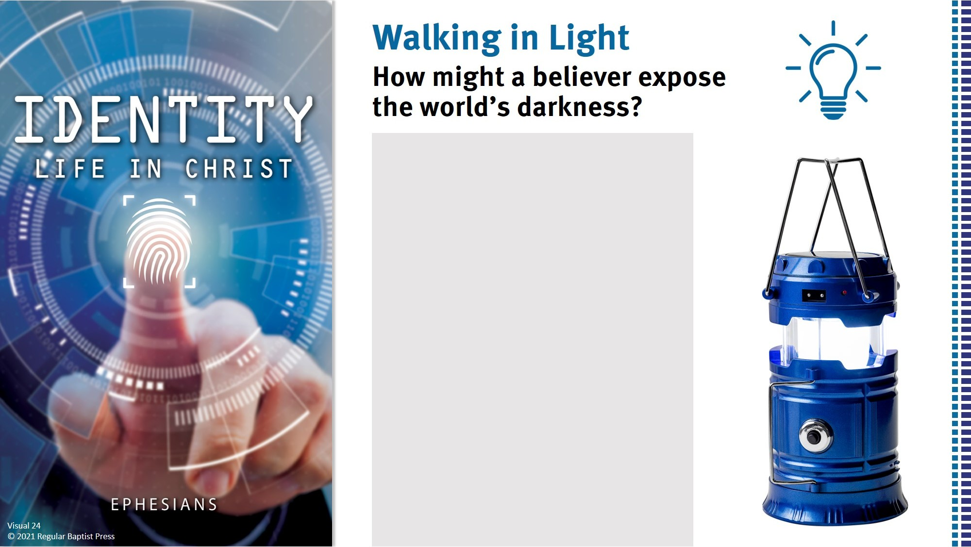
By standing up for truth.
By sharing the gospel.
By praising God publicly.
By showing others love.
By refusing to go along with the world.
By being honest in all things.

Slide 13
II. Walk in Light (5:8–17)
A. Recognize your light (5:8)
B. Depend on the Spirit (5:9, 10)
C. Shine brightly to expose sin (5:11–14)
D. Buy up opportunities to shine (5:15–17)

