Slide 1




Slide 2
I. Preface to the Mystery (Eph. 3:1–4)
A. Reception of the mystery (3:1–3)
B. Revelation of the mystery (3:3, 4)
C. Review of the definition of mystery (3:5)

Slide 3
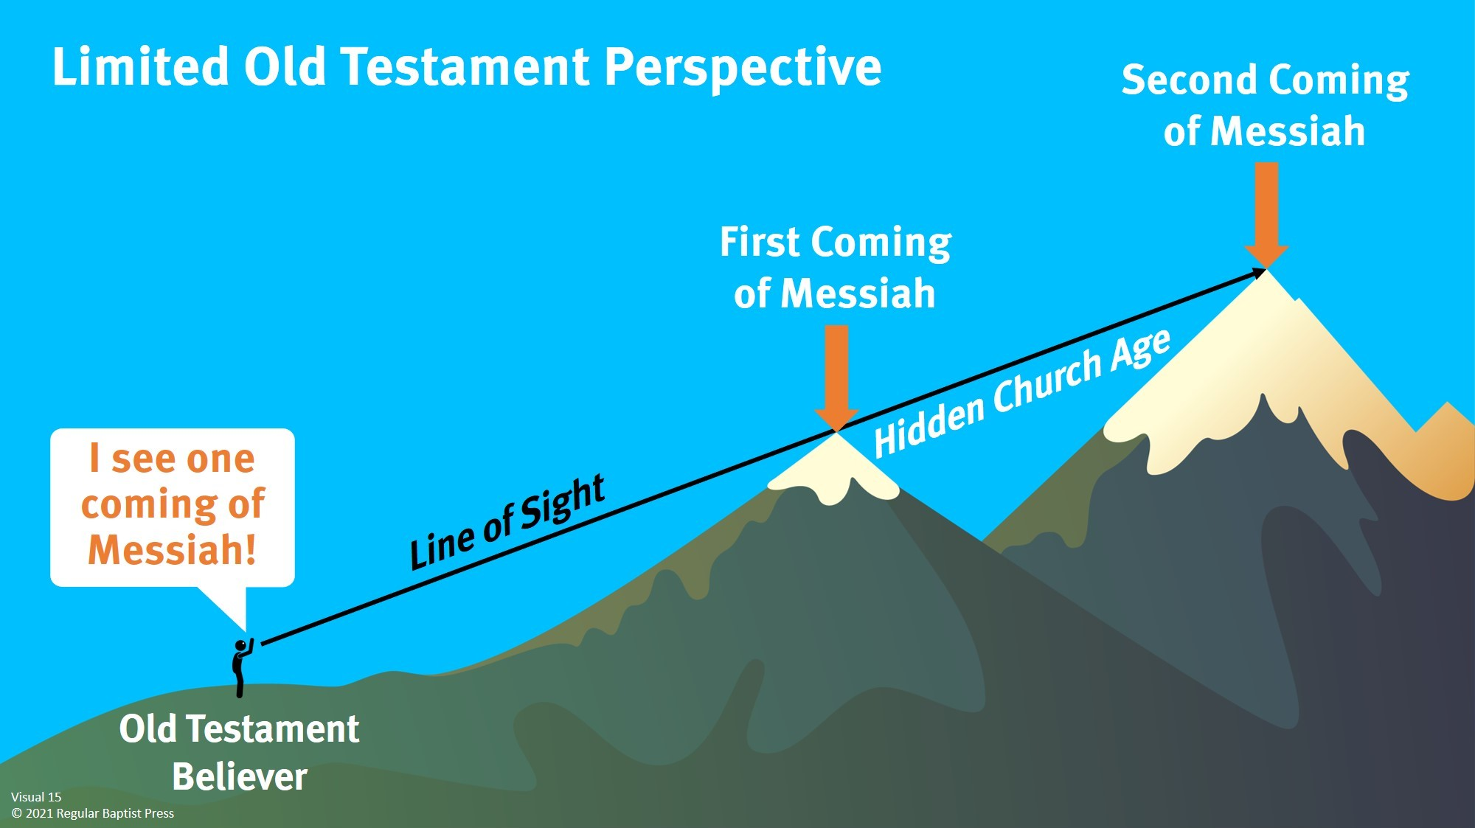

Slide 4

I. Preface to the Mystery (Eph. 3:1–4)
A. Reception of the mystery (3:1–3)
B. Revelation of the mystery (3:3, 4)
C. Review of the definition of mystery (3:5)
What part of the Bible tells us how to organize and conduct church ministry?

Slide 5
I. Preface to the Mystery (Eph. 3:1–4)
A. Reception of the mystery (3:1–3)
B. Revelation of the mystery (3:3, 4)
C. Review of the definition of mystery (3:5)
What benefits does the Old Testament provide for the church?

Slide 6
II. Content of the Mystery (3:6)
On a practical level, what are a few implications of equality in Christ regardless of cultural backgrounds?

Slide 7
II. Content of the Mystery (3:6)
Do you agree that unbelievers see Christians setting a good example of harmony with those of different cultures?

Slide 8
II. Content of the Mystery (3:6)
A. Gentiles are fellow heirs
What does is mean to be a fellow heir?

Slide 9
II. Content of the Mystery (3:6)
A. Gentiles are fellow heirs
B. Gentiles are fellow members
How else would being fellow members impact Jewish and Gentile believers in the same church?

Slide 10
II. Content of the Mystery (3:6)
A. Gentiles are fellow heirs
B. Gentiles are fellow members
C. Gentiles are fellow partakers

Slide 11
III. Minister of the Mystery (3:7–9)
A. Paul’s attitude (3:7, 8)
What can we learn from Paul’s response to being chosen by God to be the minister of the mystery?

Slide 12
III. Minister of the Mystery (3:7–9)
A. Paul’s attitude (3:7, 8)
How does humility help when reaching people cross-culturally?

Slide 13
III. Minister of the Mystery (3:7–9)
A. Paul’s attitude (3:7, 8)
B. Paul’s actions (3:8, 9)

Slide 14

Forgiveness.
Redemption.
Eternal life.
Promise of glorification.
Daily sanctification.
Peace.
Joy.
Fellowship with God.

Slide 15
IV. Reasons for the Mystery (3:10–13)
A. Provide a lesson (3:10, 11)
B. Promote boldness (3:12, 13)

Slide 16

Support missionaries.
Participate in missions.
Learn about the cultures represented around us.
Encourage our children toward missions.
Pray for cross-cultural mission works.

