Slide 1




Slide 2
I. Ephesians’ Setting and Purpose
A. Paul’s history with Ephesus

Slide 3
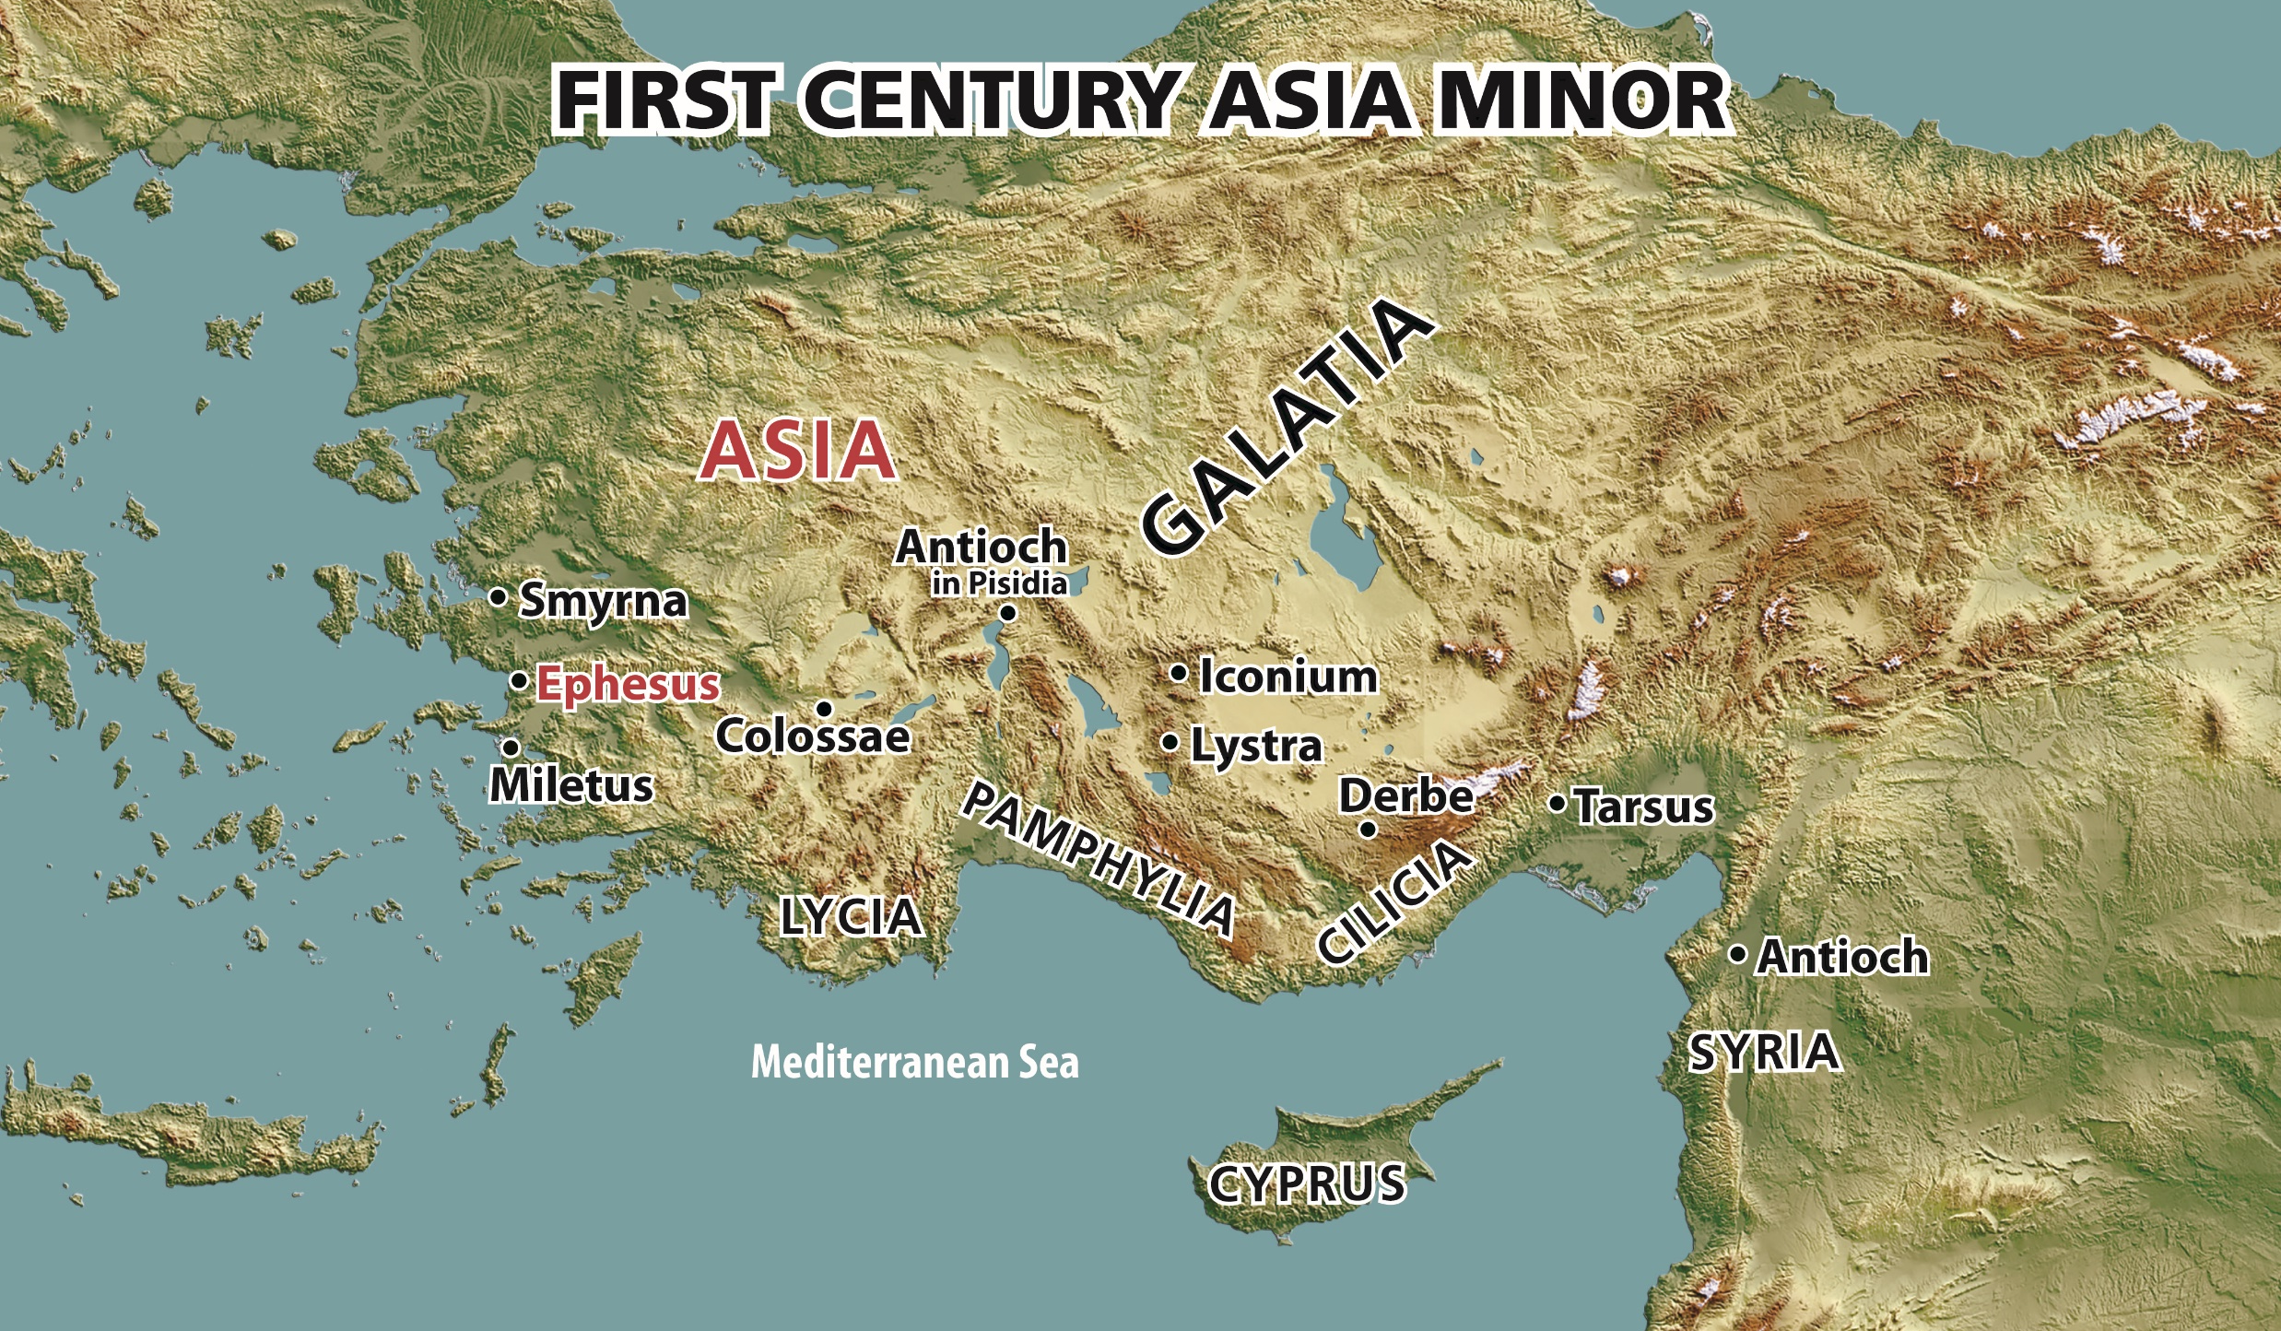

Slide 4
I. Ephesians’ Setting and Purpose
A. Paul’s history with Ephesus
B. Ephesus’ obsession with Diana

Slide 5
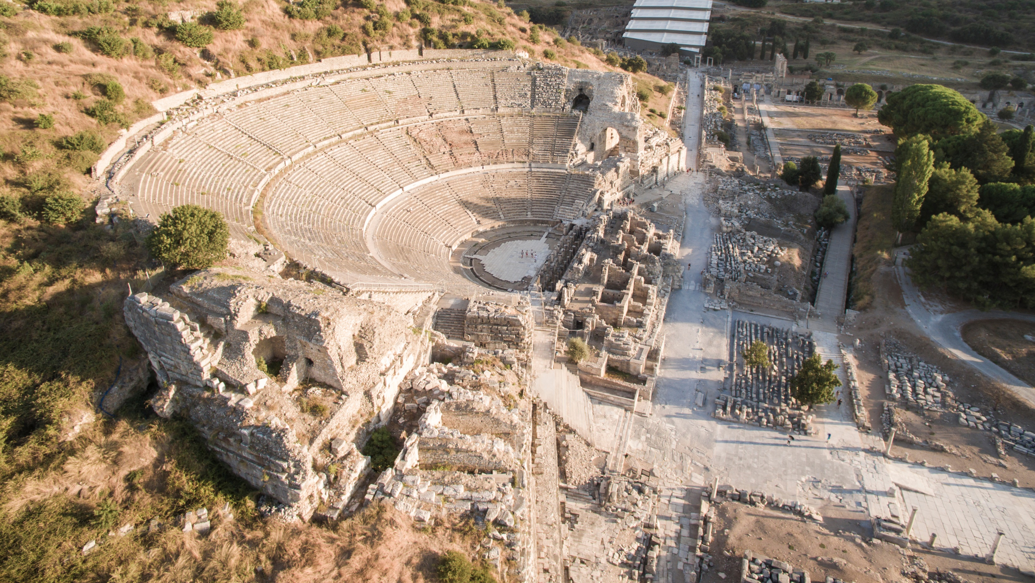


Slide 6
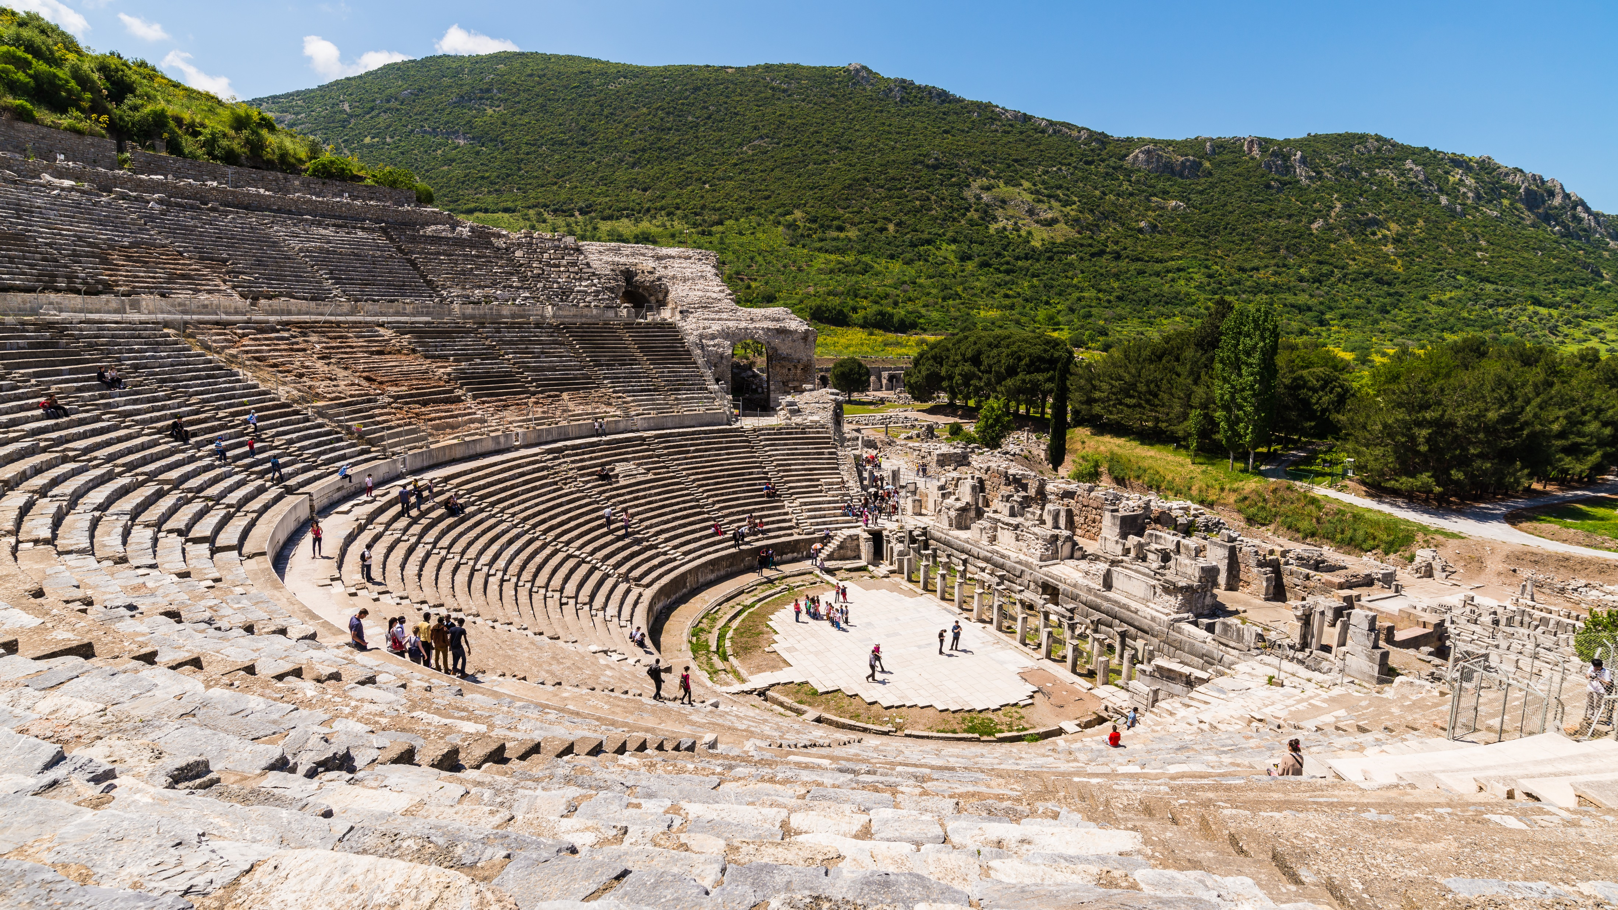

Slide 7


Slide 8
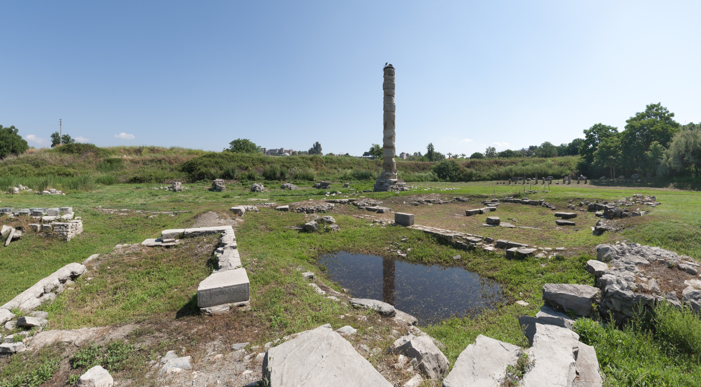


Slide 9

I. Ephesians’ Setting and Purpose
A. Paul’s history with Ephesus
B. Ephesus’ obsession with Diana
How would you describe the gratefulness the Ephesians showed to Diana, the one they believed protected life and provided for needs?

Slide 10
I. Ephesians’ Setting and Purpose
A. Paul’s history with Ephesus
B. Ephesus’ obsession with Diana
How might we show our gratefulness to God, the one true provider of our needs, including our need for salvation?

Slide 11
I. Ephesians’ Setting and Purpose
A. Paul’s history with Ephesus
B. Ephesus’ obsession with Diana
C. Paul’s emphasis on life “in Christ”

Slide 12

Physical traits
“Race”
Economic status
Sexuality
Generational groupings
Political affiliation
Religion
Level of wokeness

Slide 13
I. Ephesians’ Setting and Purpose
A. Paul’s history with Ephesus
B. Ephesus’ obsession with Diana
C. Paul’s emphasis on life “in Christ”
How has the world’s method of assigning identity influenced how you approach and interact with people?

Slide 14
II. Paul’s Personal Greeting (1:1, 2)
What might the pagan Ephesians conclude about the prospects of living devoted to God?

Slide 15
II. Paul’s Personal Greeting (1:1, 2)
When has your shared faith helped you connect with a believer from a different culture?

Slide 16
III. Introduction to Life in Christ (1:3-5)
A. God bestowed us with blessings (1:3)
How do the blessings of Christ compare to the Ephesian wealth? To what might you compare your blessings in Christ?

Slide 17
III. Introduction to Life in Christ (1:3-5)
A. God bestowed us with blessings (1:3)
B. God chose us to salvation (1:4)
Why should the doctrine of election motivate us to share the gospel? What difference will our witnessing make in eternity?

Slide 18

Speech
Thoughts
Motives
Desires
Actions
Relationships
Entertainment
Choices
Finances
Goals

Slide 19
III. Introduction to Life in Christ (1:3-5)
A. God bestowed us with blessings (1:3)
B. God chose us to salvation (1:4)
C. God predestinated us to adoption (1:5)
Why should God’s adoption of us give us a deep sense of God’s love for us?

Slide 20
Speech
Thoughts
Motives
Desires
Actions
Relationships
Entertainment
Choices
Finances
Goals

