Slide 1




Slide 2

I. Gentile Separation from Christ (2:11, 12)
A. Heathen (2:11)
B. Without Christ (2:12)
What word would you use to sum up the life of every believer before trusting Christ as Savior?

Slide 3
I. Gentile Separation from Christ (2:11, 12)
A. Heathen (2:11)
B. Without Christ (2:12)
C. Strangers (2:12)
Looking back at your life before salvation, do you see yourself as being a stranger from God? Explain.

Slide 4
II. Union in Christ (2:13–22)
A. Person of peace (2:13, 14)
How has salvation affected your relationships with fellow believers?

Slide 5
II. Union in Christ (2:13–22)
A. Person of peace (2:13, 14)
B. Program for peace (2:14–18)
What Bible accounts indicate that a “wall” separated the Jews from the Gentiles?

Slide 6
II. Union in Christ (2:13–22)
A. Person of peace (2:13, 14)
B. Program for peace (2:14–18)
How should the designation “one new man in Christ” affect the way believers today view one another?

Slide 7
II. Union in Christ (2:13–22)
A. Person of peace (2:13, 14)
B. Program for peace (2:14–18)
What might disunity in a local church do to the testimony of Christ’s work on the cross?

Slide 8
II. Union in Christ (2:13–22)
A. Person of peace (2:13, 14)
B. Program for peace (2:14–18)
How might equal access to the Father’s throne of grace serve as a unifying factor among believers?

Slide 9
II. Union in Christ (2:13–22)
A. Person of peace (2:13, 14)
B. Program for peace (2:14–18)
C. Pictures of peace (2:19–22)
1. Fellow citizens (2:19)
What responsibilities do fellow citizens have to one another? How do those responsibilities apply to the citizen relationship believers share in Christ?

Slide 10
II. Union in Christ (2:13–22)
A. Person of peace (2:13, 14)
B. Program for peace (2:14–18)
C. Pictures of peace (2:19–22)
1. Fellow citizens (2:19)
2. Family members (2:19)
What responsibilities do family members have toward one another? How do those responsibilities apply to the family relationship believers share?

Slide 11
II. Union in Christ (2:13–22)
A. Person of peace (2:13, 14)
B. Program for peace (2:14–18)
C. Pictures of peace (2:19–22)
1. Fellow citizens (2:19)
2. Family members (2:19)
3. Building blocks (2:20, 21)
How might a local church practically look to Christ as its chief cornerstone?

Slide 12
II. Union in Christ (2:13–22)
A. Person of peace (2:13, 14)
B. Program for peace (2:14–18)
C. Pictures of peace (2:19–22)
1. Fellow citizens (2:19)
2. Family members (2:19)
3. Building blocks (2:20, 21)
4. Holy temple (2:21, 22)
Why should being the temple of the Holy Spirit help believers unify?

Slide 13
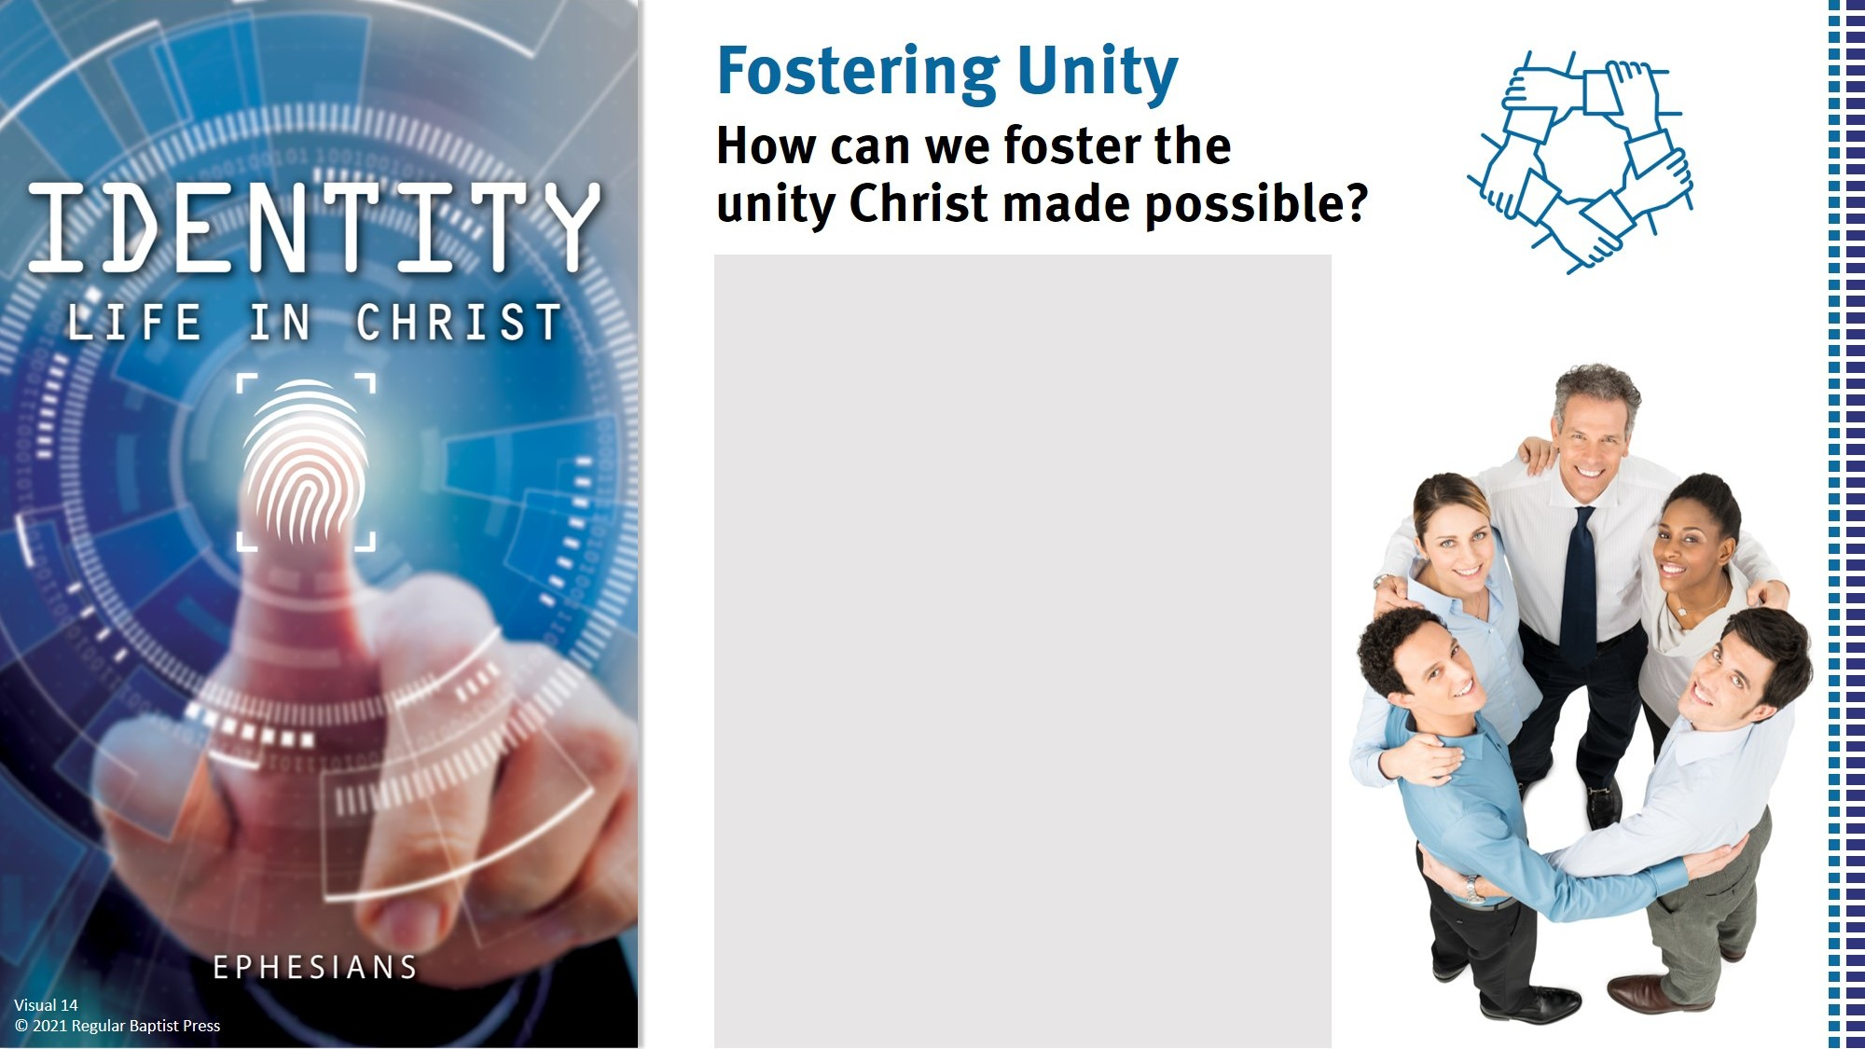
Be in the Word together.
Settle disagreements.
Live by the Holy Spirit.
Recognize good service.
Have a clear doctrinal base.
Seek to glorify God.
Pray for each other.

