Slide 1




Slide 2

I. The Character of Paul’s Prayer (1:15, 16)
A. Informed (1:15)
What is the relationship between faith and love?

Slide 3
I. The Character of Paul’s Prayer (1:15, 16)
A. Informed (1:15)
B. Intercessory (1:16)
What generally characterizes your requests in your intercessory prayers?

Slide 4
I. The Character of Paul’s Prayer (1:15, 16)
A. Informed (1:15)
B. Intercessory (1:16)
In what sense are physical needs also spiritual needs?

Slide 5
II. The Content of Paul’s Prayer (1:17–23)
A. Spiritual resource (1:17)
What might characterize a prayer from someone who fails to recognize God as the resource for spiritual change?

Slide 6
II. The Content of Paul’s Prayer (1:17–23)
A. Spiritual resource (1:17)
B. Spiritual request (1:17)
When has God answered your prayer for wisdom?

Slide 7
II. The Content of Paul’s Prayer (1:17–23)
A. Spiritual resource (1:17)
B. Spiritual request (1:17)
C. Spiritual results (1:18–23)
What actions could a believer take to gain an intimate knowledge of God?

Slide 8

Examine God’s character and ways in His Word.
Study how God interacted with Bible characters.
Read biographies of those who knew God well.
Develop close friendships with people who know God well.

Slide 9
II. The Content of Paul’s Prayer (1:17–23)
A. Spiritual resource (1:17)
B. Spiritual request (1:17)
C. Spiritual results (1:18–23)
1. Immediate result: Enlightenment (1:18)
How did your affections, intellect, and will change after becoming a believer? How have they changed since?

Slide 10
II. The Content of Paul’s Prayer (1:17–23)
A. Spiritual resource (1:17)
B. Spiritual request (1:17)
C. Spiritual results (1:18–23)
1. Immediate result: Enlightenment (1:18)
2. Ultimate result: Knowledge (1:18–23)
a. Of the hope of His calling (1:18)
b. Of the riches of His inheritance (1:18)
According to 1 Peter 2:9, why should believers not belittle themselves, as if they are worthless?

Slide 11
II. The Content of Paul’s Prayer (1:17–23)
A. Spiritual resource (1:17)
B. Spiritual request (1:17)
C. Spiritual results (1:18–23)
1. Immediate result: Enlightenment (1:18)
2. Ultimate result: Knowledge (1:18–23)
a. Of the hope of His calling (1:18)
b. Of the riches of His inheritance (1:18)
c. Of the greatness of His power (1:19–23)
How should the availability of God’s resurrection power affect your prayer life?

Slide 12
II. The Content of Paul’s Prayer (1:17–23)
A. Spiritual resource (1:17)
B. Spiritual request (1:17)
C. Spiritual results (1:18–23)
1. Immediate result: Enlightenment (1:18)
2. Ultimate result: Knowledge (1:18–23)
a. Of the hope of His calling (1:18)
b. Of the riches of His inheritance (1:18)
c. Of the greatness of His power (1:19–23)
How should knowing the permanence of Christ’s position help us as believers in the present?

Slide 13
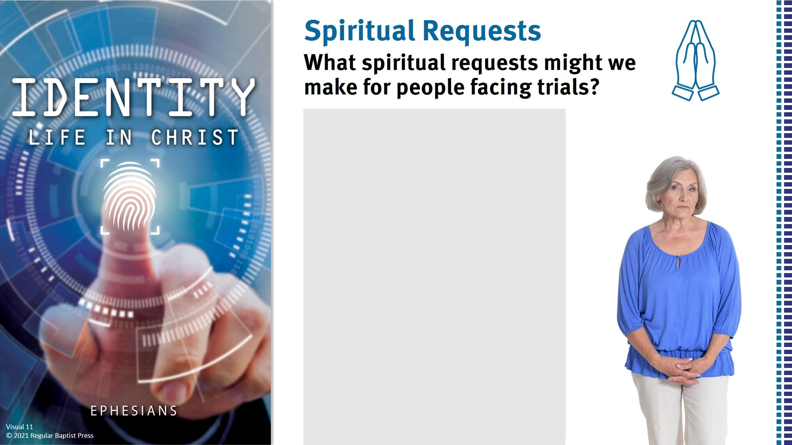
For growth in their faith
For abiding joy
For knowledge of God
For wisdom
For a strong testimony
For strength to endure
For a desire to glorify God

