Slide 1




Slide 2
I. Why God Blessed Us (1:6)

Slide 3
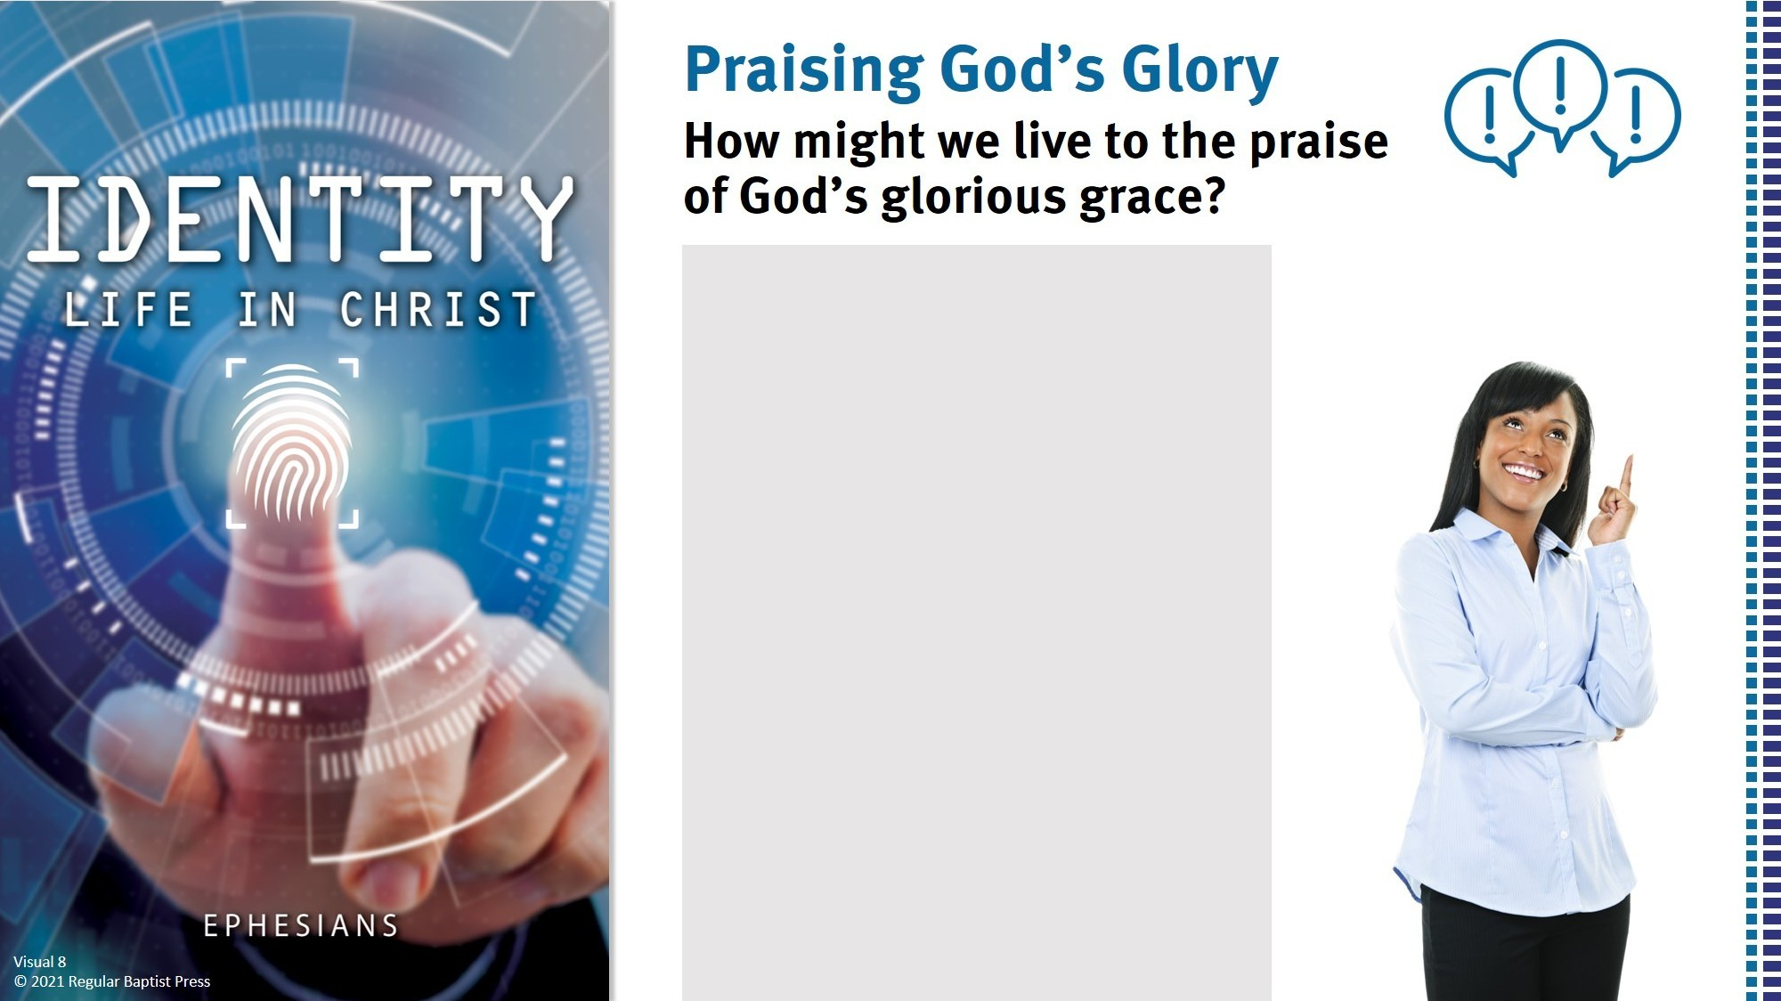
By sharing the gospel.
By testifying of God’s
enabling.
By thanking God for His
grace.
By depending on God’s
grace every day.
By discipling others to
appreciate God’s grace.

Slide 4

II. How God Blessed Us (1:7–14)
A. Redemption (1:7–10)
According to Hebrews 9:22, Why did our redemption require the shedding of Jesus’ blood?

Slide 5
II. How God Blessed Us (1:7–14)
A. Redemption (1:7–10)
1. Its means (1:7b)
What might we gain from remembering the awful state from which God redeemed us?

Slide 6
II. How God Blessed Us (1:7–14)
A. Redemption (1:7–10)
1. Its means (1:7b)
2. Its meaning (1:7c)

Slide 7
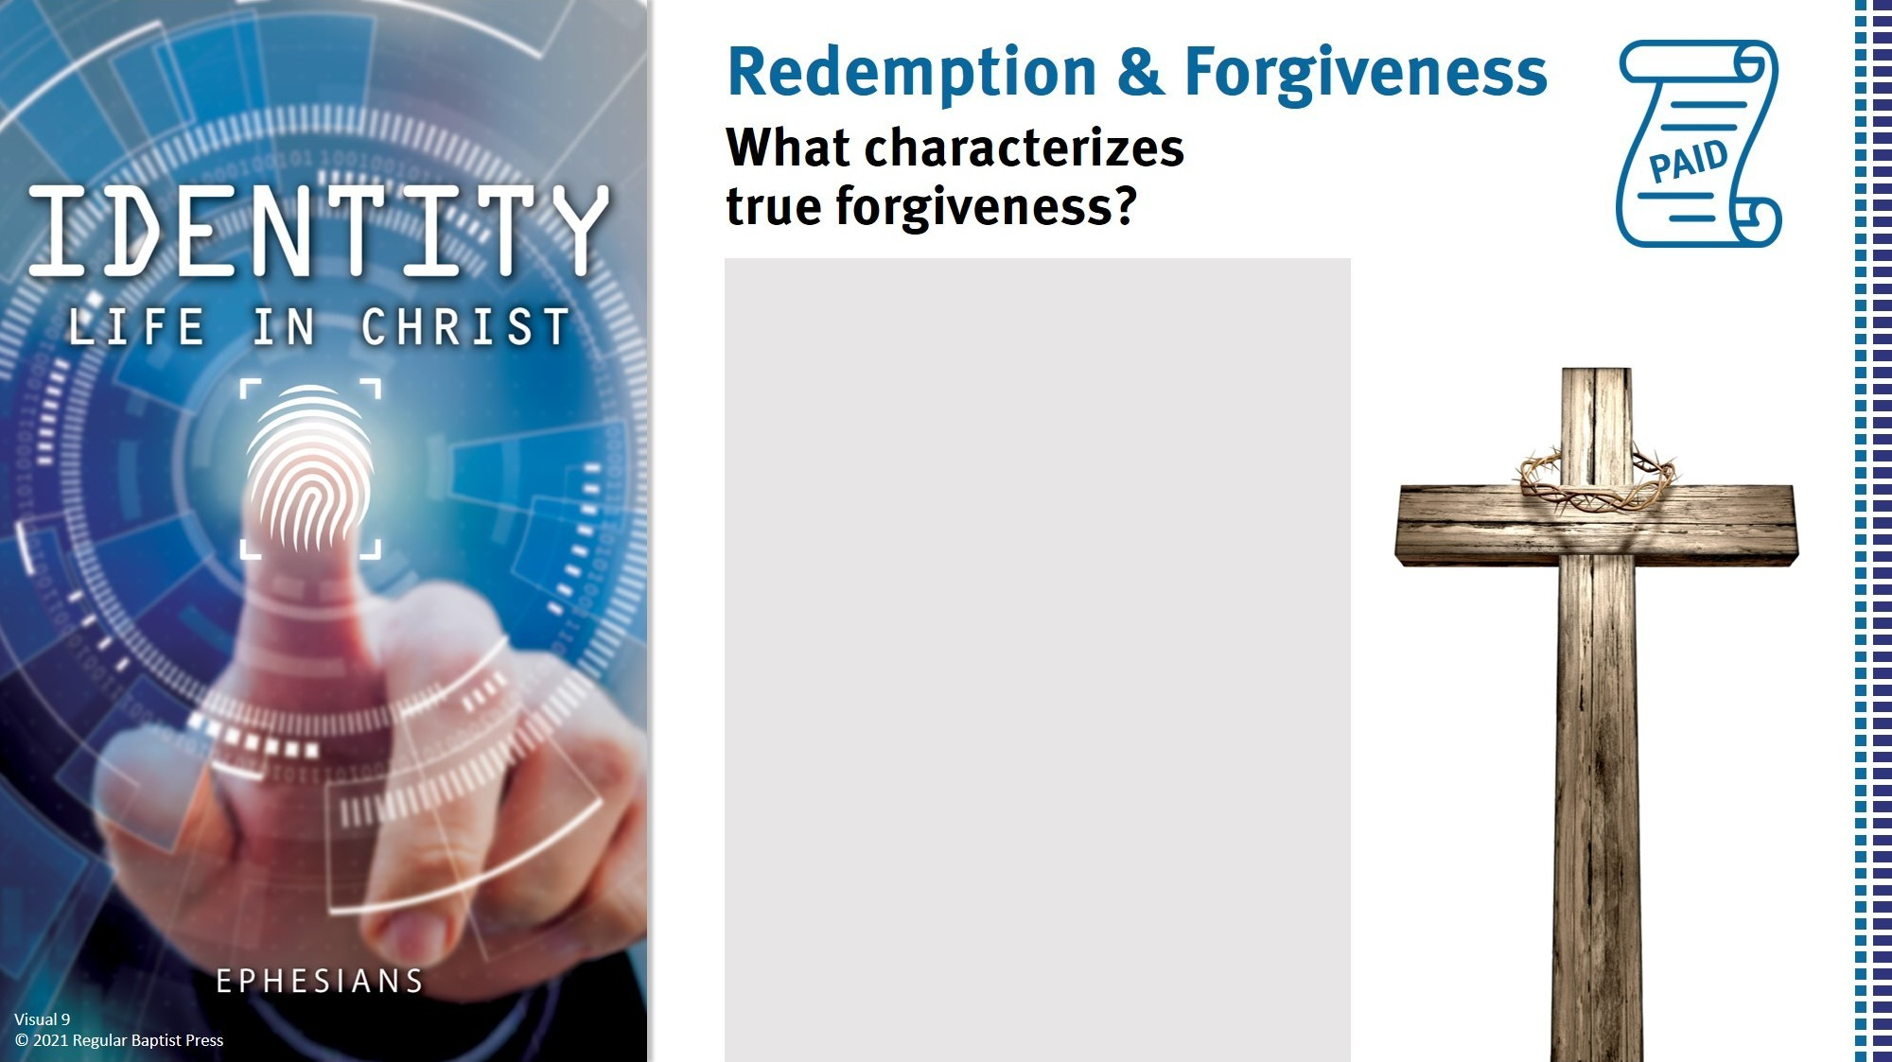
PAID
No one keeps a grudge.
No one mentions the
offense.
Love flows freely.
The forgiven expresses
gratitude.

Slide 8
II. How God Blessed Us (1:7–14)
A. Redemption (1:7–10)
1. Its means (1:7b)
2. Its meaning (1:7c)
According to 1 Peter 1:18–22, what has our redemption done for us?

Slide 9
II. How God Blessed Us (1:7–14)
A. Redemption (1:7–10)
1. Its means (1:7b)
2. Its meaning (1:7c)
3. Its measure (1:7d–10)
What did God communicate to us by abundantly pouring out His grace toward us?

Slide 10
II. How God Blessed Us (1:7–14)
A. Redemption (1:7–10)
1. Its means (1:7b)
2. Its meaning (1:7c)
3. Its measure (1:7d–10)
How should we respond to the revelation of the culmination of all things in Christ?

Slide 11
II. How God Blessed Us (1:7–14)
A. Redemption (1:7–10)
1. Its means (1:7b)
2. Its meaning (1:7c)
3. Its measure (1:7d–10)
B. Inheritance (1:11–14)
1. For the Jews (1:11, 12)
Why did God devise a plan for Jewish believers?

Slide 12
II. How God Blessed Us (1:7–14)
A. Redemption (1:7–10)
1. Its means (1:7b)
2. Its meaning (1:7c)
3. Its measure (1:7d–10)
B. Inheritance (1:11–14)
1. For the Jews (1:11, 12)
2. For the Gentiles (1:13, 14)
Why is certainty about a future inheritance such an attractive prospect in our world today?

Slide 13
II. How God Blessed Us (1:7–14)
A. Redemption (1:7–10)
1. Its means (1:7b)
2. Its meaning (1:7c)
3. Its measure (1:7d–10)
B. Inheritance (1:11–14)
1. For the Jews (1:11, 12)
2. For the Gentiles (1:13, 14)
How should knowing that the Holy Spirit is the keeper of our spiritual inheritance affect our hope for the future?

