Slide 1


Slide 2
I. Reasons for Good Works
A. To fulfill our purpose
B. To prepare for the Judgment Seat of Christ
C. To imitate Christ

Slide 3
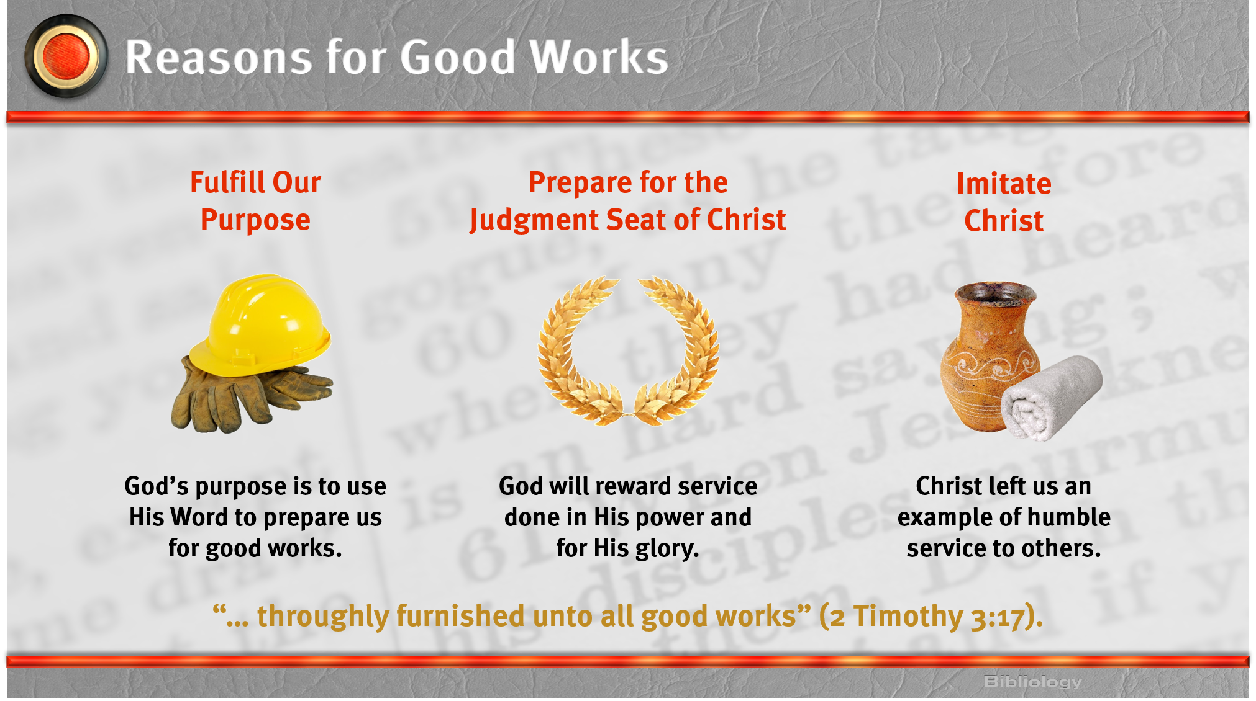

Slide 4
II. Implementing Good Works
A. Prepare your heart

Slide 5
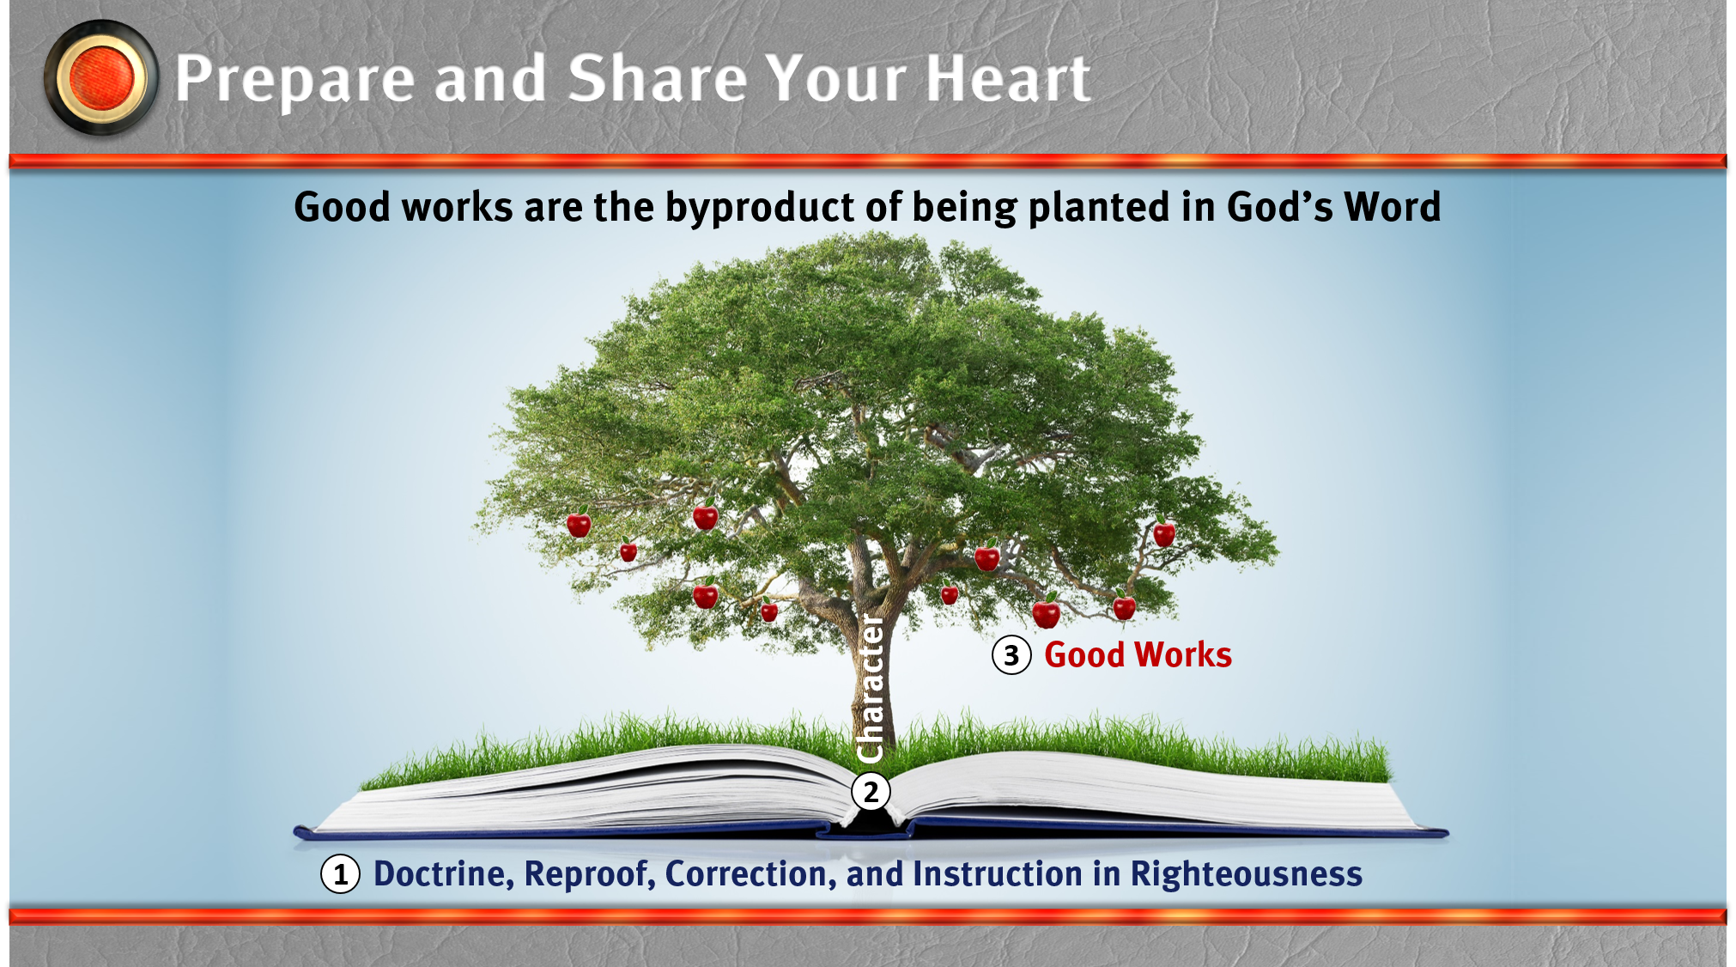

Slide 6
II. Implementing Good Works
A. Prepare your heart
B. Share your heart

Slide 7
III. Effects of Good Works
A. Hunger for the Word
B. Opportunities for evangelism
C. Fellowship with God

