Slide 1


Slide 2
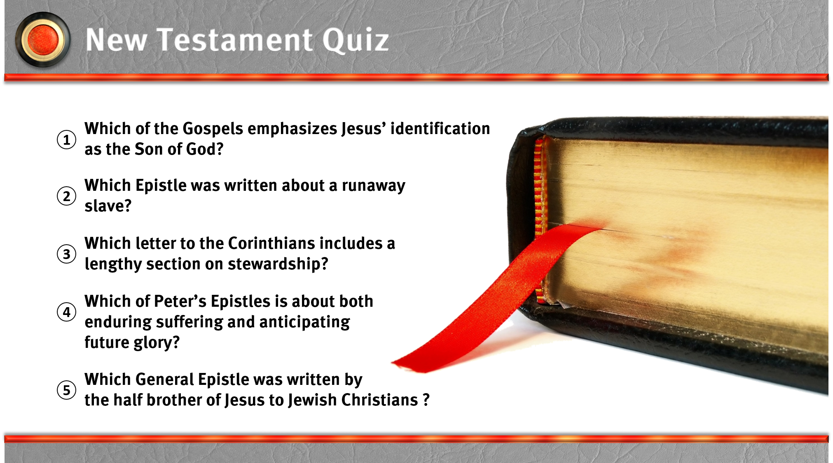

Slide 3
I. The Gospels and Acts

Slide 4
II. The Pauline Epistles

Slide 5
III. The General Epistles and Revelation

