Slide 1


Slide 2
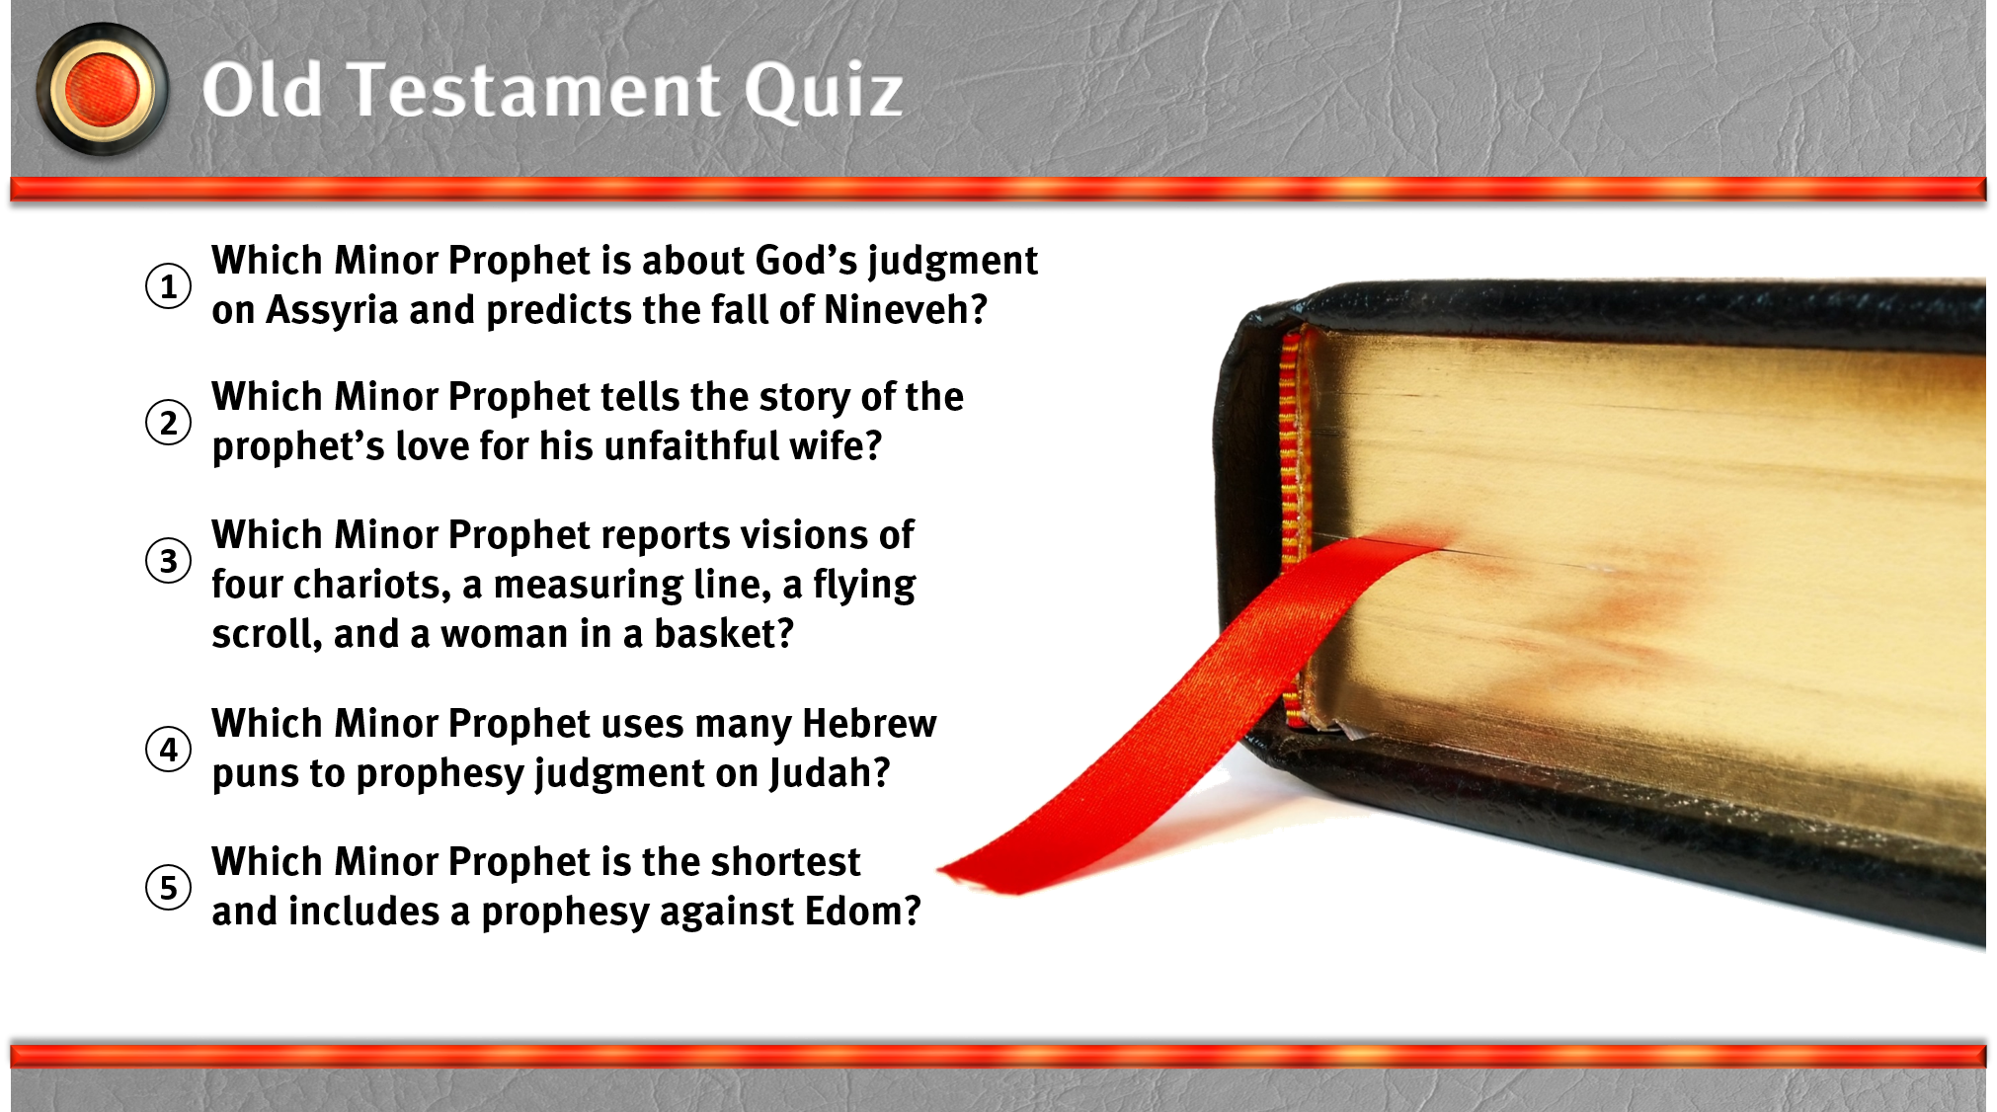

Slide 3
I. The Books of the Law

Slide 4
II. The Books of History

Slide 5
III. The Books of Poetry

Slide 6
IV. The Books of Prophecy
A. Major Prophets
B. Minor Prophets

