Slide 1


Slide 2


Slide 3
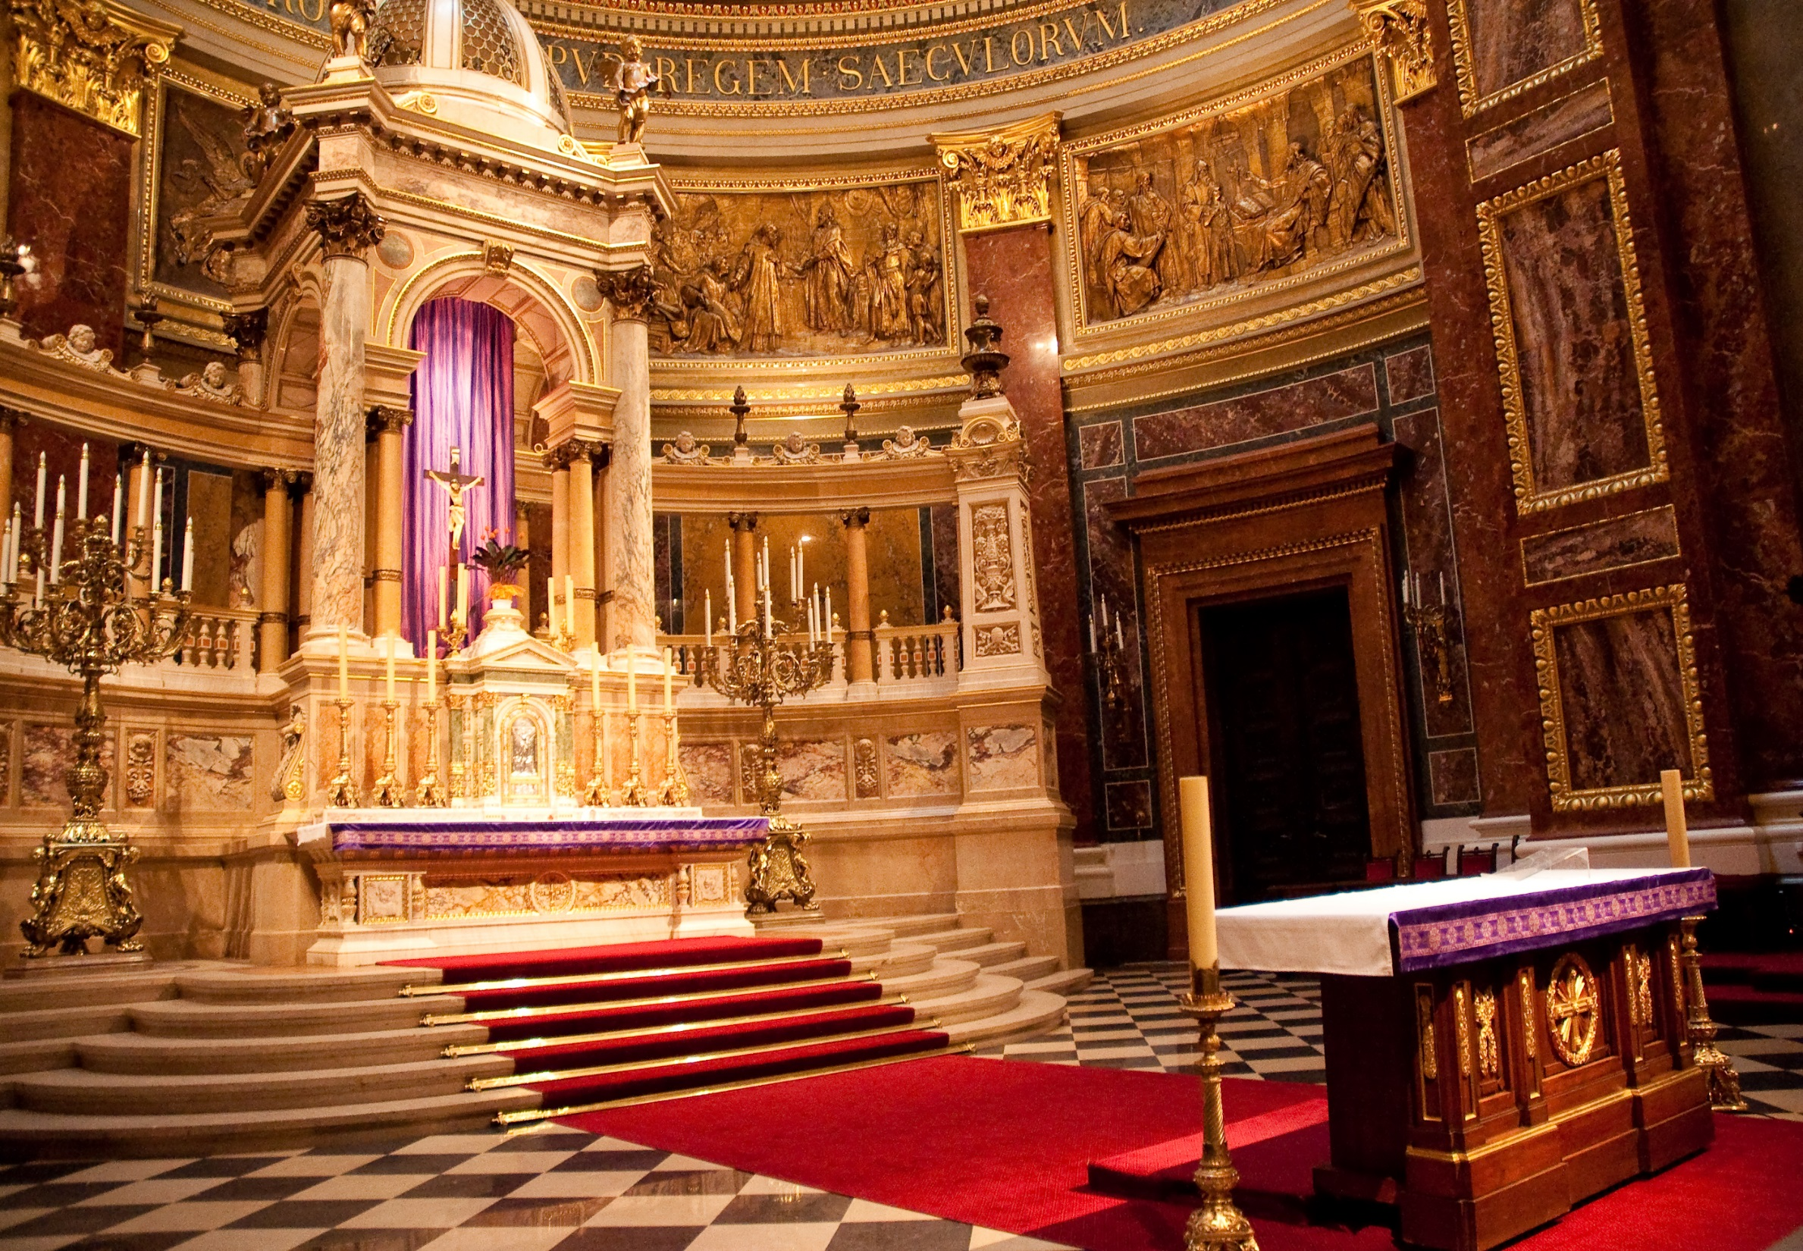

Slide 4
I. Views on the Authority of Scripture
A. Sola scriptura
B. Scripture plus tradition

Slide 5
II. Biblical Evidence for Sola Scriptura
A. Bible’s basis for faith and practice
B. Jesus’ rebuke of Pharisaical tradition
C. Bible’s warnings about changing Scripture
D. Inclusion of apostolic writings in the Canon
E. God’s commands concerning revelation
F. Bible’s perspicuity

Slide 6
