Slide 1


Slide 2
I. God’s Purpose Includes Communication
A. God made people in His image
B. God gave people His Word

Slide 3
II. God’s Process for Communication
A. The believer’s job
B. The Spirit’s job

Slide 4
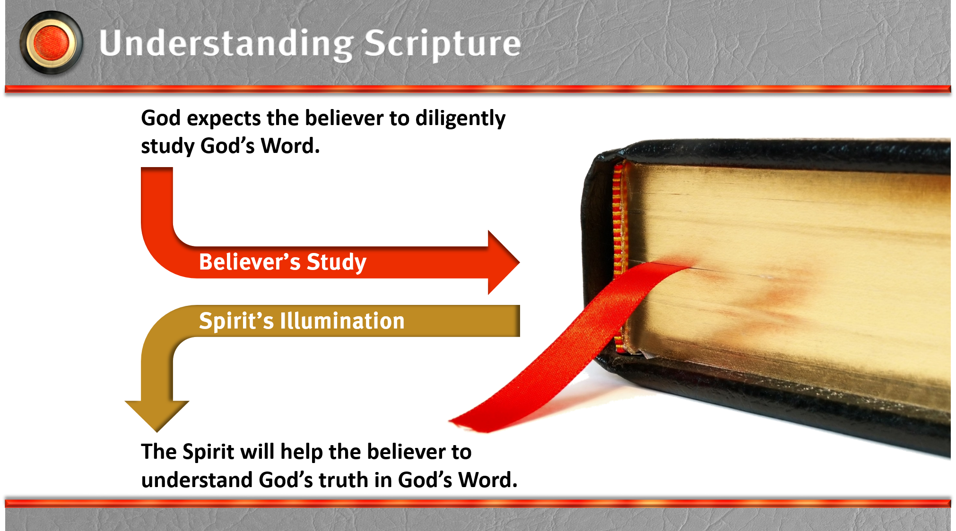

Slide 5
III. Man’s Problem with Communication
A. Man believes objectivity is impossible
B. Man believes history is irrefutable

