Slide 1


Slide 2
I. Transmission of Scriptural Text
A. Masoretic text

Slide 3
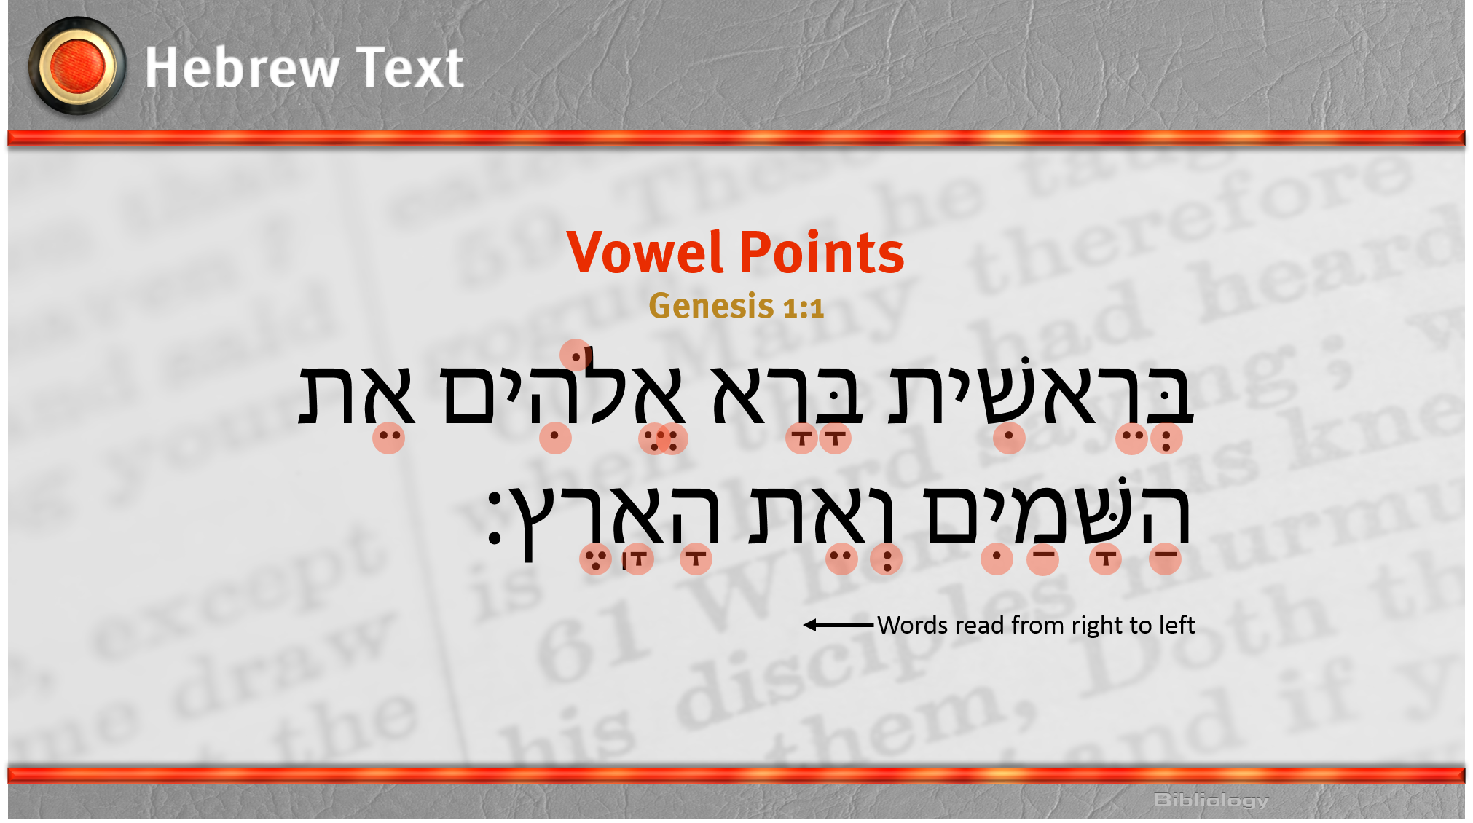

Slide 4
I. Transmission of Scriptural Text
A. Masoretic text
B. Septuagint (LXX)
C. Dead Sea Scrolls
D. Ancient copies of the New Testament

Slide 5
II. History of the Bible
A. Middle Ages
B. Reformation
C. English translations

Slide 6
III. Principles for Translation Work
A. Have a high view of Scripture
B. Be reasonably literal
C. Work as a team

Slide 7


