Slide 1


Slide 2
I. Definition of Canonicity

Slide 3
II. Five Tests of Canonicity
A. Authority
B. Writer
C. Authenticity
D. Power
E. Reception

Slide 4
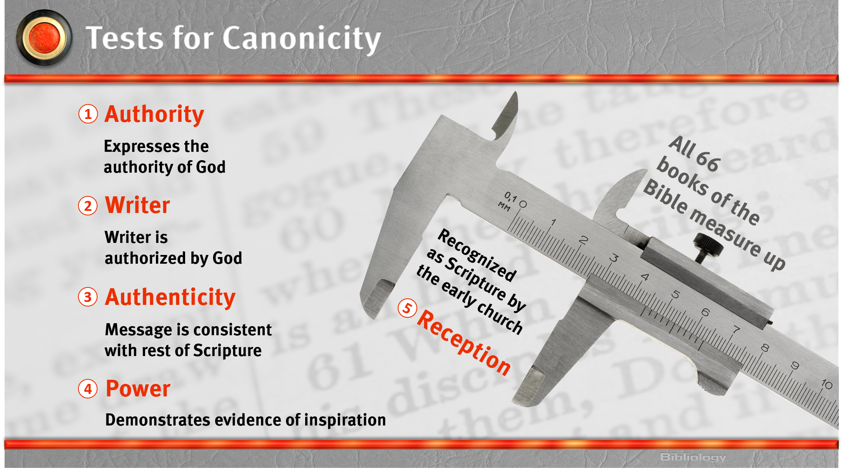

Slide 5
III. Importance of Canonicity

