Slide 1


Slide 2
I. Definitions
A. Inerrancy
B. Infallibility

Slide 3
II. Importance
A. Inerrancy and authority
B. Inerrancy and interpretation

Slide 4
III. Debate
A. Arguments for qualified inerrancy
1. Based on language
2. Based on content

Slide 5
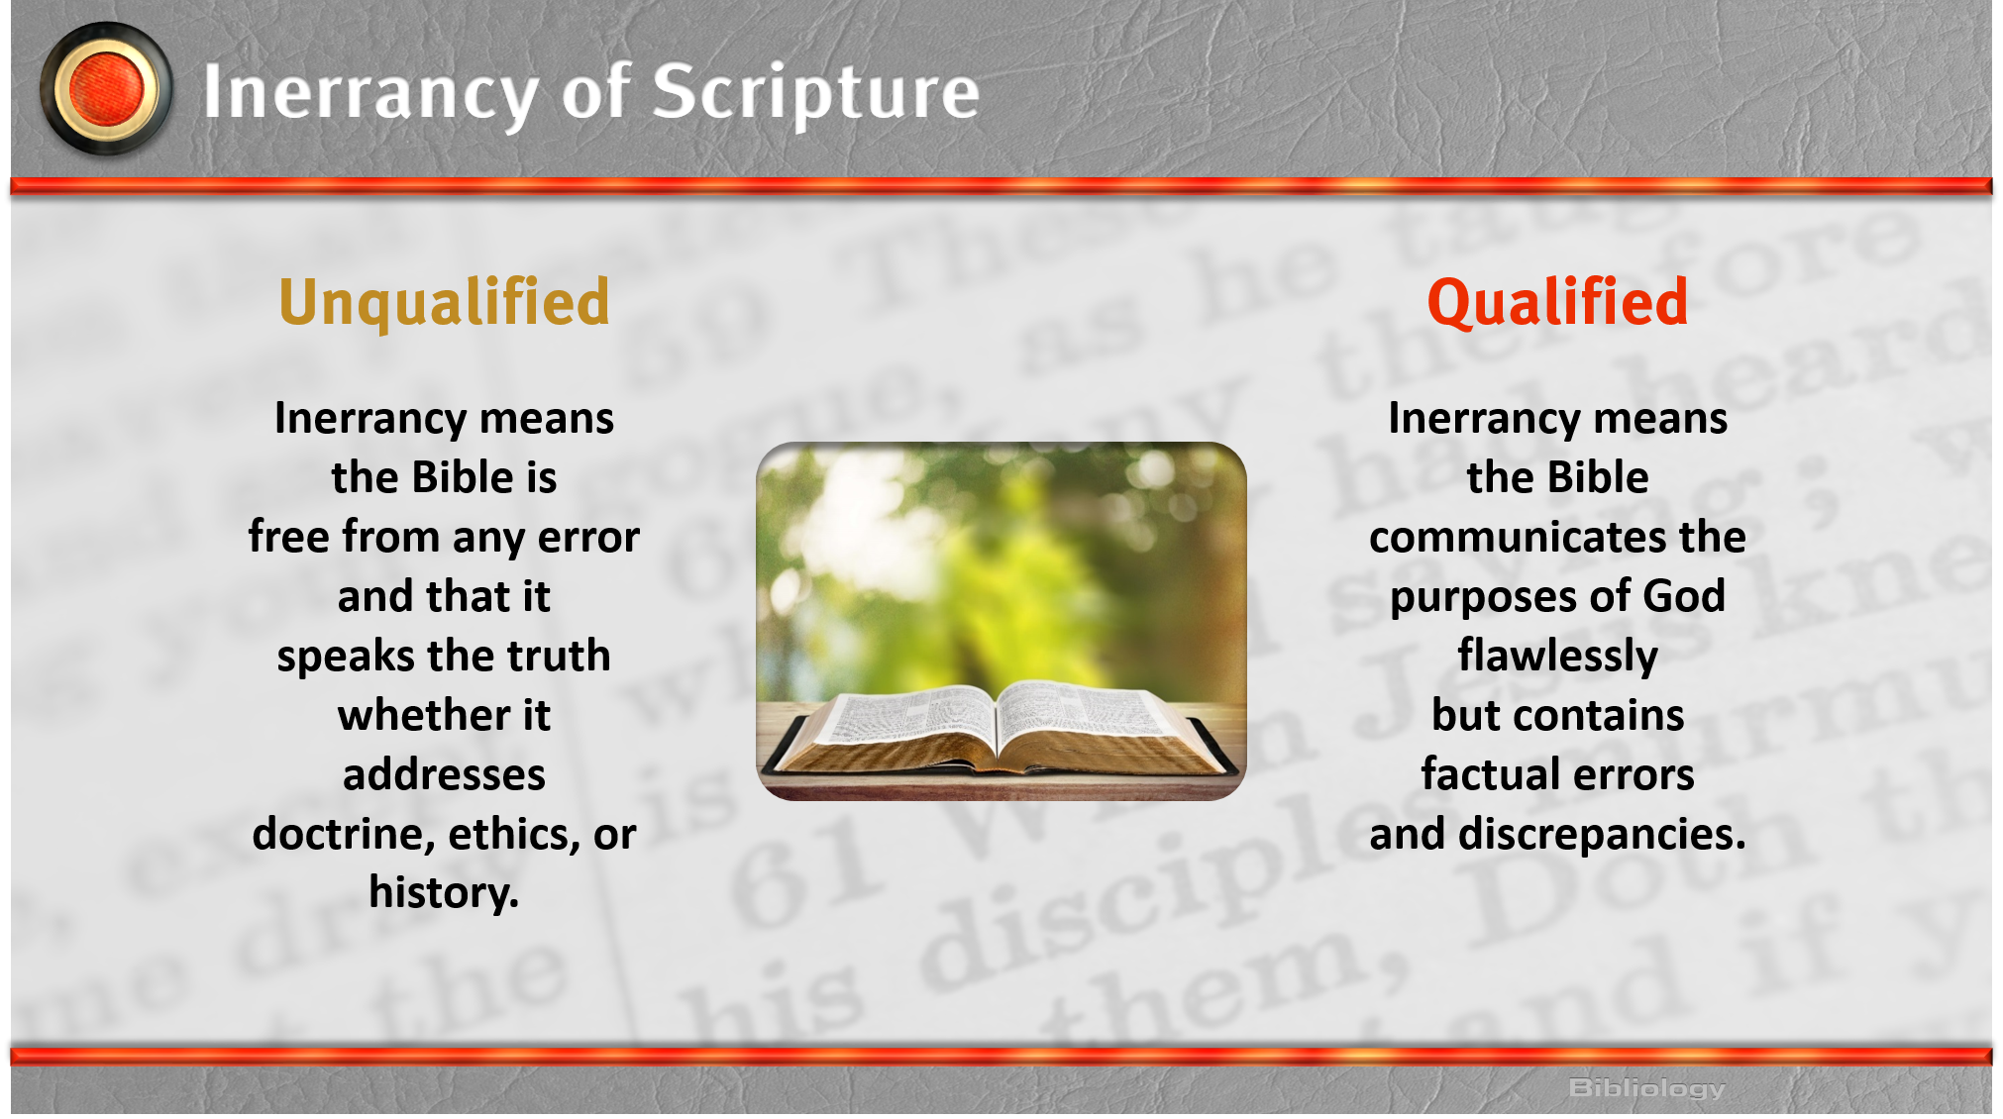

Slide 6
III. Debate
A. Arguments for qualified inerrancy
1. Based on language
2. Based on content
B. Answers to qualified inerrancy advocates
C. Ambitions of qualified inerrancy advocates

