Slide 1


Slide 2


Slide 3


Slide 4
I. Definition of Inspiration
Inspiration may be defined as God’s superintendence of human authors so that, using their own individual personalities, they composed and recorded without error His revelation to man in the words of the original autographs.
Charles Ryrie, A Survey of Bible Doctrine [Chicago: Moody Publishers, 1972], 38

Slide 5
II. Explanation of Inspiration
A. The Scriptures are God-breathed
B. The Scriptures had human writers
C. The Scriptures are God’s Word to humanity

Slide 6
III. Extent of Inspiration
A. The original manuscripts are inspired
B. The words are inspired

Slide 7
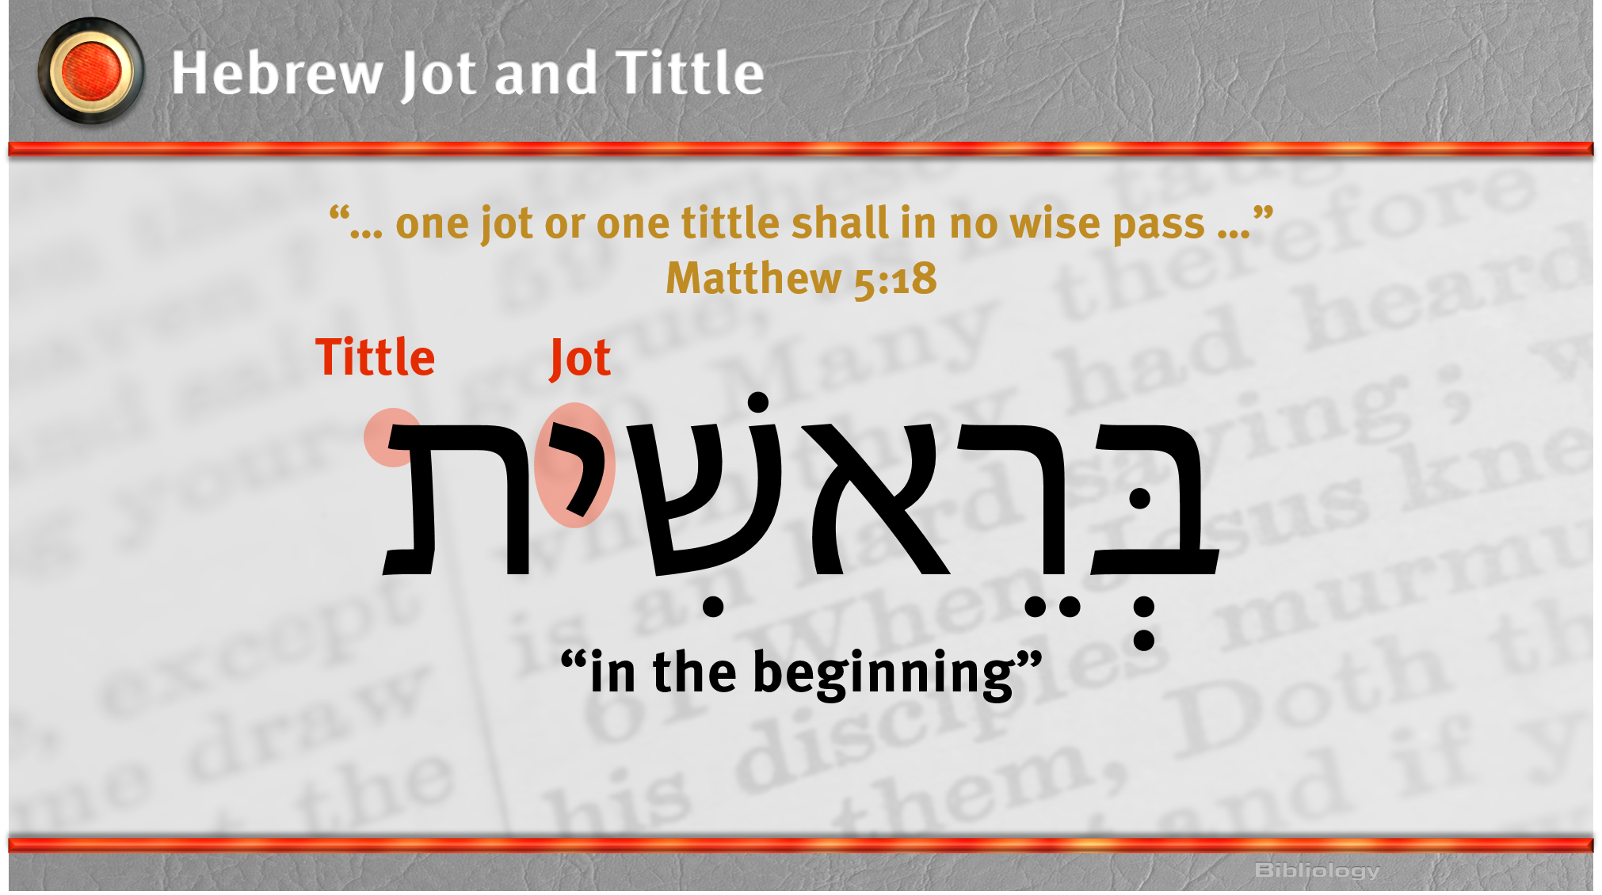

Slide 8
III. Extent of Inspiration
A. The original manuscripts are inspired
B. The words are inspired
C. The whole text of Scripture is inspired

