Slide 1



Slide 2
I. Servants with a Selfish Attitude (5:1–11)
A. The selfishness was serious (5:1–10)
B. The discipline was swift (5:11)

Slide 3
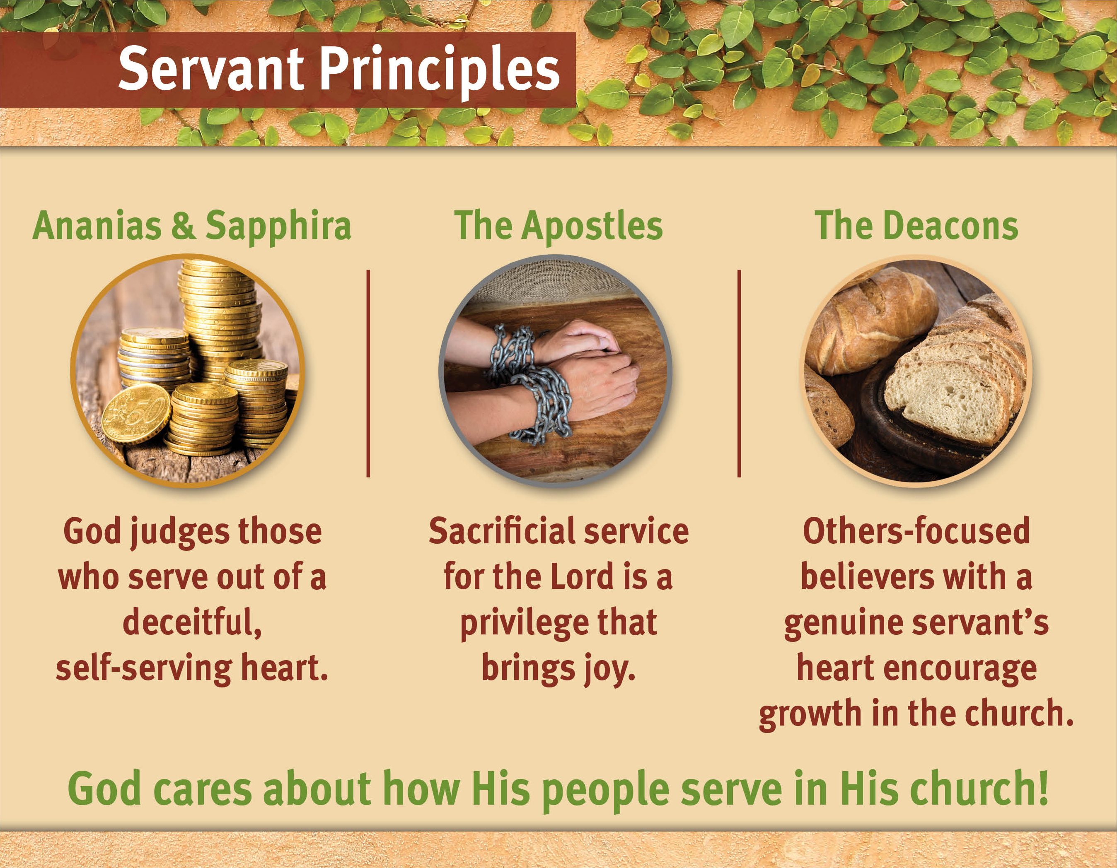

Slide 4
II. Servants with a Sacrificial Attitude (5:12–42)
A. The apostles’ influence expands (5:12–16)
B. The apostles take a stand (5:17–42)

Slide 6
III. Servants with a Selfless Attitude (6:1–7)
A. The situation: Neglected widows (6:1)
B. The solution: Appoint Spirit-filled servants (6:2–7)

Slide 7
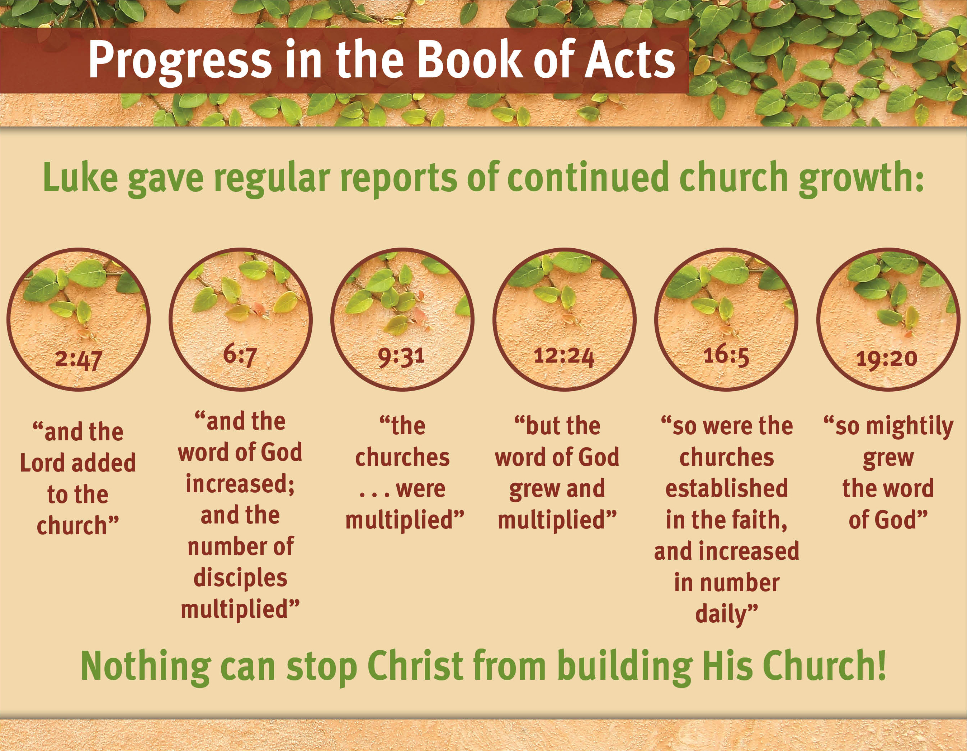

Slide 9
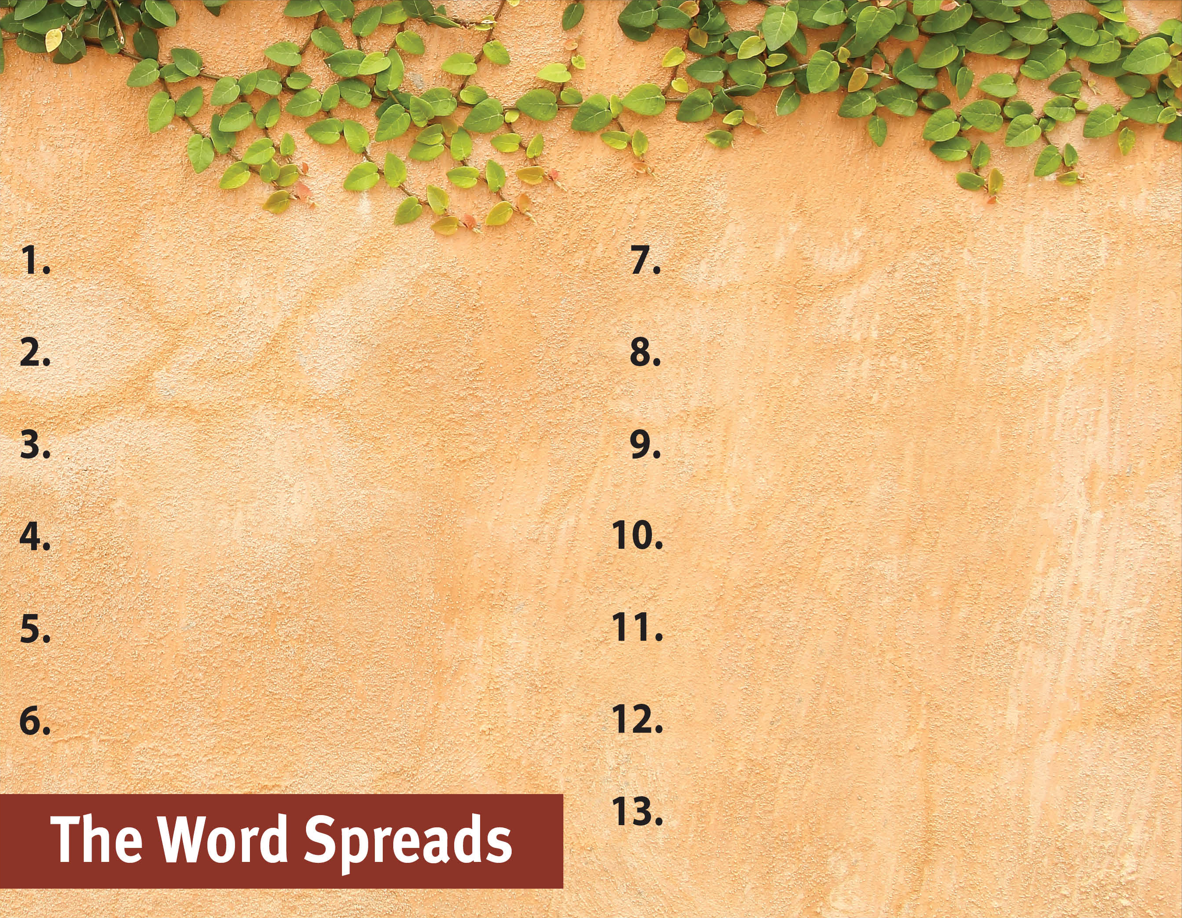
Commit to spread the Word.
Serve God by the Spirit.
Pray for God’s great grace.
Serve with a genuine sacrificial heart.

