Slide 1


Slide 2
I. Preparation for the Church (1)
  A. Jesus’ preparation (1:1–11)
  1. Jesus resurrection (1:1–3)
  2. Jesus’ instructions (1:4–8)
  3. Jesus’ ascension (1:9–11)
  B. People’s preparation (1:12–26)
  1. Supplication to God (1:12–14)
  2. Selection of an apostle (1:15–26)

Slide 3
II. Establishment of the Church (2)
A. Holy Spirit’s arrival (2:1–13)
B. Peter’s explanation (2:14–36)

Slide 4
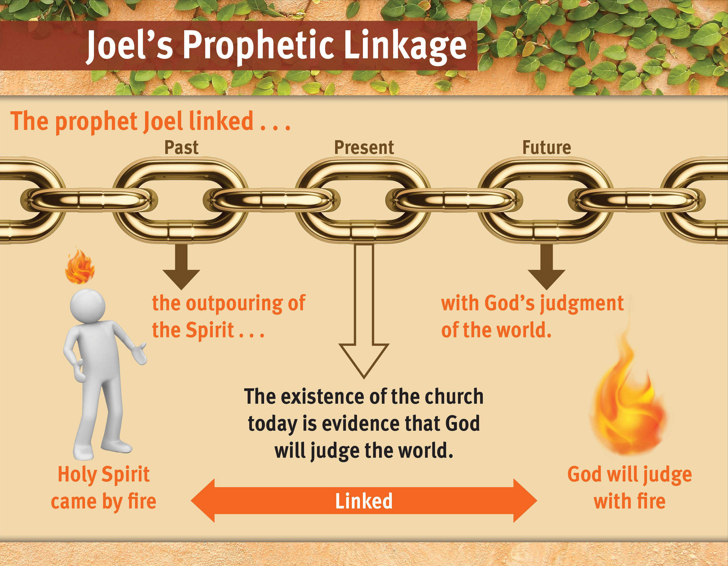

Slide 5
II. Establishment of the Church (2)
A. Holy Spirit’s arrival (2:1–13)
B. Peter’s explanation (2:14–36)
C. The people’s response (2:37–47)

Slide 6
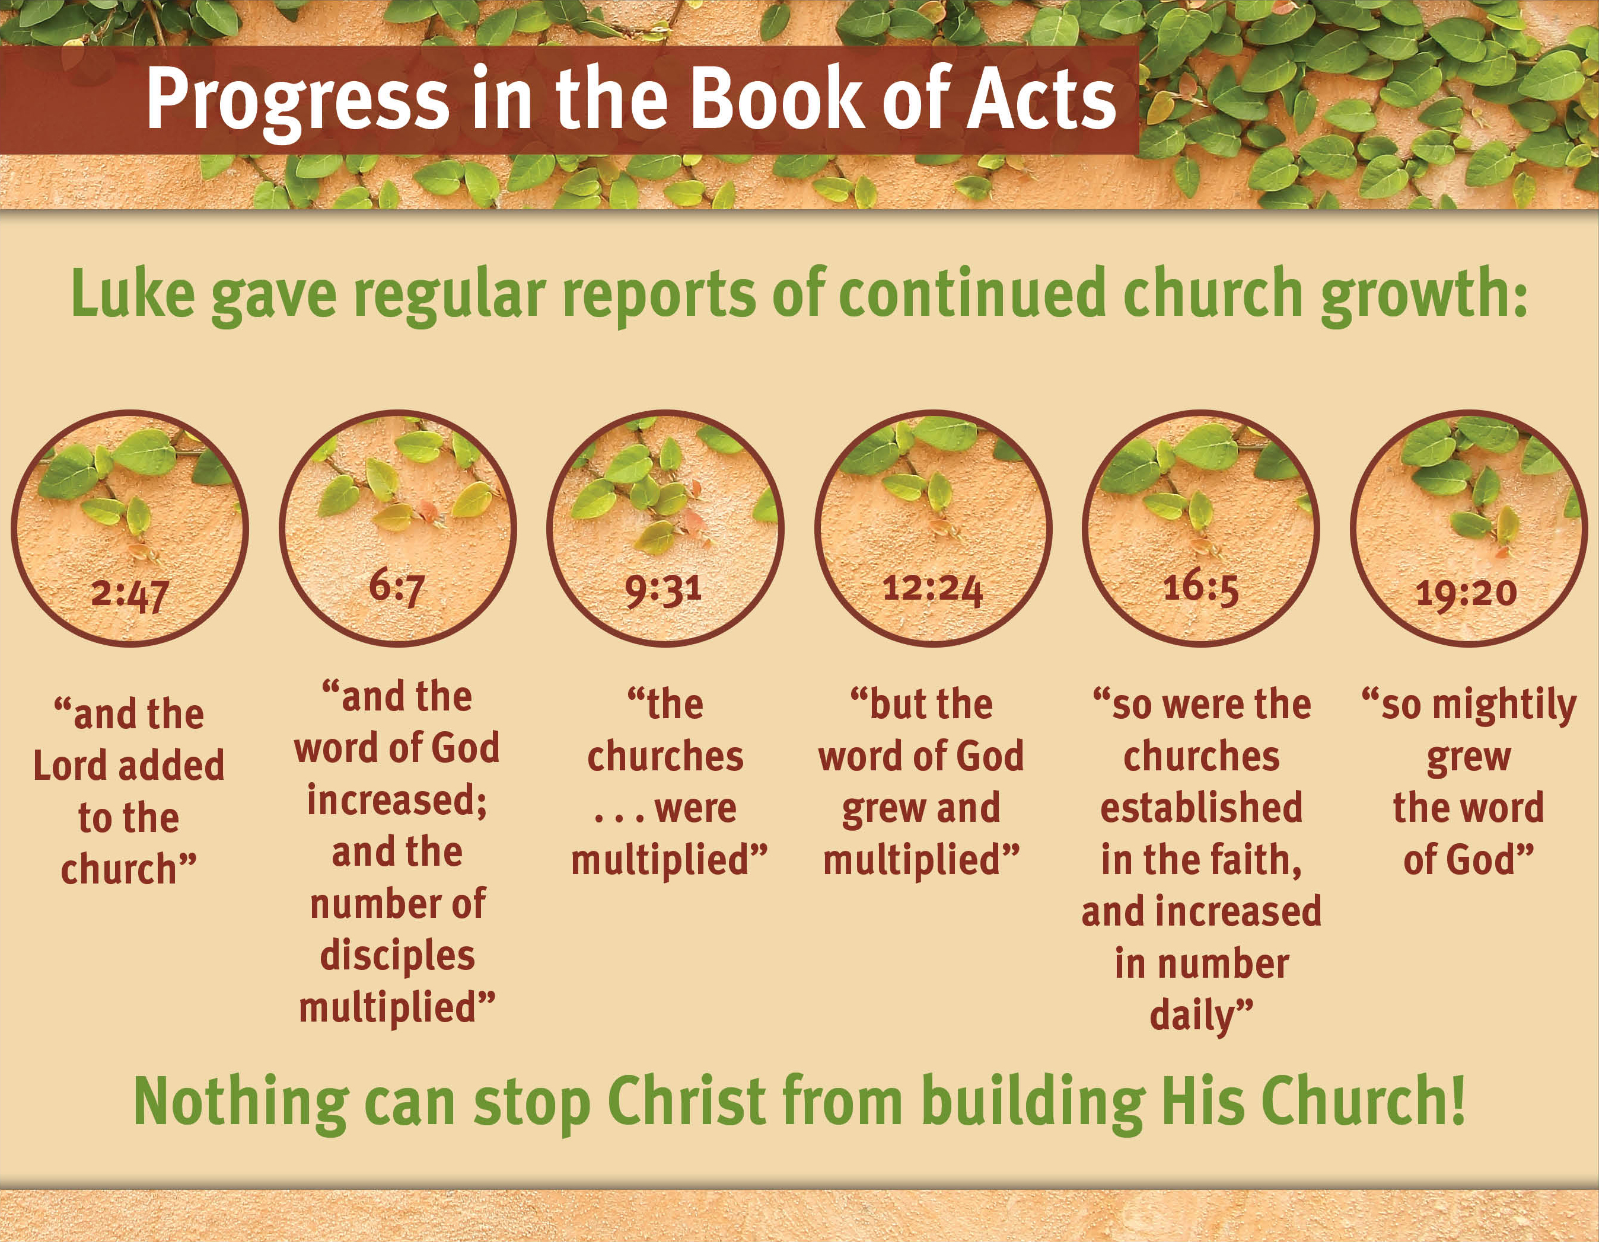

Slide 7
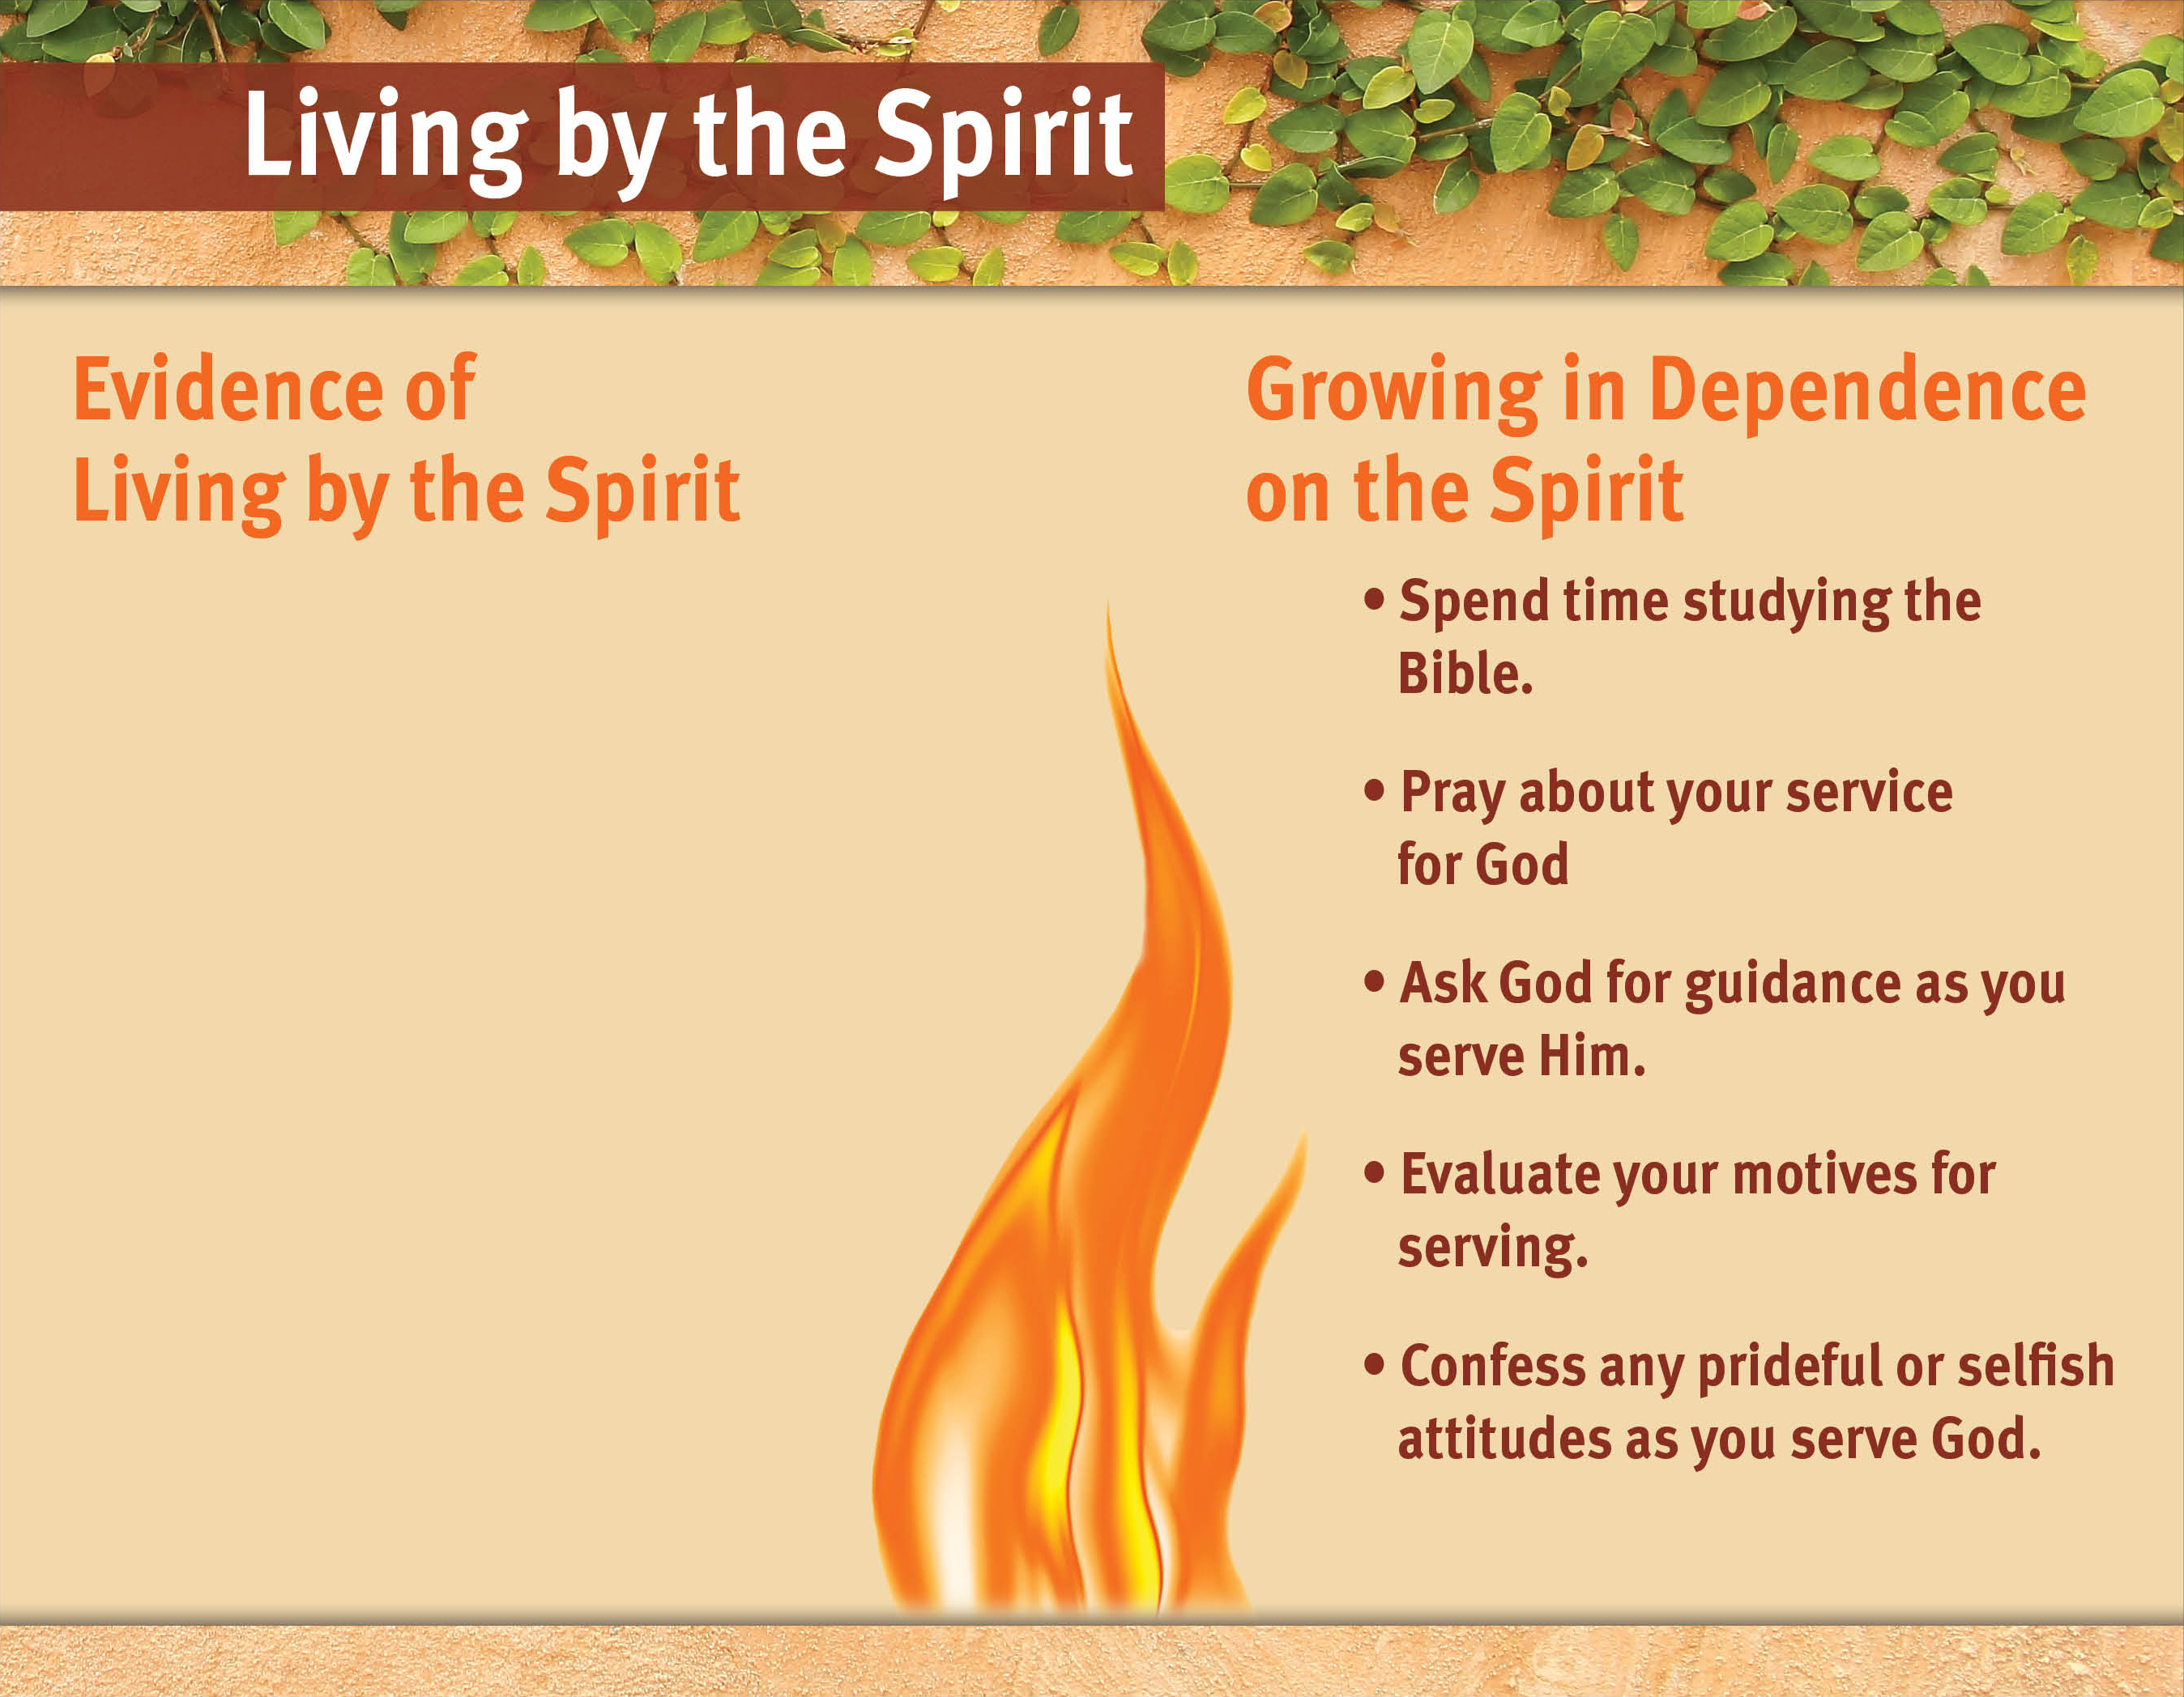
The fruits of the Spirit will be evident in your life.
You will be sensitive to the Spirit’s leading.
You will be convicted of your sin and seek God’s forgiveness.
You will give God the glory for ministry success.
You will live with humble dependence on God.

Slide 8
The fruits of the Spirit will be evident in your life.
You will be sensitive to the Spirit’s leading.
You will be convicted of your sin and seek God’s forgiveness.
You will give God the glory for ministry success.
You will live with humble dependence on God.

Slide 9
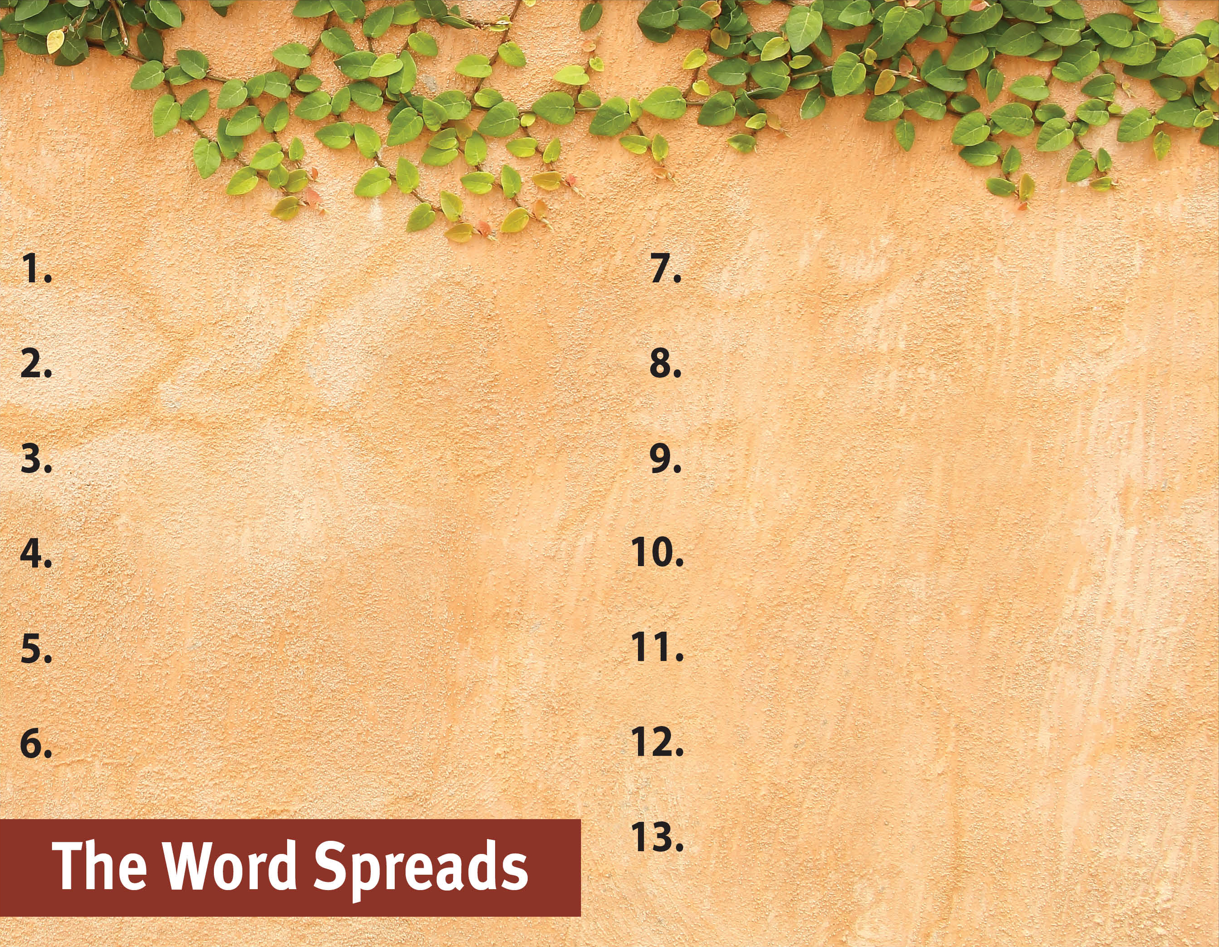
Commit to spread the Word.
Serve God by the Spirit.

