Slide 1



Slide 2
I. God’s Sufficient Grace for Salvation (3)
A. Peter illustrates God’s grace (3:1–11)
B. Peter explains God’s grace (3:12–16)
C. Peter offers God’s grace (3:17–26)
D. People react to God’s grace (4:1–4)

Slide 3
II. God’s Enabling Grace for Service (4)
A. Apostles witness by God’s grace (4:5–12)
B. Apostles answer by God’s grace (4:13–22)
C. Believers pray for God’s grace (4:23–30)

Slide 4
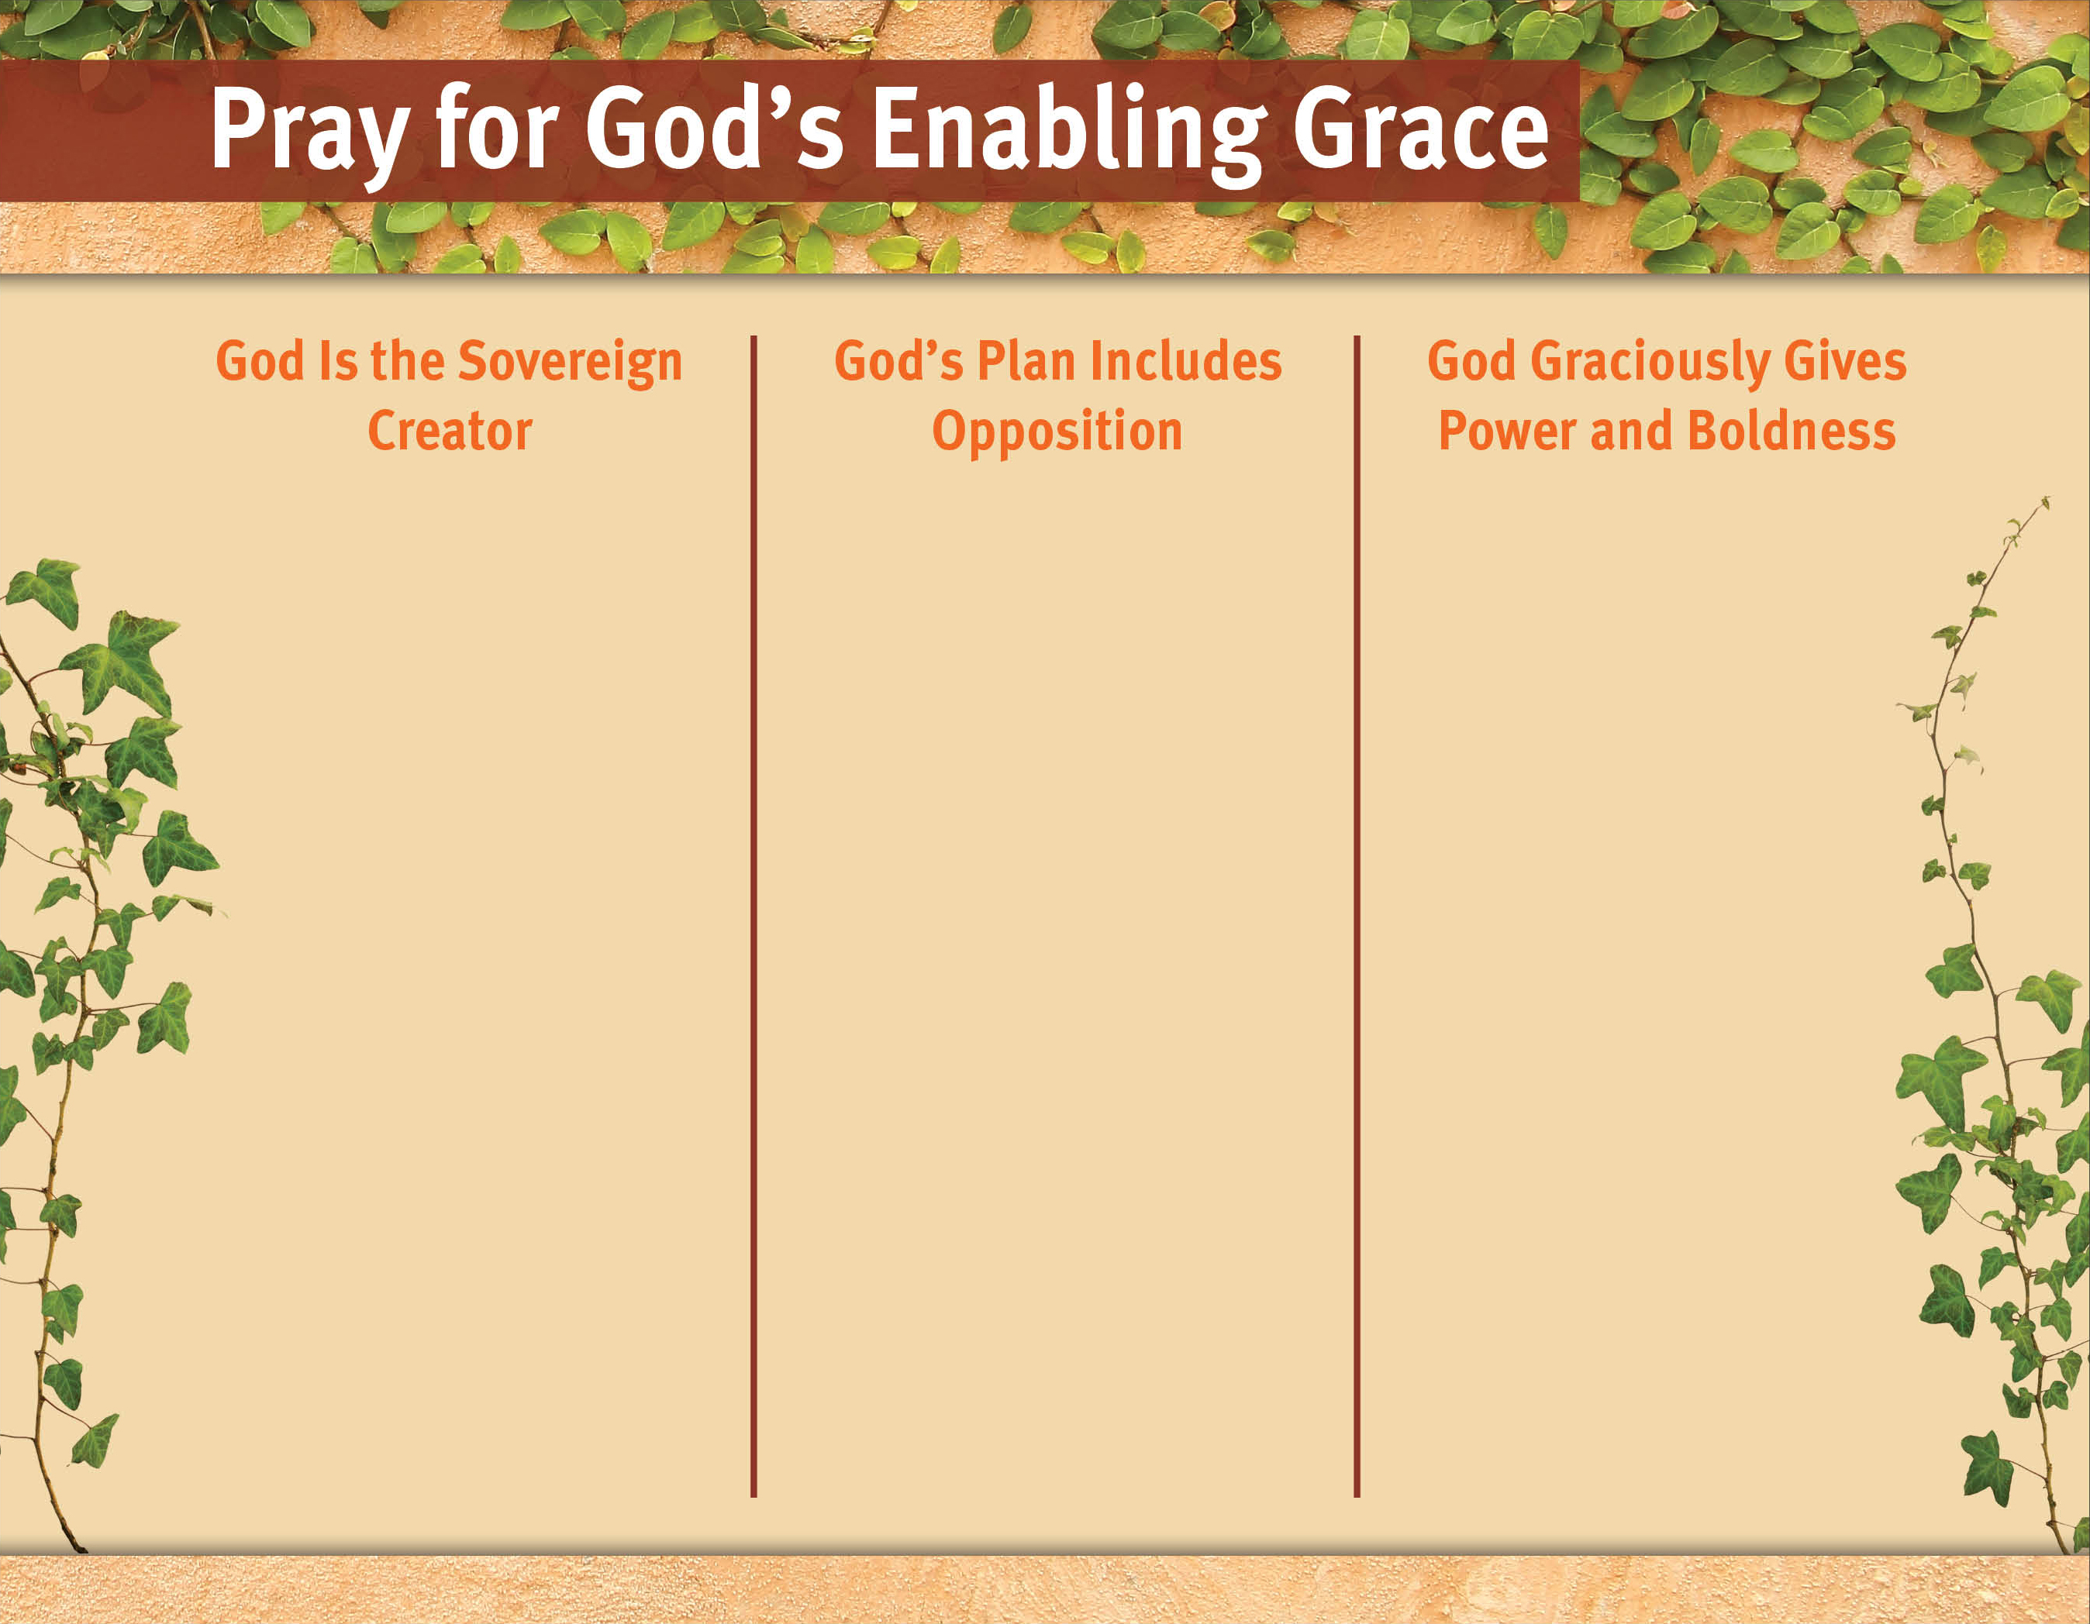
It reminds us of His infinite power and ultimate rule over all.
It helps us put our fears into the proper perspective.
We won’t see the opposition as a sign of God’s weakness or disinterest.
We will continue to trust God through the opposition.
Doing so is a humble acknowledgement of our need for God’s grace.
It shifts our dependence off ourselves and on to God.
God will answer our prayer for boldness.

Slide 5
II. God’s Enabling Grace for Service (4)
A. Apostles witness by God’s grace (4:5–12)
B. Apostles answer by God’s grace (4:13–22)
C. Believers pray for God’s grace (4:23–30)
D. God gives His grace (4:31–37)

Slide 6
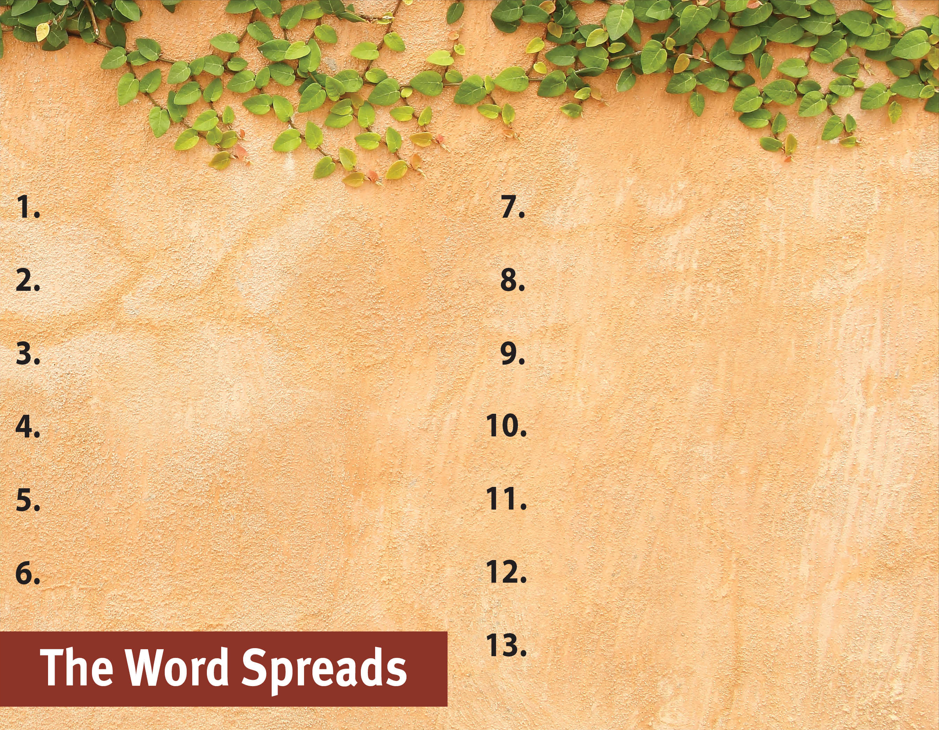
Commit to spread the Word.
Serve God by the Spirit.
Pray for God’s great grace.

