Slide 1


Slide 2
I. Luke, the Writer

Slide 3
II. Overview of Acts
A. Date
B. Literary nature
C. Purpose
D. Basic outline
E. Chronology

Slide 4
Acts 1:1—6:3
Gospel to Jerusalem
James
Acts 13; 14
1st Missionary Journey
Galatians
Acts 15
Jerusalem Council
Acts 15:36—18:22
2nd Missionary Journey
1 & 2 Thessalonians
Acts 18:23—21:16
3rd Missionary Journey
1 & 2 Corinthians; Romans
Acts 21:17—28:31
Rome Imprisonment
Ephesians; Colossians; Philippians; Philemon

Slide 5
II. Overview of Acts
A. Date
B. Literary nature
C. Purpose
D. Basic outline
E. Chronology
F. Key emphases
1. Jesus is alive
2. Jesus is one with His church
3. Jesus’ gospel is powerful

Slide 6
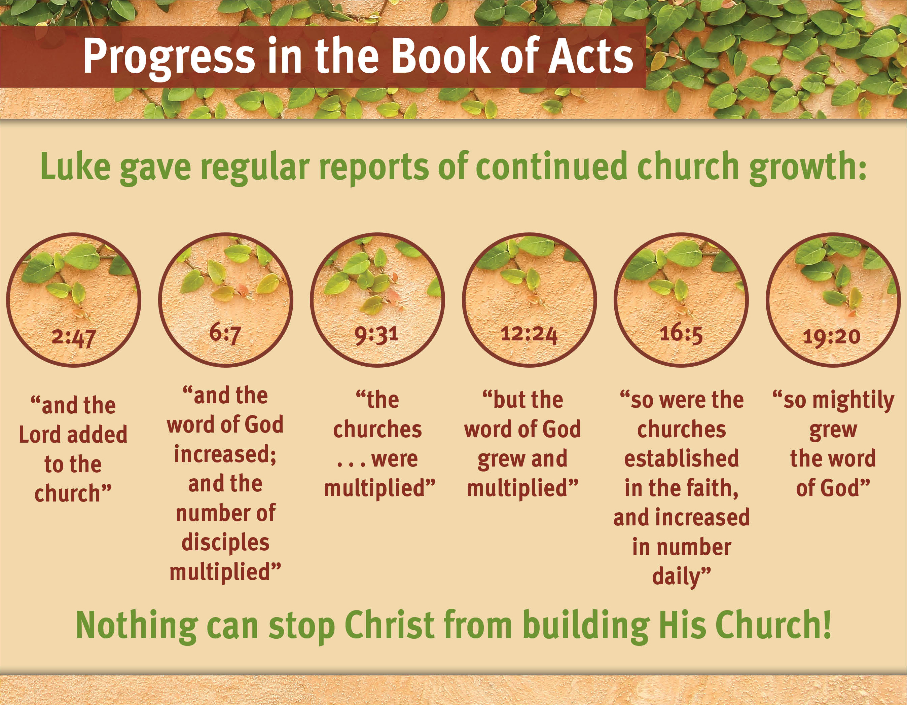

Slide 7
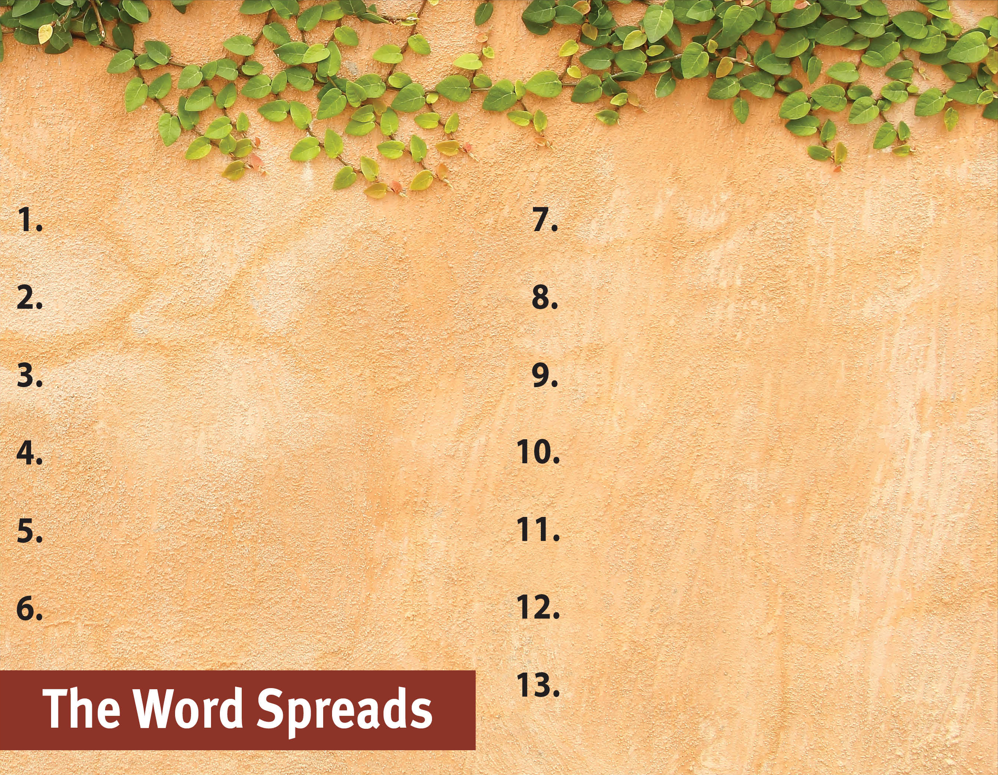
Commit to spread the Word.

