Slide 1



Slide 2
I. Paul’s Voyage to Rome (27:1—28:12)

Slide 3
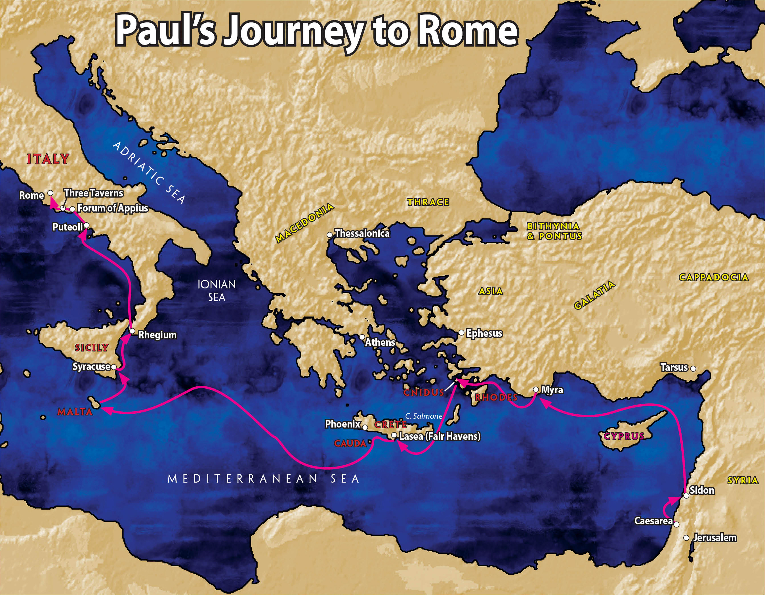

Slide 4
I. Paul’s Voyage to Rome (27:1—28:12)
A. Voyage to Fair Haven (27:1–8)
B. The storm at sea (27:9–26)
C. The shipwreck at Malta (27:27–44)
D. Paul’s ministry at Malta and trip to Rome (28:1–12)

Slide 5
II. Paul in Rome (28:13–31)
A. Paul’s arrival at Rome (28:13–16)
B. Paul’s ministry at Rome (28:17–31)

Slide 6
III. Paul’s Ministry after His Release (2 Timothy; Titus)

Slide 7
IV. Conclusion

Slide 8
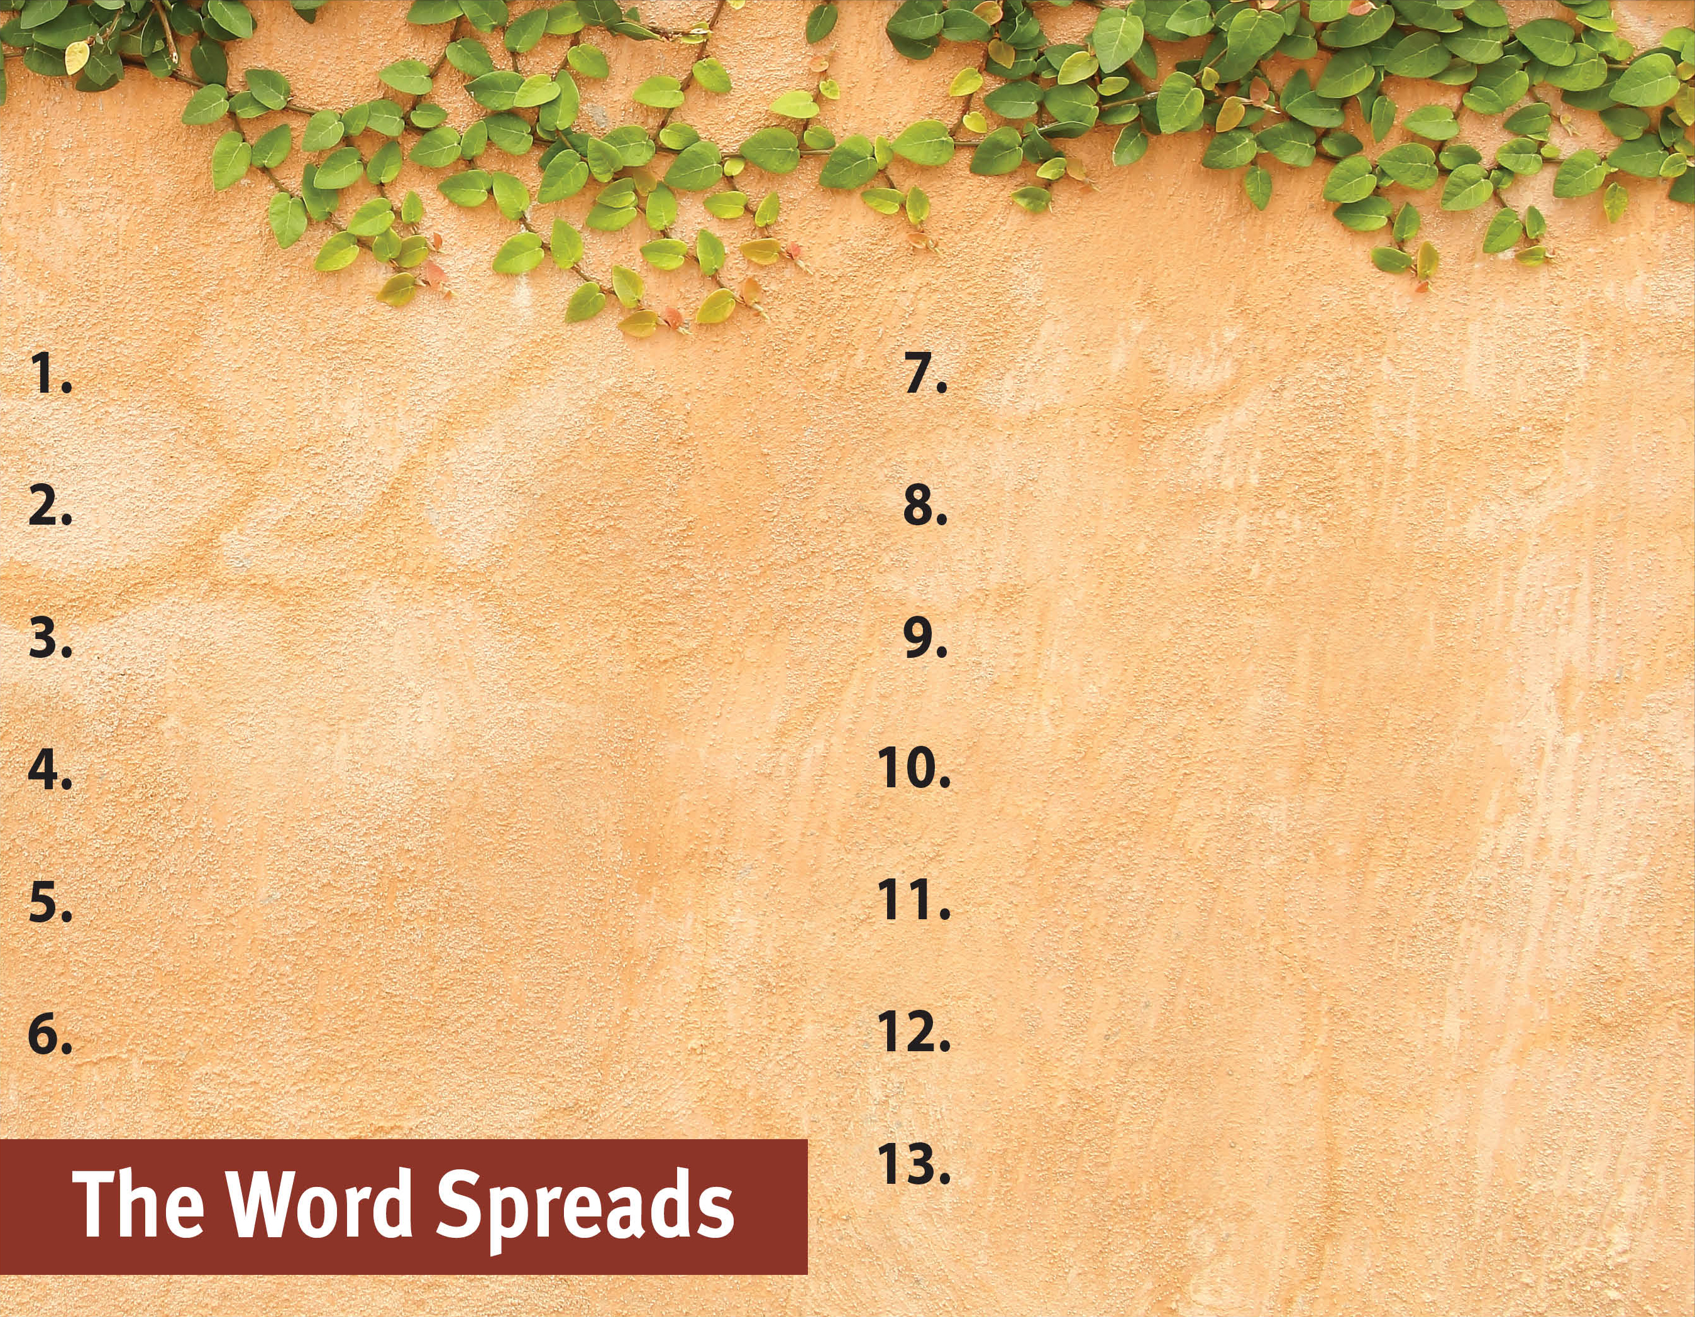
Commit to spread the Word.
Witness to all people.
Serve God by the Spirit.
Be active in and support missions.
Pray for God’s great grace.
Hold to pure doctrine.
Serve with a genuine, sacrificial heart.
Be sensitive to the Spirit’s leading.
Recognize the Spirit’s power is superior.
Focus on serving God, not self.
Set no limits on the gospel.
Trust God steadfastly in all circumstances.
Rejoice in God’s faithfulness.

