Slide 1



Slide 2
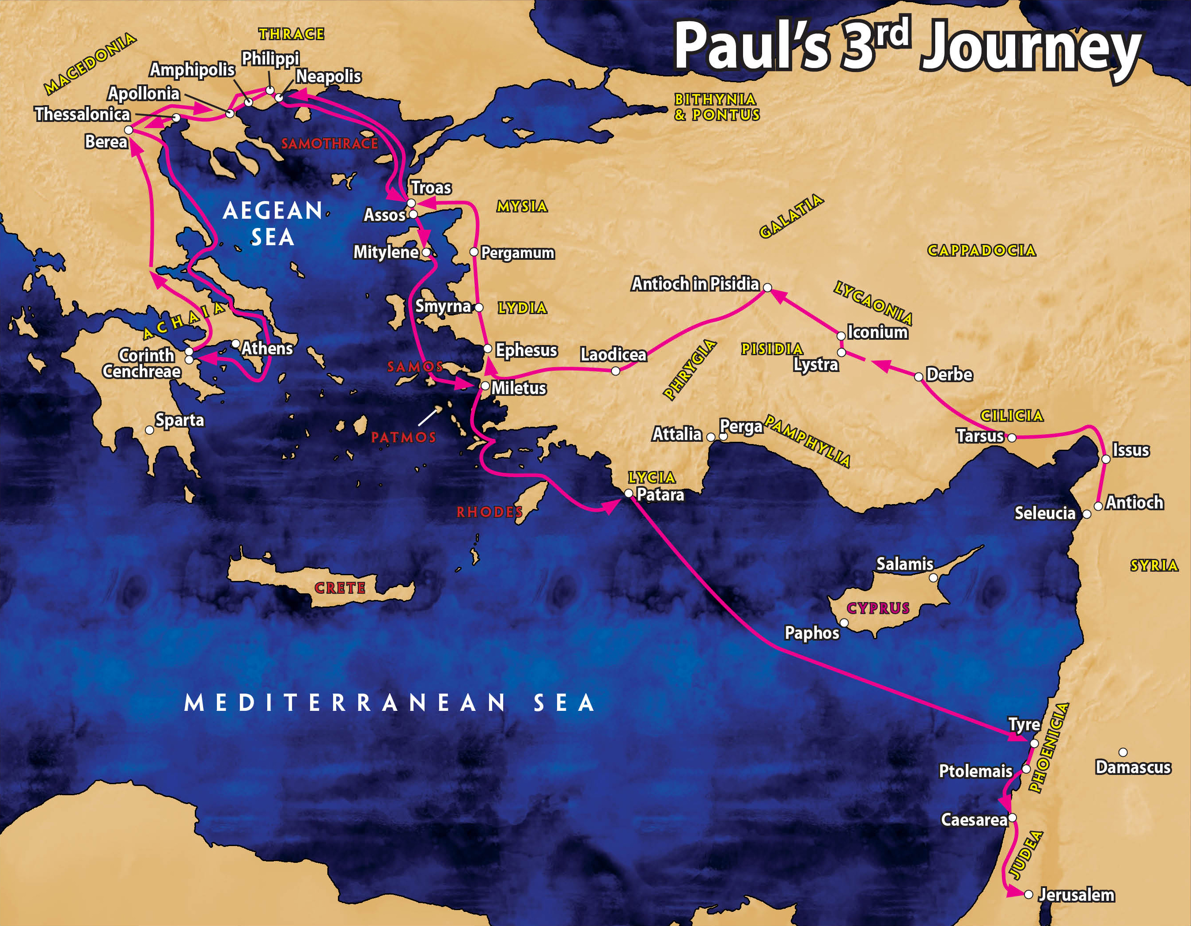

Slide 3
    I. Ministry in Galatia and Phrygia (18:22, 23)

Slide 4
II. Ministry in Ephesus (18:24—19:41)
A. Work of Apollos (18:24–28)
B. Encounter with John’s disciples (19:1–7)
C. Triumph of the gospel (19:8–20)

Slide 5
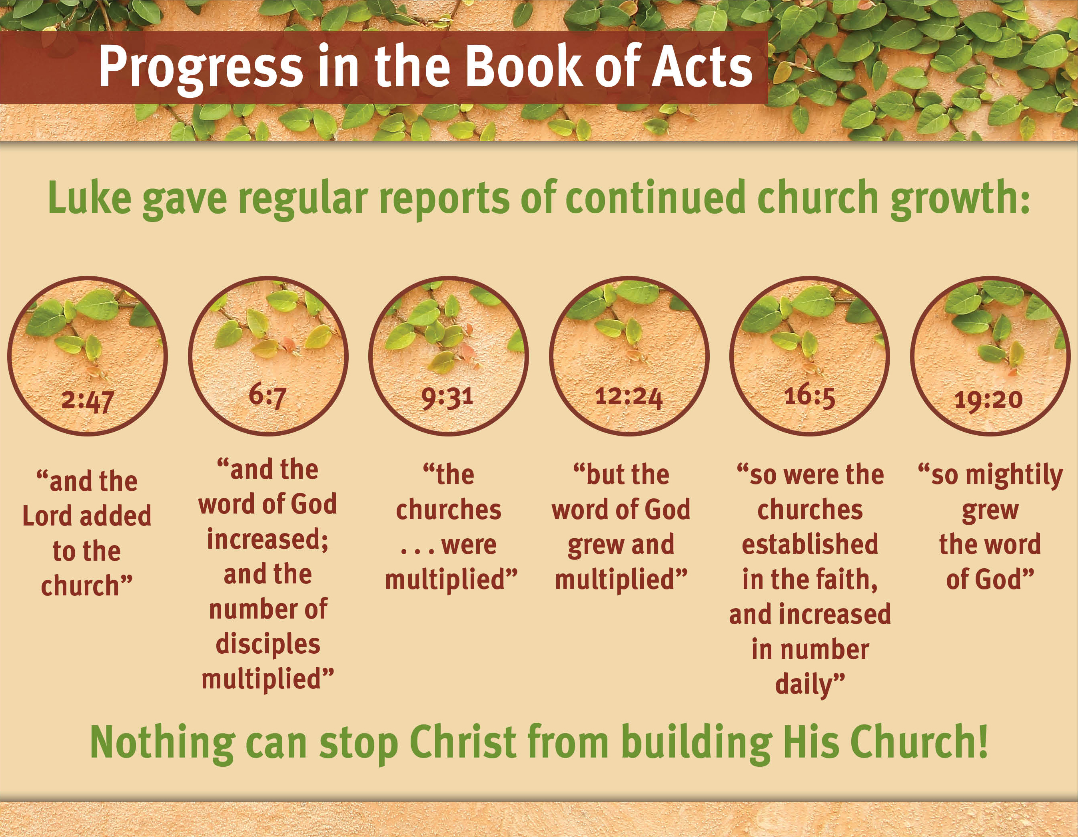

Slide 6
II. Ministry in Ephesus (18:24—19:41)
A. Work of Apollos (18:24–28)
B. Encounter with John’s disciples (19:1–7)
C. Triumph of the gospel (19:8–20)
D. Paul’s plan to visit Jerusalem and Rome (19:21–23)
E. Riot in Ephesus (19:24–41)

Slide 7
    III. Ministry in Macedonia and Greece (20:1–5)

Slide 8
    IV. Ministry in Troas (20:6–12)

Slide 9
    V. Ministry at Miletus to the Ephesian Elders (20:13–38)
    A. Paul reviews (20:17–21)
    B. Paul testifies (20:22–27)
    C. Paul warns (20:28–38)

Slide 10
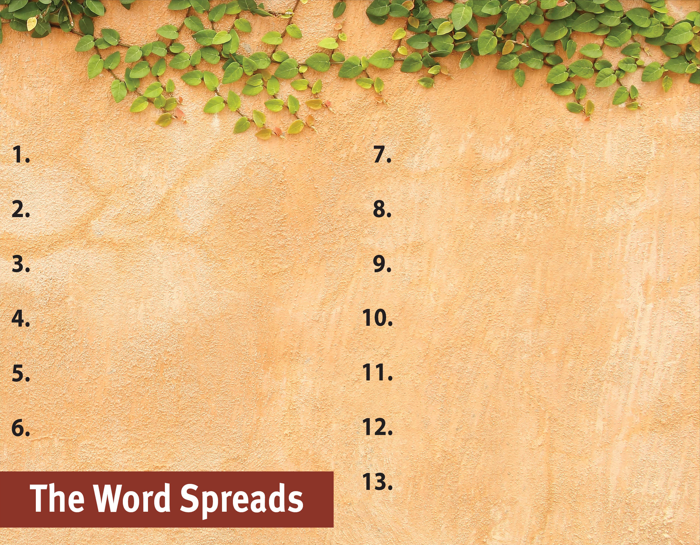
Commit to spread the Word.
Witness to all people.
Serve God by the Spirit.
Be active in and support missions.
Pray for God’s great grace.
Hold to pure doctrine.
Serve with a genuine,
sacrificial heart.
Be sensitive to the Spirit’s leading.
Recognize the Spirit’s power
is superior.
Focus on serving God, not self.
Set no limits on the gospel.

