Slide 1



Slide 2
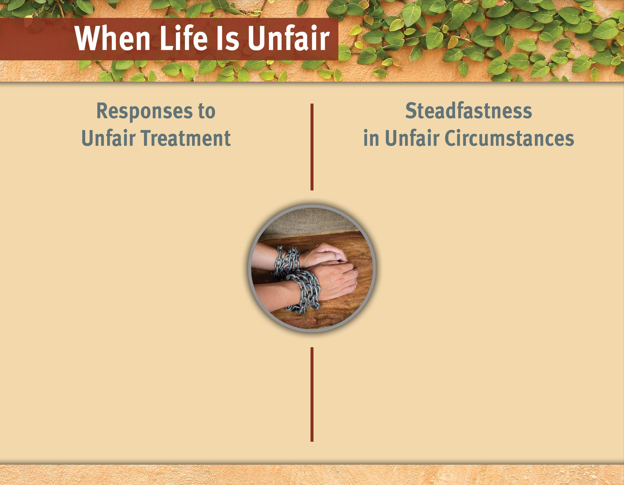
Become violent.
Seek revenge.
Demand justice.
Gossip about those who treated us unfairly.
Hold a grudge.

Slide 3
I. Paul’s Journey to Jerusalem (21:1–14)
A. Paul warned in Tyre (21:1–6)
B. Paul warned in Caesarea (21:7–14)

Slide 4
II. Paul’s Reception in Jerusalem (21:15—23:35)
A. Meeting with the Jerusalem elders (21:15–26)
B. Seizure of Paul in the temple (21:27–36)
C. Paul’s defense before the people (21:37— 22:29)
D. Paul’s appearance before the Sanhedrin and the conspiracy (23:1–35)

Slide 5
III. Paul’s Steadfastness before Powerful Rulers (24:1—26:32)
A. Imprisonment under Felix (24:1–27)
1. The charges against Paul (24:1–9)
2. Paul’s defense (24:10–21)
3. Felix’s indecision and Paul’s detention (24:22–27)
B. Imprisonment under Festus (25:1—26:32)
1. Paul’s defense before Festus (25:1–12)
2. Paul’s case discussed with Herod Agrippa II
(25:13—26:32)

Slide 6
Become violent.
He did not compromise the gospel.
Seek revenge.
He spoke the truth with confidence.
Demand justice.
He did not whine about his situation.
Gossip about those who treated us unfairly.
He trusted that God was working behind the scenes.
Hold a grudge.
He used his appearances before dignitaries as opportunities to witness.

Slide 7
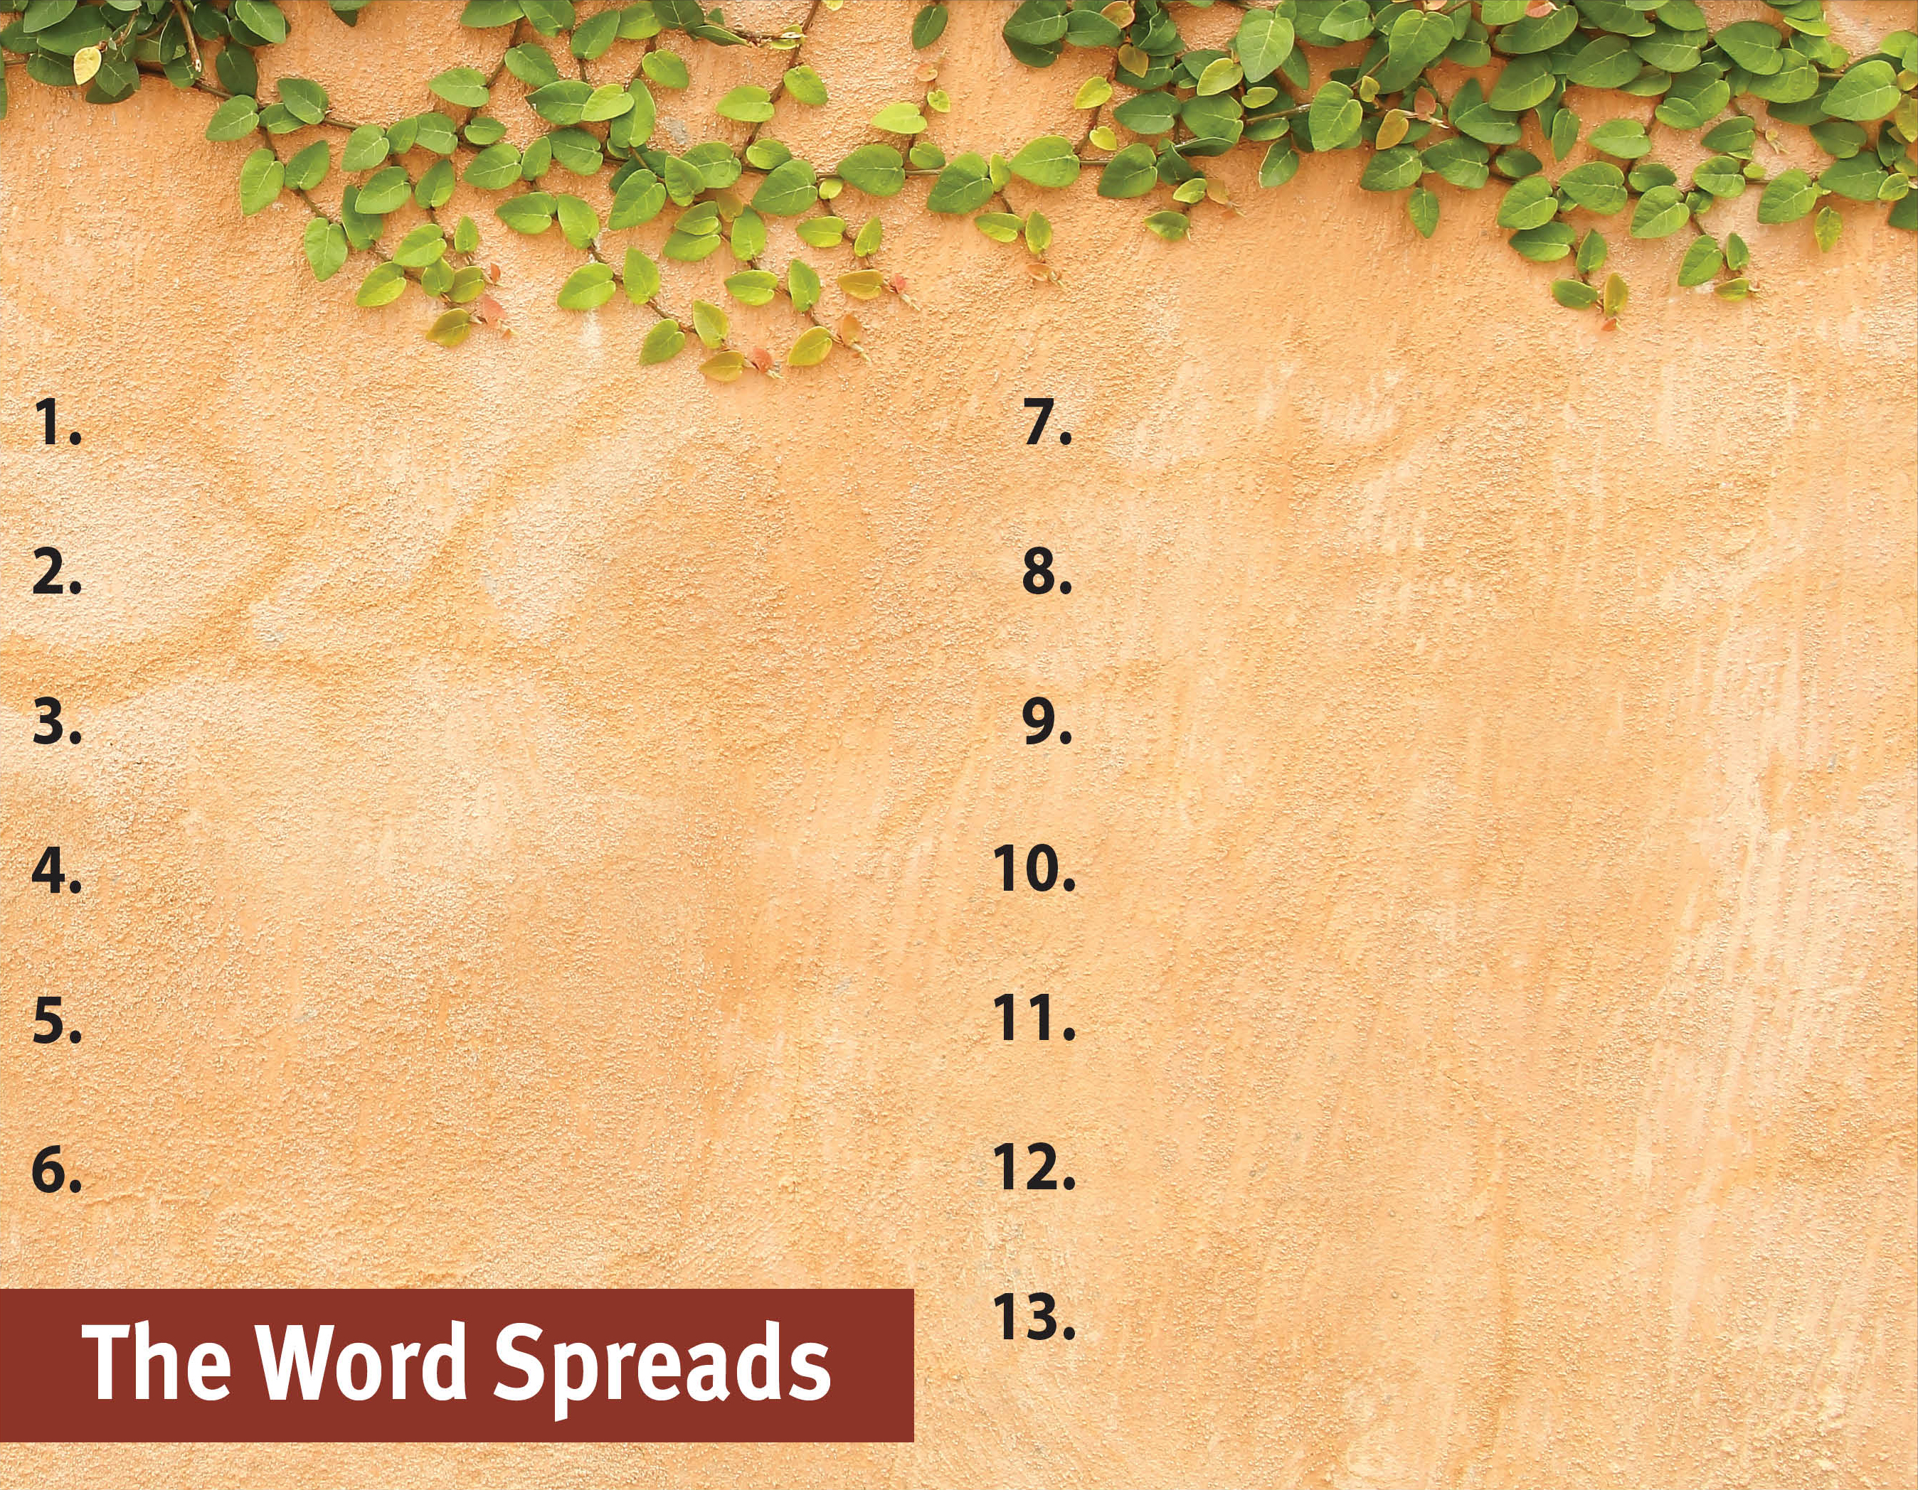
Commit to spread the Word.
Witness to all people.
Serve God by the Spirit.
Be active in and support missions.
Pray for God’s great grace.
Hold to pure doctrine.
Serve with a genuine, sacrificial heart.
Be sensitive to the Spirit’s leading.
Recognize the Spirit’s power is superior.
Focus on serving God, not self.
Set no limits on the gospel.
Trust God steadfastly in all circumstances.

