Slide 1



Slide 2
    I. Stage One of the Journey (15:36—16:5)
    A. Preparation for ministry (15:36–40)
    B. Departure (15:41—16:5)

Slide 3
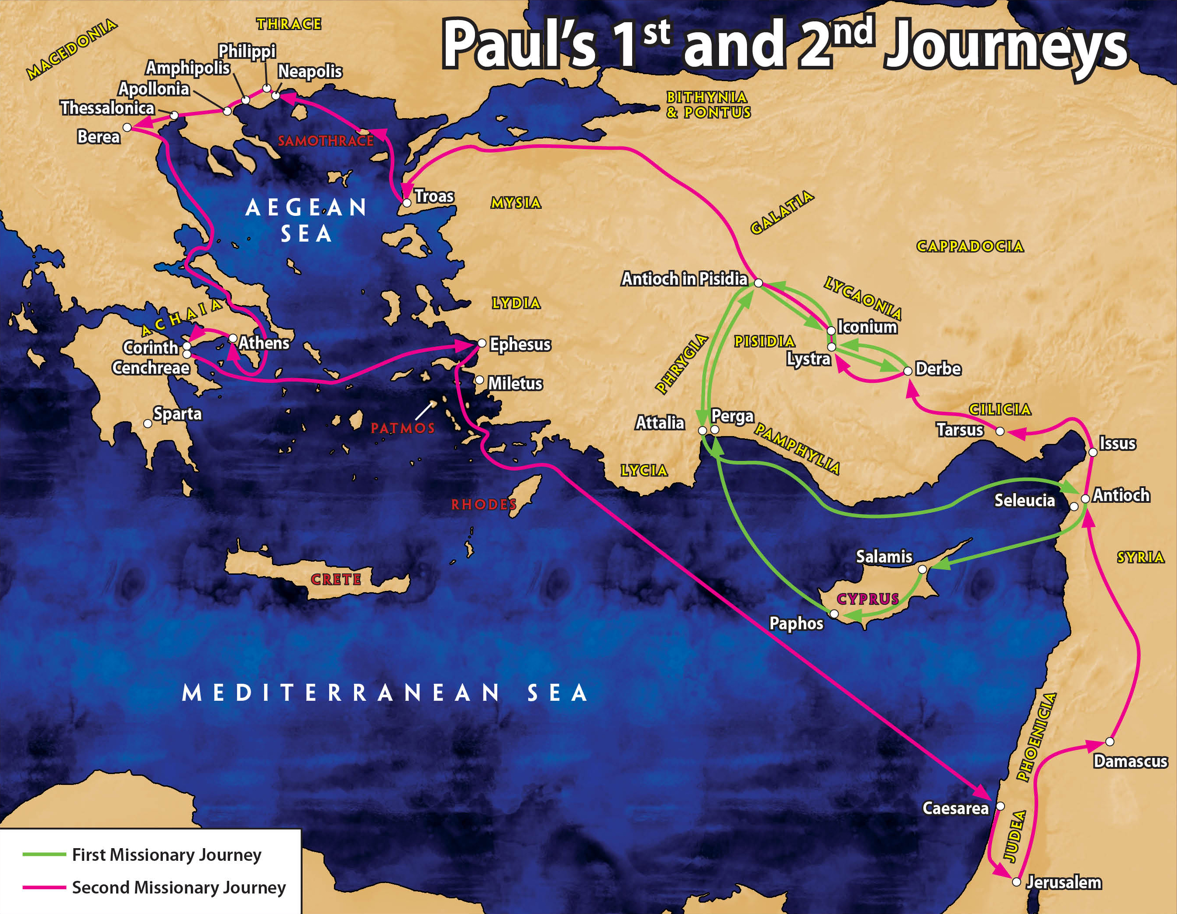

Slide 4
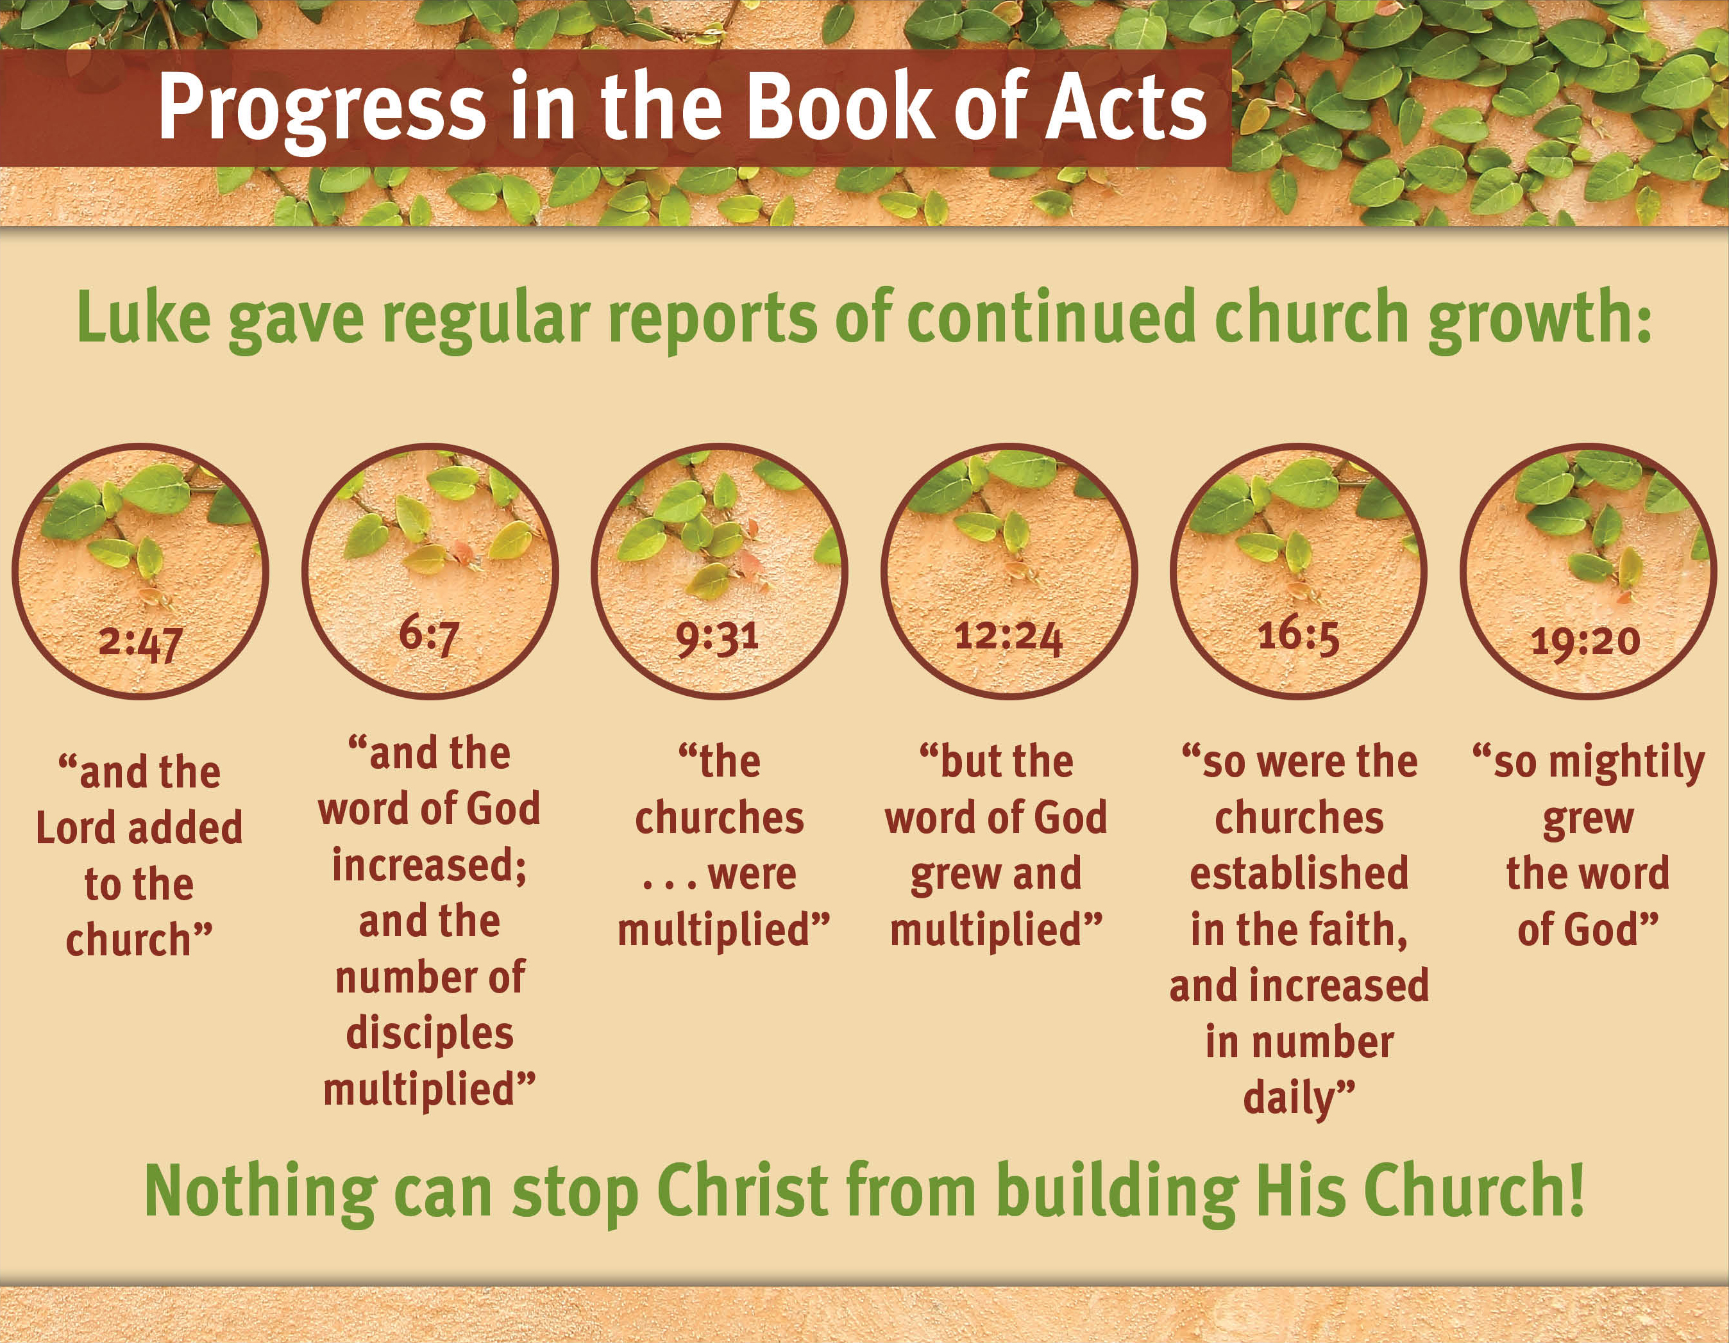

Slide 5
II. Stage Two of the Journey (16:6—18:22)
A. Call into Macedonia (16:6–10)
1. Direction of the Holy Spirit (16:6–8)
2. The vision of the Macedonian (16:9, 10)

Slide 6
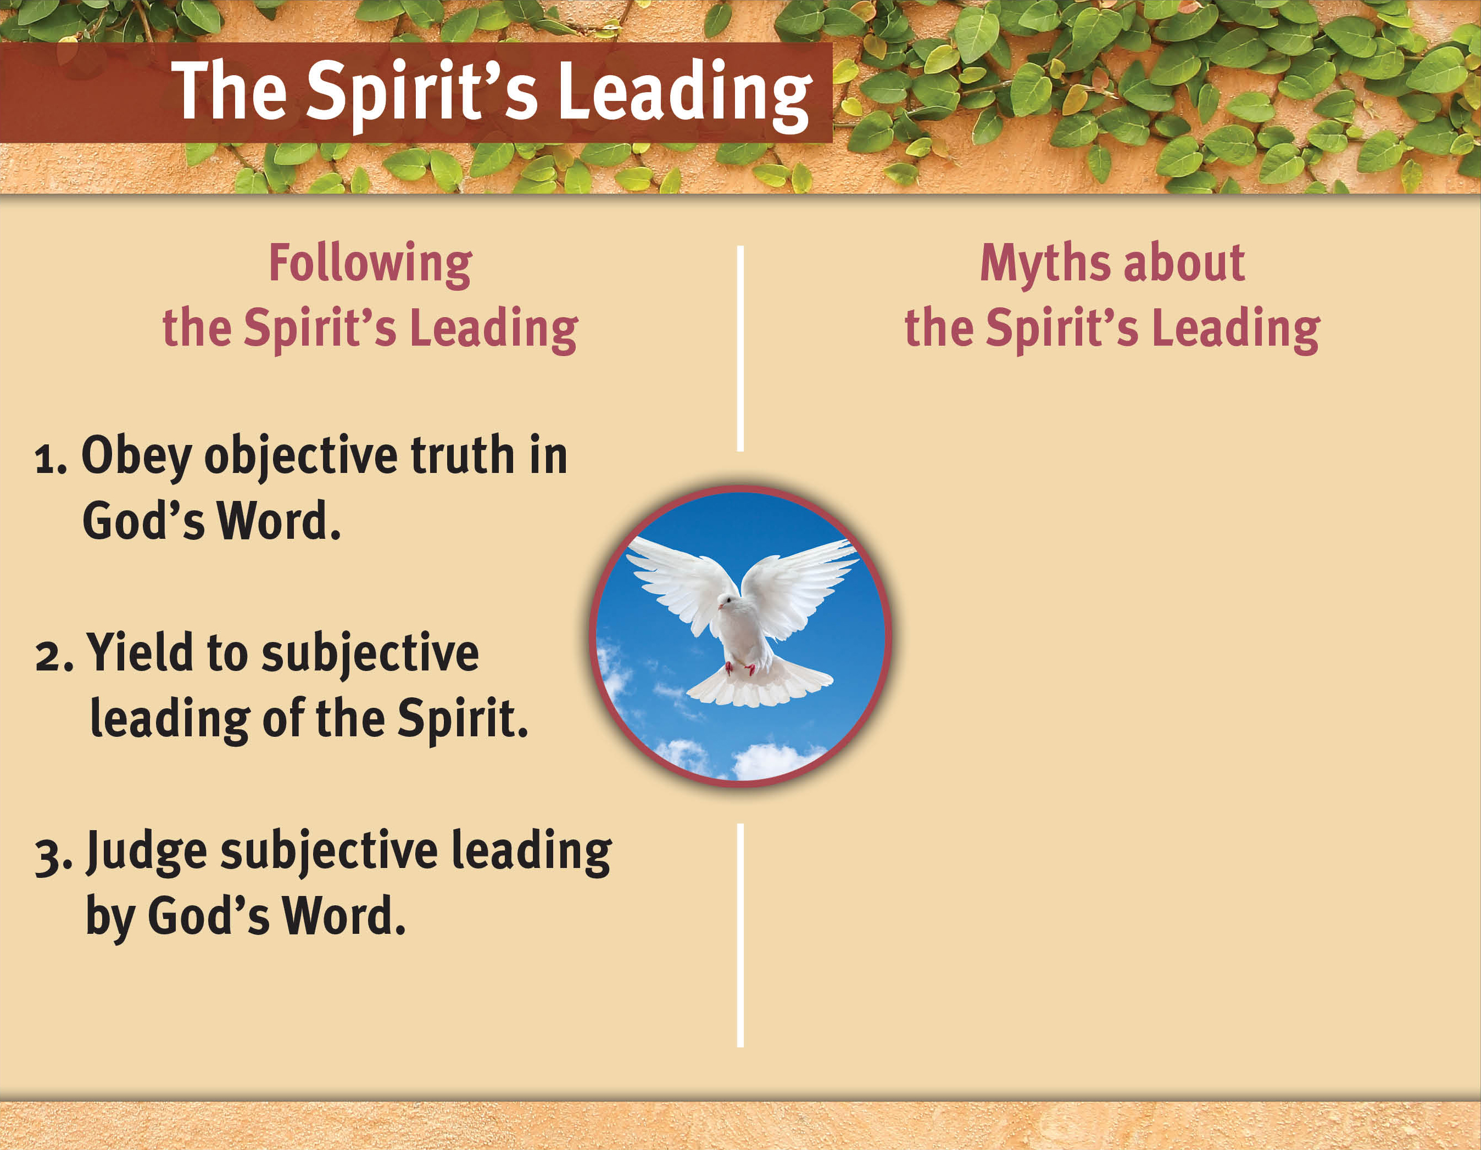

Slide 7
II. Stage Two of the Journey (16:6—18:22)
A. Call into Macedonia (16:6–10)
B. Ministry in Philippi (16:11–40)
1. Conversion of Lydia (16:14, 15)
2. Expulsion of a demon (16:16–18)
3. Salvation of the Philippian jailer (16:19–40)
C. The ministry in Thessalonica (17:1–9)
D. The ministry at Berea (17:10–15)
E. The ministry at Athens (17:16–34)
F. The ministry at Corinth and trip home (18:1–22)

Slide 8
The Spirit leads us according
to what we find comfortable.
Our emotions indicate the Spirit’s leading.
The Spirit always
explains His leading.
The Spirit always leads us to ease and prosperity.

Slide 9
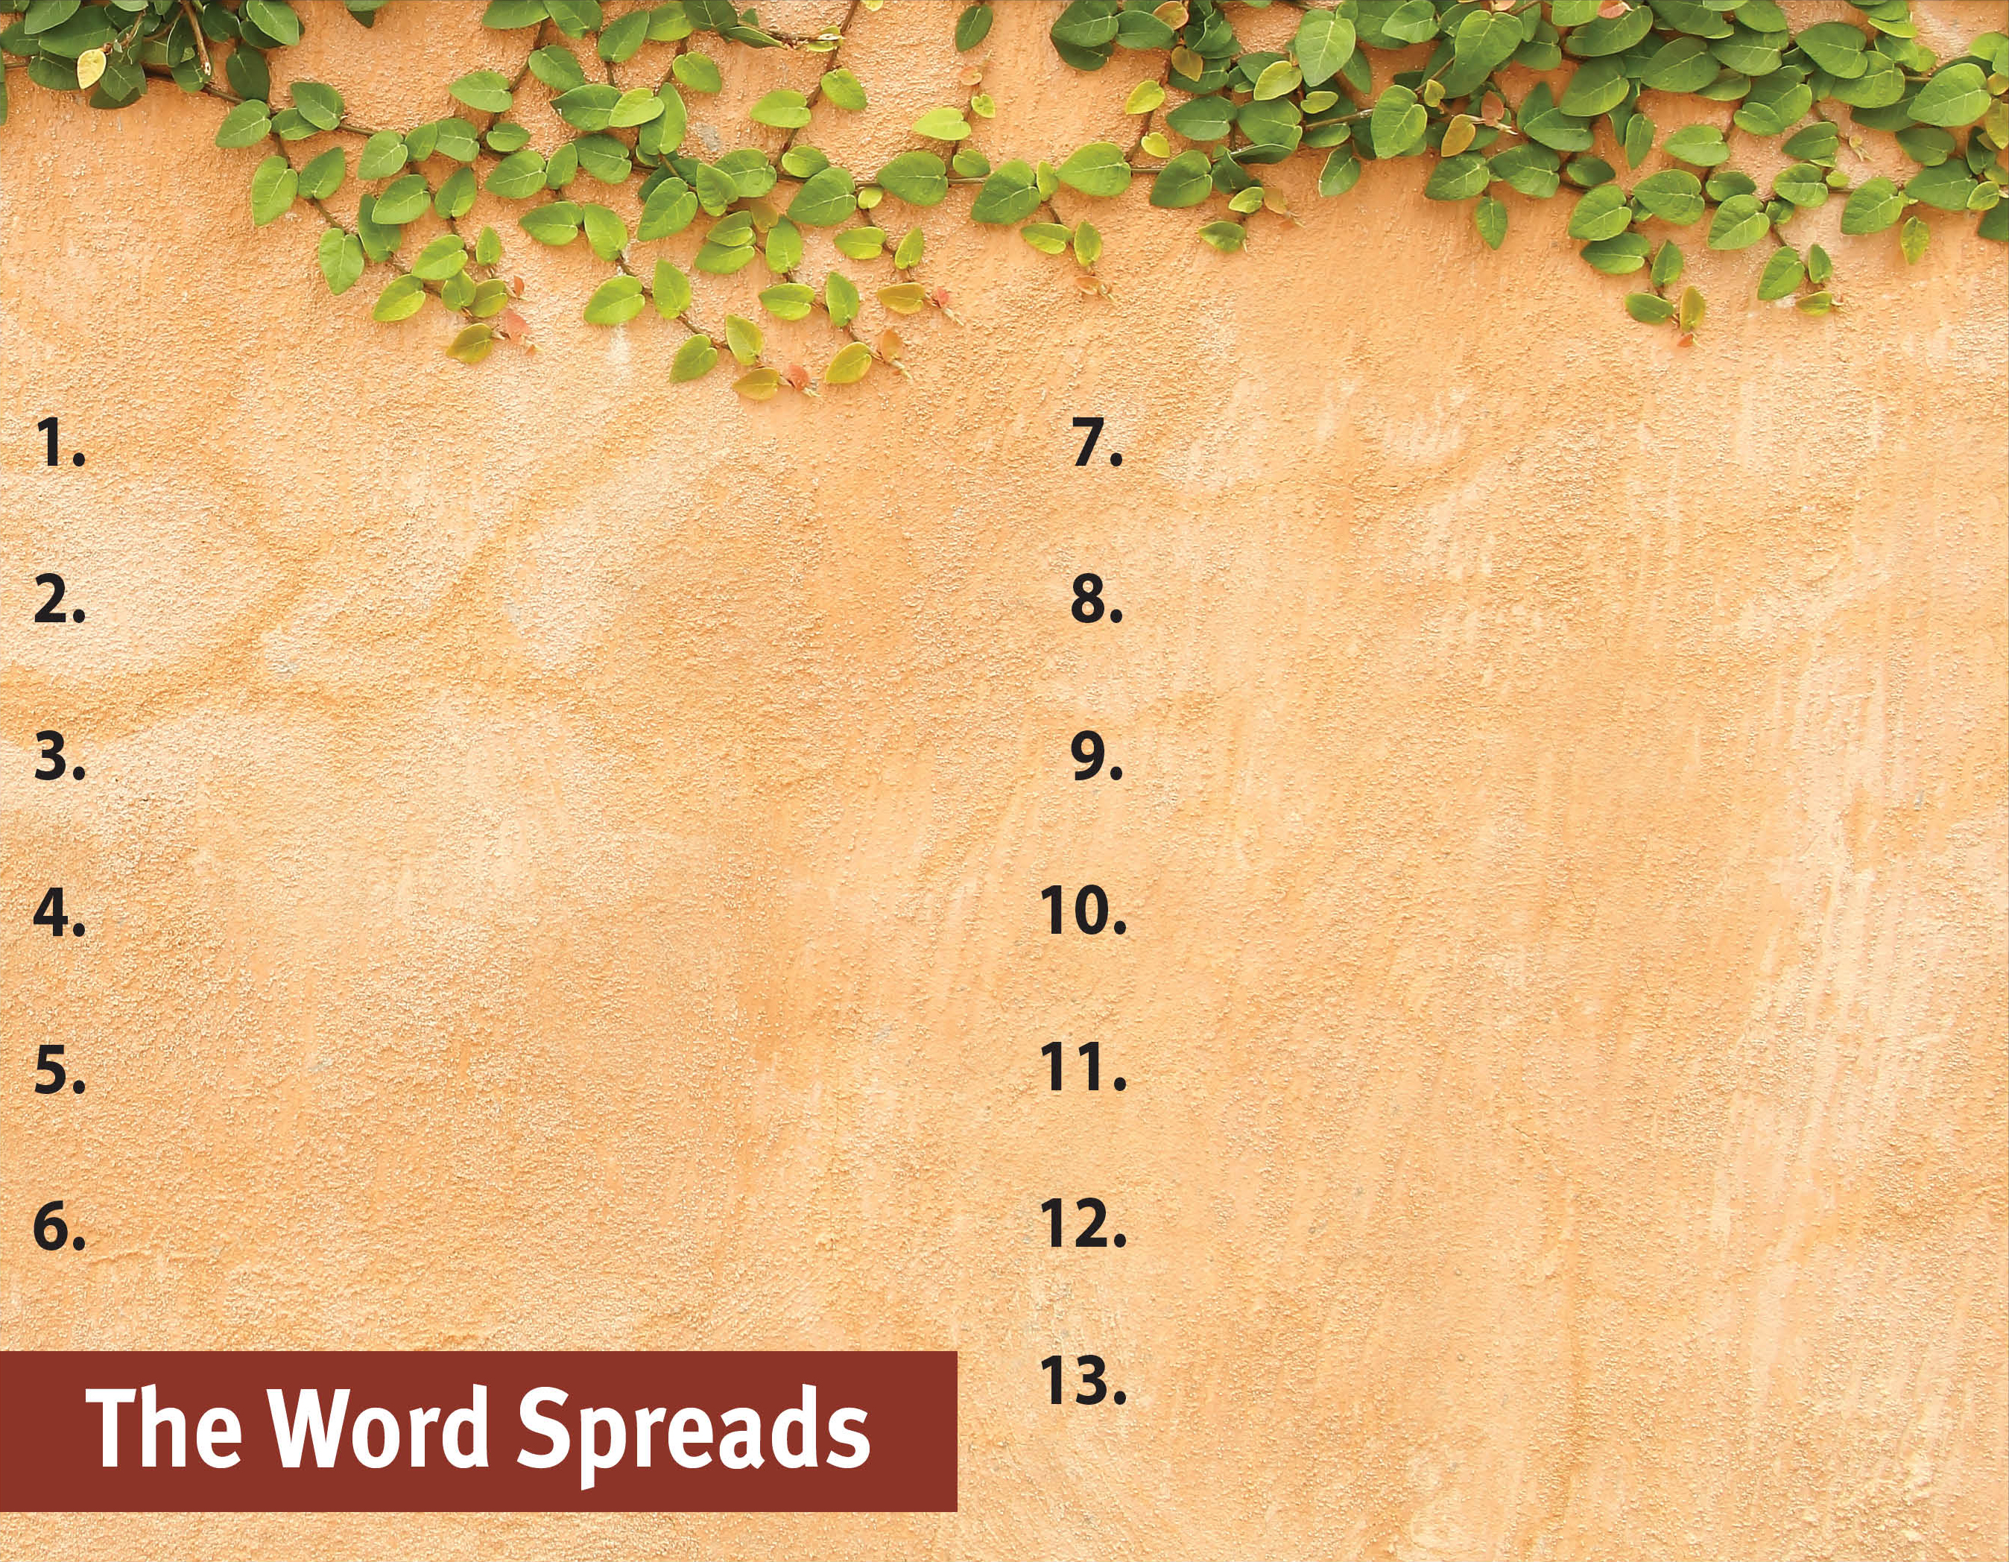
Commit to spread the Word.
Witness to all people.
Serve God by the Spirit.
Be active in and support missions.
Pray for God’s great grace.
Hold to pure doctrine.
Serve with a genuine,
sacrificial heart.
Be sensitive to the Spirit’s leading.
Recognize the Spirit’s power
is superior.
Set no limits on the gospel.

